Slide 1
Fizika
9-sinf
Mavzu:
Masalalar yechish.
O‘qituvchi: Toshkent shahar Uchtepa tumani
287-maktab fizika fani o‘qituvchisi
Xodjayeva Maxtuma Ziyatovna.

Slide 2
Linzaning optik kuchi: $D=\frac{1}{F}$; $F=\frac{1}{D}$
Linzaning optik kuchi: 𝐷=1/𝐹; 𝐹=1/𝐷
Fokus masofasi: $F=\frac{1}{(n−1)∙(\frac{1}{R_{1}}+\frac{1}{R_{2}})}$
Fokus masofasi: 𝐹=1/((𝑛−1)∙(1/𝑅_1 +1/𝑅_2 ))
$\frac{1}{F}=\frac{1}{d}+\frac{1}{f}$; $−\frac{1}{F}=\frac{1}{d}−\frac{1}{f}$
1/𝐹=1/𝑑+1/𝑓; −1/𝐹=1/𝑑−1/𝑓

Slide 3
Masala
Buyumni fokus masofasi 7,5 cm bo‘lgan yig‘uvchi linzadan 10 cm masofada joylashgan. Uning tasviri linzadan qanday masofada hosil bo‘ladi? Linzaning kattalashtirishi qanday?

Slide 4
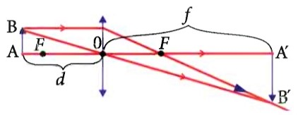

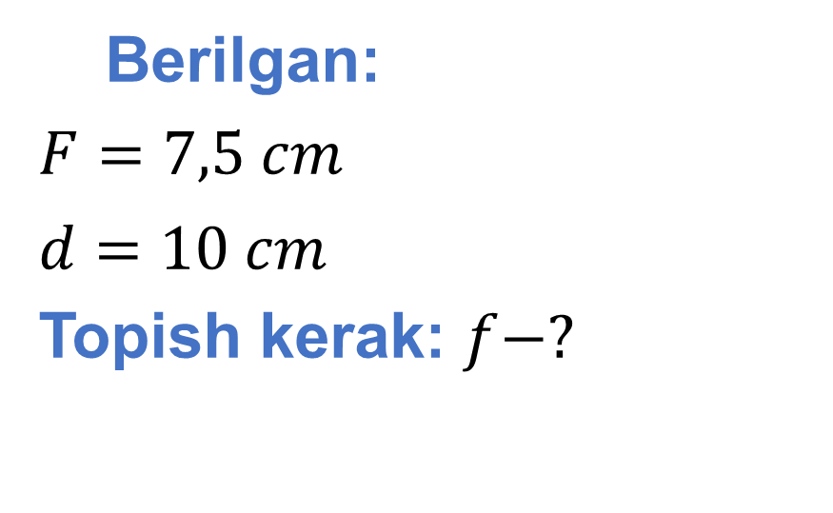
Berilgan:
$F=7,5 cm$
$d=10 cm$
Topish kerak: $f−?$
Formula:
$\frac{1}{F}=\frac{1}{d}+\frac{1}{f}$ $f=\frac{dF}{d−F}$
$K=\frac{f}{d}=\frac{F}{d−F}$

Slide 5

Yechish: $f=\frac{10∙7,5}{10−7,5} cm=30$ cm
$$K=\frac{30 cm}{10 cm}=3$$
Javob: $f=30 cm; K=3.$

Slide 6
Masala
Linzadan 50 cm uzoqlikdagi jismning mavhum tasviri 2 marta kichiklashgan holda bo‘ldi. Linzaning optik kuchini toping.

Slide 7
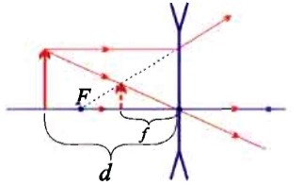
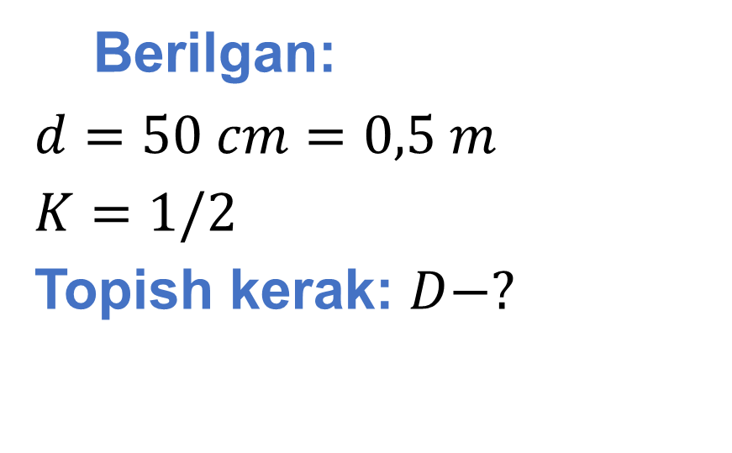
Berilgan:
$d=50 cm=0,5 m$
$K=1/2$
Topish kerak: $D−?$
Formula:
$K=\frac{f}{d}$ $f=d∙K$
$D=\frac{1}{d}−\frac{1}{f}=\frac{1}{d}−\frac{1}{d∙K}=\frac{K−1}{d∙K}$

Slide 8

Yechish: $D=\frac{0,5−1}{0,5∙0,5} dptr=−2 dptr$
Javob: $D=$ $−2 dptr$

Slide 9
27-mashq 2-masala
Havoga nisbatan nur sindirish ko‘rsatkichi 1,5 ga teng shishadan yasalgan sirtning egrilik radiuslari 20 cm va 25 cm bo‘lgan ikkiyoqlama qavariq linzaning optik kuchini toping.

Slide 10

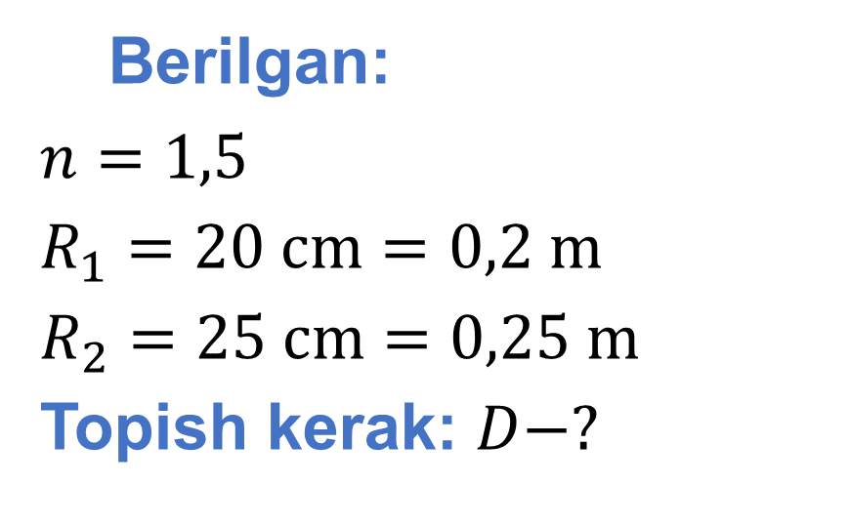
Berilgan:
$n=1,5$
$R_{1}=20 cm=0,2 m$
$R_{2}=25 cm=0,25 m$
Topish kerak: $D−?$
Formula:
$$D=(n−1)\left(\frac{1}{R_{1}}+\frac{1}{R_{2}}\right)$$
Yechish: $D=\left(1,5−1\right)\left(\frac{1}{0,2 m}+\frac{1}{0,25 m}\right)=4,5 dptr$
Javob: $D=4,5 dptr$

Slide 11
27-mashq 4-masala
O‘quvchi laboratoriya ishini bajara turib ekranda yonib turgan shamning aniq tasvirini hosil qildi.
Agar buyumdan linzagacha bo‘lgan masofa 15 cm, linzadan ekrangacha bo‘lgan masofa esa 60 cm bo‘lsa, linzaning fokus masofasi va optik kuchi qanday?

Slide 12
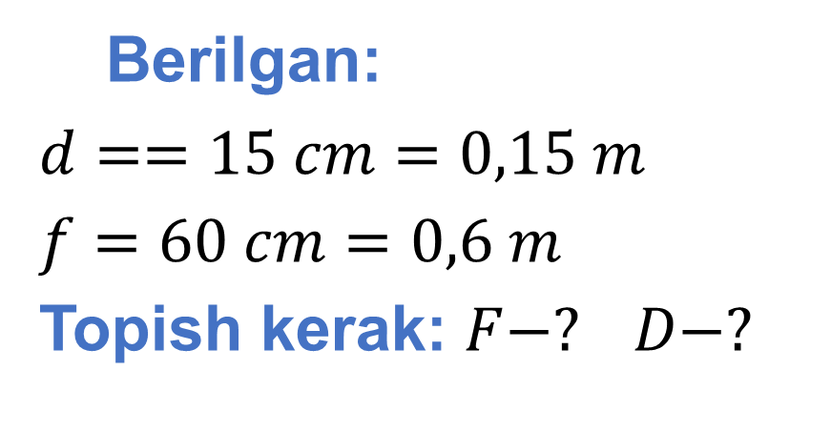
Berilgan:
$d==15 cm=0,15 m$
$f=60 cm=0,6 m$
Topish kerak: $F−? D−?$
Formula:
$\frac{1}{F}=\frac{1}{d}+\frac{1}{f}$ $F=\frac{fd}{f+d}$ $D=\frac{1}{F}$
Yechish: $F=\frac{0,6 m∙0,15 m}{0,6 m+0,15 m}=0,12 m=12 cm$
$D=\frac{1}{0,12 m}=8,33 dptr$
Javob: $F=12 cm; D=8,33 dptr.$

Slide 13
Masala
Buyumning mavhum tasviri linzadan 50 cm masofada hosil bo‘ldi.
Agar buyumdan linzagacha masofa 20 cm bo‘lsa, linzaning optik kuchini aniqlang.

Slide 14
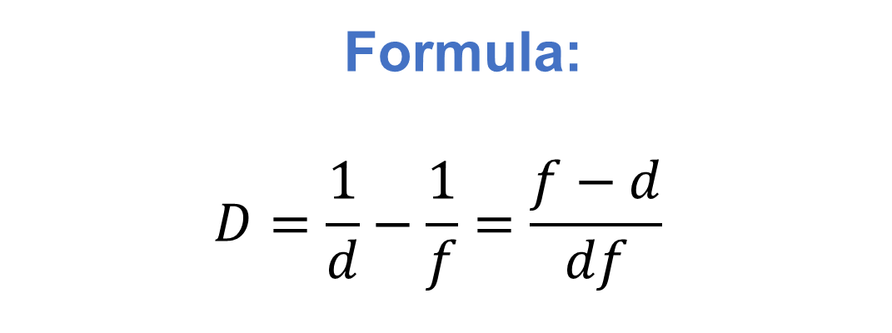
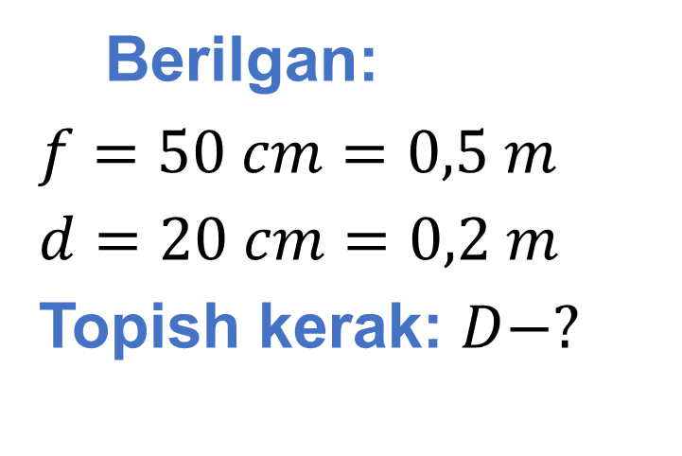
Berilgan:
$f=50 cm=0,5 m$
$d=20 cm=0,2 m$
Topish kerak: $D−?$
Formula:
$$D=\frac{1}{d}−\frac{1}{f}=\frac{f−d}{df}$$
Yechish: $D=\frac{0,5 m−0,2 m}{0,2 m ∙ 0,5 m }=3 dptr$
Javob: $D=3 dptr$

Slide 15
Mustaqil bajarish uchun topshiriqlar
149-bet 27-mashq
3-, 5-, 7-, 8-masalalarni yechish.

