Slide 1
MATEMATIKA
6- sinf
MAVZU: MASALA VA TESTLAR YECHISH

Slide 2
1033- masala
Tenglamani yeching:
1) 0,9 ∙ (- 4x) ∙(-0,5) = - 6,3
2) -0,24 ∙ (- 0,5y) ∙(-10) = - 1,2
3) -2,4 : 2,3 = x : 6,9
4) y : (-3,5) = 4 : 1,4

Slide 3
YECHISH
2) -0,24 ∙ (- 0,5y) ∙ (-10) = -1,2
4) y : (-3,5) = 4 : 1,4
-1,2y = - 1,2
y ∙ 1,4= (-3,5) ∙ 4
y = - 1,2 : (-1,2)
1,4y = - 14
y = 1
y = - 14 : 1,4
y = - 10

Slide 4
MASALA
Agar biror uch xonali sonning dastlab chap tomoniga, so‘ngra o‘ng tomoniga qo‘yilsa, hosil bo‘lgan to‘rt xonali sonlardan birinchisi ikkinchisidan 3 555 ga ortiq bo‘ladi. Shu sonni toping.
Yechish:
Uch xonali son x bo‘lsin,
chap tomoniga yozilsa 7000 + x
o‘ng tomoniga yozilsa 10x + 7
7000 + x – (10x + 7) = 3555

Slide 5
MASALA
7000 + x – (10x + 7) = 3555
7000 + x – 10x - 7 = 3555
6993 – 9x = 3555
– 9x = 3555 - 6993
7382 – 3827 =3555
– 9x = - 3438
x = - 3438 : (-9)
x = 382
Javob: 382

Slide 6
1035- masala
Muyassar bir son o‘yladi. Uni 5 ga ko‘paytirib, 4 ga bo‘ldi. Natijadan 10 ni ayirdi. Hosil bo‘lgan sonning 30% ini 3 ga bo‘lgan edi 8 chiqdi. Muyassar o‘ylagan sonni toping.
Yechish:
o‘ylangan son - x
5x : 4 - 10
30% = 0,3
(5x : 4 – 10) ∙ 0,3 : 3 = 8

Slide 7
YECHISH
(5x : 4 – 10) ∙ 0,3 : 3 = 8
5x = 90 ∙ 4
(5x : 4 – 10) ∙ 0,3 = 8 ∙ 3
5x = 360
x = 360 : 5
(5x : 4 – 10) ∙ 0,3 = 24
x = 72
5x : 4 – 10= 24 : 0,3
5x : 4 – 10 = 80
5x : 4 = 80 + 10
Javob: 72
5x : 4 = 90

Slide 8
TEST 9
3(x + 1) = 5(x + 1) + 4
1. Tenglamani yeching:
A) 2 B) –3 D) 1 E) –1
Yechish:
3(x + 1) = 5(x + 1) + 4
– 2x = 6
3x + 3 = 5x + 5 + 4
x = 6 : (– 2)
3x + 3 = 5x + 9
x = –3
3x – 5x = 9 - 3
Javob: B

Slide 9
TEST 9
4. Ikki sonning yig‘indisi 140 ga teng. Birinchi sonning 8% i ikkinchi sonning 6% iga teng. Shu sonlarni toping.
A) 60; 80 B) 75; 65 D) 50; 90 E) 70; 70
Yechish:
Birinchi son x bo‘lsa, ikkinchi son 140 - x
8% = 0,08 6% = 0,06
Javob: A
0,08x = (140 – x) 0,06
8x + 6x = 840
8x = (140 – x) 6
14x = 840
8x = 840 – 6x
x = 60

Slide 10
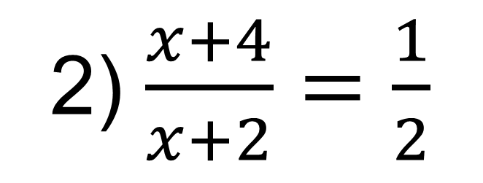
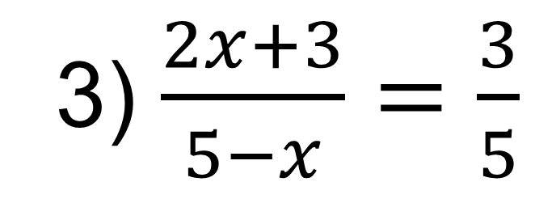
1034- masala
1. Tenglamani yeching:
1) $\frac{5x −7}{x+4}=$3
2) $\frac{x+4}{x+2}=\frac{1}{2}$
3) $\frac{2x+3}{5−x}=\frac{3}{5}$
4) $\frac{−3x+4}{4x−1}=\frac{7}{−5}$

Slide 11
MUSTAQIL BAJARISH UCHUN TOPSHIRIQLAR:
Darslikning 195- betidagi
1038-,1039- masalalar va 9- test topshiriqlarini yeching.

