Slide 1
MATEMATIKA
6- sinf
MAVZU: SODDA HOLLARDA BIR NOMA’LUMLI KASR KOEFFITSIYENTLI CHIZIQLI TENGLAMALARNI YECHISH

Slide 2

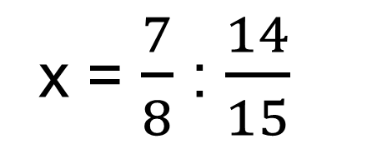

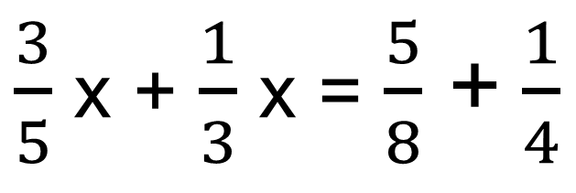
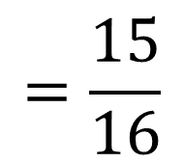
1- misol
Tenglamani yeching:
$\frac{3}{5}$ x - $\frac{1}{4}$ + $\frac{1}{3}$ x = $\frac{5}{8}$
Yechish:
$\frac{3}{5}$ x - $\frac{1}{4}$ + $\frac{1}{3}$x = $\frac{5}{8}$
3
5
2
$\frac{3}{5}$ x + $\frac{1}{3}$ x = $\frac{5}{8}$ + $\frac{1}{4}$
$$\frac{7}{8}$$
$\frac{14}{15}$ x =
1
x = $\frac{7}{8}$ : $\frac{14}{15}$
= $\frac{7}{8}$ ∙ $\frac{15}{14}$
$$=\frac{15}{16}$$
2

Slide 3
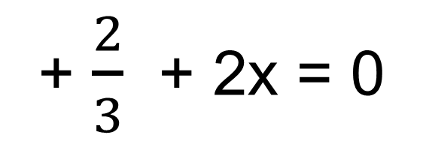
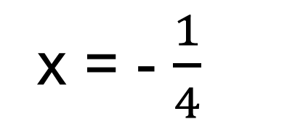
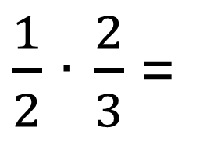

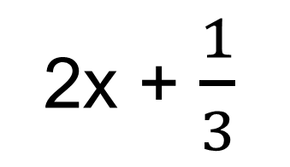


2- misol
$\frac{1}{2}$(4x + $\frac{2}{3}$ ) + $\frac{1}{3}$ (2 + 6x) = 0
Tenglamani yeching:
Yechish:
$\frac{1}{2}$(4x + $\frac{2}{3}$ ) + $\frac{1}{3}$ (2 + 6x) = 0
2
2x + $\frac{1}{3}$
+ $\frac{2}{3}$ + 2x = 0
$\frac{1}{2}$∙ 4 =
$$\frac{2}{3}$$
2
$\frac{1}{3}$∙ 2 =
1
1
$\frac{1}{2}$∙ $\frac{2}{3}$ =
$$\frac{1}{3}$$
4x + 1 = 0
2
$\frac{1}{3}$∙ $6$ =
$$2$$
4x = - 1
1
1
x = - $\frac{1}{4}$

Slide 4
MASALA
Men bir son o‘yladim. Agar uni 2 ga ko‘paytirib, hosil bo‘lgan ko‘paytmani 8 ga bo‘lib, bo‘linmaga 20 ni qo‘shib, yig‘indidan 15 ni ayirsam, 10 hosil bo‘ladi. Men o‘ylagan sonni toping.
Yechish:
1-usul
20
40
5
25

Slide 5
YECHISH
2- usul
O‘ylangan son x
U 2 ga ko‘paytirildi 2x
Ko‘paytma natijasi 8 ga bo‘lindi 2x : 8
Hosil bo‘lgan bo‘linmaga 2x : 8 + 20
Hosil bo‘lgan yig‘indidan 15 ayirildi 2x : 8 + 20 – 15
va ayirmada 10 hosil bo‘ldi 2x : 8 + 20 – 15 = 10

Slide 6
YECHISH
2- usul
2x : 8 + 20 – 15 = 10
2x : 8 + 5 = 10
2x : 8 = 10 - 5
2x : 8 = 5
2x = 5 ∙ 8
2x = 40
x = 40 : 2
x = 20

Slide 7
1032- masala
1) 2,5(4 - 2x) – 5(1 - 3x) = 5
2) $\frac{2}{3}$ (3x – 1) - $\frac{1}{9}$ (9x - 2 $\frac{1}{4}$) = $\frac{1}{4}$
3) - (x – 5) – 1,2(5 – 4x) = 2,8
4) -1 $\frac{1}{3}$ (x – 3) - $\frac{2}{3}$ (x + 1,5) = 5

Slide 8
MUSTAQIL BAJARISH UCHUN TOPSHIRIQLAR:
Darslikning 195- betidagi
1041-, 1042-, 1043-, 1044- masalalarni
yeching.

