Slide 1
MATEMATIKA
6- sinf
MAVZU: MASALALAR
YECHISH

Slide 2
CHIZIQLI TENGLAMALARNI YECHISH
1- misol.
5(-2x + 3) = 10 – 4x tenglamani yeching
Yechish:
5(-2x + 3) = 10 – 4x
-10x + 15 = 10 – 4x
-10x + 4x = 10 - 15
-6x = -5
-6x : (-6) = -5 : (-6)
x = $\frac{5}{6}$

Slide 3
CHIZIQLI TENGLAMALARNI YECHISH
2- misol.
3x + 2 = 4(x +1) – x tenglamani yeching
Yechish:
3x + 2 = 4(x +1) – x
3x + 2 = 4x + 4 – x
3x + 2 = 3x + 4
3x – 3x = 4 – 2
0 = 2
Javob: tenglama yechimga ega emas.

Slide 4
CHIZIQLI TENGLAMALARNI YECHISH
3- misol.
6x + 3 = 5(x + 2) + x - 7 tenglamani yeching
Yechish:
6x + 3 = 5(x +2) + x - 7
6x + 3 = 5x + 10 + x - 7
6x + 3 = 6x + 3
6x – 6x = 3 – 3
0 = 0
Javob: x- istalgan son,
tenglama cheksiz ko‘p yechimga ega.

Slide 5
TENGLAMALARNI YECHISH
4- misol.
Tenglamani yeching: (2x + 1)(5x – 15)(x – 4) = 0
Yechish:
(2x + 1)(5x – 15)(x – 4) = 0
1) 2x + 1 = 0
2) 5x - 15 = 0
3) x – 4 = 0
2x = -1
5x = 15
x = 4
x = - $1:2$
x = $15 :5$
x = - 0,5
x = $3$
Javob: -0,5 ; 3; 4

Slide 6
1014- masala
Ikkita ketma-ket kelgan natural sonlar yig‘indisi 821 ga teng. Shu sonlarni toping.
Yechish:
birinchi son – x ,
ikkinchi son – x + 1
Tenglama tuzamiz:
x + x + 1 = 821
birinchi son : 410
ikkinchi son: 411
2x + 1 = 821
2x = 821 - 1
Javob: 410, 411
2x = 820
x = 410

Slide 7
1016- masala
To‘g‘ri to‘rtburchakning qo‘shni tomonlari yig‘indisi 52 cm ga teng. Bo‘yi enidan 1,6 marta ortiq. Shu to‘g‘ri to‘rtburchakning bo‘yi va enini toping.
Yechish:
Enini – x desak,
bo‘yi – 1,6x
Tenglama tuzamiz:
x + 1,6x = 52
eni: 20 cm
bo‘yi: 20 ∙ 1,6 = 32(cm)
2,6x = 52
x = 52 : 2,6
x = 20
Javob: 32 cm va 20 cm

Slide 8
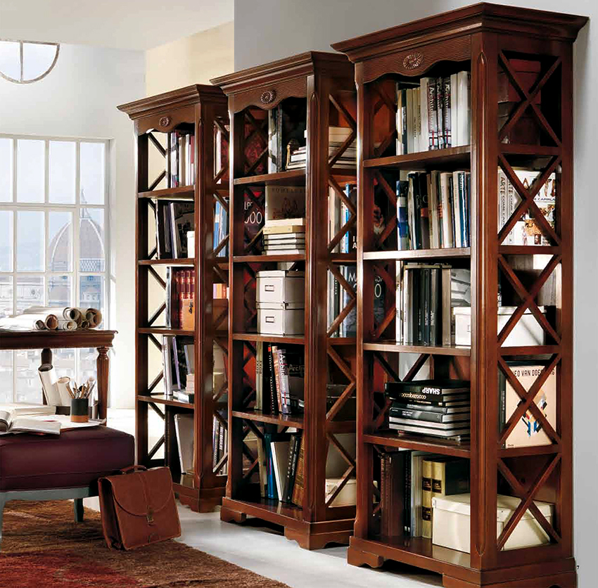
1017- masala
Uchta shkafda jami 253 ta kitob bor. Birinchi shkafda ikkinchisiga qaraganda 11 ta ortiq, uchinchisiga qaraganda 6 ta kam kitob bor. Har bir shkafda nechtadan kitob borligini toping.

Slide 9
YECHISH
I shkafda – x desak,
II shkafda – x – 11
III shkafda – x + 6
86
253 ta
86 - 11 = 75
86 + 6 = 92
Tenglama tuzamiz:
x + (x – 11) + (x + 6) = 253
x + x – 11 + x + 6 = 253
3x - 5 = 253
Javob: 86 ta, 75 ta, 92 ta
3x = 253 + 5
3x = 258
x = 86

Slide 10
TENGLAMANI YECHING
1012- masala
1) -9 ∙ (2x - 7) + 17 ∙ (x – 1) = 0
3) 5(x + 4) = 9x + 12
2) -7 ∙ (2x - 3) + 5 ∙ (3x – 2) = 0
4) 8 - 5(4 – 3x) = 18
1013- masala
1) -8(3x - 2) + 5(5x – 3) = 0
2) 5x + 6 - (3x – 4) = x – 3(2x – 4)

Slide 11
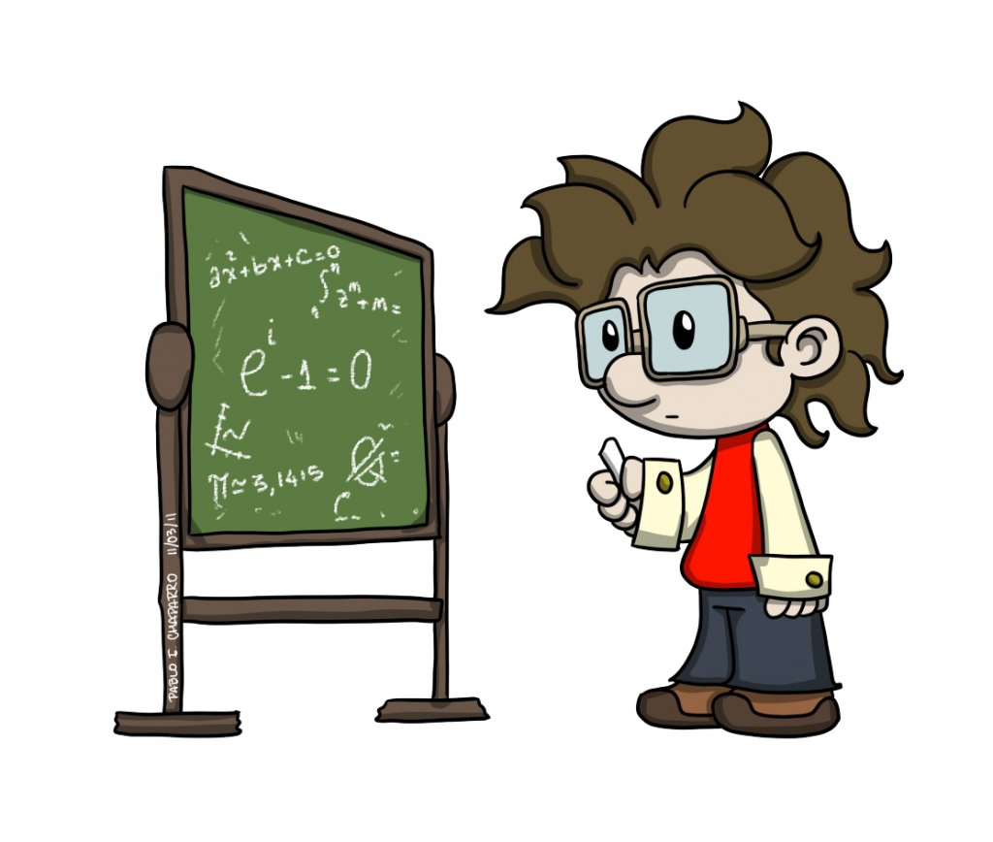
MUSTAQIL BAJARISH UCHUN TOPSHIRIQLAR:
Darslikning 191- betidagi
1026-, 1027-, 1028-, 1029- masalalarni
yeching.

