Slide 1
MATEMATIKA
6- sinf
MAVZU: MASALA VA TESTLAR YECHISH

Slide 2
TEST 8
1. Ko‘paytirishni bajaring:
(-25) ∙ 3 ∙ 4
A) 75 B) 100 D) -100 E) -300
Yechish:
(-25) ∙ 3 ∙ 4
= - 100 ∙ 3 = - 300
Javob: E

Slide 3
TEST 8
(-8) ∙ 5 + (-3) ∙ 6 – (-28)
3. Amallarni bajaring:
A) 30 B) -30 D) - 584 E) 86
Yechish:
(-8) ∙ 5 + (-3) ∙ 6 – (-28) =
- 40 + (-18) – (-28) =
= - 40 – 18 + 28
= -58 + 28 = - 30
Javob: B

Slide 4
TEST 8
5. Bo‘lishni bajaring:
(- 128) : (- 4) : (- 8) : 2
A) - 4 B) - 128 D) 2 E) -2
Yechish:
(- 128) : (- 4) : (- 8) : 2
= - 32 : 8 : 2
= - 2
Javob: E

Slide 5
TEST 8
6. Hisoblang:
(- 3)³ : (- 3)² + (- 2)³ : (-1)⁴ – (-1)⁸ : (-1)⁷
A) 10 B) - 10 D) -11 E) 12
Yechish:
(- 3)³ : (- 3)² + (- 2)³ : (-1)⁴ – (-1)⁸ : (-1)⁷ =
= (-27) : 9 + (-8) : 1 – 1 : (-1)
= (-3) + (-8) – (-1) =
= – 3 – 8 + 1 = – 10
Javob: B

Slide 6
TEST 8
12. Hisoblang:
72,09 : (- 9) + (- 3,2) ∙ 5
A) – 240 B) – 24,01 D) 0,6 E) – 0,6
Yechish:
72,09 : (- 9) + (- 3,2) ∙ 5 =
- 8,01 + (- 16) =
- 24,01
Javob: B

Slide 7
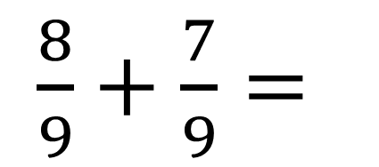
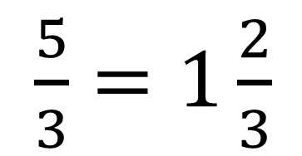

TEST
Hisoblang:
0,(8) + 0,(7)
A) $\frac{3}{5}$ B) 1$\frac{2}{3}$ D) 1$\frac{1}{4}$ E) 1,(5)
Yechish:
$\frac{8}{9}+\frac{7}{9}=$
$\frac{15}{9}=$
$\frac{5}{3}=1\frac{2}{3}$
0,(8) + 0,(7) =
Javob: B

Slide 8
TEST
$− \frac{21}{6}+2,\left(2\right)$ ning butun qismini toping
A) -2 B) -1 D) 0 E) 1
Yechish:
9
2
$− \frac{21}{6}$ + 2,(2) =
-3 $\frac{3}{6}+2\frac{2}{9}=$
-(3$\frac{1}{2}−2\frac{2}{9})=$
$−1\frac{5}{18}$
Javob: A

Slide 9
972- masala
Yig‘indini hisoblang, natijani davriy kasr ko‘rinishida yozing:
1) $\frac{2}{3}+1\frac{5}{9}+(−\frac{8}{9})$
2) $2\frac{7}{9}+(−1\frac{2}{3})+\frac{5}{9}$
3) 3$\frac{2}{3}+(−1\frac{1}{9})+\frac{7}{9}$

Slide 10
MUSTAQIL BAJARISH UCHUN TOPSHIRIQLAR:
Darslikning 180- betidagi
979- masala, 8- test topshiriqlarini
yeching.

