Slide 1
MATEMATIKA
6- sinf
MAVZU: MASALALAR
YECHISH

Slide 2
OG‘ZAKI BAJARAMIZ
7² =
49
(- 7)² =
49
11² =
121
121
(- 11)² =
27
-27
3³ =
(- 3)³ =
64
-64
(- 4)³ =
4 ³ =

Slide 3
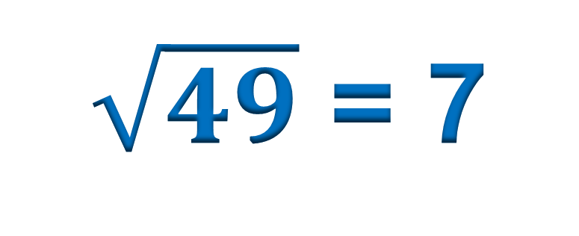
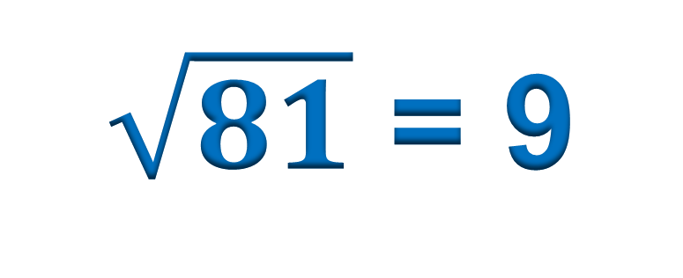
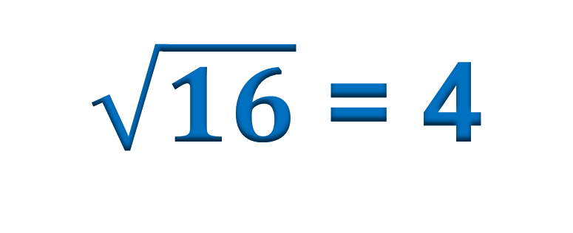
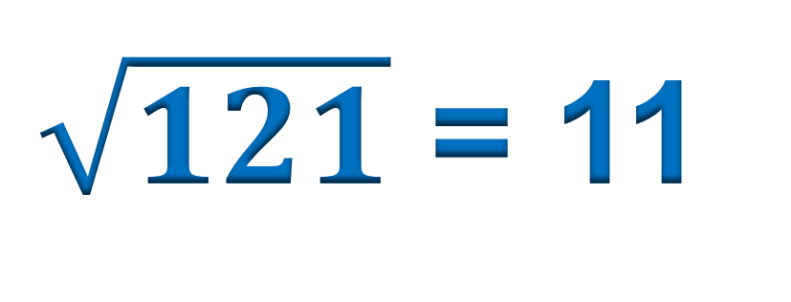
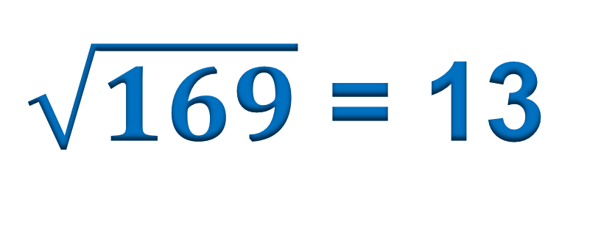
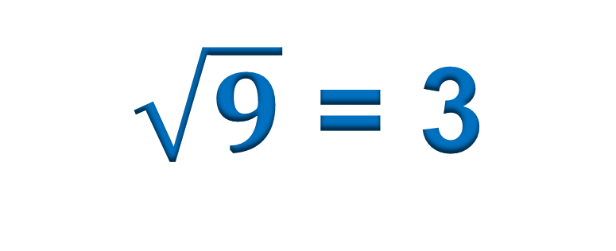
OG‘ZAKI BAJARAMIZ
$\sqrt{16}$ = 4
$\sqrt{81}$ = 9
$\sqrt{49}$ = 7
$\sqrt{121}$ = 11
$\sqrt{9}$ = 3
$\sqrt{169}$ = 13

Slide 4
965- masala
Hisoblang:
1) (- 1)¹³ – (- 1)¹⁵ + (- 1)¹⁷
2) (- 2)³ – (- 3)³ + (- 3)²
Yechish:
1) (- 1)¹³ – (- 1)¹⁵ + (- 1)¹⁷ =
(- 1) – (- 1) + (- 1) =
= - 1 + 1 - 1 = -1
2) (- 2)³ – (- 3)³ + (- 3)² =
- 8 – (- 27) + 9 =
= - 8 + 27 + 9
= - 8 + 36 = 28

Slide 5
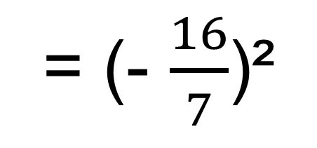
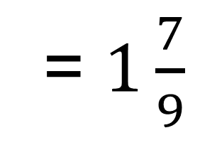
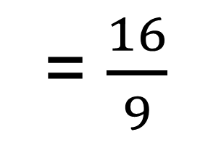
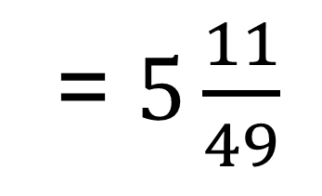

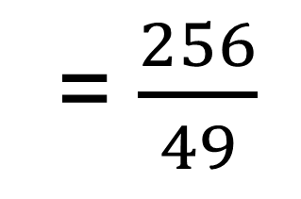
966- masala
Agar x = - 5; -9,3; -0,8; -8; -1$\frac{1}{3}$; -2$\frac{2}{7}$ bo‘lsa, x²
ifodaning qiymatini toping
Yechish:
1) x² = (-5)² =
2) x² = (-9,3)² =
86,49
25
5) x² = (-1$\frac{1}{3}$)²
= (- $\frac{4}{3}$)²
= $\frac{16}{9}$
= $1\frac{7}{9}$
6) x² = (- 2$\frac{2}{7}$)²
= (- $\frac{16}{7}$)²
= $\frac{256}{49}$
= $5\frac{11}{49}$

Slide 6
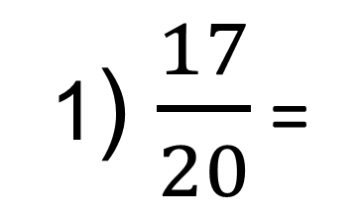
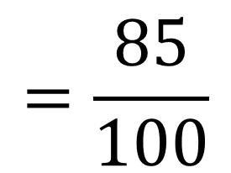
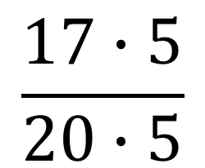
MASALA
1) $\frac{17}{20}$ 2) $\frac{2}{3}$ kasrlarni o‘nli kasr ko‘rinishida
ifodalang:
1) $\frac{17}{20}$ =
$$\frac{17∙5}{20∙5}$$
$$=\frac{85}{100}$$
Yechish:
= 0,85
17
20
3
,0
2
2)
,0
-
-
160
0,
18
8
0,
5
6
6
6…
0
10
2
0
-
-
18
100
0
2

Slide 7
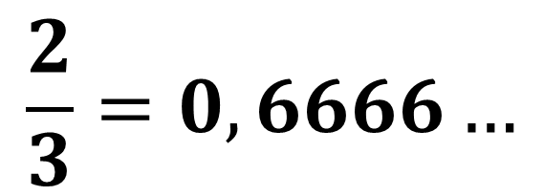
DAVRIY O‘NLI KASRLAR
$$\frac{2}{3}=0,6666…$$
= 0,(6)
Verguldan keyin bir yoki bir necha raqami uzluksiz ketma-ket takrorlanadigan cheksiz o‘nli kasr sof davriy o‘nli kasr deyiladi. Takrorlanadigan raqamlar majmuasi (to‘plami) kasrning davri deyiladi va qavsga olib yoziladi.
Masalan,
3,888… = 3,(8)
0,151515… = 0,(15)
12,541541… = 12,(541)

Slide 8
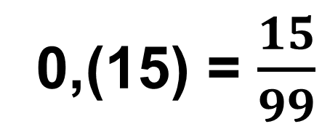
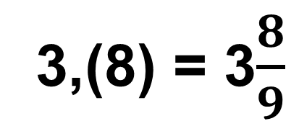
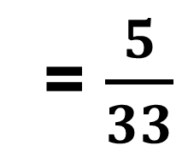
DAVRIY O‘NLI KASRLAR
Sof davriy o‘nli kasrni oddiy kasrga aylantirish uchun uning davridagi sonni kasrning surati deb, davrida nechta raqam bo‘lsa, shuncha 9 dan iborat sonni oddiy kasrning maxraji deb olish kifoya qiladi.
Masalan,
3,(8) = 3$\frac{8}{9}$
0,(15) = $\frac{15}{99}$
= $\frac{5}{33}$
12,(541) = 12 $\frac{541}{999}$

Slide 9
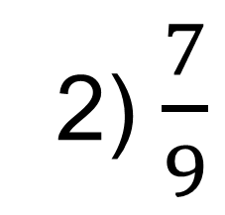
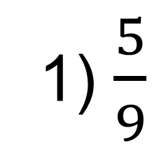
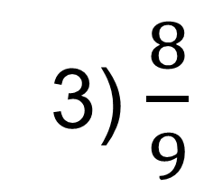
969- masala
Davriy o‘nli kasr ko‘rinishida ifodalang:
1) $\frac{5}{9}$
2) $\frac{7}{9}$
3) $\frac{8}{9}$

Slide 10
MASALALAR
970- masala
Ushbu davriy o‘nli kasrni qisqa ko‘rinishda yozing:
1) 5,222…
2) 1,373737…
3) 3,108108…
971- masala
Cheksiz o‘nli kasr ko‘rinishida yozing:
1) 1,(3)
2) 0,(28)
3) 0,(001)

Slide 11
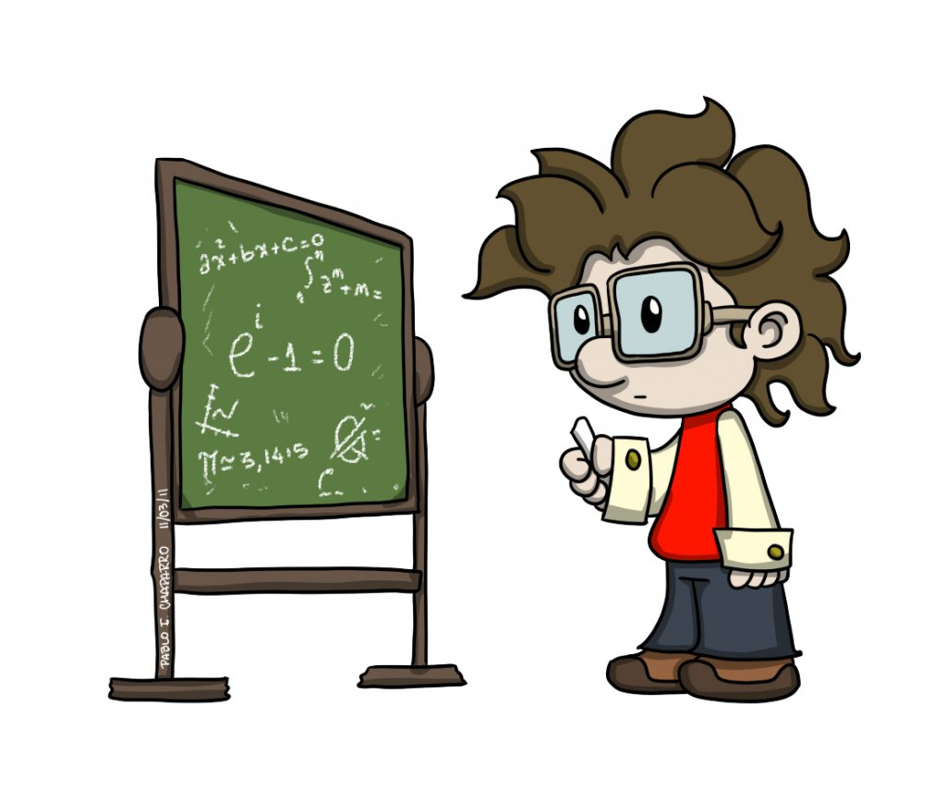
MUSTAQIL BAJARISH UCHUN TOPSHIRIQLAR:
Darslikning 180- betidagi
976-, 977-, 978- masalalarni
yeching.

