Slide 1
MATEMATIKA
6- sinf
MAVZU: MASALALAR YECHISH

Slide 2
TO‘G‘RI JAVOBNI TOPING
- 11 + (- 8) =
-3
-19
-5
19
3

Slide 3
TO‘G‘RI JAVOBNI TOPING
- 15 + (- 28) =
-33
-13
-43
33
43

Slide 4
TO‘G‘RI JAVOBNI TOPING
- 23 + (- 29) =
-42
-6
52
6
-52

Slide 5
TO‘G‘RI JAVOBNI TOPING
- 51 + (- 63) =
-12
-51
12
-114
-163

Slide 6
819- masala
To‘g‘ri tengsizlik hosil bo‘lishi uchun (*) o‘rniga “>” yoki
“<“ belgilardan qaysini qo‘yish kerak?
1) -12 + (-15) * -29
2) -18 + (-17) * -34?
Yechish:
1) -12 + (-15) * -29
2) -18 + (-17) * -34?
>
<
-27 * -29
-35 * -34
>
<

Slide 7
820- masala
Agar 1) a = -2,5 va b= -3,5; 2) a = 0,53 va
b = -3,53; 3) a = 7,7 va b = 2,3 bo‘lsa - a + (- b) ifodaning qiymatini toping.
Yechish:
1) a = -2,5 va b= -3,5
-a = 2,5 - b= 3,5
- a + (- b) = 2,5 + 3,5 = 6

Slide 8
YECHISH
2) a = 0,53 va b = -3,53;
-a = -0,53 - b= 3,53
- a + (- b) = -0,53 + 3,53 =
3,53 – 0,53
= 3
3) a = 7,7 va b = 2,3
-a = -7,7 - b= -2,3
- a + (- b) = -7,7+ (-2,3) =
– 10

Slide 9
820- masala
Ifodaning qiymatini toping.
1) (-$2\frac{3}{7}$+(-$7\frac{4}{7}$)) + (-$1\frac{4}{9}$ + (-$3\frac{5}{9}$))
2) (-$11\frac{1}{8}$+(-$3\frac{1}{4}$)) + (-$10\frac{7}{11}$ + (-$4\frac{4}{11}$))
3) (-$5\frac{1}{3}$+(-$\frac{2}{3}$)) + (-$1\frac{3}{5}$)
4) (-$2\frac{1}{3}$+(-$\frac{1}{6}$)) + (-$1\frac{1}{2}$)

Slide 10
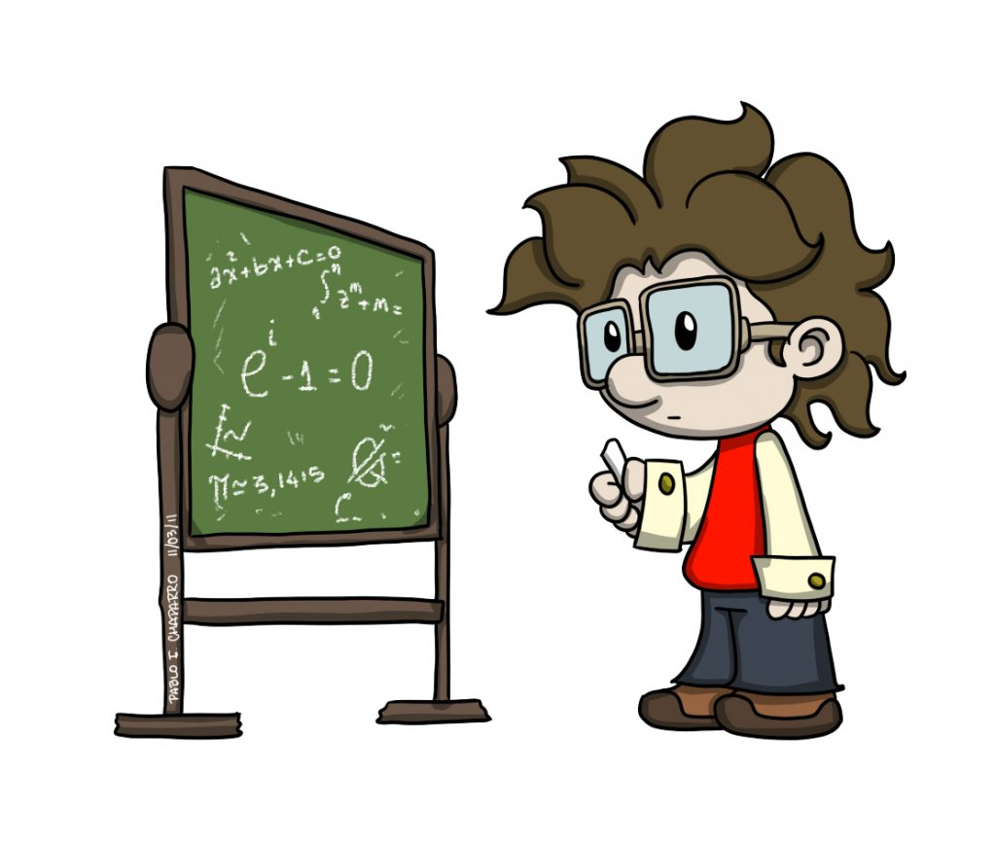
MUSTAQIL BAJARISH UCHUN TOPSHIRIQLAR:
Darslikning 151- betidagi
815-, 834-, 835- masalalarni
yeching.

