Slide 1
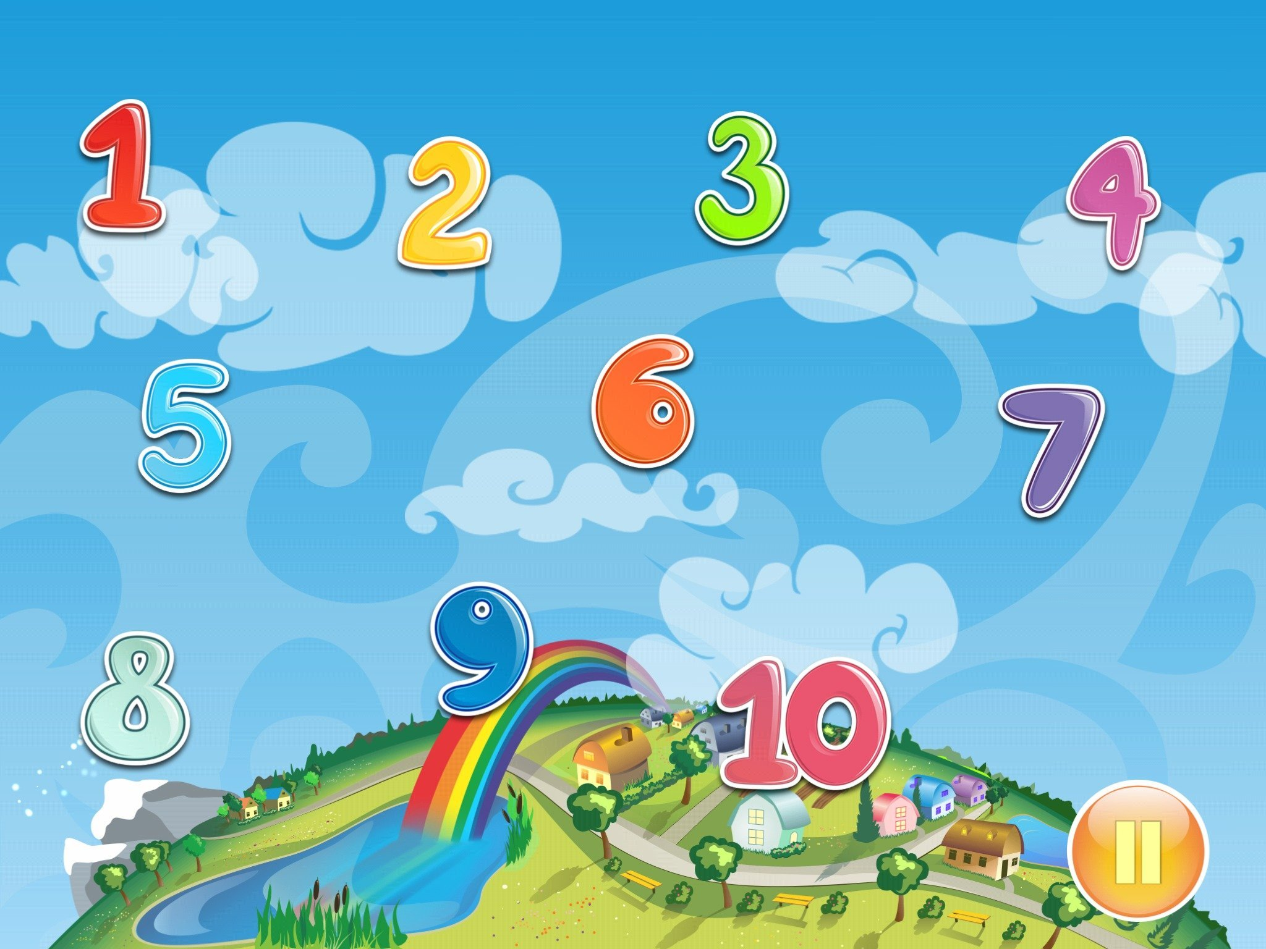
Matematika
2-sinf

Slide 2
Mavzu:
Qo‘shishga doir masalalar
(18-dars, 31-bet)

Slide 3
Mustaqil topshiriqni
tekshiring:
30-bet, 5-misol.

Slide 4
30-bet, 5-misol
Hisoblaymiz.
53 + 8 =
61
6 + 87 =
93
36 + 27 =
63
44 + 38 =
82
55 + 35 =
90
88 + 12 =
100

Slide 5
31-bet, 1-misol
Hisoblaymiz:
1
1
1
1
2 9
5
6 7
3
4
+
7 7
6
4 8
4
4 8
+
+
+
+
3
5
5
3
7
1
5
1
8
1

Slide 6
31-bet, 2-masala
Jami necha nafar o‘quvchi muzeyga borgan?
Yechish: 1) 27 + 8 = 35 (nafar) – 2-sinf
2) 27 + 35 = 62 (nafar) – jami
Javob: jami 62 nafar o‘quvchi muzeyga borgan.

Slide 7
31-bet, 4-misol
Namuna asosida jadvalni to‘ldiramiz.
+ | 3 | 15 | 38 | 53
27 | 27 + 3 = 30
46
27 + 15 = 42
27 + 38 = 65
27 + 53 = 80
46 + 3 = 49
46 + 15 = 61
46 + 38 = 84
46 + 53 = 99

Slide 8
31-bet, 3-misol
Qaysi ifodaning qiymati 31 dan katta?
58 - 42 =
16
64 - 21 =
43
51 - 21 =
30
74 - 51 =
23

Slide 9
31-bet, 5-topshiriq
Namuna asosida ikkinchi shaklga mos keluvchi
shaklni chizamiz.

Slide 10
Mustaqil topshiriq:
31-bet,
6-misol.

Slide 11
31-bet, 6-misol
Hisoblaymiz.
15 + 65 =
80
47 + 13 =
62 + 19 =
54 + 9 =

Slide 12
E’tiboringiz uchun
rahmat!

