Slide 1
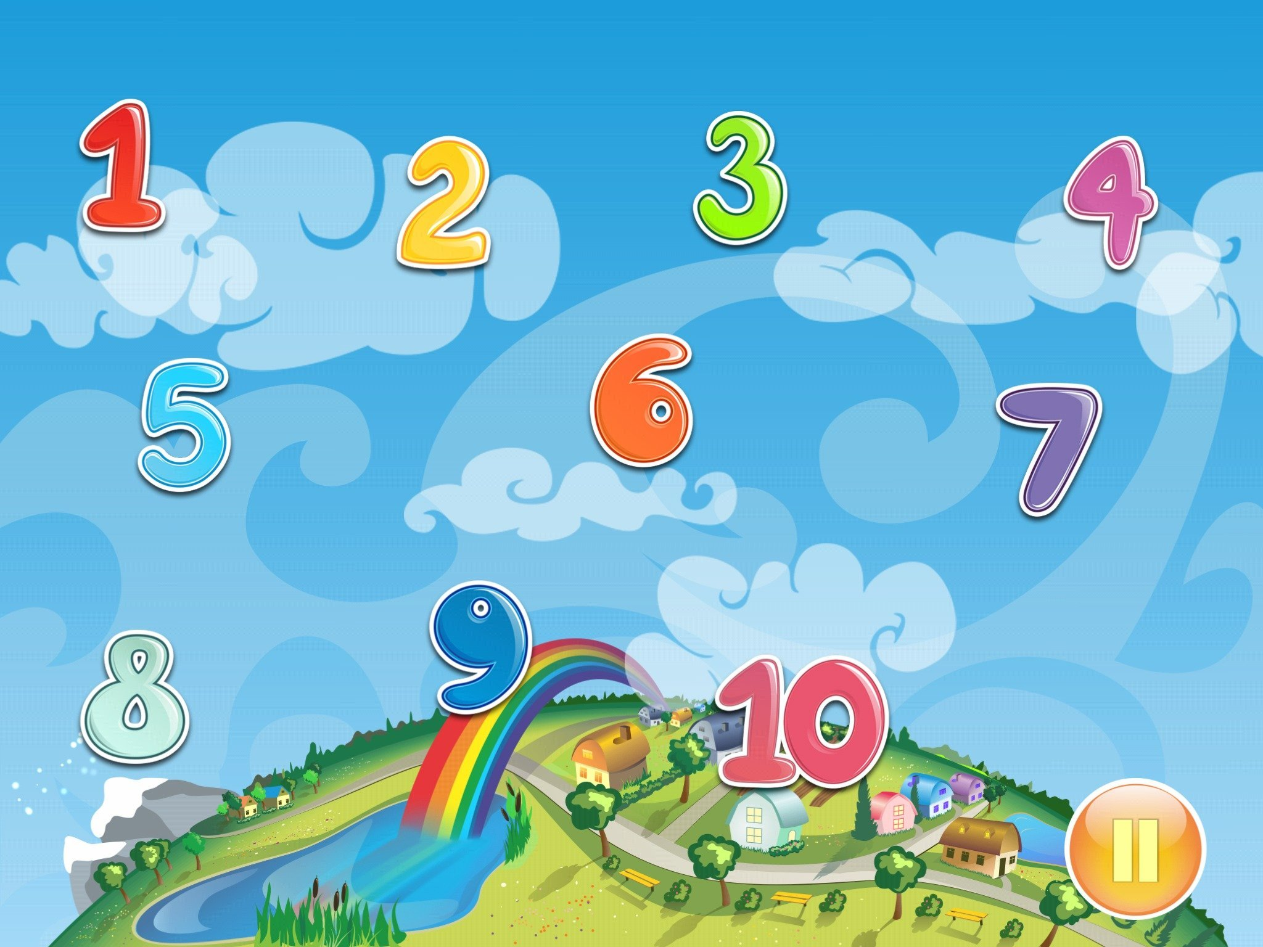
Matematika
2-sinf

Slide 2
Mavzu:
Qo‘shishga doir masalalar
(15-dars, 28-bet)

Slide 3
Mustaqil topshiriqni
tekshiring:
27-bet, 6-misol.

Slide 4
27-bet, 6-misol
6 5
7 2
9 8
6 5
9 0
7 2
9 1

Slide 5
28-bet, 1-masala
Jami jihozlar nechta?

Slide 6
28-bet, 1-masala
Jami jihozlar nechta?
- 32 ta
- ?, 19 ta ko‘p
Jami - ? ta
Yechish: 1) 32 + 19 = 51 (ta) -
2) 32 + 51 = 83 (ta) –jami.
Javob: jami 83 ta jihoz.

Slide 7
28-bet, 2-misol
Taqqoslaymiz:
31 + 57 62 – 52
37 – 27 48 – 17
>
<
88 10
10 31
>
<
47 + 13 38 + 22
=
60 60
=

Slide 8
28-bet, 3-masala
Uchinchi chavandoz necha kun sayohat qilgan?
Yechish: 1) 19 + 6 = 25 (kun) – 2 chavandoz
2) 25 – 5 = 20 (kun) – 3 chavandoz
3) 19 + 25 + 20 = 64 (kun) – jami.
Javob: 3 – chavandoz 64 kun sayohat qilgan.

Slide 9
28-bet, 4-misol
Hisoblaymiz:
10 + 10 + 10 = 30
= 10
4 – 2 = 2
= 2
10 + 4 + 4 = 18
= 4
10 + 4 + 2 = 16

Slide 10
Mustaqil topshiriq:
28-bet,
5-misol.

Slide 11
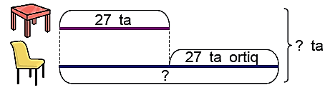
28-bet, 5-masala
Stullar soni nechta? Jami stol va stullar-chi?

Slide 12
E’tiboringiz uchun
rahmat!

