Slide 1
Matematika
2-sinf

Slide 2
Mavzu:
100 ichida sonlarni xonadan
o‘tib qo‘shish usullari
(takrorlash)
(14-dars, 27-bet)

Slide 3
Mustaqil topshiriqni
tekshiring:
26-bet, 5-misol.

Slide 4
26-bet, 5-misol
Hisoblaymiz:
1
1
1
1
7
6 8
2 9
3 5
3 6
+
7 8
3 6
9
3 2
2 5
+
+
+
+
8
5
7
7
6
1
6
0
7
2

Slide 5
27-bet, 1-masala
Tenglik to‘g‘ri bo‘lishi uchun bo‘sh kataklarga mos
sonlarni yozamiz.
30
60
88 = 58 +
30
58 = - 2
60
88 – 58 = 30
58 + 2 = 60

Slide 6
27-bet, 2-misol
Natijalarni topamiz
1
1
1
2 3
4 0
3 8
6 3
+
1 7
3 9
2 5
1 9
+
+
+
4
0
7
9
6
3
8
2

Slide 7
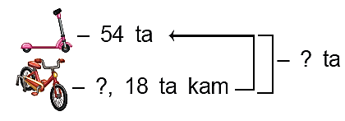
27-bet, 3-masala
Masalani yechamiz:
Samokat va velosipedlar jami nechta?
Yechish: 1) 54 – 18 = 36 (ta) – velosipedlar
2) 54 + 36 = 90 (ta) – jami.
Javbob: jami 90 ta.

Slide 8
ROLIK

Slide 9
27-bet, 4-masala
Qaysi shakllarning 4 ta tomoni bor?
5 ta
4 ta
3 ta
4 ta
- ta
4 ta
4 ta

Slide 10
27-bet, 5-misol
Yulduzchalar o‘rniga mos sonlarni qo‘yamiz:
1 6
1 9
3 4
*
6
1
+
*
5
8
+
2 8
1
+
1
3
-
1
*
*
3 1
3 2
5 2
4 4

Slide 11
Mustaqil topshiriq:
27-bet,
6-misol.

Slide 12
27-bet, 6-misol
9 8

Slide 13
E’tiboringiz uchun
rahmat!

