Slide 1
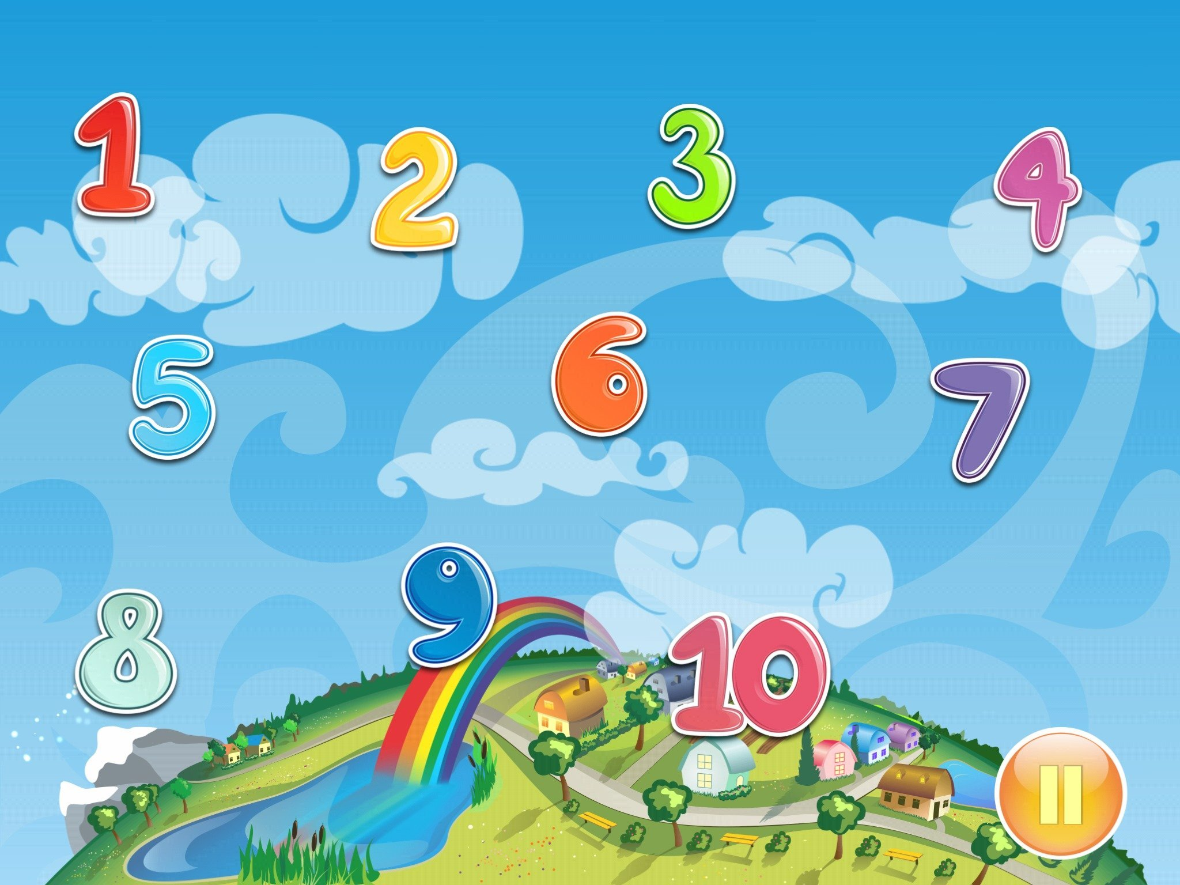
Matematika
2-sinf

Slide 2
Mavzu:
100 ichida sonlarni xonadan
o‘tib qo‘shish usullari
(11-dars, 24-bet)

Slide 3
Mustaqil topshiriqni
tekshiring:
23-bet, 5-misol.

Slide 4
23-bet, 5-misol
Bo‘sh kataklarga mos sonlarni yozamiz:
42 + > 69
89 – < 69
21
42
36
27
26
51
42 + 36 > 27
89 – 21 < 69
42 + 42 > 69
89 – 27 < 69
42 + 51 > 69
89 – 26 < 69

Slide 5
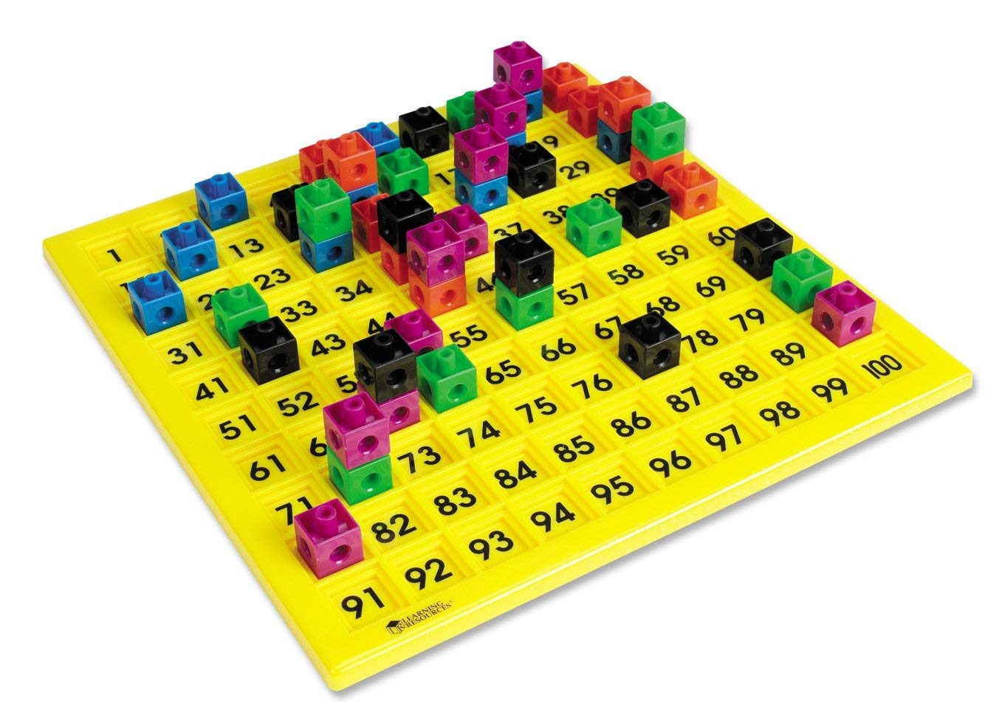

Slide 6
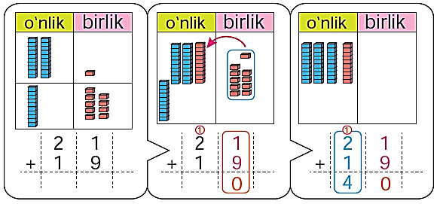
24-bet, 1-misol
Hisoblashlar qanday bajarilgan:

Slide 7
24-bet, 2-misol
Hisoblaymiz:
1
1
1
1
4 5
6 7
8 2
7 9
+
1 5
2 3
1 8
2 1
+
+
+
6
0
9
0
10
0
10
0

Slide 8
24-bet, 3-topshiriq
Geometrik shakllar nechtadan?
1-shaklda:
Uchburchaklar: 5 ta
2-shaklda:
Uchburchaklar: 4 ta
To‘rtburchaklar: 2 ta
To‘rtburchaklar: 4 ta

Slide 9
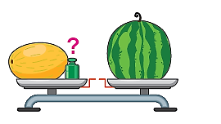
24-bet, 4-masala
22 kg
Qovun, tarvuz va tarozi toshi
birgalikda 22 kg. Tarvuz 11 kg,
qovun 9 kg bo‘lsa, tarozidagi
toshning massasini topamiz.
Tarvuz – 11 kg
Qovun – 9 kg
22 kg
Tarozi toshi – ? kg
Yechish: 1) 11 + 9 = 20 (kg) – tarvuz va qovunning massasi
2) 22 – 20 = 2 (kg) – Tarozi toshining massasi.

Slide 11
Mustaqil topshiriq:
24-bet,
5-misol.

Slide 12
24-bet, 5-misol
Hisoblaymiz:
2 0
3 5
4 2
6 4
+
6 0
3 5
1 8
1 6
+
+
+
8
0

Slide 13
E’tiboringiz uchun
rahmat!

