Slide 1

Matematika
2-sinf

Slide 2

Mavzu:
100 ichida sonlarni xonadan
o‘tib qo‘shish usullari
(12-dars, 25-bet)

Slide 3

Mustaqil topshiriqni
tekshiring:
24-bet, 5-misol.

Slide 4

24-bet, 5-misol
Hisoblaymiz:
1
1
1
1
2 0
3 5
4 2
6 4
2 8
+
7 2
6 0
3 5
1 8
1 6
+
+
+
+
8
0
7
0
6
0
8
0
10
0

Slide 5
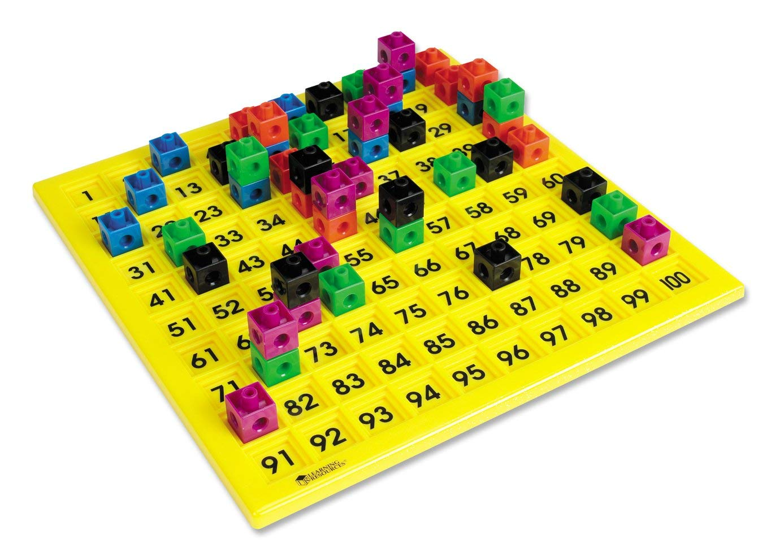

Slide 6
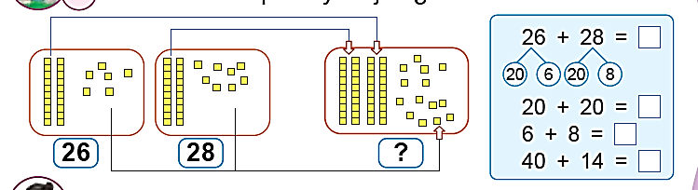
25-bet, 1-misol
Hisoblashlar qanday bajarilgan:
54
40
14
54
54

Slide 7
25-bet, 2-misol
Sonlarni o‘nlik va birliklarga ajratib hisoblaymiz.
4 4 + 1 7 =
61
6 3 + 1 9 =
82
40
4
10
7
60
3
10
9
40 + 10 = 50
60 + 10 = 70
4 + 7 = 11
3 + 9 = 12
50 + 11 = 61
70 + 12 = 82

Slide 8

25-bet, 3-topshiriq
Har bir parrandaning massasini topamiz.
10 kg
1) 2 + 5 = 7 (kg)
3) 6 + 2 + 2 = 10 (kg)
2) 7 – 1 = 6 (kg)
3) 10 – 2 – 5 = 3 (kg)
g‘oz: 6 (kg)
tovuq: 6 (kg)

Slide 9

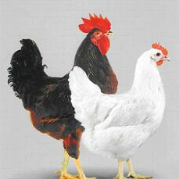
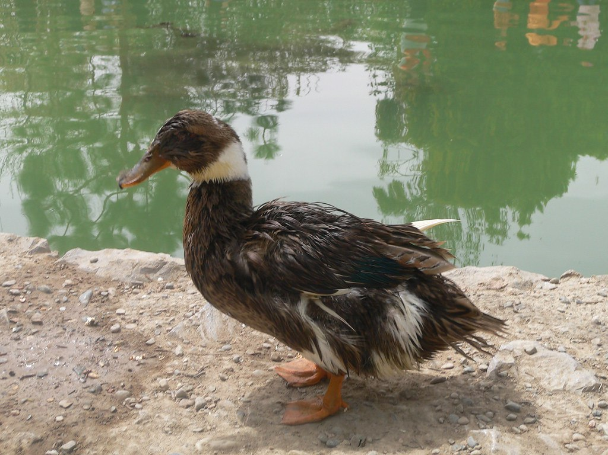
Tovuq, o‘rdak, g‘oz, kurka go‘shti, tuxumi va pati uchun boqiladi.

Slide 10
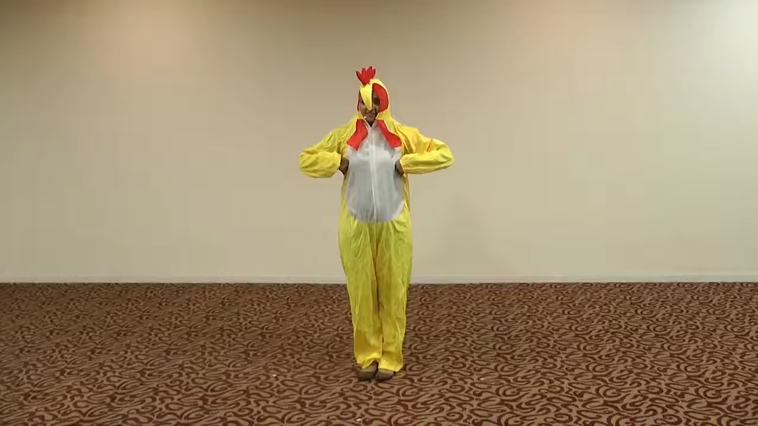

Slide 11
25-bet, 4-topshiriq
Taqqoslaymiz:
37 + 19 62
53 – 22 71
<
<
56 62
31 71
<
<
84 92 - 31
>
84 61
>

Slide 12

Mustaqil topshiriq:
25-bet,
5-masala.

Slide 13
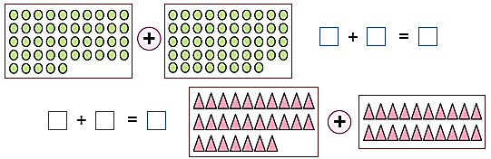
25-bet, 5-masala

Slide 14

E’tiboringiz uchun
rahmat!

