Slide 1
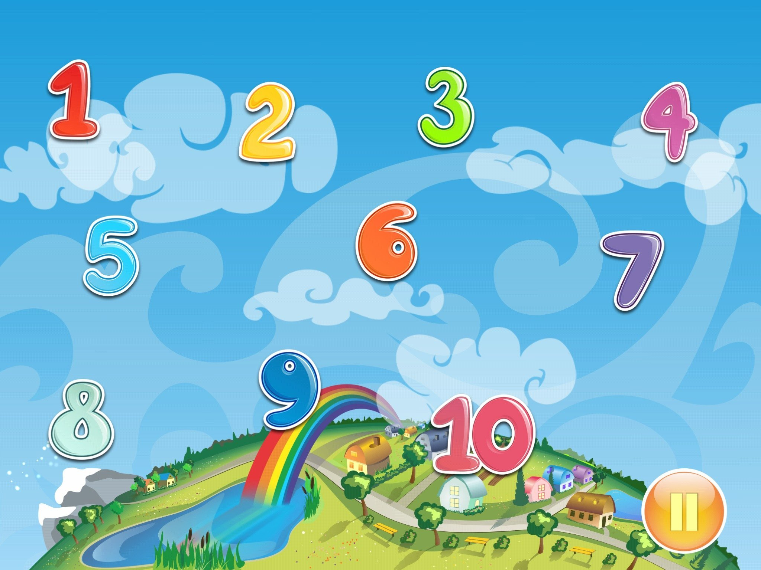
Matematika
2-sinf

Slide 2
Mavzu:
100 ichida sonlarni xonadan
o‘tib qo‘shish usullari
(13-dars, 26-bet)

Slide 3
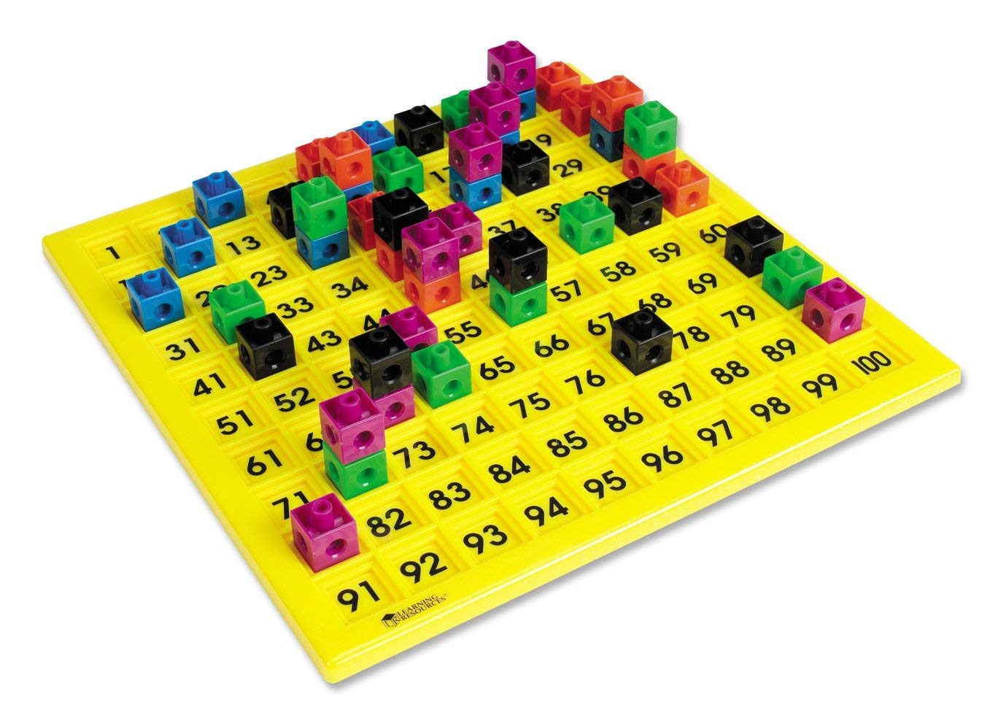

Slide 4
Mustaqil topshiriqni
tekshiring:
25-bet, 5-misol.

Slide 5
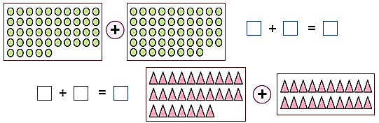
25-bet, 5-misol
Shakllar asosida ifodalar tuzib, hisoblaymiz.
45
48
93
27
20
47

Slide 6
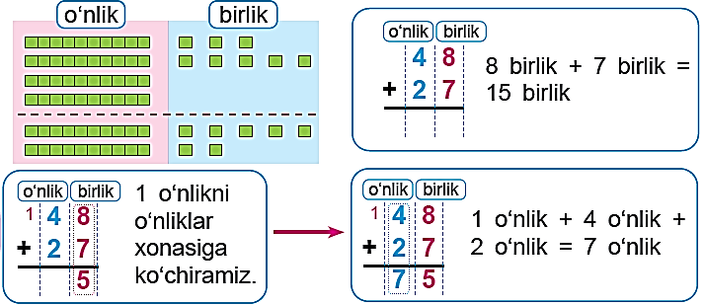
26-bet, 1-misol
Hisoblashni tushuntiramiz:

Slide 7
26-bet, 2-misol
Hisoblaymiz:
1
1
1
1
8 5
6
2 8
4 2
3 3
+
5 7
9
6 7
1 7
2 9
+
+
+
+
9
4
7
3
4
5
7
1
9
0

Slide 8
26-bet, 3-misol
Qaysi ifodaning qiymati 74 ga teng?
2 5 + 3 3 =
58
3 1 + 1 9 =
50
20
5
30
3
30
1
10
9
20 + 30 = 50
30 + 10 = 40
5 + 3 = 8
1 + 9 = 10
50 + 8 = 58
40 + 10 = 50

Slide 9
26-bet, 3-misol
Qaysi ifodaning qiymati 74 ga teng?
2 8 + 4 8 =
76
3 6 + 3 8 =
74
20
8
40
8
30
6
30
8
20 + 40 = 60
30 + 30 = 60
8 + 8 = 10
6 + 8 = 14
60 + 16 = 76
60 + 14 = 74

Slide 10
25-bet, 4-topshiriq
Bir kunda qancha shakar sotilgan?
Yechish: 42 + 19 = (40 + 10) + (2 + 9) = 50 + 11 = 61 (kg)
Javob: 1 kunda 61 kg shakar sotilgan.

Slide 11
ROLIK

Slide 12
Mustaqil topshiriq:
26-bet,
5-misol.

Slide 13
26-bet, 5-misol
Hisoblaymiz:
7
6 8
2 9
3 5
3 6
+
7 8
3 6
9
3 2
2 5
+
+
+
+
8
5

Slide 14
26-bet, 5-misol
Hisoblaymiz:
1
1
1
1
7
6 8
2 9
3 5
3 6
+
7 8
3 6
9
3 2
2 5
+
+
+
+
8
5
7
7
6
1
6
0
7
2

Slide 15
E’tiboringiz uchun
rahmat!

