Slide 1

Matematika
2-sinf

Slide 2

Mavzu:
100 ichida sonlarni xonadan
o‘tib qo‘shish usullari
(6-dars, 18-bet)

Slide 3

Mustaqil topshiriqni
tekshiring:
18-bet, 5-misol.

Slide 4

18-bet, 5-misol
39 + 1 = 40
66 + 4 =70
82 + 8 = 90
67 + 3 = 70
45 + 5 = 50
71 + 9 = 80

Slide 5


BUGUN DARSDA:
Ifodalarni hisoblaymiz
Masalalar yechamiz
Geometrik shakllar

Slide 6

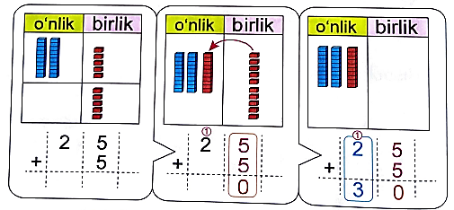
18-bet, 1-misol
Hisoblash qanday bajarilgan?

Slide 7
19-bet, 2-misol
Hisoblaymiz:
1
1
1
1
1
2 5
4 4
6 1
5 8
7 3
+
5
+
6
+
9
+
2
+
7
3
0
5
0
7
0
6
0
8
0

Slide 8



19-bet, 3-masala
Jami necha kilogramm sabzavot sarflangan?
20 kg
5 kg
? kg
5 kg

Slide 9
19-bet, 3-masala
Jami necha kilogramm sabzavot sarflangan?
bodring – 20 kg;
20 + 5 = 25 (kg) – baqlajon;
2) 25 + 5 = 30 (kg) – pomidor;
3) 20 + 25 + 30 = 75 (kg) – jami.
Javob: jami 75 kg sabzavot sarflangan.

Slide 10
19-bet, 4-masala
Pastdagi shakllar yuqoridagi qaysi
shakllardan yasalgan?

Slide 11

Mustaqil topshiriq:
19-bet,
5-misol.

Slide 12
19-bet, 5-misol
Qaysi juftlikdagi sonlar yig‘indisi o‘zaro teng?
27
3
48
2
6
54
27 + 3 = 30
48 + 2 = 50
4
46
81
9

Slide 13

E’tiboringiz uchun
rahmat!

