Slide 1
Matematika
2-sinf

Slide 2
Mavzu:
100 ichida sonlarni xonadan
o‘tib qo‘shish usullari

Slide 3
Mustaqil topshiriqni
tekshiring:
17-bet, 5-misol.

Slide 4
17-bet, 5-misol
22 = +
76 = +
83 = +
20
2
70
6
80
3
45 = +
79 = +
92 = +
40
5
70
9
90
2

Slide 5
BUGUN DARSDA:
Ifodalarni hisoblaymiz
Uchburchaklar sonini topamiz
Qiziqarli masalalar

Slide 6
17-bet, 1-misol
Hisoblash qanday bajarilgan?
40
10
40

Slide 7
18-bet, 2-misol
Hisoblaymiz:
62 + 8 =
70
74 + 6 =
80
60
2
70
4
62 + 8 =
70
74 + 6 =
80

Slide 8
18-bet, 2-misol
Hisoblaymiz:
81 + 9 =
90
37 + 3 =
40
80
1
30
7
81 + 9 =
90
37 + 3 =
40

Slide 9
18-bet, 3-masala
Shaklda nechta uchburchak bor ?
Shaklda 8 ta uchburchak bor .

Slide 10
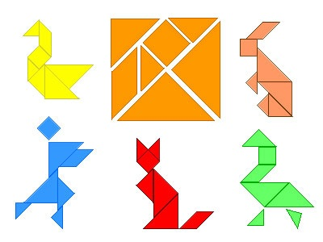
Tarkibida uchburchaklar bo‘lgan shakllar

Slide 12
18-bet, 4-masala
3 ta sariq koptokcha massasi nechta qizil koptokcha massasiga teng?
1 ta sariq koptokcha = 2 ta qizil koptokcha
2 + 2 + 2 = 6 (ta)
Javob: 3 ta sariq koptokcha 6 ta qizil koptokcha massasiga teng.

Slide 13
Mustaqil topshiriq:
17-bet,
5-misol.

Slide 14
17-bet, 5-misol
22 = +
76 = +
83 = +
20
2
70
6
80
3
45 = +
79 = +
92 = +
40
5
70
9
90
2

Slide 15
E’tiboringiz uchun
rahmat!

