Slide 1
Matematika
2-sinf

Slide 2
Ko‘pburchak va uning perimetri (10-dars)

Slide 3
Mustaqil topshiriqni tekshirish:
63-bet. 5-topshiriq

Slide 4
5-topshiriq.(63-bet)
To‘g‘ri to‘rtburchakning eni
14 cm, bo‘yi 6 cm. Uning
perimetri necha santimetr?

Slide 5
5-topshiriq. (63-bet)
14 cm
6 cm
P=6+14+6+14=40 cm
P=40 (cm)

Slide 6
Shakllarning perimetrini topamiz
va taqqoslaymiz. (63-bet)
1.
2 cm
1 cm
1 cm
1 cm
8 cm=8 cm
1 cm
2 cm
2 cm
1 cm
1 cm
2 cm
1 cm
1 cm
P=2+2+2+2=8 cm
P=8 (cm)
P=1+1+1+1+1+1+1+1=8 cm
P=8 (cm)

Slide 7
Ikkinchi shaklning perimetri nimaga teng? (63-bet)
2.
2 cm
2 cm
2 cm
2 cm
2+2+2+2=8
4 + + + =
4
4
4
1 6

Slide 8
Chizma asosida masala tuzamiz va yechamiz.
(64-bet)
35 m
?
20 m
15 m
S
O
Z
Sinfxona
Oshxona
Sportzal
Yechish: 35-20=15 (m)
Javob: oshxonadan sportzalgacha 15 metr.

Slide 9
Mustaqil topshiriq:
64-bet.
4-topshiriq

Slide 10
Shakllarning perimetrlarini taqqoslaymiz.(63-bet)
4.
8 cm
3 cm
3 cm
6 cm
4 cm
4 cm
6 cm

Slide 11
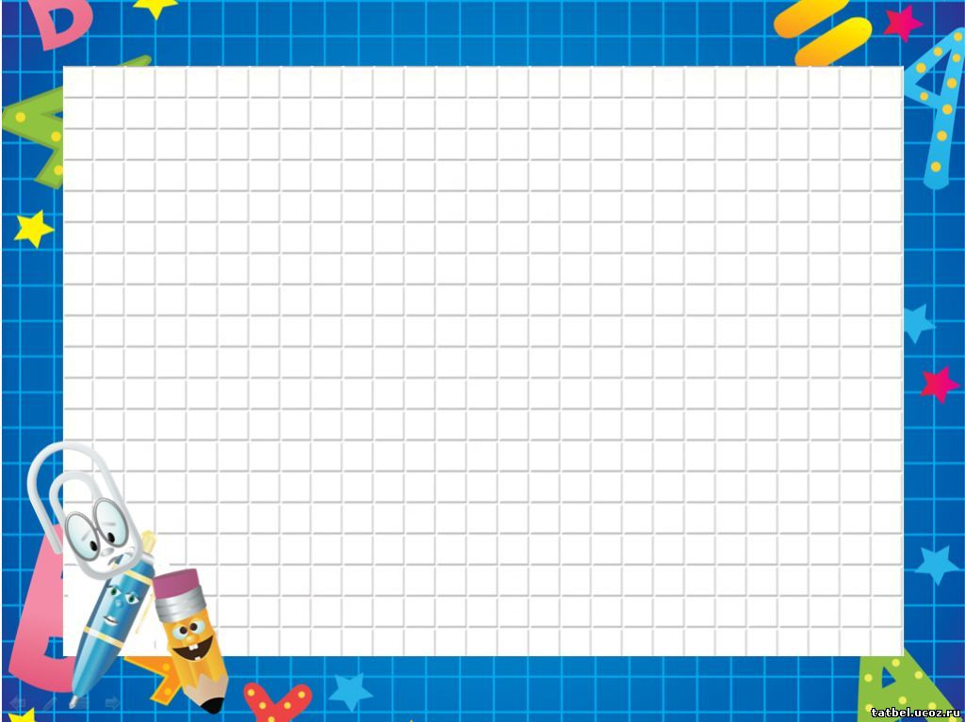
E’tiboringiz
uchun rahmat!

