Slide 1
Matematika
2-sinf

Slide 2
Ko‘pburchak va uning perimetri (9-dars)

Slide 3
Mustaqil topshiriqni tekshirish:
62-bet. 6-topshiriq

Slide 4
6.
Ko‘pburchaklarni chizamiz va perimetrini hisoblaymiz. (62-bet)
8 cm
8 cm
P=2+8+8+2+8+8=36
2 cm
2 cm
P=36 (cm)
8 cm
8 cm

Slide 5
6.
Ko‘pburchaklarni chizamiz va perimetrini hisoblaymiz. (62-bet)
2 cm
2 cm
P=4+2+2+4+2+2=16
P=16 (cm)
4 cm
4 cm
2 cm
2 cm

Slide 6
6.
Ko‘pburchaklarni chizamiz va perimetrini hisoblaymiz. (62-bet)
2 cm
2 cm
P=2+2+2+2+2=10
P=10 (cm)
2 cm
2 cm
2 cm

Slide 7
1.
Shakllarning perimetri nimaga teng? (62-bet)
2 cm
P=2+2+2+2=8
P=8 (cm)

Slide 8
1.
Shakllarning perimetri nimaga teng? (62-bet)
3 cm
3 cm
P=3+3+3+3+4=16
P=16 (cm)
3 cm
3 cm
4 cm

Slide 9
1.
Shakllarning perimetri nimaga teng? (62-bet)
4 cm
4 cm
P=2+4+4+2+4+4=20
2 cm
2 cm
P=20 (cm)
4 cm
4 cm

Slide 10
2.
Rasm asosida jadvalni to‘ldiramiz. (62-bet)
Ranglar
Kataklar soni
Yashil
16
16
Qizil
?
Siyohrang
16
?
16
Sariq
?
Jami:
64

Slide 11
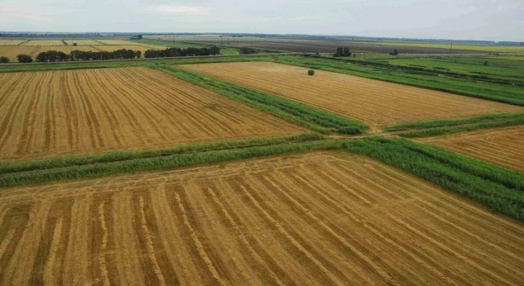
3-masala. (63-bet)
Bo‘yi 20 metr, eni 30 metr bo‘lgan yer maydonini o‘rash uchun necha metr devor qurish kerak?
Yechish: 20+30+20+30=
100
20 m
Javob: 100 metr devor qurish kerak.
30 m

Slide 12
4-misol. Namunadagidek hisoblaymiz.
1
47
5
64
8
45
5
59
4
78
3
48
8
5
2
72
50
63
81
56

Slide 13
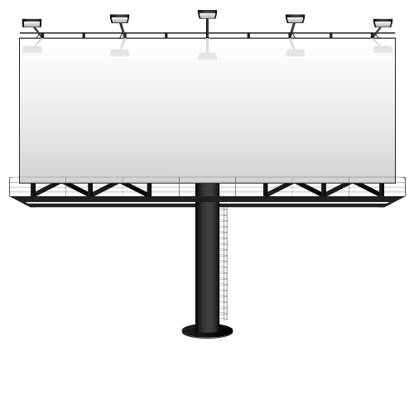
Mustaqil topshiriq:
63-bet. 5-topshiriq

Slide 14
5-topshiriq.(63-bet)
To‘g‘ri to‘rtburchakning eni
14 cm, bo‘yi 6 cm. Uning
perimetri necha santimetr?

Slide 15
E’tiboringiz uchun rahmat!

