Slide 1
Matematika
2-sinf

Slide 2
Mavzu:
Ko‘pburchak va uning perimetri (8-dars)

Slide 3
Mustaqil topshiriqni tekshirish:
61-bet. 5-topshiriq

Slide 4
5.
Shakllarning perimetrini hisoblaymiz.
10 cm
9 cm
10 cm
3 cm
P=9+3+9+3=24
P=24 (cm)
P=10+10+10+10=40
P=40 (cm)

Slide 5
1.
Eslaymiz. Shakllarning qaysi biri ko‘pburchak emas? (61-bet)

Slide 6
2.
3 cm
3 cm
Ko‘pburchakning perimetri
uning barcha tomonlari
uzunliklari yig‘indisiga teng.
2 cm
2 cm
3 cm
3 cm
2 cm+3 cm+3 cm+2 cm+3 cm+3 cm=
16 cm

Slide 7
3.
Ko‘pburchaklar perimetri nimaga teng?
3 cm
6 cm
5 cm
3 cm
2 cm
4 cm
1 cm
3 cm
7 cm
4 cm
5 cm
P= 5 cm+3 cm+4 cm=
12 cm
P=12 (cm)

Slide 8
3.
Ko‘pburchaklar perimetri nimaga teng?
3 cm
6 cm
5 cm
3 cm
2 cm
4 cm
1 cm
3 cm
7 cm
4 cm
5 cm
P= 2 cm+3 cm+4 cm+5 cm=
14 cm
P=14 (cm)

Slide 9
3.
Ko‘pburchaklar perimetri nimaga teng?
3 cm
6 cm
5 cm
3 cm
2 cm
4 cm
1 cm
3 cm
7 cm
4 cm
5 cm
P= 1 cm+6 cm+3 cm+7 cm=
17 cm
P=17 (cm)

Slide 10
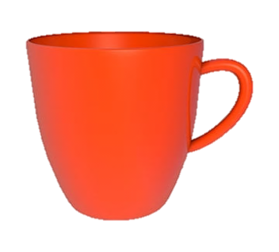
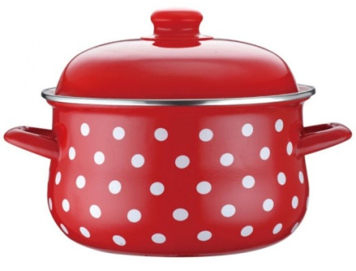
4.
Qaysi biri simmetrik?
-----------
-----------
-----------
--------------
-------------
-------------
-------------
--------------

Slide 11
5.
Namuna asosida hisoblaymiz. (62-bet)
+8
+7
+1
63 70 71
63+7+1=
70+1=
71

Slide 12
5.
Namuna asosida hisoblaymiz. (62-bet)
+7
+4
+3
86 90
93
86+4+3=
90+3=
93

Slide 13
5.
Namuna asosida hisoblaymiz. (62-bet)
+9
+6
+3
74 80
83
74+6+3=
80+3=
83

Slide 14
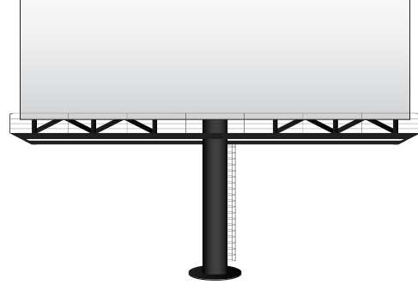
Mustaqil topshiriq:
62-bet. 6-topshiriq

Slide 15
6.
Ko‘pburchaklarni chizamiz
va perimetrini hisoblaymiz.
8 cm
2 cm
2 cm
8 cm
2 cm
2 cm
2 cm
2 cm
4 cm
2 cm
2 cm
4 cm
8 cm
8 cm
2 cm
2 cm
2 cm

Slide 16
E’TIBORINGIZ
UCHUN RAHMAT!

