Slide 1
Matematika
2-sinf

Slide 2
1-SINFDA O‘TILGANLARNI TAKRORLASH
Mavzu:
Yuz ichida qo‘shish va ayirish

Slide 3
Savollarga javob bering:
1) 1 dan 10 gacha 1 talab sanang:
1, 2, 3, 4, 5, 6, 7, 8, 9, 10.
2) 10 dan 50 gacha 5 talab sanang:
10, 15, 20, 25, 30, 35, 40, 45, 50.
3) 10 dan 100 gacha 10 talab sanang:
10, 20, 30, 40, 50, 60, 70, 80, 90, 100

Slide 4
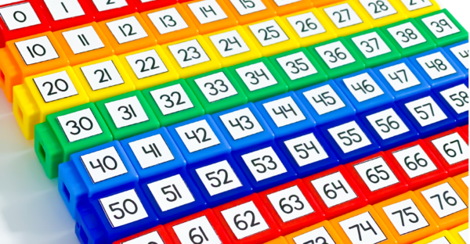

Slide 5
1-misol
Hisoblashni tushuntiramiz:
30 + 20 = ?
30 + 20 = 50
+
=

Slide 6
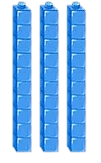
1-misol
50 - 20 = ?
50 - 20 = 30
=

Slide 7
1-misol
50 - 30 = ?
50 - 30 = 20
=

Slide 8
2-misol
Bo‘laklab hisoblaymiz:
30 + 40 + 20 =
90 - 40 - 10 =
40
90
70
50
90
40

Slide 9
3-masala
Nechta o‘yinchoq qoldi?
Bor edi | Keltirildi | Sotildi | Qoldi
40 ta | 30 ta | 50 ta | ? ta
Yechish:
40 + 30 – 50 = 70 – 50 = 20 (ta)
Javob: 20 ta o‘yinchoq qoldi.

Slide 10
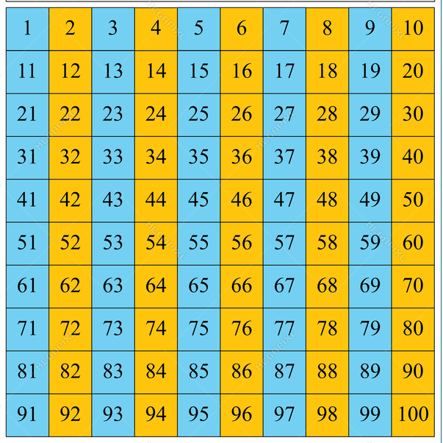
4-masala
Juft va toq sonlar
“Juft va toq sonlar” jadvali

Slide 11
4-masala
1 dan 30 gacha bo‘lgan sonlar ichida
15 ta toq son bor.

Slide 12
5-misol
Bo‘sh kataklarga mos sonlarni yozamiz:
+
=
80
20 + 60 = 80
30 + 50 = 80
60 + 20 = 80
50 + 30 = 80
40 + 40 = 80

Slide 13
Mustaqil topshiriq:
7-bet,
6-misol.

Slide 14
6-misol
Hisoblaymiz:
20 + 10 =
30
40 + 20 =
50 + 50 =
20 - 10 =
40 - 40 =

Slide 15
E’tiboringiz uchun
rahmat!

