Slide 1
Geometriya
9-sinf
Mavzu: Amaliy-tatbiqiy masalalarni yechish

Slide 2
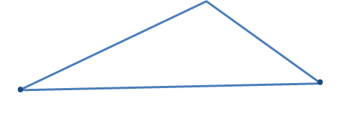
Uchburchaklar o‘xshashlik alomatlarining isbotlashga doir masalalarga tatbiqlari
1-masala. Uchburchak bissektrisasi o‘zi tushgan tomonni qolgan ikki tomonga proporsional kesmalarga ajratishini isbotlang.
$$A$$
$∆ABC$, $AA_{1}−$bissektrisa
$$⋅$$
$$⋅$$
$$C$$
$$B$$
$$\frac{AB}{AC}=\frac{{BA}_{1}}{{CA}_{1}}$$
$$A_{1}$$

Slide 3
Uchburchaklar o‘xshashlik alomatlarining isbotlashga doir masalalarga tatbiqlari
$$A$$
$$⋅$$
Yechish. $AA_{1}$ to‘g‘ri chiziqqa $BE$ va $CF$ perpendikularlar tushiramiz.
$$⋅$$
$$E$$
$$⋅$$
$$C$$
$$B$$
Unda $∠CAF=∠BAE$ bo‘lgani uchun, to‘g‘ri burchakli $CAF$ va $BAE$ uchburchaklar o‘xshash bo‘ladi.
$$⋅$$
$$A_{1}$$
$$F$$

Slide 4
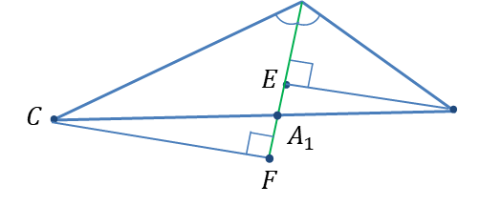
Uchburchaklar o‘xshashlik alomatlarining isbotlashga doir masalalarga tatbiqlari
O‘xshash uchburchaklarning mos tomonlari proporsionalligidan
$∆CAF∾$ $∆BAE ⇒ \frac{AC}{AB}=\frac{CF}{BE}$ (1)
Shunga o‘xshash $∆CA_{1}F∾$ $∆BA_{1}E ⇒ \frac{CA_{1}}{BA_{1}}=\frac{CF}{BE}$ (2)
(1) va (2) tengliklarni solishtirsak, $\frac{AC}{AB}=\frac{CA_{1}}{BA_{1}}$
yoki $\frac{AB}{AC}=\frac{{BA}_{1}}{{CA}_{1}}$ bo‘ladi.
$$⋅$$
$$A$$
Bu${BA}_{1}$ va ${CA}_{1}$ kesmalar proporsional ekanligini anglatadi.
$$B$$

Slide 5
Uchburchaklar o‘xshashlik alomatlarining isbotlashga doir masalalarga tatbiqlari
2-masala. $ABC$uchburchakning $BD$ bissektrisasi uchburchakka tashqi chizilgan aylanani $B$ va $P$ nuqtalarda kesadi.
$∆ABP∾$ $∆BDC$ ekanligini isbotlang.
$$⋅$$
Yechish. $∆ABP$ va $∆BDC$ da:
1. Shartga ko‘ra, $∠DBC=∠ABP$;
2. $∠DCB$ va $∠APB$ lar bitta yoyga tiralganligi uchun, $∠DCB=∠APB.$
$$B$$
$$⋅$$
$$⋅$$
$$⋅$$
$$D$$
Demak, uchburchaklar o‘xshashligining 1-alomatiga ko‘ra, $∆ABP∾$ $∆BDC$.
$$A$$
$$C$$
$$⋅$$
$$P$$

Slide 6
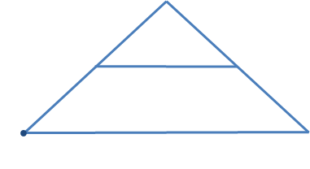
Amaliy mashq va tatbiq
1. Uchburchaklarning o‘xshashligidan foydalanib, uchburchak o‘rta chizig‘i uchburchakning bir tomoniga parallel va shu tomonning yarmiga teng ekanligini isbotlang.
$$B$$
$$⋅$$
$∆ABC$, $MN−$o‘rta chiziq $MA=MB, NC=NB$
$$⋅$$
$$⋅$$
$$M$$
$$N$$
$$⋅$$
$$MN∥AC, MN=\frac{1}{2}AC$$
$$C$$
$$A$$

Slide 7
Amaliy mashq va tatbiq
Yechish. $∆ABC$va $∆MBN$ uchun:
$∠B−$umumiy, $\frac{BM}{AB}=\frac{BN}{BC}=\frac{1}{2}.$
Shuning uchun, uchburchaklar o‘xshashligining 2-alomatiga ko‘ra, bu ikki uchburchak o‘xshash.
Demak, $∆MBN∾$ $∆ABC ⇒$
$\left\{\begin{aligned}∠BMN=∠A, \\ \frac{MN}{AC}=\frac{1}{2}\end{aligned}\right.$ $⇒$ $\left\{\begin{aligned}MN∥AC, \\ MN=\frac{1}{2}AC.\end{aligned}\right.$
$$B$$
$$⋅$$
$$⋅$$
$$⋅$$
$$M$$
$$N$$
$$⋅$$
$$A$$
$$C$$

Slide 8
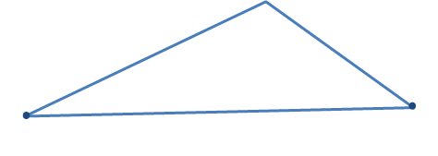
Masalalar yechish
12.1. Uchburchak bissektrisasi o‘zi tushgan tomonda ajratgan kesmalari va uchburchakning qolgan tomonlari orasidagi proporsionallikni yozib ko‘rsating.
1) $∆ABC$, $AA_{1}−$bissektrisa bo‘lsin.
U holda,
$$\frac{AB}{AC}=\frac{{BA}_{1}}{{CA}_{1}};$$
$$A$$
$$⋅$$
$$⋅$$
$$C$$
$$B$$
$$A_{1}$$

Slide 9
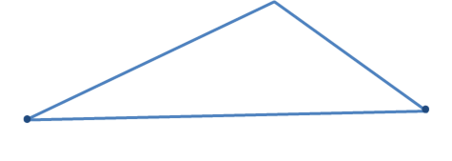
Masalalar yechish
$$⋅$$
2) $∆ABC$, $BB_{1}−$bissektrisa bo‘lsin.
$$A$$
$$⋅$$
U holda, $\frac{AB}{BC}=\frac{{AB}_{1}}{{CB}_{1}};$
$$B_{1}$$
$$C$$
$$B$$
$$⋅$$
$$A$$
3) $∆ABC$, $CC_{1}−$bissektrisa bo‘lsin.
$$⋅$$
$$C_{1}$$
U holda, $\frac{AC}{BC}=\frac{{AC}_{1}}{{BC}_{1}}.$
$$C$$
$$B$$
$$⋅$$

Slide 10
Masalalar yechish
12.2. To‘g‘ri burchakli $ABC$uchburchakning $C$ to‘g‘ri burchagidan $CD$ balandlik o‘tkazilgan. $∠ACD=∠CBD$ bo‘lishini isbotlang. Hosil bo‘lgan shaklda nechta o‘zaro o‘xshash uchburchaklarni ko‘rsata olasiz?
$$⋅$$
$$A$$
Yechish.
1) $∆ABC$ va $∆ACD$ to‘g‘ri burchakli uchburchaklar bo‘lib, $∠A−$umumiy burchakdir. Bundan, bu uchburchaklarning uchinchi burchaklari o‘zaro tengligi kelib chiqadi, ya’ni $∠ACD=∠CBD;$
$$⋅$$
$$D$$
$$⋅$$
$$⋅$$
$$C$$
$$B$$

Slide 11
Masalalar yechish
2) Hosil bo‘lgan shaklda nechta o‘zaro o‘xshash uchburchaklar borligini ko‘rsatamiz.
a) $∆ABC$ va $∆ACD$ to‘g‘ri burchakli uchburchaklar bo‘lib, $∠A−$umumiy burchakdir.
To‘g‘ri burchakli uchburchaklarning bittadan o‘tkir burchagi mos ravishda teng bo‘lsa, ular o‘xshash bo‘ladi.
Demak, $∆ABC$ $∾$ $∆ACD.$
$$⋅$$
$$A$$
$$⋅$$
$$D$$
$$⋅$$
$$⋅$$
$$C$$
$$B$$

Slide 12
Masalalar yechish
b) $∆ABC$ va $∆BCD$ to‘g‘ri burchakli uchburchaklar bo‘lib, $∠B−$umumiy burchakdir.
To‘g‘ri burchakli uchburchaklarning bittadan o‘tkir burchagi mos ravishda teng bo‘lsa, ular o‘xshash bo‘ladi.
Demak, $∆ABC$ $∾$ $∆BCD.$
$$⋅$$
$$A$$
$$⋅$$
$$D$$
$$⋅$$
$$⋅$$
$$C$$
$$B$$

Slide 13
Masalalar yechish
c) $∆ACD$ va $∆BCD$ to‘g‘ri burchakli uchburchaklar bo‘lib, $∠B=$ $∠C.$
To‘g‘ri burchakli uchburchaklarning bittadan o‘tkir burchagi mos ravishda teng bo‘lsa, ular o‘xshash bo‘ladi.
Demak, $∆ACD$ $∾$ $∆BCD.$
$$⋅$$
$$A$$
$$⋅$$
$$D$$
$$⋅$$
$$⋅$$
$$C$$
$$B$$

Slide 14
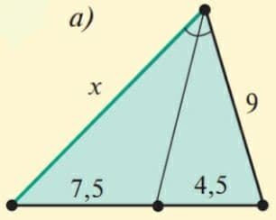
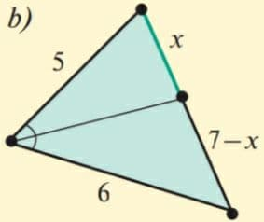
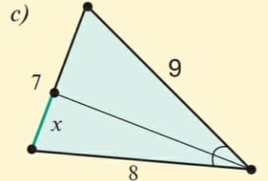
Masalalar yechish
12.3. Quyidagi rasmdagi ma’lumotlar asosida $x$ ni toping.

Slide 15
Masalalar yechish
12.3. Quyidagi rasmdagi ma’lumotlar asosida $x$ ni toping.
$$B$$
$ABC$ uchburchakda $BD−$bissektrisa bo‘lib,
bunda $\frac{AB}{BC}=\frac{AD}{DC}$
$$\frac{x}{7,5}=\frac{9}{4,5}, x=\frac{9∙7,5}{4,5}=15;$$
Demak, $x=15.$
$$⇒$$
$$A$$
$$D$$
$$C$$

Slide 16
Masalalar yechish
12.3. Quyidagi rasmdagi ma’lumotlar asosida $x$ ni toping.
$$B$$
$ABC$ uchburchakda $AD−$bissektrisa bo‘lib,
bunda $\frac{AB}{AC}=\frac{BD}{DC}$
$$\frac{5}{6}=\frac{x}{7−x}, 5∙\left(7−x\right)=6x,$$
$$⇒$$
$$D$$
$$A$$
$35−5x=6x,$
$$11x=35,$$
$x=\frac{35}{11}$;
$$C$$
Demak, $x=\frac{35}{11}.$

Slide 17
Masalalar yechish
12.3. Quyidagi rasmdagi ma’lumotlar asosida $x$ ni toping.
$$B$$
$ABC$ uchburchakda $CD−$bissektrisa bo‘lib,
bunda $\frac{BC}{AC}=\frac{BD}{AD}$
$$\frac{9}{8}=\frac{7−x}{x}, 9x=8∙\left(7−x\right),$$
$$⇒$$
$$D$$
$$D$$
$9x=56−8x,$
$$17x=56,$$
$x=\frac{56}{17}$;
$$A$$
$$C$$
Demak, $x=\frac{56}{17}.$

Slide 18
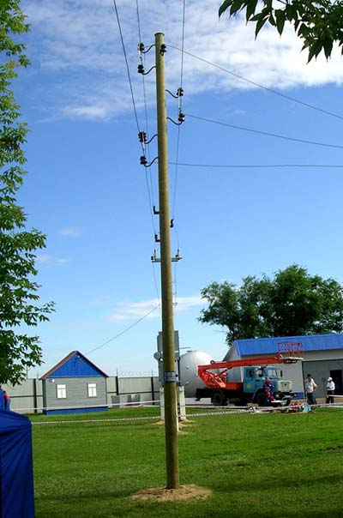
Masalalar yechish
13.1. Bo‘yi $170 cm$ bo‘lgan odam soyasining uzunligi $1 m$ bo‘lsa, balandligi $5,4 m$ bo‘lgan simyog‘och soyasining uzunligini toping.
Yechish.
$5,4 m=540 cm, 1 m=100 cm;$ $\frac{540}{170}=\frac{x}{100}, x=\frac{54}{17}m=3\frac{3}{17} m.$
$5,4 m$
Javob:
Simyog‘och soyasining
uzunligi $3\frac{3}{17} m$.
$$x$$
$170 cm$
$1 m$

Slide 19
Mustaqil bajarish uchun topshiriq
Darslikning 40-betidagi 12.4-, 12.9-, 12.10- mashqlarni va 43-betidagi 13.9-, 13.10- mashqlarni bajaring.

