Slide 1

Geometriya
9-sinf
Mavzu: 0° dan 180° gacha bo‘lgan burchakning sinusi, kosinusi, tangensi va kotangensi

Slide 2
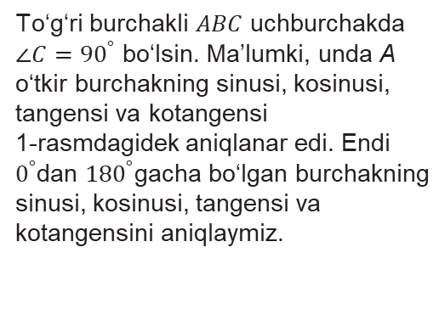
Burchak sinusi, kosinusi, tangensi va kotangensi
To‘g‘ri burchakli $ABC$ uchburchakda $∠{C=90}^{°}$ bo‘lsin. Ma’lumki, unda A o‘tkir burchakning sinusi, kosinusi, tangensi va kotangensi
1-rasmdagidek aniqlanar edi. Endi $0^{°}$dan ${180}^{°}$gacha bo‘lgan burchakning sinusi, kosinusi, tangensi va kotangensini aniqlaymiz.

Slide 3
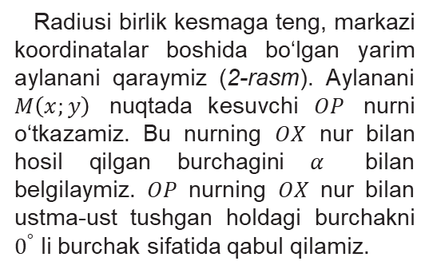
Burchak sinusi, kosinusi, tangensi va kotangensi
Radiusi birlik kesmaga teng, markazi koordinatalar boshida bo‘lgan yarim aylanani qaraymiz (2-rasm). Aylanani $M\left(x;y\right)$ nuqtada kesuvchi $OP$ nurni o‘tkazamiz. Bu nurning $OX$ nur bilan hosil qilgan burchagini $α$ bilan belgilaymiz. $OP$ nurning $OX$ nur bilan ustma-ust tushgan holdagi burchakni $0^{°}$ li burchak sifatida qabul qilamiz.

Slide 4
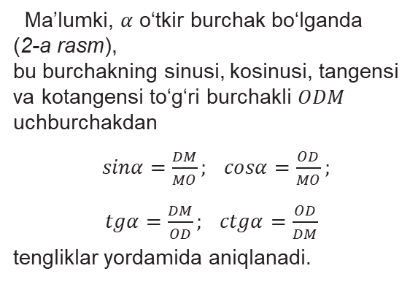
Burchak sinusi, kosinusi, tangensi va kotangensi
Ma’lumki, $α$ o‘tkir burchak bo‘lganda
(2-a rasm),
bu burchakning sinusi, kosinusi, tangensi va kotangensi to‘g‘ri burchakli $ODM$ uchburchakdan
$sinα=\frac{DM}{MO};$ $cosα=\frac{OD}{MO};$
$tgα=\frac{DM}{OD};$ $ctgα=\frac{OD}{DM}$
tengliklar yordamida aniqlanadi.

Slide 5
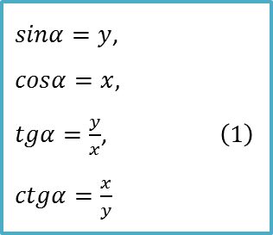

Burchak sinusi, kosinusi, tangensi va kotangensi
Agar $MO=1$, $DM=y$, $OD=x$ ekanligini hisobga olsak,
$sinα=y$,
$cosα=x,$
$tgα=\frac{y}{x}$, $\left(1\right)$
$ctgα=\frac{x}{y}$
tengliklarga ega bo‘lamiz.

Slide 6
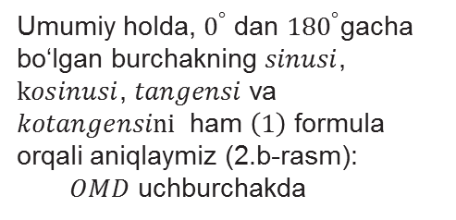


Burchak sinusi, kosinusi, tangensi va kotangensi
Umumiy holda, $0^{°}$ dan ${180}^{°}$gacha bo‘lgan burchakning $sinusi$, $kosinusi$, $tangensi$ va
$kotangensini$ ham $\left(1\right)$ formula orqali aniqlaymiz (2.b-rasm):
$OMD$ uchburchakda
$${OD}^{2}+{DM}^{2}={MO}^{2}$$
yoki
$x^{2}+y^{2}=1$.

Slide 7

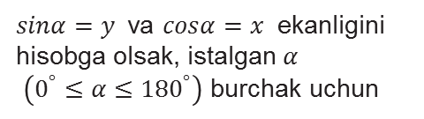
Burchak sinusi, kosinusi, tangensi va kotangensi
$sinα=y$ va $cosα=x$ ekanligini hisobga olsak, istalgan $α$
$\left(0^{°}≤α≤{180}^{°}\right)$ burchak uchun
${\sin^{2}α+cos}^{2}α=1$ $\left(2\right)$
asosiy trigonometrik ayniyatni hosil qilamiz.

Slide 8



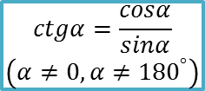
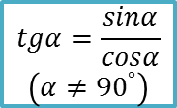
Burchak sinusi, kosinusi, tangensi va kotangensi
Ta’rifga ko‘ra, $tgα=\frac{y}{x},$ $ctgα=\frac{x}{y},$ $x=cosα,$ $y=sinα$ bo‘lgani uchun,
$$tgα=\frac{sinα}{cosα}$$
$$\left(α≠{90}^{°}\right)$$
$$ctgα=\frac{cosα}{sinα}$$
$$\left(α≠0, α≠{180}^{°}\right)$$
$$tgα∙ctgα=1$$
$$\left(α≠0, α≠{90}^{°}, α≠{180}^{°}\right)$$
ayniyatlar o‘rinlidir.
(2) tenglikning har ikki qismini oldin $\cos^{2}α$ ga, keyin $\sin^{2}α$ ga bo‘lib,
$1+{tg}^{2}α=\frac{1}{\cos^{2}α}$ $\left(α≠{90}^{°}\right)$
$1+{ctg}^{2}α=\frac{1}{\sin^{2}α}$ $\left(α≠0, α≠{180}^{°}\right)$
ayniyatlarni hosil qilamiz.

Slide 9
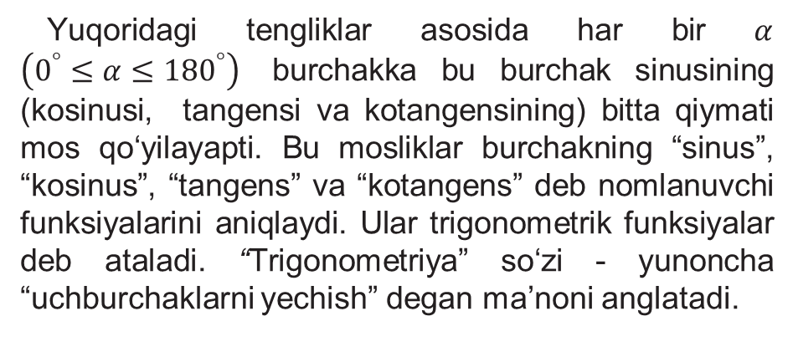
Burchak sinusi, kosinusi, tangensi va kotangensi
Yuqoridagi tengliklar asosida har bir $α$ $\left(0^{°}≤α≤{180}^{°}\right)$ burchakka bu burchak sinusining (kosinusi, tangensi va kotangensining) bitta qiymati mos qo‘yilayapti. Bu mosliklar burchakning “sinus”, “kosinus”, “tangens” va “kotangens” deb nomlanuvchi funksiyalarini aniqlaydi. Ular trigonometrik funksiyalar deb ataladi. “Trigonometriya” so‘zi - yunoncha “uchburchaklarni yechish” degan ma’noni anglatadi.

Slide 10
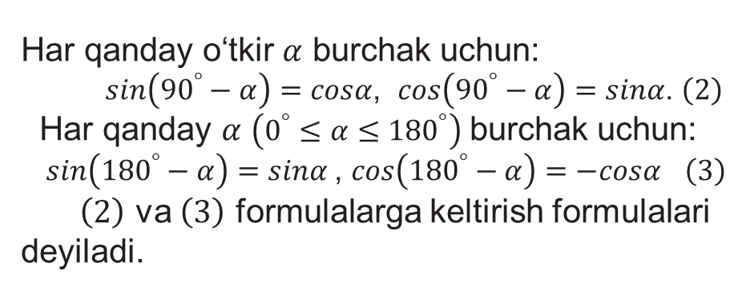
Burchak sinusi, kosinusi, tangensi va kotangensi
Har qanday o‘tkir $α$ burchak uchun:
$sin\left({90}^{°}−α\right)=cosα$, $cos\left({90}^{°}−α\right)=sinα$. $\left(2\right)$
Har qanday $α$ $\left(0^{°}≤α≤{180}^{°}\right)$ burchak uchun:
$sin\left({180}^{°}−α\right)=sinα$, $cos\left({180}^{°}−α\right)=−cosα$ $\left(3\right)$
$\left(2\right)$ va $\left(3\right)$ formulalarga keltirish formulalari deyiladi.

Slide 11


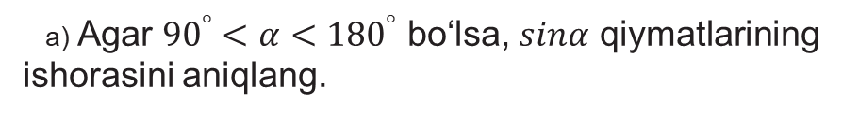



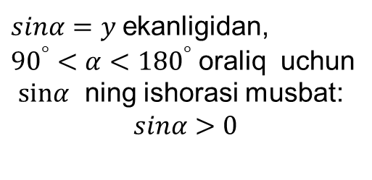
25.1-mashq
a) Agar ${90}^{°}<α<{180}^{°}$ bo‘lsa, $sinα$ qiymatlarining ishorasini aniqlang.
$$y$$
$sinα=y$ ekanligidan,
${90}^{°}<α<{180}^{°}$ oraliq uchun
$sinα$ ning ishorasi musbat:
$$sinα>0$$
$$sinα$$
$$+$$
$$+$$
$$−$$
$$−$$
$$x$$

Slide 12



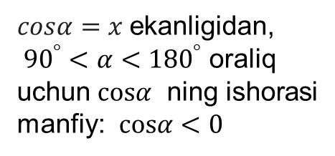
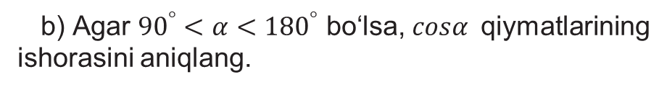


25.1-mashq
b) Agar ${90}^{°}<α<{180}^{°}$ bo‘lsa, $cosα$qiymatlarining ishorasini aniqlang.
$$y$$
$$cosα$$
$cosα=x$ ekanligidan,
${90}^{°}<α<{180}^{°}$ oraliq uchun $cosα$ ning ishorasi manfiy: $cosα<0$
$$−$$
$$+$$
$$x$$
$$−$$
$$+$$

Slide 13
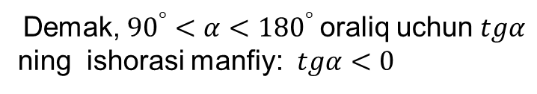


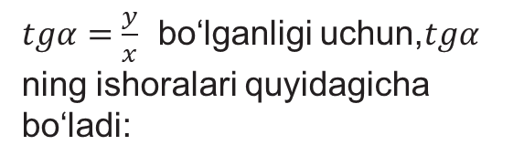
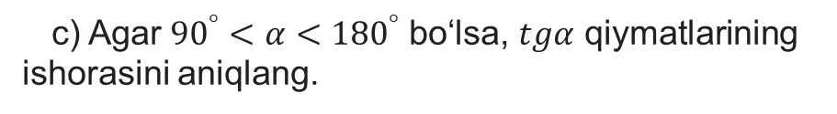

25.1-mashq
c) Agar ${90}^{°}<α<{180}^{°}$ bo‘lsa, $tgα$ qiymatlarining ishorasini aniqlang.
$$y$$
$tgα=\frac{y}{x}$ bo‘lganligi uchun,$tgα$ ning ishoralari quyidagicha bo‘ladi:
$$tgα$$
$$−$$
$$+$$
$$+$$
$$−$$
$$x$$
Demak, ${90}^{°}<α<{180}^{°}$ oraliq uchun $tgα$
ning ishorasi manfiy: $tgα<0$

Slide 14
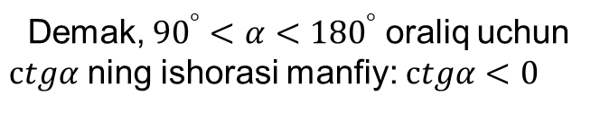

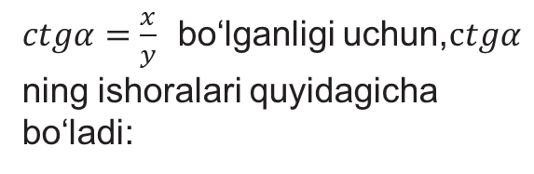
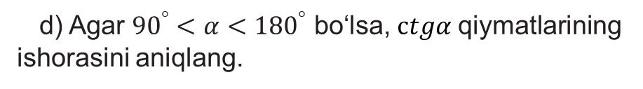


25.1-mashq
d) Agar ${90}^{°}<α<{180}^{°}$ bo‘lsa, $ctgα$ qiymatlarining ishorasini aniqlang.
$$y$$
$ctgα$
$ctgα=\frac{x}{y}$ bo‘lganligi uchun,$ctgα$ ning ishoralari quyidagicha bo‘ladi:
$$−$$
$$+$$
$$+$$
$$−$$
$$x$$
Demak, ${90}^{°}<α<{180}^{°}$ oraliq uchun $ctgα$ ning ishorasi manfiy: $ctgα<0$

Slide 15
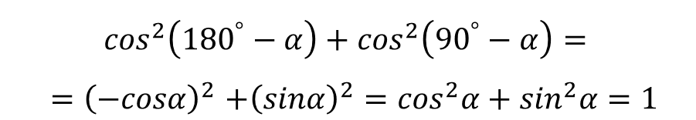
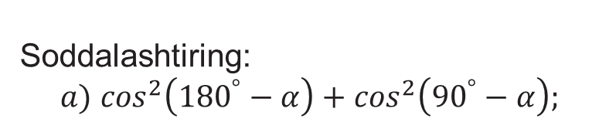
25.5-mashq
Soddalashtiring:
$a)$ $\cos^{2}\left({180}^{°}−α\right)+\cos^{2}\left({90}^{°}−α\right);$
$\cos^{2}\left({180}^{°}−α\right)+\cos^{2}\left({90}^{°}−α\right)=$
${=\left(−cosα\right)}^{2}+{\left(sinα\right)}^{2}=\cos^{2}α+\sin^{2}α=1$

Slide 16
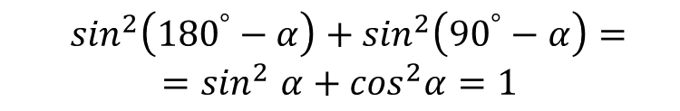
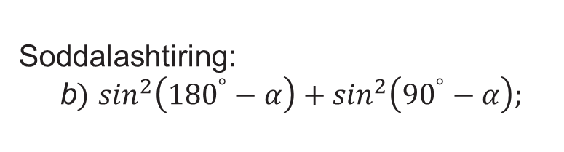
25.5-mashq
Soddalashtiring:
b$)$ $\sin^{2}\left({180}^{°}−α\right)+\sin^{2}\left({90}^{°}−α\right);$
$\sin^{2}\left({180}^{°}−α\right)+\sin^{2}\left({90}^{°}−α\right)={=sin}^{2}α+\cos^{2}α=1$

Slide 17

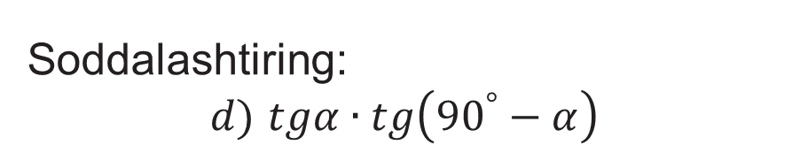
25.5-mashq
Soddalashtiring:
$d)$ $tgα∙tg\left({90}^{°}−α\right)$
$$tgα∙tg\left({90}^{°}−α\right)=tgα∙ctgα=1$$

Slide 18

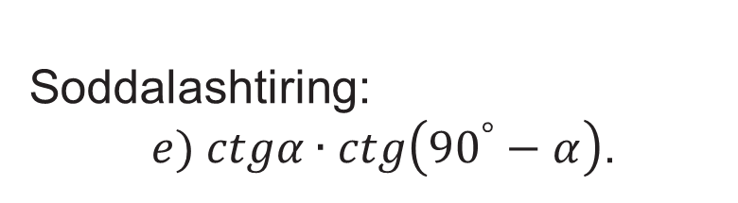
25.5-mashq
Soddalashtiring:
$e) ctgα∙ctg\left({90}^{°}−α\right)$.
$$e) ctgα∙ctg\left({90}^{°}−α\right)=ctgα∙tgα=1$$

Slide 19












25.6-mashq
$ABC$ uchburchakda $∠A={150}^{°}$ va $AC=7 cm$ bo‘lsa, uchburchakning $C$ uchidan tushirilgan balandligini toping
$$C$$
$$sinA=\frac{DC}{AC}$$
$$sin{150}^{°}=\frac{h}{7}$$
$$sin\left({180}^{°}−{30}^{°}\right)=\frac{h}{7}$$
$$h=?$$
$$B$$
$$A$$
$$sin{30}^{°}=\frac{h}{7}$$
$$\frac{1}{2}=\frac{h}{7}$$
$$D$$
$$Javob: h=3,5$$

Slide 20

Mustaqil bajarish uchun topshiriqlar
Darslikning 77-sahifasidagi 25.7-25.8-25.9-masalalarni bajaring.

