Slide 1

Geometriya
9-sinf
Mavzu: O‘xshash ko‘pburchaklarning xossalari

Slide 2
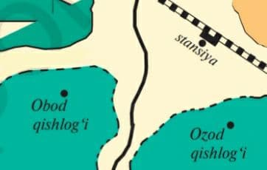
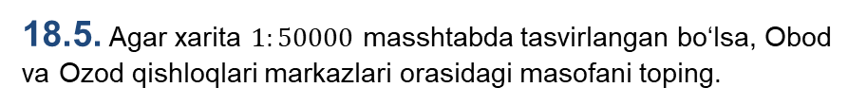
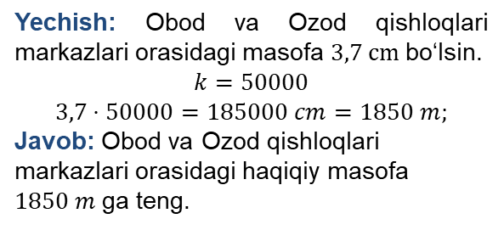
Mustahkamlash
18.5. Agar xarita $1:50000$ masshtabda tasvirlangan bo‘lsa, Obod va Ozod qishloqlari markazlari orasidagi masofani toping.
Yechish: Obod va Ozod qishloqlari markazlari orasidagi masofa $3,7 cm$ bo‘lsin.
$$k=50000$$
$$3,7⋅50000=185000 cm=1850 m;$$
Javob: Obod va Ozod qishloqlari markazlari orasidagi haqiqiy masofa $1850 m$ga teng.

Slide 3
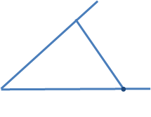




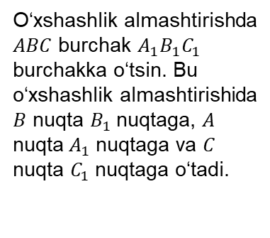










Mustaqil bajarilgan topshiriqlarni tekshirish
18.6. O‘xshashlik almashtirishida nurlar orasidagi burchak saqlanishini isbotlang.
O‘xshashlik almashtirishda $ABC$ burchak $A_{1}B_{1}C_{1}$ burchakka o‘tsin. Bu o‘xshashlik almashtirishida $B$ nuqta $B_{1}$nuqtaga, $A$ nuqta $A_{1}$ nuqtaga va $C$ nuqta $C_{1}$ nuqtaga o‘tadi.
$$A_{1}$$
$$A_{1}$$
$$⋅$$
$$⋅$$
$$⋅$$
$$A$$
$$⋅$$
$$⋅$$
$$⋅$$
$$⋅$$
$$B$$
$$B_{1}$$
$$C$$
$$C_{1}$$
$$C_{1}$$

Slide 4

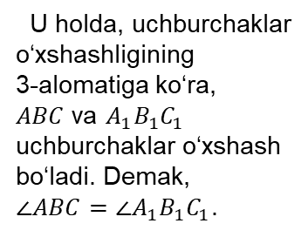
Mustaqil bajarilgan topshiriqlarni tekshirish
$$k=\frac{A_{1}C_{1}}{AC}=\frac{A_{1}B}{AB}=\frac{BC_{1}}{BC}$$
U holda, uchburchaklar o‘xshashligining
3-alomatiga ko‘ra,
$ABC$ va $A_{1}B_{1}C_{1}$ uchburchaklar o‘xshash bo‘ladi. Demak,
$∠ABC=∠A_{1}B_{1}C_{1}$.
$$A_{1}$$
$$A_{1}$$
$$⋅$$
$$⋅$$
$$⋅$$
$$A$$
$$⋅$$
$$⋅$$
$$⋅$$
$$⋅$$
$$B$$
$$B_{1}$$
$$C$$
$$C_{1}$$
$$C_{1}$$

Slide 5
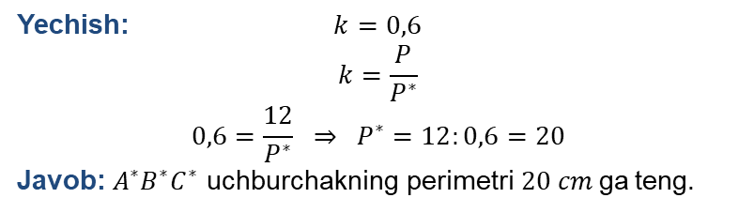
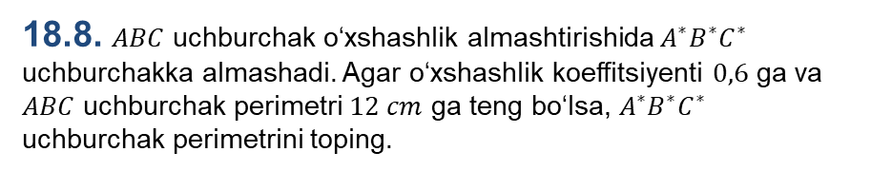
Mustaqil bajarilgan topshiriqlarni tekshirish
18.8. $ABC$ uchburchak o‘xshashlik almashtirishida $A^{∗}B^{∗}C^{∗}$ uchburchakka almashadi. Agar o‘xshashlik koeffitsiyenti $0,6$ ga va $ABC$ uchburchak perimetri $12 cm$ ga teng bo‘lsa, $A^{∗}B^{∗}C^{∗}$ uchburchak perimetrini toping.
Yechish: $k=0,6$
$$k=\frac{P}{P^{∗}}$$
$$0,6=\frac{12}{P^{∗}} ⇒ P^{∗}=12:0,6=20$$
Javob: $A^{∗}B^{∗}C^{∗}$ uchburchakning perimetri$20 cm$ga teng.

Slide 6
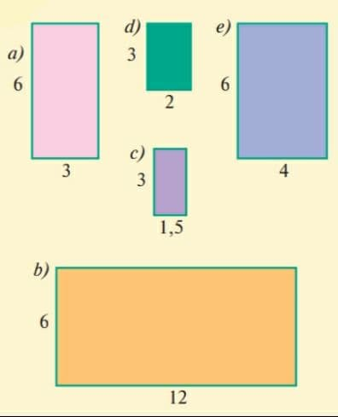
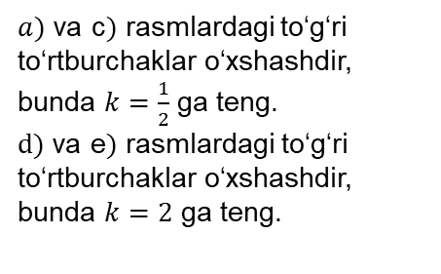
Mustaqil bajarilgan topshiriqlarni tekshirish
18.9. Rasmdan o‘xshash to‘g‘ri to‘rtburchaklar juftliklarini toping va o‘xshashlik koeffitsiyentlarini aniqlang.
$a)$ va c$)$ rasmlardagi to‘g‘ri to‘rtburchaklar o‘xshashdir, bunda $k=\frac{1}{2}$ ga teng.
$d)$ va e$)$ rasmlardagi to‘g‘ri to‘rtburchaklar o‘xshashdir, bunda $k=2$ ga teng.

Slide 7






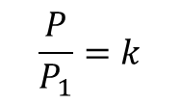


Teorema
1-teorema. O‘xshash ko‘pburchaklar perimetrlarining nisbati o‘xshashlik koeffitsiyentiga teng.
$$B_{3}$$
$$A_{3}$$
$$\frac{P}{P_{1}}=k$$
$$B_{2}$$
$$A_{2}$$
$$A_{1}$$
$$A_{n}$$
$$B_{1}$$
$$B_{n}$$

Slide 8


Teoremaning isboti
Isbot. Haqiqatan ham,
$A_{1}A_{2}…A_{n}$ va $B_{1}B_{2}…B_{n}$
ko‘pburchaklar o‘xshash va o‘xshashlik koeffitsiyenti$k$ bo‘lsa,
$B_{1}B_{2}=k∙A_{1}A_{2}$,
$B_{2}B_{3}=k∙A_{2}A_{3}$, … ,
$B_{n}B_{1}=k∙A_{n}A_{1}$ bo‘ladi.
Bundan ${P=B}_{1}B_{2}+B_{2}B_{3}+…+B_{n}B_{1}={k∙A}_{2}+{k∙A}_{2}A_{3}+…+{k∙A}_{n}A_{1}=k∙\left(A_{1}A_{2}+A_{2}A_{3}+…+A_{n}A_{1}\right)=k∙P_{1}$
tenglikni hosil qilamiz.
Demak,
$\frac{P}{P_{1}}=k$.
Teorema isbotlandi.

Slide 9
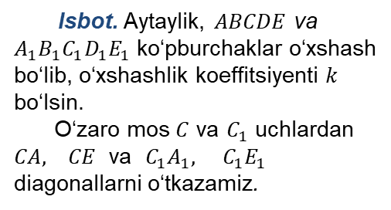
Teorema
2-teorema. O‘xshash ko‘pburchaklarni bir xil sondagi o‘xshash ko‘pburchaklarga ajratish mumkin.
Isbot. Aytaylik, $ABCDE$ va $A_{1}B_{1}C_{1}D_{1}E_{1}$ ko‘pburchaklar o‘xshash bo‘lib, o‘xshashlik koeffitsiyenti $k$ bo‘lsin.
O‘zaro mos $C$ va $C_{1}$ uchlardan $CA, CE$ va $C_{1}A_{1}, C_{1}E_{1}$ diagonallarni o‘tkazamiz.

Slide 10

Teoremaning isboti
Natijada, ko‘pburchaklar bir xil sondagi uchburchaklarga ajraldi. Hosil bo‘lgan uch juft mos uchburchaklarning o‘xshashligini ko‘rsatamiz.
1. $∆ABC\sim ∆A_{1}B_{1}C_{1}$. Chunki bu ko‘pburchaklarda, shartga ko‘ra,
$∠B=∠B_{1}$, $\frac{AB}{A_{1}B_{1}}=\frac{BC}{B_{1}C_{1}}=k$. Uchburchaklar o‘xshashligining
2-alomatiga ko‘ra, $∆ABC\sim ∆A_{1}B_{1}C_{1}$.

Slide 11

Teoremaning isboti
2. $∆CDE\sim ∆C_{1}D_{1}E_{1}$.
Shartga ko‘ra,
$∠D=∠D_{1}$, $\frac{CD}{C_{1}D_{1}}=\frac{DE}{D_{1}E_{1}}=k$. Uchburchaklar o‘xshashligining
2-alomatiga ko‘ra, $∆CDE\sim ∆C_{1}D_{1}E_{1}$.

Slide 12

Teoremaning isboti
3. $∆ACE\sim ∆A_{1}C_{1}E_{1}$.
Haqiqatan, $∠CAE=∠C_{1}A_{1}E_{1}$ burchaklarni qaraymiz:
$∠CAE=∠BAE−∠CAB$,
$∠C_{1}A_{1}E_{1}=∠B_{1}A_{1}E_{1}−∠C_{1}A_{1}B_{1}$.
Bu yerda, $∠BAE=∠B_{1}A_{1}E_{1}$ (berilgan o‘xshash beshburchaklarning mos burchaklari). $∠CAB=∠C_{1}A_{1}B_{1}$ (o‘xshash $ABC$ va $A_{1}B_{1}C_{1}$ uchburchaklarning mos burchaklari).
Demak, $∠CAE=∠C_{1}A_{1}E_{1}$.

Slide 13
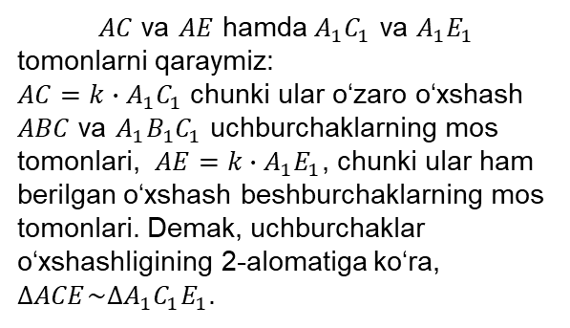
Teoremaning isboti
$AC$ va $AE$ hamda $A_{1}C_{1}$ va $A_{1}E_{1}$ tomonlarni qaraymiz:
$AC=k∙A_{1}C_{1}$ chunki ular o‘zaro o‘xshash $ABC$ va $A_{1}B_{1}C_{1}$ uchburchaklarning mos tomonlari, $AE=k∙A_{1}E_{1}$, chunki ular ham berilgan o‘xshash beshburchaklarning mos tomonlari. Demak, uchburchaklar o‘xshashligining 2-alomatiga ko‘ra, $∆ACE\sim ∆A_{1}C_{1}E_{1}$.

Slide 14
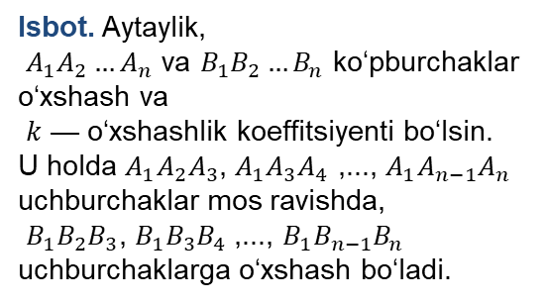
Teorema
3-teorema. O‘xshash ko‘pburchaklar yuzlarining nisbati o‘xshashlik koeffitsiyentining kvadratiga teng.
Isbot. Aytaylik,
$A_{1}A_{2}…A_{n}$ va $B_{1}B_{2}…B_{n}$ ko‘pburchaklar o‘xshash va
$k$ — o‘xshashlik koeffitsiyenti bo‘lsin. U holda $A_{1}A_{2}A_{3}$, $A_{1}A_{3}A_{4}$ ,..., $A_{1}A_{n−1}A_{n}$
uchburchaklar mos ravishda,
$B_{1}B_{2}B_{3}$, $B_{1}B_{3}B_{4}$ ,..., $B_{1}B_{n−1}B_{n}$ uchburchaklarga o‘xshash bo‘ladi.

Slide 15

Teoremaning isboti
O‘xshash uchburchaklar yuzlarining nisbati $k^{2}$ ga teng bo‘ladi:
$S_{A_{1}A_{2}A_{3}}=k^{2}S_{B_{1}B_{2}B_{3}}$,
$S_{A_{1}A_{3}A_{4}}=k^{2}S_{B_{1}B_{3}B_{4}}$,…,
$S_{A_{1}A_{n−1}A_{n}}{ =k}^{2}S_{B_{1}B_{n−1}B_{n}}$
Bu tengliklarning mos qismlarini qo‘shsak,
$S_{A_{1}A_{2}…{ A}_{n}}=k^{2}S_{B_{1}B_{2}…{ B}_{n}}$ bo‘ladi.
Teorema isbotlandi.

Slide 16








Masalalar yechish
1-Masala. Perimetrlari $18 cm$ va $24 cm$ bo‘lgan ikkita o‘xshash ko‘pburchak yuzlarining nisbatini toping.
$$B_{3}$$
1) $\frac{P}{P_{1}}=k$
$$P=24, { P}_{1}=18$$
$k=\frac{24}{18}=\frac{4}{3};$
2) $\frac{S}{S_{1}}=k^{2}={\left(\frac{4}{3}\right)}^{2}=\frac{16}{9}$.
$$A_{3}$$
$$B_{2}$$
$$A_{2}$$
$$A_{1}$$
$$A_{n}$$
$$B_{1}$$
$$B_{n}$$

Slide 17










19.4-mashq
Yuzlari $6 m^{2}$ va ${24 m}^{2}$ bo‘lgan ikkita to‘rtburchak o‘xshash. O‘xshashlik koeffitsiyentini toping.
B
C
$$B_{1}$$
$$C_{1}$$
$${S_{ABCD}=24 m}^{2}$$
$${S_{A_{1}B_{1}C_{1}D_{1}}=6 m}^{2}$$
$$A_{1}$$
$$D_{1}$$
A
D
3-teoremaga ko‘ra:
$$k^{2}=\frac{S_{ABCD}}{S_{A_{1}B_{1}C_{1}D_{1}}}=\frac{24}{6}=4$$
$$S_{ABCD}=k^{2}S_{A_{1}B_{1}C_{1}D_{1}}$$
$$k=2.$$

Slide 18


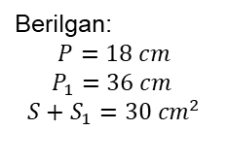










19.5-mashq
Ikkita ko‘pburchakning perimetrlari 18 cm va 36 cm ga, yuzlarining yig‘indisi esa 30${ cm}^{2}$ ga teng. Ko‘pburchaklar yuzlarini toping.
$$k=\frac{P}{P_{1}},$$
formulalarga ko‘ra o‘xshashlik koeffitsiyentini va yuzalarni topamiz:
Berilgan:
$$P=18 cm$$
$$P_{1}=36 cm$$
$$S+S_{1}=30 {cm}^{2}$$
$$k^{2}=\frac{S}{S_{1}}$$
$S=?$ ${ S}_{1}=?$
$$k=\frac{P}{P_{1}}=\frac{18}{36}=\frac{1}{2};$$
$$\frac{1}{4}=\frac{S}{S_{1}}$$
$$S_{1}=4S$$
$${S+S}_{1}=30{ cm}^{2}$$
$${S+4S=30 cm}^{2}$$
$${5S=30 cm}^{2}$$
${S=6 cm}^{2}$,
$S_{1}=4∙6=24{ cm}^{2}$.

Slide 19

Mustaqil bajarish uchun topshiriqlar
Darslikning 61-sahifasidagi 19.6- 19.9- masalalarni bajaring.

