Slide 1
Geometriya
9
sinf
Mavzu:
To‘g‘ri burchakli uchburchaklarning o‘xshashlik alomatlari
Komilov Mirodil Xosiljonovich X.T.V. tasarrufidagi AFIDUM matematika fani o‘qituvchisi.

Slide 2
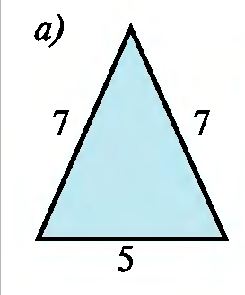
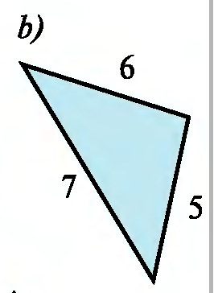
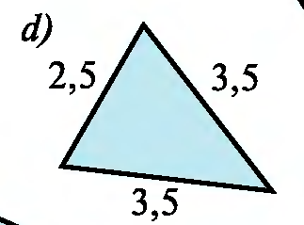
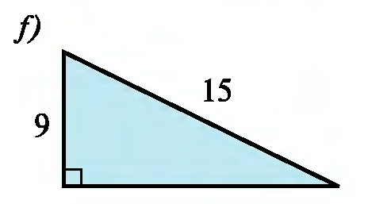
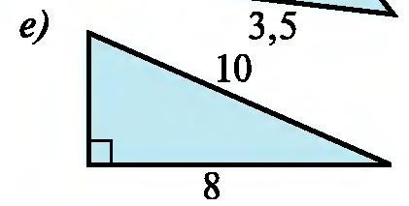
Mustaqil bajarilgan topshiriqni tekshirish
10.3 Rasmdagi o‘xshash uchburchaklar juftliklarini ko‘rsating.

Slide 3
Mustaqil bajarilgan topshiriqni tekshirish
$$\frac{7}{3,5}=\frac{7}{3,5}=\frac{5}{2,5}=2$$
O‘xshash bo‘ladi.

Slide 4
Mustaqil bajarilgan topshiriqni tekshirish
$$x$$
$$6$$
$$y$$
$$12$$
$$x^{2}={10}^{2}−8^{2}$$
$$y^{2}={15}^{2}−9^{2}$$
$$\frac{6}{9}=\frac{8}{12}=\frac{2}{3}$$
$$x^{2}=100−64$$
$$y^{2}=225−81$$
$$x^{2}=36$$
$$y^{2}=144$$
$$x=6$$
$$y=12$$
O‘xshash bo‘ladi.

Slide 5
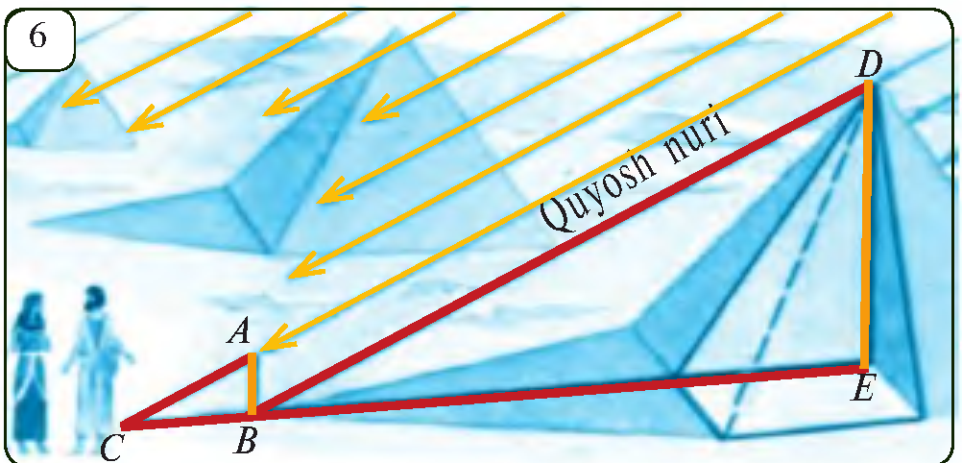
Tarixiy lavhalar
Misrliklar unga qiyin
masala beradi:
ulkan piramidalardan
birining balandligini
qanday hisoblash
mumkin?
Fales tayoqchani yerga qoqdi va shunday dedi: “Qachonki shu tayoqcha soyasining uzunligi tayoqchaning uzunligi bilan teng bo‘lsa, piramida soyasining uzunligi piramida balandligiga teng”

Slide 6
T.B.U.larni o‘xshashlik alomatlari
1-teorema. To‘g‘ri burchakli uchburchaklarning bittadan o‘tkir burchagi mos ravishda teng bo‘lsa, ular o‘xshash bo‘ladi.
2-teorema. To‘g‘ri burchakli uchburchaklarning katetlari mos ravishda proporsional bo‘lsa, ular o‘xshash bo‘ladi.
3-teorema. To‘g‘ri burchakli uchburchaklardan birining gipotenuzasi va kateti ikkinchisining gipotenuzasi va katetiga mos ravishda proporsional bo‘lsa, ular o‘xshash bo‘ladi.

Slide 7
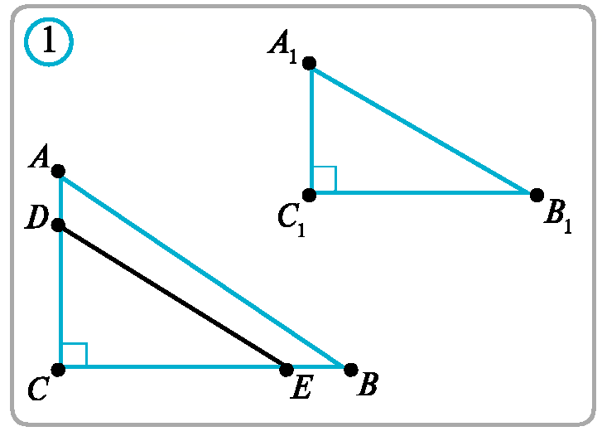
3-teorema isboti
$∆ABC$ da $CE=C_{1}B_{1}$ va
$DE∥AB$
B.B. $=> ∆DEC∾∆ABC$
$$\frac{AB}{DE}=\frac{CB}{CE}$$
$$CE=C_{1}B_{1} => \frac{AB}{DE}=\frac{CB}{C_{1}B_{1}}$$

Slide 8
3-teorema isboti
$$\left.\begin{aligned}\frac{AB}{DE}=\frac{CB}{C_{1}B_{1}} \\ \frac{AB}{A_{1}B_{1}}=\frac{CB}{C_{1}B_{1}}\end{aligned}\right\} DE=A_{1}B_{1}$$
$$∆DEC; ∆A_{1}B_{1}C_{1}$$
1) $CE=C_{1}B_{1}$
2) $DE=A_{1}B_{1}$
3) $∠C=∠C_{1}=90°$
$$∆ABC∾∆DEC$$
$$∆DEC=∆A_{1}B_{1}C_{1}$$
$$∆ABC∾∆A_{1}B_{1}C_{1}$$

Slide 9
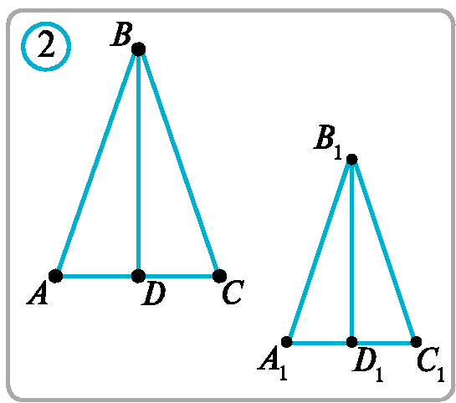
Masalalar yechish
Agar ikkita teng yonli uchburchakdan birining yon tomoni va balandligi ikkinchisining yon tomoni va balandligiga proporsional bo‘lsa, bu uchburchaklar- ning o‘xshash ekanligini isbotlang.
$∆ABD; ∆A_{1}B_{1}D_{1}$- to‘g‘ri burchakli
uchburchaklarni qaraymiz.
$$\frac{AB}{A_{1}B_{1}}=\frac{BD}{B_{1}D_{1}}$$
$$∆ABD∾ ∆A_{1}B_{1}D_{1}$$
$$∠BDA= ∠D_{1}B_{1}A_{1}$$

Slide 10
Masalalar yechish
$$∆ABD∾ ∆A_{1}B_{1}D_{1}$$
$$∠BDA= ∠D_{1}B_{1}A_{1}$$
$$BD, B_{1}D_{1} ⟹h=m=l$$
$$∠B=2∠DBA$$
$$⟹∠B=∠B_{1}$$
$$∠B_{1}=2∠D_{1}B_{1}A_{1}$$
$$∆ABC, ∆A_{1}B_{1}C_{1}$$
$∠B=∠B_{1}$, $\frac{AB}{A_{1}B_{1}}=\frac{BC}{B_{1}C_{1}}$
T.B.T. $=>∆ABC∾∆A_{1}B_{1}C_{1}$

Slide 11
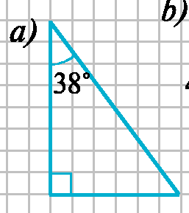
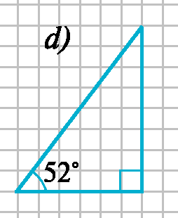
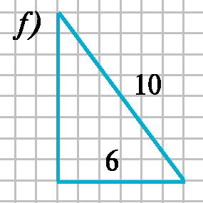
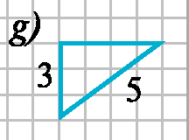
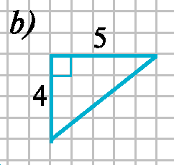
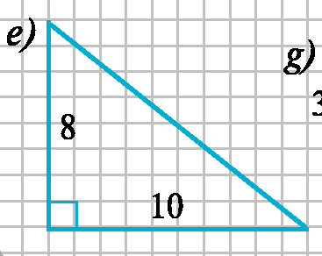
Masalalar yechish
11.1. Rasmdan o‘xshash uchburchaklarni toping.
$$\frac{10}{6}=\frac{5}{3}$$
$$a∾d$$
$$38°$$
$$f∾g$$
$$52°$$
$$\frac{5}{10}=\frac{4}{8}$$
$$b∾e$$

Slide 12
Masalalar yechish
11.2. Katetlari 3 m va 4 m bo‘lgan to‘g‘ri burchakli uchburchakka o‘xshash uchburchakning bir kateti 27 m bo‘lsa, ikkinchi katetini toping.
$$\frac{3}{27}=\frac{4}{x}$$
$$3$$
$$27$$
$$x=\frac{27∙4}{3}=36$$
$$4$$
$$x$$

Slide 13
Masalalar yechish
11.2. Katetlari 3 m va 4 m bo‘lgan to‘g‘ri burchakli uchburchakka o‘xshash uchburchakning bir kateti 27 m bo‘lsa, ikkinchi katetini toping.
$$\frac{3}{x}=\frac{4}{27}$$
$$3$$
$$x$$
$$4$$
$$x=\frac{27∙3}{4}=20,25$$
$$27$$

Slide 14
Masalalar yechish
11.5. Katetlari 10 cm va 12 cm bo‘lgan to‘g‘ri burchakli uchburchakka bitta burchagi umumiy bo‘lgan kvadrat ichki chizilgan. Agar kvadratning bitta uchi gipotenuzada ekanligi ma’lum bo‘lsa, kvadratning tomonini toping.
$$10$$
$$a$$
$$a$$
$$12$$

Slide 15
Masalalar yechish
$$\frac{10}{10−a}=\frac{12}{a}$$
$$10−a$$
$$10$$
$$a$$
$$10a=120−12a$$
$$22a=120$$
$$a$$
$$a=\frac{120}{22}=\frac{60}{11}=5\frac{5}{11}$$
$$12$$

Slide 16
Masalalar yechish
11.6. $ABC$ uchburchak berilgan. Unga $ADEF$ romb shunday ichki chizilganki, $D, E$ va $F$ nuqtalar mos ravishda uchburchakning $AB,$ $BC$ va $CA$ tomonlarida yotadi. Agar $AB=c, AC=b$ bo‘lsa, romb tomonini toping.
$$B$$
$$∆ABC∾∆DBE$$
$$\frac{AB}{DB}=\frac{AC}{DE}$$
$$\frac{c}{c−x}=\frac{b}{x}$$
$$x$$
$$E$$
$$D$$
$$x$$
$$x$$
$$x=\frac{bc}{b+c}$$
$$x$$
$$cx=bc−bx$$
$$A$$
$$C$$
$$F$$

Slide 17
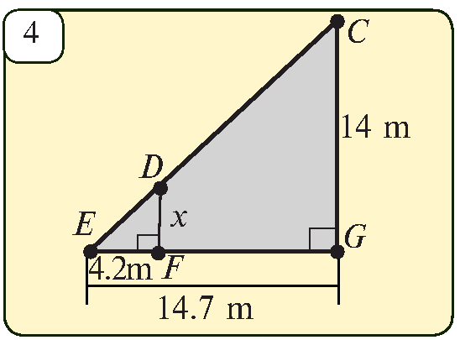
Masalalar yechish
11.7. 4-rasmda berilgan ma’lumotlar asosida noma’lum kesma uzunligini toping.
$∆CEG∾∆DEF$
$$\frac{EG}{EF}=\frac{CG}{DF}$$
$$\frac{14,7}{4,2}=\frac{14}{x}$$
$$x=\frac{4,2∙14}{14,7}=4 m$$

Slide 18
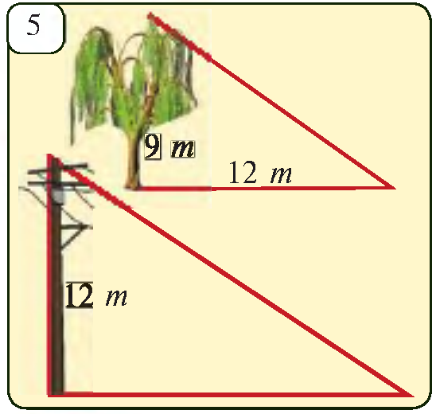
Masalalar yechish
11.8. Tol daraxtining balandligi 9 m, simyog‘ochning balandligi esa 12 m. Agar tolning soyasi 12 m ni tashkil qilsa, simyog‘ochning soyasi uzunligini toping
$$\frac{12}{9}=\frac{x}{12}$$
$$x=\frac{12∙12}{9}=16 m$$

Slide 19
Mustaqil yechish uchun topshiriq
Darslikning
39-betidagi 11.3, 11.4, 11.9-mashqlar.

