Slide 1
Geometriya
9
sinf
Mavzu:
Uchburchaklar o‘xshashligining uchinchi alomati
Komilov Mirodil Xosiljonovich X.T.V. tasarrufidagi AFIDUM matematika fani o‘qituvchisi.

Slide 2
Mustaqil bajarilgan topshiriqni tekshirish
9.5. $ABC$ va $A_{1}B_{1}C_{1}$ uchburchaklarda $∠A=∠A_{1}$, $\frac{AB}{A_{1}B_{1}}=\frac{AC}{A_{1}C_{1}}=\frac{4}{3}$.
$a)$ Agar $AB$ kesma $A_{1}B_{1}$kesmadan 5 cm ortiq bo‘lsa, $AB$ va $A_{1}B_{1}$tomonlarni toping.
$$B_{1}$$
$$B$$
$$A_{1}$$
$$C_{1}$$
$$\left.\begin{aligned}∠A=∠A_{1} \\ \frac{AB}{A_{1}B_{1}}=\frac{AC}{A_{1}C_{1}}\end{aligned}\right\}$$
$$A$$
$$C$$
$$∆ABC∾∆A_{1}B_{1}C_{1}$$

Slide 3
Mustaqil bajarilgan topshiriqni tekshirish
$a)$ $∠A=∠A_{1}; \frac{AB}{A_{1}B_{1}}=\frac{AC}{A_{1}C_{1}}=\frac{4}{3}; AB=A_{1}B_{1}+5$
$$B_{1}$$
$$B$$
$$∆ABC∾∆A_{1}B_{1}C_{1}$$
$$A_{1}$$
$$C_{1}$$
$$A$$
$$C$$
$$\frac{A_{1}B_{1}+5}{A_{1}B_{1}}=\frac{4}{3}$$
$$3A_{1}B_{1}+15=4A_{1}B_{1}$$
$$A_{1}B_{1}=15$$
$$AB=A_{1}B_{1}+5=15+5=20$$

Slide 4
Mustaqil bajarilgan topshiriqni tekshirish
$b)$ $∠A=∠A_{1}; \frac{AB}{A_{1}B_{1}}=\frac{AC}{A_{1}C_{1}}=\frac{4}{3}; A_{1}B_{1}=AB−6$
$$B_{1}$$
$$B$$
$$∆ABC∾∆A_{1}B_{1}C_{1}$$
$$A_{1}$$
$$C_{1}$$
$$A$$
$$C$$
$$\frac{AB}{AB−6}=\frac{4}{3}$$
$$3AB=4AB−24$$
$$AB=24$$
$$A_{1}B_{1}=AB−6=24−6=18$$

Slide 5
Mustaqil bajarilgan topshiriqni tekshirish
$c)$ $∠A=∠A_{1}; \frac{AB}{A_{1}B_{1}}=\frac{AC}{A_{1}C_{1}}=\frac{4}{3}; S+S_{1}=400$
$$B_{1}$$
$$B$$
$$∆ABC∾∆A_{1}B_{1}C_{1}$$
$$A_{1}$$
$$C_{1}$$
$$\frac{S}{S_{1}}={\left(\frac{4}{3}\right)}^{2}=\frac{16}{9}$$
$$A$$
$$C$$
$$9S=6400−16S$$
$$\frac{S}{400−S}=\frac{16}{9}$$
$$25S=6400$$
$$S=256$$
$$S_{1}=400−S=144$$

Slide 6
T.T.T. alomati
Agar bir uchburchakning uchta tomoni ikkinchi uchburchakning uchta tomoniga mos ravishda proporsional bo‘lsa, bunday uchburchaklar o‘xshash bo‘ladi.
$$B$$
$$∆ABC; ∆A_{1}B_{1}C_{1}$$
$$\frac{AB}{A_{1}B_{1}}=\frac{AC}{A_{1}C_{1}}=\frac{BC}{B_{1}C_{1}}$$
$$A$$
$$C$$
$$B_{1}$$
$$∆ABC∾∆A_{1}B_{1}C_{1}$$
$$A_{1}$$
$$C_{1}$$

Slide 7
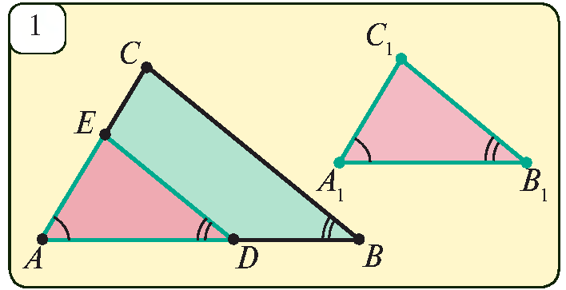
T.T.T. alomati isboti
$ABC$ da $D∈AB$ $AD=A_{1}B_{1}$
$$BC∥DE$$
B.B. $=>$ $∆AED∾∆ACB$
$$\frac{AB}{AD}=\frac{BC}{DE}$$
$$\frac{AB}{A_{1}B_{1}}=\frac{BC}{B_{1}C_{1}}$$
$$DE=B_{1}C_{1}$$

Slide 8
T.T.T. alomati isboti
$$\frac{AB}{A_{1}B_{1}}=\frac{AC}{A_{1}C_{1}}$$
$$\frac{AB}{AD}=\frac{AC}{AE}$$
$$A_{1}C_{1}=AE$$
$$DE=B_{1}C_{1};$$
$$A_{1}C_{1}=AE; AD=A_{1}B_{1}$$
$$T.T.T.=> ∆ADE=∆A_{1}B_{1}C_{1}$$
$$∆ADE∾∆ABC$$
$$∆ABC∾∆A_{1}B_{1}C_{1}$$

Slide 9
Masalalar yechish
Agar ikkita teng yonli uchburchakdan birining asosi va yon tomoni ikkinchisining asosi va yon tomoniga proporsional bo‘lsa, bu uchburchaklarning o‘xshash ekanligini isbotlang.
$$\frac{AB}{A_{1}B_{1}}=\frac{AC}{A_{1}C_{1}}$$
$$B$$
$$B_{1}$$
$$\frac{AB}{A_{1}B_{1}}=\frac{BC}{B_{1}C_{1}}$$
$$A_{1}$$
$$C_{1}$$
$$A$$
$$C$$
$$\frac{AB}{A_{1}B_{1}}=\frac{AC}{A_{1}C_{1}}=\frac{BC}{B_{1}C_{1}} =>T.T.T.=>∆ABC∾∆A_{1}B_{1}C_{1}$$

Slide 10
Masalalar yechish
10.2. $AC=14 cm, AB=11 cm, BC=13 cm, A_{1}C_{1}=28 cm, A_{1}B_{1}=22 cm, B_{1}C_{1}=26 cm$ ekanligi ma’lum. $ABC$ va $A_{1}B_{1}C_{1}$ uchburchaklar o‘xshash bo‘ladimi?
$$B$$
$$∆ABC; ∆A_{1}B_{1}C_{1}$$
$$11$$
$$13$$
$$\frac{AB}{A_{1}B_{1}}=\frac{AC}{A_{1}C_{1}}=\frac{BC}{B_{1}C_{1}}$$
$$14$$
$$A$$
$$C$$
$$B_{1}$$
$$\frac{11}{22}=\frac{14}{28}=\frac{13}{26}=\frac{1}{2}$$
$$26$$
$$22$$
$$T.T.T. =>∆ABC∾∆A_{1}B_{1}C_{1}$$
$$A_{1}$$
$$28$$
$$C_{1}$$

Slide 11
Masalalar yechish
10.4. $ABCD$ trapetsiyaning $AB$ va $CD$ yon tomonlari davom ettirilsa, $E$ nuqtada kesishadi. Agar $AB=5 cm, BC=10 cm, CD=6 cm, AD=15 cm$ bo‘lsa, $AED$ uchburchak yuzini toping.
$$E$$
$$S_{u}$$
$$B$$
$$C$$
$$S_{t}$$
$AB=5 cm, BC=10 cm, CD=6 cm, AD=15 cm$
$$S_{AED}=S_{u}+S_{t}=?$$
$$A$$
$$D$$

Slide 12
Masalalar yechish
$$S_{AED}=S_{u}+S_{t}=?$$
$$E$$
$AB=5 cm, BC=10 cm, CD=6 cm, AD=15 cm$
$$5^{2}−x^{2}=6^{2}−{\left(5−x\right)}^{2}$$
$$S_{u}$$
$$25−x^{2}=36−25+10x−x^{2}$$
$$10$$
$$B$$
$$C$$
$$10x=14 =>x=1,4$$
$$h=\sqrt{5^{2}−{1,4}^{2}}=4,8$$
$$S_{t}$$
$$6$$
$$5$$
$$h$$
$$S_{t}=\frac{10+15}{2}∙4,8=60$$
$$x$$
$$15$$
$$A$$
$$D$$

Slide 13
Masalalar yechish
$$S_{AED}=S_{u}+S_{t}=S_{u}+60$$
$$E$$
$$∆AED∾∆BEC$$
$$\frac{S_{AED}}{S_{u}}={\left(\frac{15}{10}\right)}^{2}$$
$$\frac{S_{u}+60}{S_{u}}=\frac{9}{4}$$
$$S_{u}$$
$$10$$
$$B$$
$$C$$
$$4S_{u}+240=9S_{u}$$
$$5S_{u}=240$$
$$S_{u}=48$$
$$S_{t}$$
$$S_{AED}=S_{u}+60=48+60=108$$
$$15$$
$$A$$
$$D$$

Slide 14
Masalalar yechish
10.5. Trapetsiyaning asoslari 6 cm va 9 cm, balandligi 10 cm. Trapetsiyaning diagonallari kesishgan nuqtadan asoslarigacha bo‘lgan masofalarni toping.
$$B$$
$$C$$
$$AD=9 cm, BC=6 cm;$$
$$h=10 cm; x=? y=?$$
$$x$$
$$O$$
$$∆AOD∾∆COB$$
$$h$$
$$\frac{BC}{AD}=\frac{x}{y}$$
$$\frac{6}{9}=\frac{x}{10−x}$$
$$y$$
$$A$$
$$D$$

Slide 15
Masalalar yechish
$$B$$
$$C$$
$$AD=9 cm, BC=6 cm;$$
$$h=10 cm; x=? y=?$$
$$x$$
$$O$$
$$∆AOD∾∆COB$$
$$h$$
$$\frac{BC}{AD}=\frac{x}{y}$$
$$\frac{6}{9}=\frac{x}{10−x}$$
$$y$$
$$A$$
$$D$$
$$60−6x=9x$$
$$15x=60 =>x=4$$
$$y=10−x=10−4=6$$

Slide 16
Masalalar yechish
10.4. Asosi 12 cm, balandligi 8 cm bo‘lgan teng yonli uchburchak ichiga kvadrat shunday ichki chizilganki, kvadratning ikkita uchi uchburchak asosida, qolgan ikki uchi esa yon tomonlarda yotadi. Kvadrat tomonini toping.
$$B$$
$$E$$
$$F$$
$$K$$
$$A$$
$$D$$
$$C$$

Slide 17
Masalalar yechish
$$AC=12 cm, BD=8 cm, a=?$$
$$B$$
$$∆ABC∾∆EBF$$
$$\frac{AC}{EF}=\frac{BD}{BK}$$
$$BK=BD−a$$
$$EF=a$$
$$E$$
$$F$$
$$K$$
$$\frac{12}{a}=\frac{8}{8−a}$$
$$a$$
$$a$$
$$96−12a=8a$$
$$A$$
$$D$$
$$C$$
$$20a=96 => a=4,8 cm$$

Slide 18
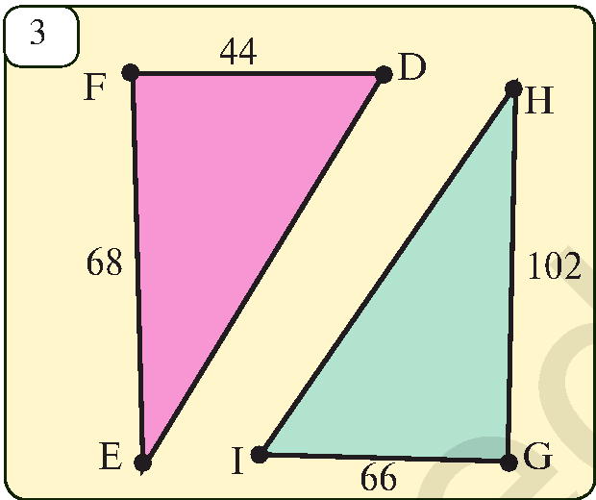
Masalalar yechish
10.10. Rasmdagi uchburchaklar qaysi alomatga ko‘ra o‘xshash?
$$∆EFD, ∆HGI$$
$$∠F=∠G=90°$$
$$\frac{EF}{HG}=\frac{68}{102}=\frac{2}{3}$$
$$\frac{FD}{GI}=\frac{44}{66}=\frac{2}{3}$$
B.T.B. $=>∆EFD∾∆HGI$

Slide 19
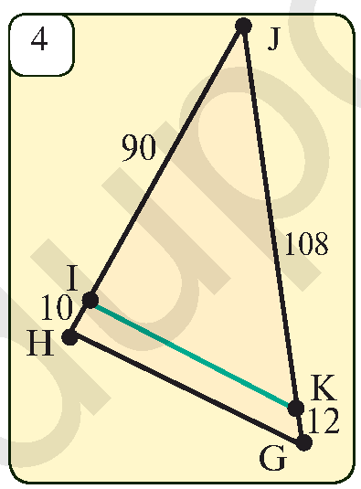
Masalalar yechish
10.11. Rasmdagi uchburchaklar qaysi alomatga ko‘ra o‘xshash?
$$∆HJG, ∆IJK$$
$∠J−$ umumiy
$$\frac{HJ}{IJ}=\frac{100}{90}=\frac{10}{9}$$
$$\frac{JG}{JK}=\frac{120}{108}=\frac{10}{9}$$
B.T.B. $=>∆HJG∾∆IJK$

Slide 20
Mustaqil yechish uchun topshiriq
Darslikning
37-betidagi 10.6, 10.9, 10.12-mashqlar.

