Slide 1
Geometriya
9
sinf
Mavzu:
Uchburchaklar o‘xshashligining ikkinchi alomati
Komilov Mirodil Xosiljonovich X.T.V. tasarrufidagi AFIDUM matematika fani o‘qituvchisi.

Slide 2
Mustaqil bajarilgan topshiriqni tekshirish
8.5. $ABCD$ parallelogrammning $CD$ tomonida $E$ nuqta olingan. $AE$ va $BC$ nurlar $F$ nuqtada kesishadi.
$a)$Agar $DE=8 cm, EC=4 cm, BC=7 cm,$
$AE=10 cm$ bo‘lsa, $EF$ va $FC$ ni toping.
$$∆ADE∾∆FCE$$
$$B$$
$$C$$
$$F$$
$$\frac{AD}{FC}=\frac{DE}{CE}=\frac{AE}{FE}$$
$$\frac{7}{FC}=\frac{8}{4}=\frac{10}{FE}$$
$$E$$
$$FC=\frac{7∙4}{8}=3,5$$
$$EF=\frac{10∙4}{8}=5$$
$$A$$
$$D$$

Slide 3
Mustaqil bajarilgan topshiriqni tekshirish
$b)$Agar $AB=8 cm, AD=5 cm, CF=2 cm,$
bo‘lsa, $DE$ va $EC$ ni toping.
$$∆ADE∾∆FCE$$
$$B$$
$$C$$
$$F$$
$$\frac{AD}{FC}=\frac{DE}{CE}=\frac{AE}{FE}$$
$$\frac{5}{2}=\frac{8−x}{x}$$
$$x$$
$$E$$
$$5x=16−2x$$
$$8−x$$
$$x=\frac{16}{7}=CE$$
$$7x=16$$
$$A$$
$$D$$
$$DE=8−x=8−\frac{16}{7}=\frac{40}{7}$$
Javob: $\frac{16}{7}; \frac{40}{7}$

Slide 4
Mustaqil bajarilgan topshiriqni tekshirish
8.8. $ABC$ uchburchakning $AC$ tomonida $D$ nuqta
olingan. Agar $∠ABC=∠BDC$ bo‘lsa, $ABC$ va $BDC$ uchburchaklar o‘xshash ekanligini isbotlang. Shuningdek, $3AB=4BD$ va $BC=9 cm$ bo‘lsa, $AC$ kesmani toping.
$$B$$
$$∠ABC=∠BDC$$
$$\frac{AB}{BD}=\frac{4}{3}; BC=9 cm$$
$$A$$
$$C$$
$$AC=?$$
$$D$$

Slide 5
Mustaqil bajarilgan topshiriqni tekshirish
$$B$$
$$B$$
$$B$$
$$C$$
$$A$$
$$C$$
$$A$$
$$C$$
$$D$$
$$∠ABC=∠BDC$$
B.B. $=> ∆ABC∾∆BDC$
$∠C −$ umumiy burchak
$$\frac{AB}{BD}=\frac{BC}{DC}=\frac{AC}{BC}$$
$$\frac{4}{3}=\frac{AC}{9}$$
$$AC=\frac{4∙9}{3}=12$$

Slide 6
T.B.T. alomati
Agar bir uchburchakning ikki tomoni ikkinchi uchburchakning ikki tomoniga proporsional va bu tomonlar hosil qilgan burchaklar teng bo‘lsa, bunday uchburchaklar o‘xshash bo‘ladi.
$$B$$
$$∆ABC; ∆A_{1}B_{1}C_{1}$$
$$\left.\begin{aligned}∠A=∠A_{1} \\ \frac{AB}{A_{1}B_{1}}=\frac{AC}{A_{1}C_{1}}\end{aligned}\right\}$$
$$A$$
$$C$$
$$B_{1}$$
$$∆ABC∾∆A_{1}B_{1}C_{1}$$
$$A_{1}$$
$$C_{1}$$

Slide 7
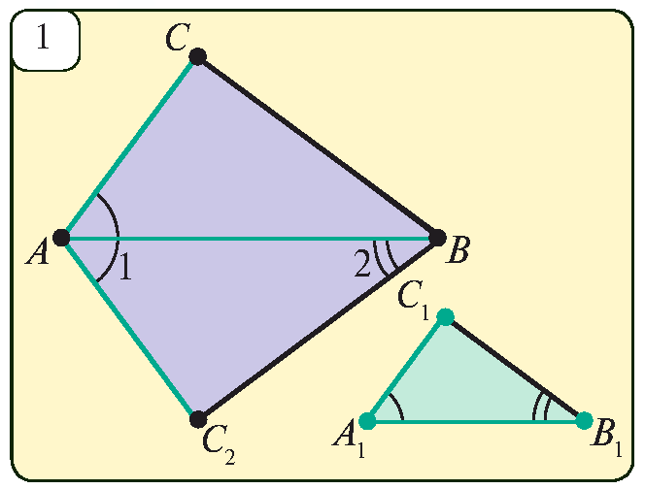
T.B.T. alomati isboti
$∠1=∠A_{1},∠2=∠B_{1}$ bo‘ladigan $ABC_{2}$ uchburchak
yasaymiz. B.B. $=>∆ABC_{2}∾∆A_{1}B_{1}C_{1}$
$$\left.\begin{aligned}\frac{AB}{A_{1}B_{1}}=\frac{AC_{2}}{A_{1}C_{1}} \\ \frac{AB}{A_{1}B_{1}}=\frac{AC}{A_{1}C_{1}}\end{aligned}\right\}AC_{2}=AC$$
$$\frac{AB}{A_{1}B_{1}}=\frac{AC_{2}}{A_{1}C_{1}}$$
$$\frac{AB}{A_{1}B_{1}}=\frac{AC}{A_{1}C_{1}}$$
T.B.T. $=> ∆ABC=∆ABC_{2}$

Slide 8
T.B.T. alomati isboti
$$∆ABC=∆ABC_{2}$$
$$\left.\begin{aligned}∠2=∠B \\ ∠2=∠B_{1}\end{aligned}\right\} =>∠B=∠B_{1}$$
$\left.\begin{aligned}∠A=∠A_{1} \\ ∠B=∠B_{1}\end{aligned}\right\} =>$ B.B. $=>$
$$∆ABC∾∆A_{1}B_{1}C_{1}$$

Slide 9
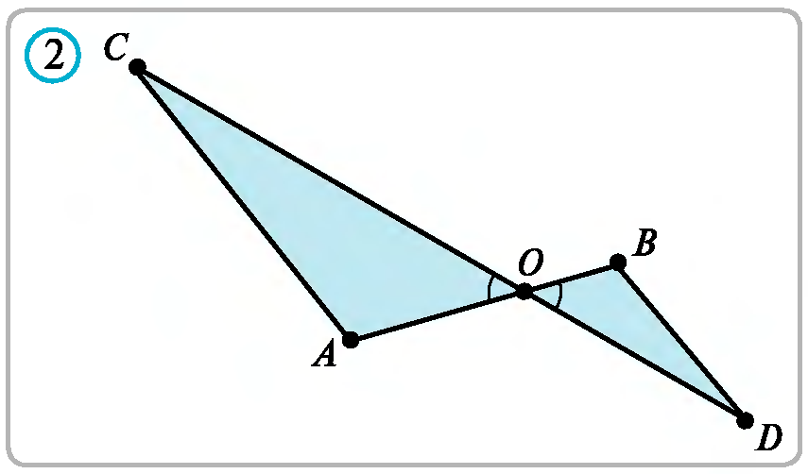
Masalalar yechish
$AB$ va $CD$ kesmalar $O$ nuqtada kesishadi, $AO=12 cm$, $BO=4 cm$, $CO=30 cm$, $DO=10 cm$ bo‘lsa, $AOC$ va $BOD$ uchburchaklar yuzlari nisbatini toping.
$$\frac{CO}{DO}=\frac{30}{10}=3$$
$$\frac{AO}{BO}=\frac{12}{4}=3$$
$$30$$
$∠AOC=∠BOD$- vertikal
$$4$$
$∆AOC∾∆BOD$
$$\frac{S_{AOC}}{S_{BOD}}=k^{2}=3^{2}=9$$
$$12$$
$$10$$

Slide 10
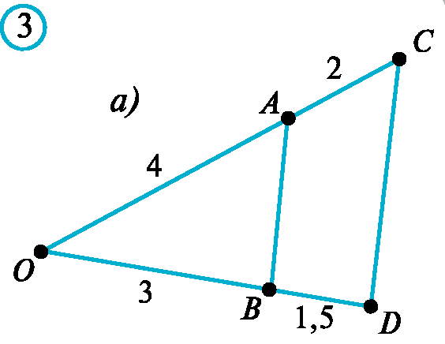
Masalalar yechish
9.3. Rasmda tasvirlangan $OAB$ va $OCD$ uchburchaklar o‘xshash bo‘ladimi? Agar o‘xshash bo‘lsa, bu uchburchaklar perimetrlarining nisbatini toping.
$$∆OAB; ∆OCD$$
$∠O−$ umumiy burchak
$$\frac{OA}{OC}=\frac{4}{6}=\frac{2}{3}$$
$$\frac{OB}{OD}=\frac{3}{4,5}=\frac{2}{3}$$
$$\frac{P_{OAB}}{P_{OCD}}=\frac{2}{3}$$
$$∆OAB∾ ∆OCD$$

Slide 11
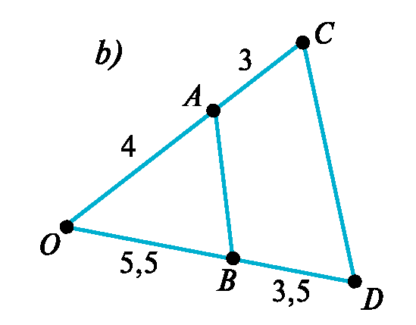
Masalalar yechish
9.3. Rasmda tasvirlangan $OAB$ va $OCD$ uchburchaklar o‘xshash bo‘ladimi? Agar o‘xshash bo‘lsa, bu uchburchaklar perimetrlarining nisbatini toping.
$$∆OAB; ∆OCD$$
$∠O−$ umumiy burchak
$$\frac{OA}{OC}=\frac{4}{7}$$
$$\frac{OB}{OD}=\frac{5,5}{9}=\frac{11}{18}$$
$∆OAB; ∆OCD$ o‘xshash emas

Slide 12
Masalalar yechish
$AC$ va $BD$ nurlar $O$ nuqtada kesishadi. Agar $AO:CO=BO:DO=3$, $AB=7 cm$ bo‘lsa, $CD$ kesmani va $AOB$ va $COD$ uchburchaklar yuzlari nisbatini toping.
$∆AOB∾∆COD$
$$B$$
$$\frac{AB}{CD}=3$$
$$\frac{7}{CD}=3=>CD=\frac{7}{3}$$
$$C$$
$$\frac{S_{AOB}}{S_{COD}}=k^{2}=3^{2}=9$$

Slide 13
Masalalar yechish
$ABC$ uchburchakda $AB=15 m, AC=20 m,$
$BC=32 m.$ Uchburchakning $AB$ tomoniga $AD=9 m$ kesma, $AC$ tomoniga esa $AE=12 m$ kesma qo‘yildi. $DE$ kesmani toping.
$$B$$
$$∆ABC; ∆ADE$$
$∠A−$ umumiy burchak
$$D$$
$$\frac{AB}{AD}=\frac{15}{9}=\frac{5}{3}$$
$$\frac{AC}{AE}=\frac{20}{12}=\frac{5}{3}$$
$$A$$
$$C$$
$$∆OAB∾ ∆OCD$$
$$E$$

Slide 14
Masalalar yechish
$$∆OAB∾ ∆OCD$$
$$AB=15 m, AC=20 m, BC=32 m$$
$$\frac{AB}{AD}=\frac{15}{9}=\frac{5}{3}$$
$$\frac{AC}{AE}=\frac{20}{12}=\frac{5}{3}$$
$$B$$
$$\frac{BC}{DE}=\frac{5}{3}$$
$$D$$
$$\frac{32}{DE}=\frac{5}{3} =>DE=\frac{96}{5}$$
$$x$$
$$DE=19,2 m$$
$$A$$
$$C$$
$$E$$

Slide 15
Masalalar yechish
9.7. Katetlari $3 dm$ va $4 dm$ bo‘lgan to‘g‘ri burchakli uchburchak bilan bir kateti $8 dm$ va gipotenuzasi $10 dm$ bo‘lgan to‘g‘ri burchakli uchburchak o‘xshash bo‘lishini isbotlang.
$$x^{2}={10}^{2}−8^{2}$$
$$x^{2}=100−64=36$$
$$10$$
$$x=6$$
$$4$$
$$8$$
$$\frac{4}{8}=\frac{1}{2}=\frac{3}{6}$$
$$∟$$
$$x$$
$$3$$
$$6$$
$$∟$$

Slide 16
Masalalar yechish
9.8. $AB$ kesma va $l$ to‘g‘ri chiziq $O$ nuqtada kesisha-di. $l$ to‘g‘ri chiziqqa $AA_{1}$ va $BB_{1}$ perpendikularlar tushirilgan. Agar $AA_{1}=2 cm$, $OA_{1}=4 cm$ va $OB_{1}=3 cm$ bo‘lsa, $BB_{1}$, $OA$ va $AB$ kesmalarni toping.
$$A$$
$$B_{1}$$
$$3$$
$$2$$
$$∟$$
$$l$$
$$∟$$
$$4$$
$$O$$
$$A_{1}$$
$$B$$

Slide 17
Masalalar yechish
$$A$$
$$BB_{1}=?$$
$$B_{1}$$
$$3$$
$$AO=?$$
$$2$$
$$∟$$
$$l$$
$$∟$$
$$AB=?$$
$$4$$
$$O$$
$$A_{1}$$
$$B$$
$$∆AOA_{1}∾∆BOB_{1}$$
$$\frac{2}{BB_{1}}=\frac{4}{3} =>BB_{1}=\frac{6}{4}=1,5$$
$$\frac{AA_{1}}{BB_{1}}=\frac{AO}{BO}=\frac{A_{1}O}{B_{1}0}$$
$$AO=\sqrt{2^{2}+4^{2}}=\sqrt{20}=2\sqrt{5}$$
$$\frac{2}{BB_{1}}=\frac{AO}{BO}=\frac{4}{3}$$
$$BO=\sqrt{3^{2}+{1,5}^{2}}=\sqrt{20}=1,5\sqrt{5}$$
$$AB=AO+OB=3,5\sqrt{5}$$

Slide 18
Mustaqil yechish uchun topshiriq
Darslikning
35-betidagi 9.5, 9.9-mashqlar.

