Slide 1
Geometriya
9
sinf
Mavzu:
Uchburchaklar o‘xshashligining birinchi alomati
Komilov Mirodil Xosiljonovich X.T.V. tasarrufidagi AFIDUM matematika fani o‘qituvchisi.

Slide 2
Mustaqil bajarilgan topshiriqni tekshirish
7.3. Ikkita o‘xshash uchburchak yuzlari 65 $m^{2}$ va 260 $m^{2}$. Birinchi uchburchakning bir tomoni 6 m bo‘lsa, ikkinchi uchburchakning unga mos tomonini toping.
$$S=65; S_{1}=260; AB=6; { A}_{1}B_{1}=?$$
$$\frac{S}{S_{1}}=k^{2}$$
$$\frac{65}{260}=\frac{1}{4}=k^{2} =>k=\frac{1}{2}$$
$$B_{1}$$
$$\frac{AB}{A_{1}B_{1}}=\frac{1}{2}$$
$$\frac{6}{A_{1}B_{1}}=\frac{1}{2}$$
$$B$$
$$A_{1}$$
$$C_{1}$$
$$A$$
$$C$$
$$A_{1}B_{1}=12$$

Slide 3
Mustaqil bajarilgan topshiriqni tekshirish
7.5. Tomonlari 12 cm, 20 cm va 13 cm bo‘lgan uchburchak berilgan. Agar kichik tomoni 9 cm bo‘lgan uchburchak berilgan uchburchakka o‘xshash bo‘lsa, uning tomonlarini toping.
$$k=\frac{12}{9}=\frac{4}{3}$$
$$\frac{4}{3}=\frac{13}{y} =>y=\frac{39}{4}$$
$$y$$
$$9$$
$$z$$
$$\frac{4}{3}=\frac{20}{z} =>z=\frac{60}{4}=15$$
$$12$$
$$13$$
Javob: $19,75; 15$
$$20$$

Slide 4
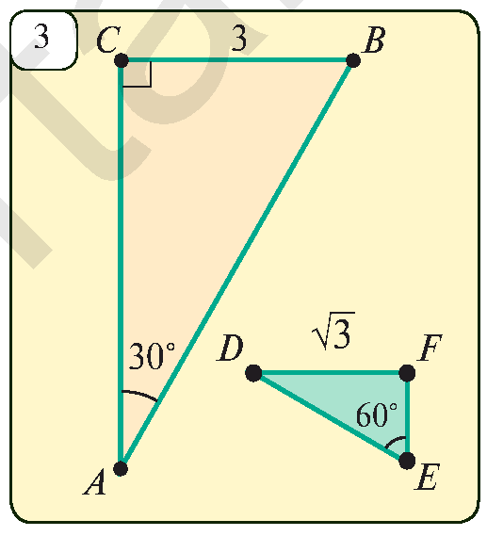
Mustaqil bajarilgan topshiriqni tekshirish
Повторение
7.7. 3-rasmda berilganlardan foydalanib uchburchaklarning o‘xshash yoki o‘xshash emasligini aniqlang.
$$∠C=∠F=90°; ∠A=30°;∠E=60°$$
$$∠B=90°−30°=60°;$$
$$∠D=90°−60°=30°;$$
$$3\sqrt{3}$$
$$6$$
$$AB=6; AC=\sqrt{6^{2}−3^{2}}=3\sqrt{3}$$
$$\sin{60°}=\frac{FD}{ED}; ED=\frac{\sqrt{3}}{\frac{\sqrt{3}}{2}}=2$$
$$1$$
$$2$$
$$FE=1$$

Slide 5
Mustaqil bajarilgan topshiriqni tekshirish
Повторение
$$∠A=30°;∠B=60°; ∠C=90°;$$
$$∠D=30°;∠E=60°; ∠F=90°;$$
$$AB=6; AC=3\sqrt{3}; BC=3$$
$$DE=2; DF=\sqrt{3}; EF=1$$
$$\frac{AB}{ED}=\frac{6}{2}=3$$
$$\frac{AC}{DF}=\frac{3\sqrt{3}}{\sqrt{3}}=3$$
$$3\sqrt{3}$$
$$6$$
$$\frac{BC}{EF}=\frac{3}{1}=3$$
$$∆ABC∾∆DEF$$

Slide 6
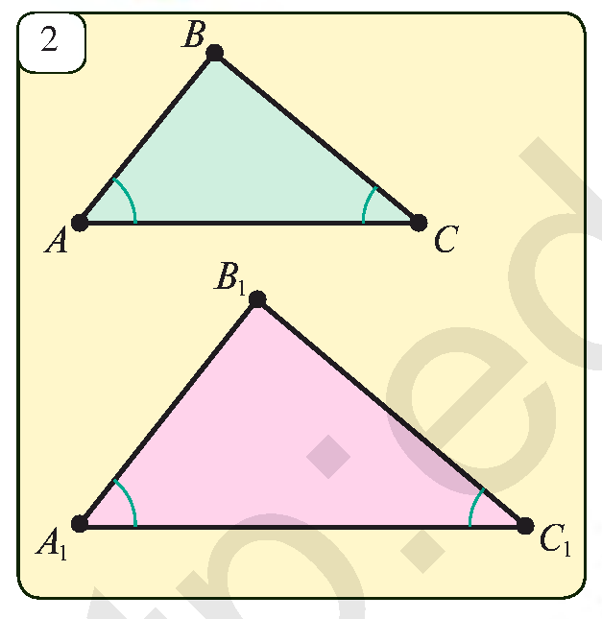
B.B. alomati
Agar bir uchburchakning ikkita burchagi ikkinchi uchburchakning ikkita burchagiga mos ravishda teng bo‘lsa, bunday uchburchaklar o‘xshash bo‘ladi.
$$∆ABC; ∆A_{1}B_{1}C_{1}$$
$$\left.\begin{aligned}∠A=∠A_{1} \\ ∠C=∠C_{1}\end{aligned}\right\} =>∆ABC∾∆A_{1}B_{1}C_{1}$$

Slide 7
B.B. alomati isboti
$$∠B=∠B_{1}; \frac{AB}{A_{1}B_{1}}=\frac{BC}{B_{1}C_{1}}=\frac{AC}{A_{1}C_{1}}$$
$$=>∆ABC∾∆A_{1}B_{1}C_{1}$$
$$\left.\begin{aligned}∠B=180°−\left(∠A+∠C\right) \\ ∠B_{1}=180°−(∠A_{1}+∠C_{1})\end{aligned}\right\}⟹∠B=∠B_{1}$$
Teng burchakka ega bo‘lgan
uchburchaklar yuzlarining nisbati
$$\frac{S_{ABC}}{S_{A_{1}B_{1}C_{1}}}=\frac{AB∙AC}{A_{1}B_{1}∙A_{1}C_{1}}$$

Slide 8
B.B. alomati isboti
$$\frac{S_{ABC}}{S_{A_{1}B_{1}C_{1}}}=\frac{AB∙AC}{A_{1}B_{1}∙A_{1}C_{1}}$$
$$\frac{S_{ABC}}{S_{A_{1}B_{1}C_{1}}}=\frac{CA∙CB}{C_{1}A_{1}∙C_{1}B_{1}}$$
$$\frac{AB}{A_{1}B_{1}}=\frac{BC}{B_{1}C_{1}}$$
$$\frac{BC}{B_{1}C_{1}}=\frac{CA}{C_{1}A_{1}}$$
$$∠B=∠B_{1}; \frac{AB}{A_{1}B_{1}}=\frac{BC}{B_{1}C_{1}}=\frac{AC}{A_{1}C_{1}}$$
$$∆ABC∾∆A_{1}B_{1}C_{1}$$

Slide 9
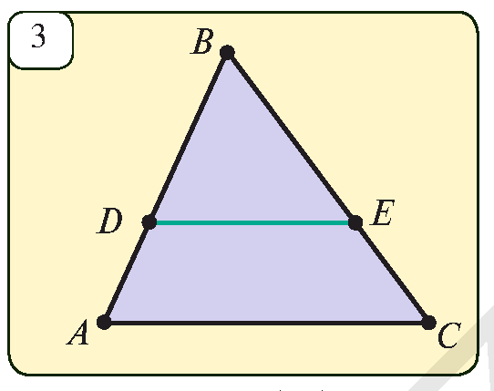
Masalalar yechish
$ABC$ uchburchakning ikki tomonini kesib o‘tuvchi va uchinchi tomoniga parallel bo‘lgan $DE$ to‘g‘ri chiziq uchburchakdan unga o‘xshash uchburchak ajratishini isbotlang.
$$AC∥DE$$
$$∆ABC∾∆DBE$$
$$∆ABC; ∆DBE$$
$∠B−$ umumiy burchak
$$AC∥DE=>∠A=∠D$$
B.B. $=> ∆ABC∾∆DBE$

Slide 10
Masalalar yechish
8.3. Rasmdagi ma’lumotlar asosida $x$ ni toping.
$$\frac{4}{3}=\frac{6}{x}$$
$$3$$
$$4$$
$$∟$$
$$x=\frac{18}{4}=4,5$$
$$x$$
$$6$$
$$∟$$
Javob: $4,5$
$$∟$$

Slide 11
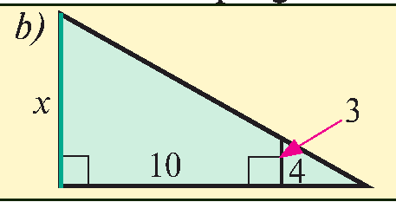
Masalalar yechish
8.3. Rasmdagi ma’lumotlar asosida $x$ ni toping.
$$\frac{x}{3}=\frac{14}{4}$$
$$x=\frac{14∙3}{4}=\frac{42}{4}=10,5$$
Javob: $10,5$

Slide 12
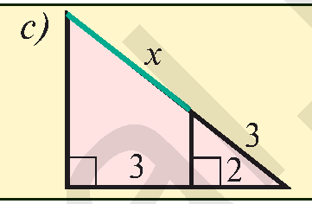
Masalalar yechish
8.3. Rasmdagi ma’lumotlar asosida $x$ ni toping.
$$\frac{x+3}{3}=\frac{5}{2}$$
$$2x+6=15$$
$$2x=9 => x=4,5$$
Javob: $4,5$

Slide 13
Masalalar yechish
8.4. Rasmdagi ma’lumotlar asosida $x$ ni toping.
$$\frac{4}{x}=\frac{2}{5}$$
$$\frac{4}{3}=\frac{2+x}{x}$$
$$\frac{6}{x}=\frac{8}{6}$$
$$x=\frac{20}{2}=10$$
$$4x=6+3x$$
$$x=\frac{36}{8}=4,5$$
$$x=6$$

Slide 14
Masalalar yechish
$ABCD$ trapetsiya diagonallari kesishishidan xosil bo‘lgan $AOD$ va $COB$ uchburchaklarning o‘xshashligini isbotlang.
$$∆AOD∾∆COB$$
$$∆AOD; ∆COB$$
$$B$$
$$C$$
$$AD∥BC=>∠CAD=∠ACB$$
$$AD∥BC=>∠DBC=∠ADB$$
$$O$$
B.B. $=> ∆AOD∾∆COB$
$$A$$
$$D$$

Slide 15
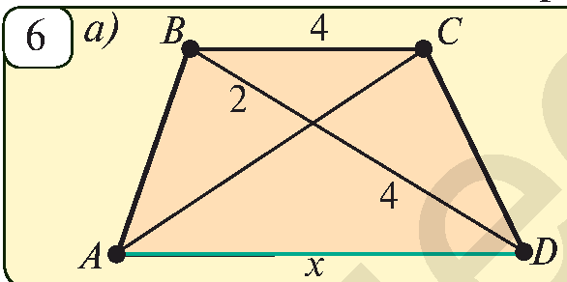
Masalalar yechish
8.6. $ABCD−$trapetsiya. Rasmdagi ma’lumotlar asosida $x$ ni toping.
$$∆AOD∾∆COB$$
$$\frac{AO}{CO}=\frac{OD}{OB}=\frac{AD}{CB}$$
$$\frac{4}{2}=\frac{x}{4}$$
$$O$$
$$x=\frac{16}{2}=8$$

Slide 16
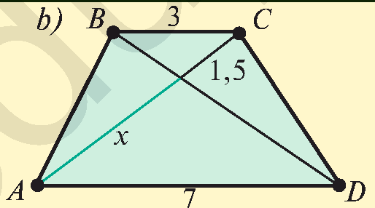
Masalalar yechish
8.6. $ABCD−$trapetsiya. Rasmdagi ma’lumotlar asosida $x$ ni toping.
$$∆AOD∾∆COB$$
$$\frac{AO}{CO}=\frac{OD}{OB}=\frac{AD}{CB}$$
$$\frac{x}{1,5}=\frac{7}{3}$$
$$O$$
$$x=\frac{7∙1,5}{3}=\frac{10,5}{3}=3,5$$

Slide 17
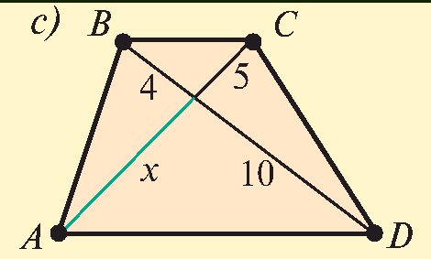
Masalalar yechish
8.6. $ABCD−$trapetsiya. Rasmdagi ma’lumotlar asosida $x$ ni toping.
$$∆AOD∾∆COB$$
$$\frac{AO}{CO}=\frac{OD}{OB}=\frac{AD}{CB}$$
$$O$$
$$\frac{x}{5}=\frac{10}{4}$$
$$x=\frac{5∙10}{4}=\frac{50}{4}=12,5$$

Slide 18
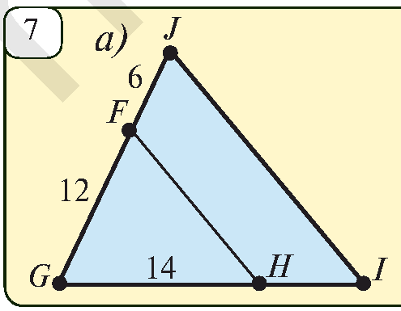
Masalalar yechish
8.6. Rasmda berilganlarga asosan noma’lum kesmani toping.
$$IJ∥HF; HI=?$$
$$∆FGH∾∆JGI$$
$$\frac{FG}{JG}=\frac{GH}{GI}=\frac{FH}{JI}$$
$$\frac{12}{18}=\frac{14}{14+x}$$
$$168+12x=252$$
$$12x=84$$
$$x=7$$

Slide 19
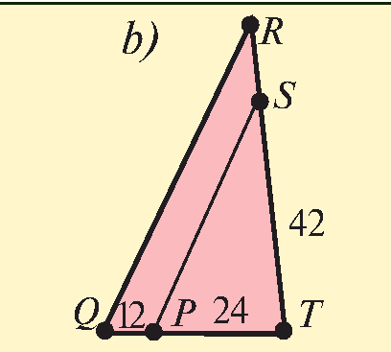
Masalalar yechish
8.6. Rasmda berilganlarga asosan noma’lum kesmani toping.
$$QR∥PS; RS=?$$
$$∆QRT∾∆PST$$
$$\frac{QR}{PS}=\frac{RT}{ST}=\frac{QT}{PT}$$
$$\frac{x+42}{42}=\frac{36}{24}$$
$$24x+1008=1512$$
$$24x=504$$
$$x=21$$

Slide 20
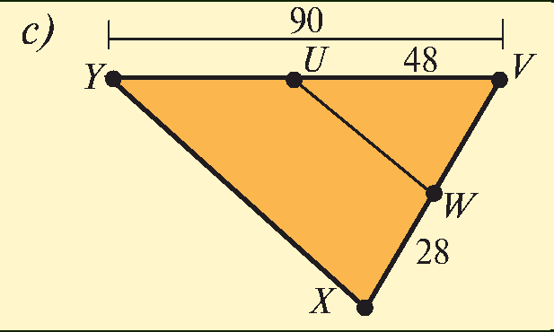
Masalalar yechish
8.6. Rasmda berilganlarga asosan noma’lum kesmani toping.
$$XY∥WX; VX=?$$
$$∆VYX∾∆VUW$$
$$\frac{VY}{VU}=\frac{YX}{UW}=\frac{VX}{VW}$$
$$\frac{90}{48}=\frac{x}{28}$$
$$x=\frac{90∙28}{48}=52,5$$

Slide 21
Mustaqil yechish uchun topshiriq
Darslikning
33-betidagi 8.5, 8.7, 8.8-mashqlar.

