Slide 1
Geometriya
9
sinf
Mavzu:
O‘xshash uchburchaklar va ularning xossalari
Komilov Mirodil Xosiljonovich X.T.V. tasarrufidagi AFIDUM matematika fani o‘qituvchisi.

Slide 2
Mustaqil bajarilgan topshiriqni tekshirish
6.6. $ABC$ uchburchak $AB$ va $AC$ tomonlarining
o‘rtalari mos ravishda $P$ va $Q$ bo‘lsin. $∆ABC∾∆APQ$
ekanligini isbotlang.
$$A$$
$PQ−$ o‘rta chiziq
$$P$$
$$Q$$
$$PQ∥BC, PQ=\frac{BC}{2}$$
$$B$$
$$C$$

Slide 3
Mustaqil bajarilgan topshiriqni tekshirish
$$PQ∥BC => ∠B=∠P; ∠C=∠Q$$
$$A$$
$$\frac{BC}{PQ}=2$$
$$\frac{AB}{AP}=2$$
$$\frac{AC}{AQ}=2$$
$$P$$
$$Q$$
$$∆ABC∾∆APQ$$
$$B$$
$$C$$

Slide 4
O‘xshash uchburchaklar
$$B$$
$$B_{1}$$
$$A$$
$$C$$
$$A_{1}$$
$$C_{1}$$
$$∠A=∠A_{1} ; ∠B=∠B_{1} ; ∠C=∠C_{1}$$
$$∆ABC∾∆A_{1}B_{1}C_{1}$$
$$\frac{AB}{A_{1}B_{1}}=\frac{BC}{B_{1}C_{1}}=\frac{AC}{A_{1}C_{1}}=k$$

Slide 5
O‘xshash uchburchaklar
$$B$$
$$B_{1}$$
$$A$$
$$C$$
$$A_{1}$$
$$C_{1}$$
$$∆ABC∾∆A_{1}B_{1}C_{1}$$
$$\frac{AB}{A_{1}B_{1}}=\frac{BC}{B_{1}C_{1}}=\frac{AC}{A_{1}C_{1}}=k$$
$$\frac{P}{P_{1}}=k$$

Slide 6
O‘xshash uchburchaklar
$$B_{1}$$
$$B$$
$$A$$
$$C$$
$$A_{1}$$
$$C_{1}$$
$$∆ABC∾∆A_{1}B_{1}C_{1}$$
$$\frac{AB}{A_{1}B_{1}}=\frac{BC}{B_{1}C_{1}}=\frac{AC}{A_{1}C_{1}}=k$$
$$\frac{S}{S_{1}}=k^{2}$$

Slide 7
O‘xshash uchburchaklar
$$B_{1}$$
$$S_{A_{1}B_{1}C_{1}}=\frac{A_{1}C_{1}∙B_{1}E}{2}$$
$$B$$
$$S_{A_{1}B_{1}C}=\frac{A_{1}C∙B_{1}E}{2}$$
$$A$$
$$C$$
$$A_{1}$$
$$E$$
$$A \left(A_{1}\right)$$
$$C_{1}$$
$$\frac{S_{A_{1}B_{1}C_{1}}}{S_{A_{1}B_{1}C}}=\frac{A_{1}C_{1}∙B_{1}E}{2}:\frac{A_{1}C∙B_{1}E}{2}=\frac{A_{1}C_{1}}{A_{1}C}$$

Slide 8
O‘xshash uchburchaklar
$$B_{1}$$
$$S_{ABC}=\frac{AB∙CF}{2}$$
$$B$$
$$F$$
$$S_{A_{1}B_{1}C}=\frac{A_{1}B_{1}∙CF}{2}$$
$$A$$
$$C$$
$$A_{1}$$
$$A \left(A_{1}\right)$$
$$C_{1}$$
$$\frac{S_{ABC}}{S_{A_{1}B_{1}C}}=\frac{AB∙CF}{2}:\frac{A_{1}B_{1}∙CF}{2}=\frac{AB}{A_{1}B_{1}}$$

Slide 9
O‘xshash uchburchaklar
$$B$$
$$B_{1}$$
$$A$$
$$C$$
$$A_{1}$$
$$C_{1}$$
$$\frac{S_{A_{1}B_{1}C_{1}}}{S_{A_{1}B_{1}C}}=\frac{A_{1}C_{1}}{A_{1}C}$$
$$\frac{S_{ABC}}{S_{A_{1}B_{1}C_{1}}}=\frac{AB}{A_{1}B_{1}}:\frac{A_{1}C_{1}}{A_{1}C}=k:\frac{1}{k}=k^{2}$$
$$\frac{S_{ABC}}{S_{A_{1}B_{1}C}}=\frac{AB}{A_{1}B_{1}}$$

Slide 10
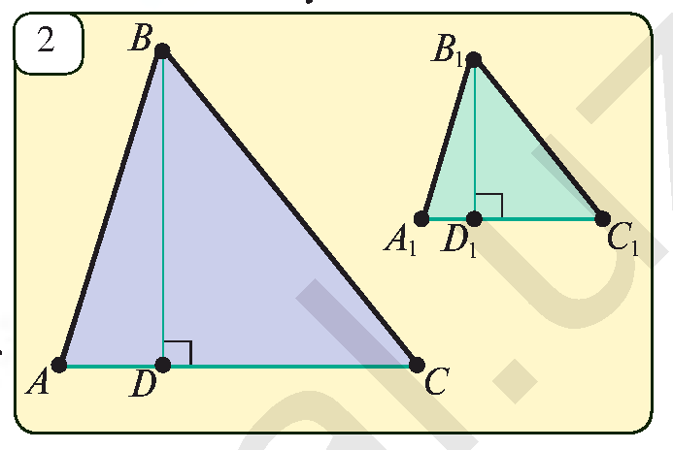
Masalalar yechish
O‘xshash uchburchaklarning mos tomonlari
nisbati shu tomonlarga tushirilgan balandliklar nisbatiga teng.
$$∆ABC∾∆A_{1}B_{1}C_{1}$$
$$\frac{AC}{A_{1}C_{1}}=\frac{BD}{B_{1}D_{1}}$$

Slide 11
Masalalar yechish
7.2. Ikkita o‘xshash $ABC$ va $A_{1}B_{1}C_{1}$ uchburchaklar
berilgan. Agar $S_{ABC}=25 {cm}^{2}$ va $S_{A_{1}B_{1}C_{1}}=81 {cm}^{2}$ bo‘lsa, o‘xshashlik
koeffitsiyentini toping.
$$\frac{S}{S_{1}}=k^{2}$$
$$\frac{25}{81}=k^{2} =>k=\frac{5}{9}$$

Slide 12
Masalalar yechish
7.4. Berilgan uchburchak tomonlari 15 cm, 25 cm va 30 cm. Agar perimetri 35 cm bo‘lgan uchburchak berilgan uchburchakka o‘xshash bo‘lsa, uning tomonlarini toping.
$$y$$
$$x$$
$$P_{1}=15+25+30=70$$
$$P=35$$
$$k=\frac{P_{1}}{P}=\frac{70}{35}=2$$
$$x=\frac{15}{2}=7,5;$$
$$z$$
$$15$$
$$25$$
$$y=\frac{25}{2}=12,5; z=\frac{30}{2}=15$$
$$30$$

Slide 13
Masalalar yechish
Повторение
$$∆ABC∾∆A_{1}B_{1}C_{1}$$
$$P_{A_{1}B_{1}C_{1}}=84 cm$$
$$P_{A_{1}B_{1}C_{1}}=84 cm$$
В
В₁
7 сm
6 сm
$$y$$
28 сm
$$x$$
24 сm
А
8 сm
С
А₁
С₁
$$z$$
32 сm
Notes:
С.М. Саврасова, Г.А. Ястребинецкий «Упражнения по планиметрии на готовых чертежах»

Slide 14
Masalalar yechish
7.6. $∆ABC∾∆A_{1}B_{1}C_{1}$va bu uchburchaklarning mos tomonlari nisbati 7:5 ga teng. Agar $ABC$ uchburchak yuzi $A_{1}B_{1}C_{1}$ uchburchak yuzidan 36 $m^{2}$ ga ortiq bo‘lsa, bu uchburchaklar yuzlarini toping.
$$B$$
$$B_{1}$$
$$\frac{A_{1}B_{1}}{AB}=\frac{7}{5}$$
$$A$$
$$C$$
$$S_{1}=S+36$$
$$A_{1}$$
$$C_{1}$$

Slide 15
Masalalar yechish
$$\frac{A_{1}B_{1}}{AB}=\frac{7}{5}$$
$$B$$
$$B_{1}$$
$$S=37$$
$$S_{1}=S+36$$
$$C$$
$$A$$
$$S_{1}=73,5$$
$$\frac{A_{1}B_{1}}{AB}=\frac{7}{5}=k$$
$$A_{1}$$
$$C_{1}$$
$$\frac{S+36}{S}=\frac{49}{25}$$
$$\frac{S_{1}}{S}=k^{2} =>\frac{S_{1}}{S}=\frac{49}{25}$$
$$25S+900=49S$$
$S=37,5$; $S_{1}=37,5+36=73,5$

Slide 16
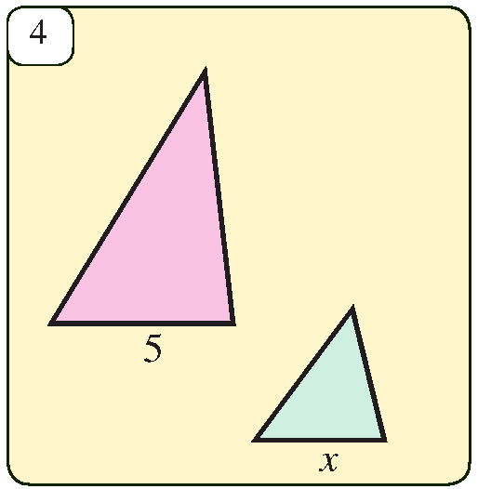
Masalalar yechish
7.8. 4-rasmdagi uchburchaklar o‘xshash va yuzlari nisbati 25:9 kabi bo‘lsa, noma’lum kesma uzunligini toping.
$$\frac{S}{S_{1}}=\frac{25}{9}; x=?$$
$$\frac{S}{S_{1}}=\frac{25}{9}=k^{2} =>k=\frac{5}{3}$$
$$\frac{5}{x}=\frac{5}{3} => x=3$$

Slide 17
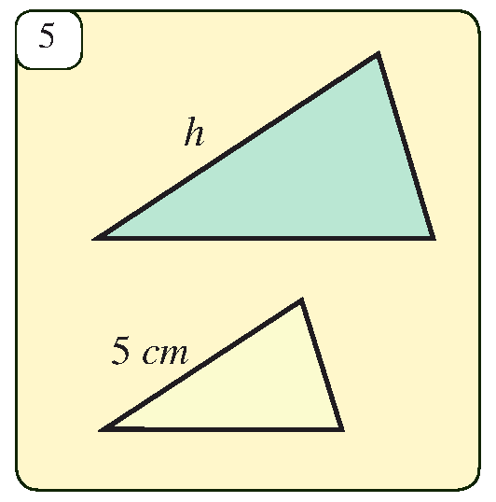
Masalalar yechish
7.9. 5-rasmdagi uchburchaklar o‘xshash va
$S_{1}:S_{2}=49:25$ bo‘lsa, noma’lum kesma uzunligini toping.
$$\frac{S_{1}}{S_{2}}=\frac{49}{25}; h=?$$
$$\frac{S_{1}}{S_{2}}=\frac{49}{25}=k^{2} =>k=\frac{7}{5}$$
$$\frac{h}{5}=\frac{7}{5} => h=7$$

Slide 18
Masalalar yechish
Ikkita o‘xshash uchburchak perimetrlari nisbati 2:3 kabi. Katta uchburchakning yuzi 27 bo‘lsa, kichik uchburchakning yuzini toping.
$$\frac{P}{P_{1}}=\frac{2}{3}; S_{1}=27; S=?$$
$$\frac{P}{P_{1}}=k =>k=\frac{2}{3};$$
$$\frac{S}{S_{1}}=k^{2} =>\frac{S}{27}=\frac{4}{9}$$
$$S=\frac{27∙4}{9}=12$$
Javob: 1$2$

Slide 19
Masalalar yechish
Ikkita o‘xshash uchburchak perimetrlari 18 va 36 ga, yuzlarining yig‘indisi 30 ga teng. Katta uchburchakning yuzini toping.
$$P=18; P_{1}=36; S+S_{1}=30; S_{1}=?$$
$$\frac{P}{P_{1}}=k =>k=\frac{18}{36}=\frac{1}{2};$$
$$\frac{S}{S_{1}}=k^{2} =>\frac{S}{S_{1}}=\frac{1}{4}$$
$$\frac{30−x}{x}=\frac{1}{4}$$
$$120−4x=x$$
$$5x=120 => x=24$$
$$S_{1}=24$$
Javob: 24

Slide 20
Masalalar yechish
Ikkita o‘xshash uchburchakning yuzlari 6 va 24, ulardan birining perimetri ikkinchisinikidan 6 ga ortiq. Katta uchburchak perimetrini toping.
$$S=6; S_{1}=24; P_{1}=P+6; P_{1}=?$$
$$\frac{S}{S_{1}}=\frac{6}{24}=\frac{1}{4}=k^{2} =>k=\frac{1}{2}$$
$$\frac{P}{P_{1}}=k$$
$$\frac{P}{P+6}=\frac{1}{2}$$
$$2P=P+6 => P=6$$
$$P_{1}=P+6=6+6=12$$
Javob: 12

Slide 21
Mustaqil yechish uchun topshiriq
Darslikning
31-betidagi 7.3, 7.5, 7.7-mashqlar.

