Slide 1
Geometriya
9
sinf
Mavzu:
Geometrik shakllarning perimetri va yuzini hisoblashga doir masalalar

Slide 2
Mustaqil bajarilgan topshiriqni tekshirish
2.15. 16-rasmda berilganlardan foydalanib, $AB$ kesma uzunligini toping.
$$8 m$$
$$9 m$$
$${AB}^{2}={\left(3,2\right)}^{2}+8^{2}$$
${AB}^{2}=10,24+64$ ${AB}^{2}=74,24$
$AB=\sqrt{74,24}≈8,62 m$
$${AB}^{2}={\left(10,8\right)}^{2}−9^{2}$$
${AB}^{2}=116,64−81$ ${AB}^{2}=35,64$
$AB=\sqrt{35,64}≈5,97 m$

Slide 3
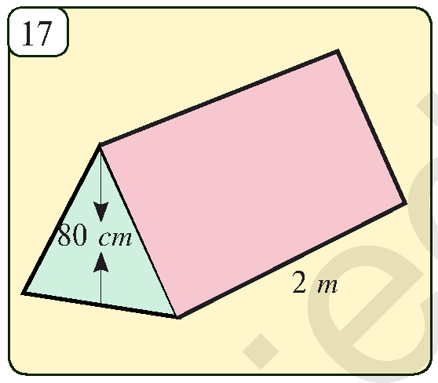
Mustaqil bajarilgan topshiriqni tekshirish
2.16. 17-rasmda tasvirlangan chodirning old tomoni teng tomonli uchburchak shaklida. Berilganlardan foydalanib chodir asosining yuzini toping.
$$a$$
$$h=80 cm, a=?$$
$$a$$
$$a$$
$h=\frac{a\sqrt{3}}{2} =>a=\frac{2h}{\sqrt{3}}$
$$h$$
$$2$$
$a=\frac{2∙0,8}{\sqrt{3}}=\frac{16\sqrt{3}}{30}=\frac{8\sqrt{3}}{15} m$
$$a$$
$S=2∙a=2∙\frac{8\sqrt{3}}{15}=\frac{16\sqrt{3}}{15} m^{2}$
$$a$$

Slide 4
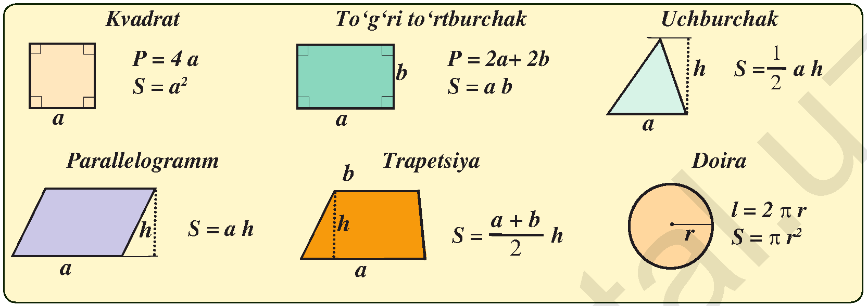
Formulalar

Slide 5
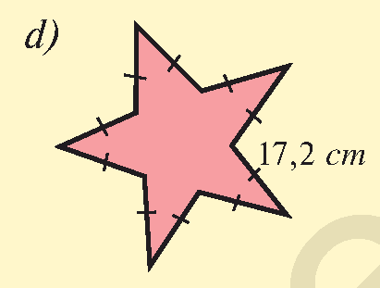
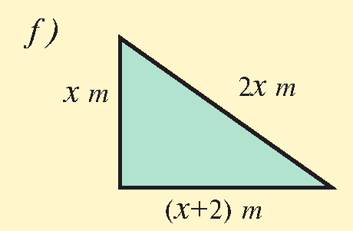
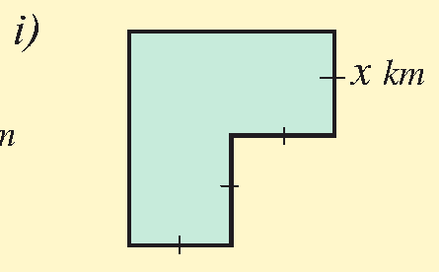
Masalalar yechish
3.1. 1-rasmda tasvirlangan ko‘pburchaklar perimetrini
hisoblang.
$$2x$$
$$a$$
$$2x$$
$$x$$
$$x$$
$$x$$
$$P=10a$$
$$P=10∙17,2$$
$$P=172 cm$$
$$P=x+2x+x+2$$
$$P=4x+2 m$$
$$P=4x+2x+2x$$
$$P=8x km$$

Slide 6
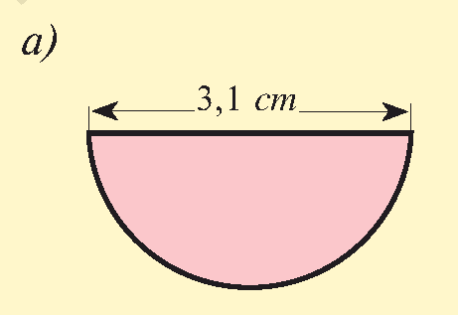
Masalalar yechish
3.2. 2-rasmda tasvirlangan geometrik shakllarning
perimetrini (chegarasining uzunligini) hisoblang.
$$P=\frac{C}{2}+d$$
$$P=\frac{πd}{2}+d=d∙\frac{π+2}{2}$$
$$P=3,1∙\frac{3,14+2}{2}=7,967 cm$$
Javob: $P=7,967 cm$
$$d$$

Slide 7
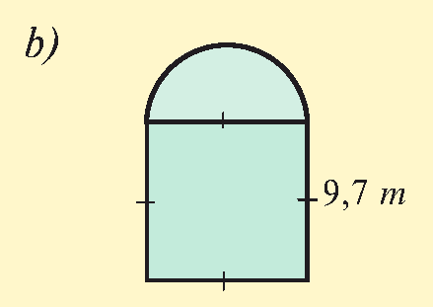
Masalalar yechish
3.2. 2-rasmda tasvirlangan geometrik shakllarning
perimetrini (chegarasining uzunligini) hisoblang.
$$P=\frac{C}{2}+3d$$
$$P=\frac{πd}{2}+3d=d∙\frac{π+6}{2}$$
$$P=3,1∙\frac{3,14+6}{2}=14,167 m$$
Javob: $P=14,167 m$
$$d$$
$$d$$
$$d$$
$$d$$

Slide 8
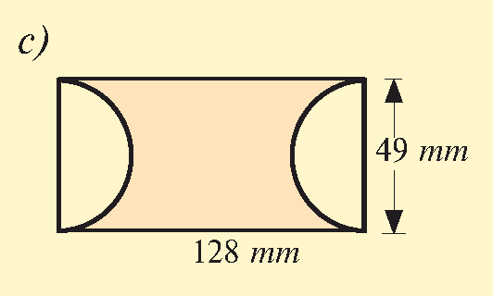
Masalalar yechish
3.2. 2-rasmda tasvirlangan geometrik shakllarning
perimetrini (chegarasining uzunligini) hisoblang.
$$P=\frac{C}{2}∙2+2a$$
$$P=πd+2a$$
$$P=3,14∙49+2∙128==409,86 mm$$
Javob: $P=409,86 mm$
$$a$$
$$d$$

Slide 9
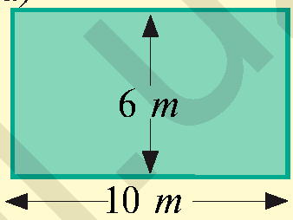
Masalalar yechish
3.3. 3-rasmda tasvirlangan gulzorlarni 32 m sim bilan
o‘rab bo‘ladimi?
$$a$$
$P=$ $20+12$
$$P=32 m$$
$$P=2a+20$$
$$a>6 =>$$
$$P>32$$
$P=$ $20+12$
$$P=32 m$$
$P=$ $20+12$
$$P=32 m$$

Slide 10
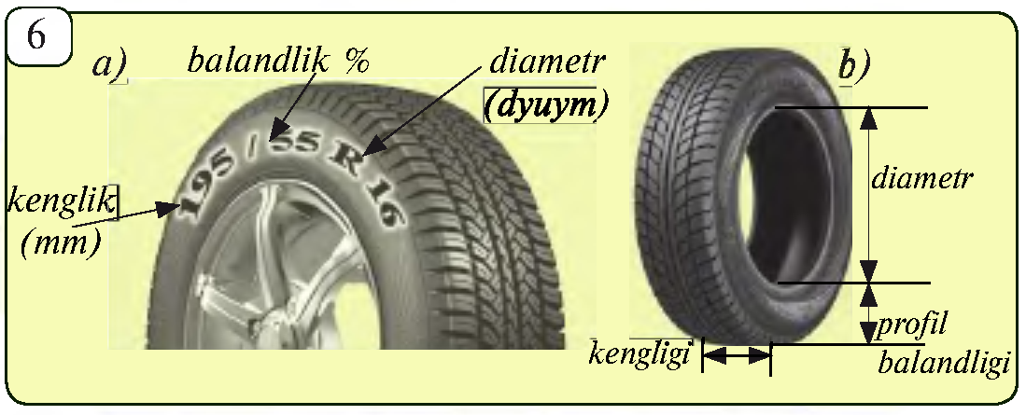
Masalalar yechish
Avtomobil shinasi
sirtidagi yozuv ma’lum
o‘lchamlarni bildiradi.
$195/55$ $R 16$
$195$- shina kengligi mm da
$55$- shina profili balandligining shina kengligiga nisbatan
foizini ko‘rsatadi. $195∙55\%=107 mm=10,7 cm$
$R16$- yozuv shina ichki diametrining dyumdagi ifodasi.
$1 dyum=2,54 cm,$ $16∙2,54=40,64 cm$.

Slide 11
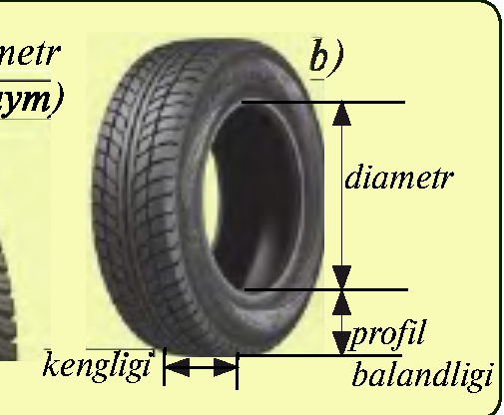
Masalalar yechish
Ravon rusumidagi Neksiya avtomobili
shinasida $175/60$ $R 15$ yozuv bor. Bu avtomobil shinasining kengligi, profili balandligi, ichki diametri va g‘ildirakning balandligi ya’ni tashqi diametrini cm larda aniqlang.
Shina kengligi - $175 mm=17,5 cm$
Profili balandligini - $175∙60\%=105 mm=10,5 cm$
Ichki diametri - $15∙2,54=38,1 cm$.
Tashqi diametri - $2∙10,5+38,1=59,1 cm$.

Slide 12
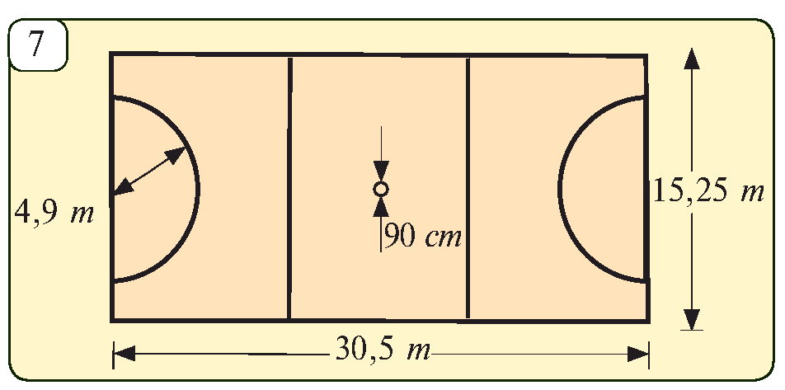
Masalalar yechish
3.8. 7-rasmda berilgan amerikancha futbol stadionining
perimetrini hisoblang. Bu stadion maydoni belgilash
uchun chiziladigan chiziqlarning jami uzunligini toping.
$$P=2(a+b)$$
$$a$$
$$P=2\left(15,25+30,5\right)=$$
$=91,5 m$
$$R$$
$$b$$
$$r$$
$$b$$
$$b$$
$l=2∙\frac{2πR}{2}+2πr+$
$+2a+4b$
$$l=2∙3,14∙4,9+$$
$$+2∙3,14∙0,9+2∙30,5+4∙15,25=158,424 m$$

Slide 13
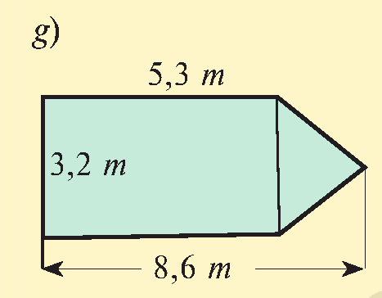
Masalalar yechish
3.10. 9-rasmda tasvirlangan turli shakldagi maydonlar-
ning yuzini toping.
$$S=S_{▭}+S_{∆}$$
$$S_{▭}=5,3∙3,2=16,96 m^{2}$$
$$h$$
$$3,2 m$$
$$3,2 m$$
$$h=8,6−5,3=3,3 m$$
$$S_{∆}=\frac{ah}{2}=\frac{3,2∙3,3}{2}=5,28 m^{2}$$
$$S=S_{∎}+S_{∆}=16,96+5,28=22,24 m^{2}$$

Slide 14
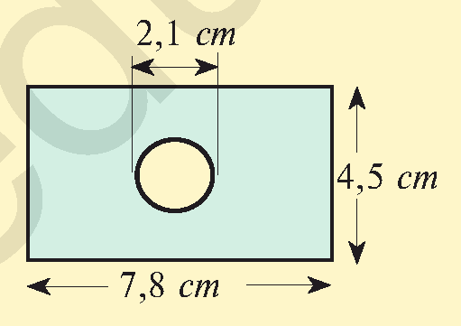
Masalalar yechish
3.10. 9-rasmda tasvirlangan turli shakldagi maydonlar-
ning yuzini toping.
$$S=S_{▭}−S_{○}$$
$$S_{▭}=4,5∙7,8=35,1 {cm}^{2}$$
$$r=\frac{d}{2}=\frac{2,1}{2}=1,05 cm$$
$$S_{○}=πr^{2}=3,14∙{\left(1,05\right)}^{2}≈3,46$$
$$S=S_{▭}−S_{○}=35,1−3,46=31,64 {cm}^{2}$$

Slide 15
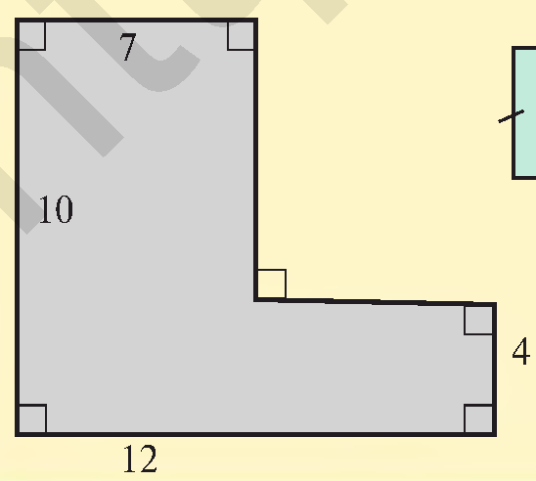
Masalalar yechish
3.10. 9-rasmda tasvirlangan turli shakldagi maydonlar-
ning yuzini toping.
$$S=S_{1}+S_{2}$$
$$S_{1}=10∙7=70 {cm}^{2}$$
$$S_{1}$$
$$S_{2}=\left(12−7\right)∙4=20 {cm}^{2}$$
$$S_{2}$$
$$S=S_{1}+S_{2}=70+20=90 {cm}^{2}$$

Slide 16
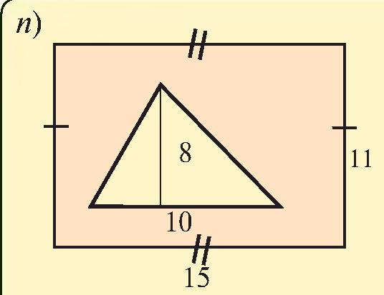
Masalalar yechish
3.10. 9-rasmda tasvirlangan turli shakldagi maydonlar-
ning yuzini toping.
$$S=S_{▭}−S_{∆}$$
$$S_{▭}=15∙11=165 {cm}^{2}$$
$$8$$
$$S_{∆}=\frac{10∙8}{2}=\frac{80}{2}=40 {cm}^{2}$$
$$10$$
$$S=S_{▭}−S_{∆}=165−40=125 {cm}^{2}$$

Slide 17
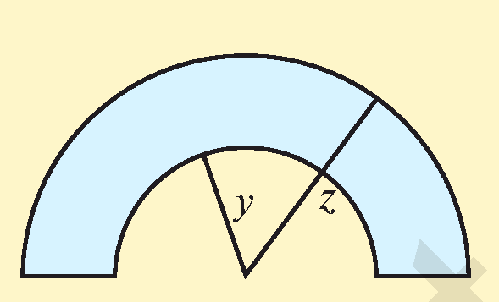
Masalalar yechish
3.10. 9-rasmda tasvirlangan turli shakldagi maydonlar-
ning yuzini toping.
$$S=S_{1}−S_{2}$$
$$S_{1}=\frac{πz^{2}}{2}$$
$$z$$
$$y$$
$$S_{2}=\frac{πy^{2}}{2}$$
$$S=S_{1}−S_{2}=\frac{πz^{2}}{2}−\frac{πy^{2}}{2}=\frac{π}{2}\left(z^{2}−y^{2}\right)$$

Slide 18
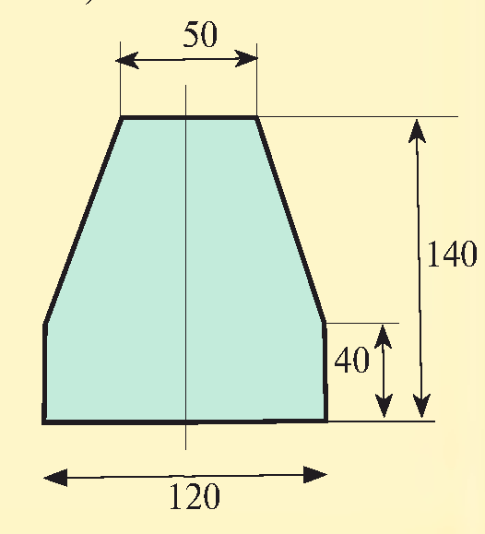
Masalalar yechish
3.10. 9-rasmda tasvirlangan turli shakldagi maydonlar-
ning yuzini toping.
$$S=S_{▭}+S_{T}$$
$$S_{▭}=120∙40=4800$$
$$S_{T}=\frac{120+50}{2}∙\left(140−40\right)=$$
$$=85∙100=8500$$
$$S=S_{▭}+S_{T}=4800+8500=13300$$

Slide 19
Mustaqil bajarish uchun topshiriqlar
Darslikning
14-betidagi 4, 5, 9, 10-mashqlar.

