Slide 1
Geometriya
9
sinf
Mavzu:
Masalalar yechish.
O‘qituvchi:
Komilov Mirodiljon
Xosiljonovich

Slide 2
Uyga vazifani tekshirish
2.9. 10-rasmdagi uchburchaklar noaniqroq tasvirlangan. Ularning qaysi biri to‘g‘ri burchakli?
${\left(\sqrt{2}\right)}^{2}+1^{2}$ ${\left(\sqrt{3}\right)}^{2}$
$2+1$ $3$
$3=3$
T.B.U.
$5^{2}+{12}^{2} {13}^{2}$
$25+144 169$
$169=169$
T.B.U.
${\left(\sqrt{39}\right)}^{2}+5^{2} 8^{2}$
$39+25 64$
$64=64$
T.B.U.

Slide 3
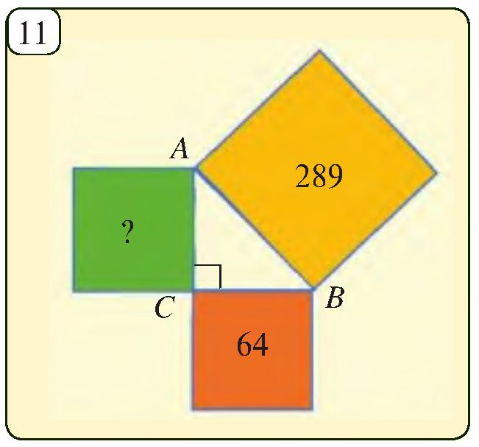
Uyga vazifani tekshirish
2.10. 11-rasmda tasvirlangan noma’lum yuzani toping.
$$S={AC}^{2}$$
$$AB=\sqrt{289}=17$$
$$BC=\sqrt{64}=8$$
$${AB}^{2}={AC}^{2}+{BC}^{2}$$
$${17}^{2}={AC}^{2}+8^{2}$$
$${AC}^{2}=289−64$$
$${AC}^{2}=225$$
$$S=225$$

Slide 4
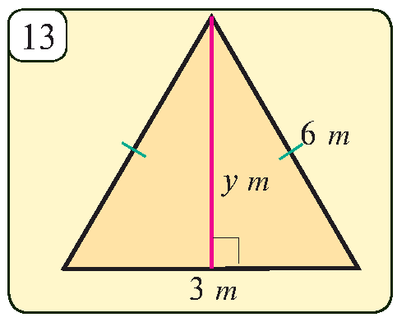
Masalalar yechish
2.12. 13-rasmdagi teng tomonli uchburchakning tomoni 6 m bo‘lsa, uning balandligini toping.
$$6^{2}=y^{2}+3^{2}$$
$$y^{2}=6^{2}−3^{2}$$
$$y^{2}=36−9$$
$$y^{2}=27$$
$$y=\sqrt{27}=3\sqrt{3}$$
Javob: $3\sqrt{3} m$

Slide 5
Masalalar yechish
2.13. 14-rasmda tasvirlangan shaklning perimetrini toping.
$$14$$
$$B$$
$${AB}^{2}={AK}^{2}+{BK}^{2}$$
$$11 m$$
$$AB=\sqrt{289+121}=\sqrt{410}$$
$$C$$
$$9 m$$
$$17 m$$
$$∟$$
$$L$$
$$8 m$$
$${BC}^{2}={KC}^{2}+{BK}^{2}$$
$$∟$$
$$K$$
$$BC=\sqrt{81+121}=\sqrt{202}$$
$$A$$
$$11 m$$
$${AD}^{2}={AL}^{2}+{LD}^{2}$$
$$D$$
$$AD=\sqrt{324+121}=\sqrt{445}$$
$${DC}^{2}={DL}^{2}+{LC}^{2}$$
$$AB=\sqrt{64+121}=\sqrt{185}$$
$$P=\sqrt{410}+\sqrt{202}+\sqrt{445}+\sqrt{185}$$

Slide 6
Masalalar yechish
2.14. 15-rasmda berilganlardan foydalanib, noma’lum uzunliklarni toping.
${\left(1,2\right)}^{2}=1^{2}+x^{2}$
$1,44=1+x^{2}$
$x^{2}=0,44$ $x=\sqrt{0,44}$
$x^{2}={\left(3,8\right)}^{2}+{\left(2,1\right)}^{2}$ $x^{2}=14,44+4,41$
$x^{2}=18,8$
$x=\sqrt{18,85}$
$x^{2}={\left(1,8\right)}^{2}+{\left(1,32\right)}^{2}$ $x^{2}=3,24+1,7424$
$x^{2}=4,9824$
$x=\sqrt{4,9824}$

Slide 7
Masalalar yechish
2.17. 18-rasmda P elektr stansiyadan A va B shaharchalarga sim tortishmoqchi. Buning uchun qancha sim kerak bo‘ladi?
$$l=AC+BC=?$$
$${AC}^{2}={13}^{2}+{42}^{2}$$
$${AC}^{2}=169+1764$$
$$14$$
$$AC=\sqrt{1933}$$
$$A$$
$$13 km$$
$$45 km$$
$$B$$
$$∟$$
$${BC}^{2}={45}^{2}+{42}^{2}$$
$${BC}^{2}=2025+1764$$
$$42 km$$
$$BC=\sqrt{3789}$$
$l=\sqrt{1933}+\sqrt{3789} km$
$$C$$

Slide 8
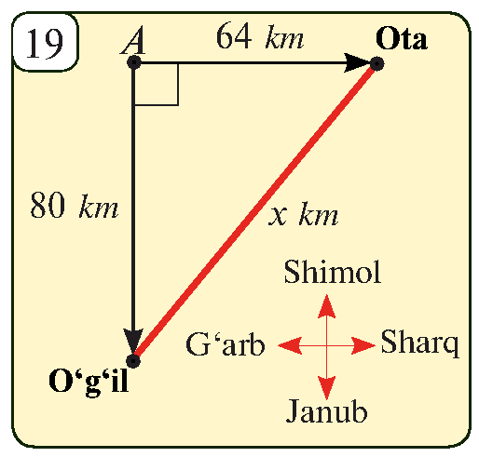
Masalalar yechish
2.17. $A$ nuqtadan ota $16 km/h$ tezlik bilan sharqqa, o‘g‘il esa $20 km/h$ tezlik bilan velosipedda janubga qarab harakatlanmoqda (19-rasm). 4 soatdan keyin ular orasidagi masofa qancha bo‘ladi?
$$16∙4=64 km$$
$$20∙4=80 km$$
$$x^{2}={64}^{2}+{80}^{2}$$
$$x^{2}=4096+6400$$
$$x^{2}=10496$$
$x=16\sqrt{41} km$

Slide 9
Masalalar yechish
To‘g‘ri burchakli uchburchakning o‘tkir burchaklarining medianalari 10 cm va 15 cm ga teng. Gipotenuzaning uzunligini toping.
$$m_{a}=10 cm$$
$$m_{b}=15 cm$$
$$c=?$$
$$b^{2}+{\left(\frac{a}{2}\right)}^{2}=m_{a}^{2}$$
$$\frac{b}{2}$$
$$a^{2}+{\left(\frac{b}{2}\right)}^{2}=m_{b}^{2}$$
$$c$$
$$b$$
$$m_{a}$$
$$\left\{\begin{aligned}b^{2}+\frac{a^{2}}{4}={10}^{2} \\ a^{2}+\frac{b^{2}}{4}={15}^{2}\end{aligned}\right.$$
$$m_{b}$$
$$\frac{b}{2}$$
$$∟$$
$$\frac{a}{2}$$
$$a$$
$$\frac{a}{2}$$

Slide 10
Masalalar yechish
$$\left\{\begin{aligned}4b^{2}+a^{2}=400 \\ 4a^{2}+b^{2}=900\end{aligned}\right.$$
$$\frac{b}{2}$$
$$+$$
$$c$$
$$b$$
$$m_{a}$$
$$5a^{2}+5b^{2}=1300$$
$$m_{b}$$
$$\frac{b}{2}$$
$$a^{2}+b^{2}=260$$
$$∟$$
$$a^{2}+b^{2}=c^{2}$$
$$a$$
$$\frac{a}{2}$$
$$\frac{a}{2}$$
$$c^{2}=260$$
$$c=\sqrt{260}=2\sqrt{65} cm$$

Slide 11
Masalalar yechish
Uchburchakning tomonlari $\sqrt{65 } cm, \sqrt{113} cm$ va 12 cm. Uning eng kichik balandligini toping.
$$\sqrt{65}<\sqrt{113}<\sqrt{144}=12$$
$$h^{2}={\left(\sqrt{65}\right)}^{2}−x^{2}$$
$$\sqrt{113} cm$$
$$\sqrt{65} cm$$
$$h^{2}={\left(\sqrt{113}\right)}^{2}−{\left(12−x\right)}^{2}$$
$$h$$
$$65−x^{2}=113−\left(144−24x+x^{2}\right)$$
$$x$$
$$∟$$
$$12−x$$
$$65−x^{2}=113−144+24x−x^{2}$$
$$12 cm$$
$$24x=96$$
$$x=4$$
$$h^{2}=65−x^{2}=65−16=49$$
$$h=7 cm$$
Javob: $7 cm$

Slide 12
Katetlarning gipotenuzadagi proyeksiyasi
$$∟$$
$$x=\frac{a^{2}}{c}$$
$$y=\frac{b^{2}}{c}$$
$$a$$
$$b$$
$$h$$
$$h^{2}=x∙y$$
$h=\frac{ab}{c}$
$$x$$
$$y$$
$$∟$$
$$c$$
$x ⇒ a$katetning $c$ dagi proyeksiyasi
$y ⇒ b$katetning $c$ dagi proyeksiyasi

Slide 13
Masalalar yechish
To‘g‘ri burchakli uchburchakning kateti 7 dm ga,
uning gipotenuzasiga proyeksiyasi 1,96 dm ga teng. Ikkinchi katetning uzunligini toping.
$$∟$$
$$a=7 dm$$
$$x=1,96 dm$$
$$b=?$$
$$x=\frac{a^{2}}{c} =>c=\frac{a^{2}}{x}$$
$$a$$
$$b$$
$$h$$
$$c=\frac{7^{2}}{1,96}=\frac{49}{1,96}=25$$
$$x$$
$$∟$$
$$c$$
$$b=\sqrt{c^{2}−a^{2}}=\sqrt{{25}^{2}−7^{2}}=\sqrt{625−49}=\sqrt{576}=24$$

Slide 14
Masalalar yechish
To‘g‘ri burchakli uchburchakning perimetri 40 cm ga, bir kateti uzunligi 8 cm ga teng. Shu katetning gipotenuzadagi proyeksiyasi uzunligini toping.
$$P=40 cm$$
$$a=8 cm$$
$$x=?$$
$$∟$$
$$8+b+c=40 =>b+c=32$$
$$c^{2}−b^{2}=8^{2}$$
$$\left(c−b\right)∙\left(c+b\right)=64$$
$$8$$
$$b$$
$$h$$
$$\left(c−b\right)∙32=64$$
$$c−b=2$$
$$\left\{\begin{aligned}c+b=32 \\ c−b=2 \end{aligned}\right. =>c=17, b=15$$
$$x$$
$$∟$$
$$c$$
$$x=\frac{a^{2}}{c}=\frac{8^{2}}{17}=\frac{64}{17}=3\frac{13}{17} cm$$

Slide 15
Mustaqil bajarish uchun topshiriqlar
Darslikning
12-betidagi 15, 16, 19-mashqlar.

Slide 16
E’TIBORINGIZ UCHUN RAHMAT!
ARALASHMAGA OID MASALALAR

