Slide 1
Geometriya
9
sinf
Mavzu:
Pifagor teoremasi va
uning tatbiqlari.
Komilov Mirodil Xosiljonovich X.T.V. tasarrufidagi AFIDUM matematika fani o‘qituvchisi.

Slide 2
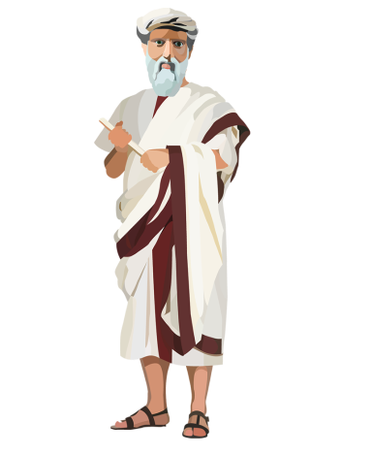
Pifagor teoremasi
Geometriyaning ikki durdonasi bor: ularning biri Pifagor teoremasi bo‘lsa, ikkinchisi kesmani o‘rta va chet nisbatda bo‘lish. I.Kepler
Pifagor teoremasi: To‘g‘ri burchakli uchburchak gipotenuzasining kvadrati katetlar kvadratlarining yig‘indisiga teng.
$$c$$
$${c^{2}=a}^{2}+b^{2}$$
$$a$$
$$b$$

Slide 3
Pifagor teoremasi isboti
Tomoni $a+b$ bo‘lgan kvadrat olamiz:
$$a$$
$$b$$
$$a$$
$$b$$
$$S_{∆}$$
$$a$$
$$S_{∆}$$
$$S_{∆}$$
$$a$$
$$a^{2}$$
$$a$$
$$b$$
$$S_{∆}$$
$$c$$
$$c^{2}$$
$$S=4S_{∆}+c^{2}$$
$$S_{∆}$$
$$b$$
$$b^{2}$$
$$b$$
$$S_{∆}$$
$$b$$
$$a$$
$$S=4S_{∆}+a^{2}+b^{2}$$
$$S_{∆}$$
$$S_{∆}$$
$$b$$
$$a$$
$$4S_{∆}+c^{2}=4S_{∆}+a^{2}+b^{2}$$
$$b$$
$$c^{2}=a^{2}+b^{2}$$

Slide 4
Masalalar yechish
$$a)$$
$$3 cm$$
$$b)$$
$$c)$$
$$∟$$
$$∟$$
$$∟$$
$$14 m$$
$$14m$$
$$15,6 cm$$
$$14,8 cm$$
$$5 cm$$
$$x cm$$
$$x cm$$
$$x m$$
$$x^{2}=5^{2}+3^{2}$$
$$x^{2}={14}^{2}+{14}^{2}$$
$$x^{2}={15,6}^{2}+{14,8}^{2}$$
$$x^{2}=25+9$$
$$x^{2}=243,36+219,04$$
$x^{2}=2$ $∙{14}^{2}$
$$x^{2}=34$$
$$x^{2}=462,4$$
$$x=14\sqrt{2}$$
$$x=\sqrt{34}$$
$$x=\sqrt{462,4}$$

Slide 5
Masalalar yechish
To‘g‘ri burchakli uchburchakning bir kateti uzunligi ikkinchi kateti uzunligidan 10 ga katta, ammo gipotenuzasi uzunligidan 10 ga kichik. Bu uchburchakning gipotenuzasi uzunligini toping.
$$A$$
$${AB}^{2}={AC}^{2}+{BC}^{2}$$
$${(x+10 )}^{2}=x^{2}+{(x−10)}^{2}$$
$$x+10$$
$$x$$
$$x^{2}+20x+100=x^{2}+x^{2}−20x+100$$
$$x^{2}−40x=0$$
$$x=0$$
$$x=40$$
$$C$$
$$x−10$$
$$B$$
$$AB=x+10=40+10=50$$
Javob: 50

Slide 6
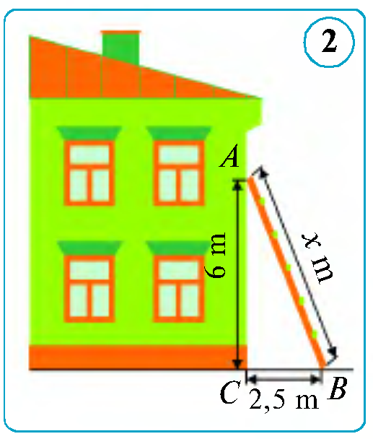
Masalalar yechish
Narvonning uzunligini toping.
$${AB}^{2}={AC}^{2}+{BC}^{2}$$
$${AB}^{2}=6^{2}+{2,5}^{2}$$
$${AB}^{2}=36+6,25$$
$${AB}^{2}=42,25$$
$$AB=6,5$$
Javob: $6,5 m$

Slide 7
Masalalar yechish
Rasmda $AC$ kesma $\sqrt{32} cm$ bo‘lsa, $AB$ kesmaning uzunligini toping.
$$A$$
$${AC}^{2}={\left(2x\right)}^{2}+{\left(2x\right)}^{2}$$
$$x$$
$$32=4x^{2}+4x^{2}$$
$$x$$
$$32=8x^{2}$$
$$x^{2}=4$$
$$x=2$$
$$x$$
$$x$$
$${AB}^{2}={\left(3x\right)}^{2}+{\left(4x\right)}^{2}$$
$$x$$
$$x$$
$${AB}^{2}={9x}^{2}+{16x}^{2}$$
$$C$$
$${AB}^{2}={25x}^{2}$$
$$x$$
$$x$$
$$AB=5x=5∙2=10$$
$$x$$
$$x$$
$$x$$
$$x$$
$$B$$
Javob: $10 cm$

Slide 8
Masalalar yechish
Noma’lum kesmalar uzunligini toping.
$$2$$
$$y^{2}=4^{2}+x^{2}$$
$$5^{2}=2^{2}+y^{2}$$
$$∟$$
$$y^{2}=5^{2}−2^{2}$$
$$x^{2}=y^{2}−4^{2}$$
$$5$$
$$y^{2}=21$$
$$x^{2}=21−16$$
$$4$$
$$y$$
$$y=\sqrt{21}$$
$$x=\sqrt{5}$$
$$∟$$
Javob: $x=\sqrt{5}, y=\sqrt{21}$
$$x$$

Slide 9
Masalalar yechish
Noma’lum kesmalar uzunligini toping.
$$1$$
$$5^{2}=3^{2}+x^{2}$$
$$y^{2}=1^{2}+x^{2}$$
$$∟$$
$$x^{2}=5^{2}−3^{2}$$
$$y^{2}=1+16$$
$$5$$
$$x^{2}=16$$
$$y^{2}=17$$
$$x$$
$$y$$
$$x=4$$
$$y=\sqrt{17}$$
$$∟$$
$$3$$
Javob: $x=4, y=\sqrt{17}$

Slide 10
Masalalar yechish
Tegishli kesmalarni yasab, $AB$ kesma uzunligini toping.
$$A$$
$$2 cm$$
$$BC=3 cm$$
$$∟$$
$$C$$
$$AC=2−1=1 cm$$
$$∟$$
$${AB}^{2}={AC}^{2}+{BC}^{2}$$
$$3 cm$$
$${AB}^{2}=1^{2}+3^{2}$$
$$B$$
$${AB}^{2}=10$$
$$∟$$
$$1 cm$$
$$AB=\sqrt{10}$$
Javob: $\sqrt{10}$

Slide 11
Pifagor teoremasiga teskari teorema
Agar uchburchak tomonlaridan birining kvadrati uning qolgan ikki tomoni kvadratlari yig‘indisiga teng bo‘lsa, u holda uchburchak to‘g‘ri burchakli bo‘ladi.
$$c$$
$$a^{2}+b^{2}=c^{2}$$
$$c$$
$$a$$
$$a$$
$$∟$$
$$b$$
$$b$$

Slide 12
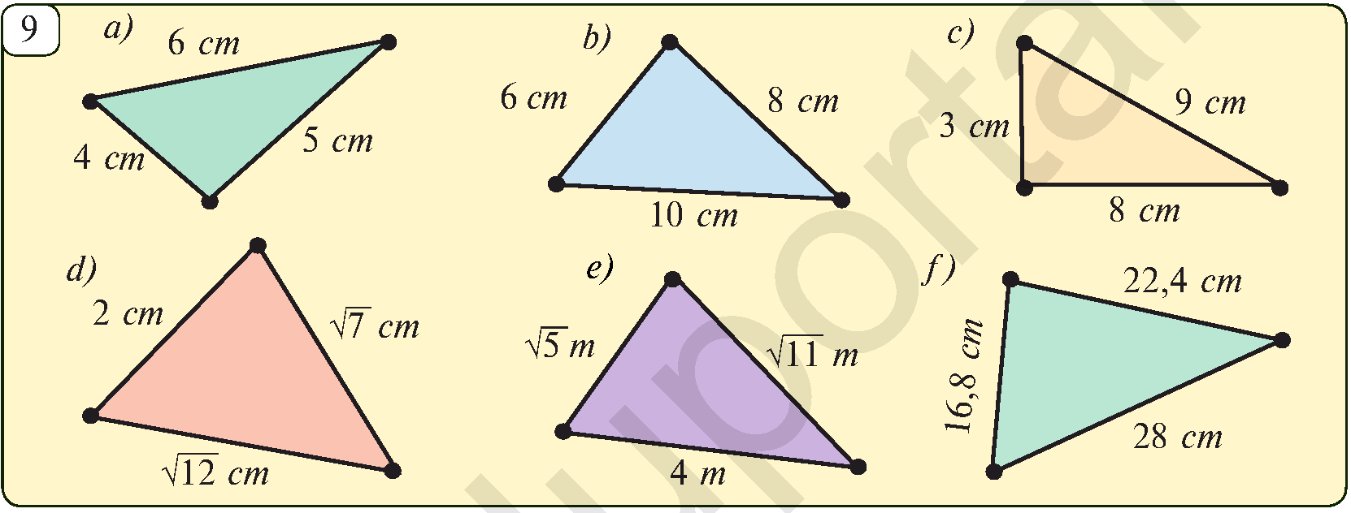
Masalalar yechish
Berilgan uchburchaklardan qaysi biri to‘g‘ri burchakli?
$4^{2}+5^{2} 6^{2}$
$16+25 36$
$41≠36$
T.B.U. emas
$6^{2}+8^{2} {10}^{2}$
$36+64 100$
$100=100$
T.B.U.
$3^{2}+8^{2} 9^{2}$
$9+64 81$
$73 ≠81$
T.B.U. emas

Slide 13
Masalalar yechish
Tomonlari $2p, p^{2}−1, p^{2}+1$ bo‘lgan uchburchak to‘g‘ri burchakli bo‘ladimi? $(p≥2)$
$${\left(p^{2}+1\right)}^{2}={\left(p^{2}−1\right)}^{2}+{\left(2p\right)}^{2}$$
$$p^{2}+1$$
$$2p$$
$$p^{4}+2p^{2}+1=p^{4}−2p^{2}+1+4p^{2}$$
$p^{4}+2p^{2}+1=$ $p^{4}+2p^{2}+1$
$$p^{2}−1$$
Javob: Ha

Slide 14
Mustaqil bajarish uchun topshiriqlar
Darslikning
10-betidagi 4, 5, 6-mashqlar;
11-betidagi 9, 10, 11-mashqlar.

Slide 15
E’TIBORINGIZ UCHUN RAHMAT!
ARALASHMAGA OID MASALALAR

