Slide 1
Geometriya
9
sinf
Mavzu:
Masalalar yechish.
Komilov Mirodil Xosiljonovich X.T.V. tasarrufidagi AFIDUM matematika fani o‘qituvchisi.

Slide 2
Uchburchak
$$B$$
$∆ABC−$uchburchak
$A,B, C$ nuqtalar $−$ uchburchak uchlari
$AB, BC, AC$ kesmalar $−$ uchburchak
tomonlari
$∠A,∠B,∠C$ $−$ uchburchak burchaklari
$$A$$
$$C$$
$P=AB+BC+AC −$ uchburchak perimetri
$$∠A+∠B+∠C=180°$$
$\left.\begin{aligned}AC−BC<AB<AC+BC \\ AC−AB<BC<AC+AB \\ BC−AB<AC<BC+1B\end{aligned}\right\} −$ uchburchak tengsizligi

Slide 3
Uchburchak
Uchburchak turlari
Tomoniga ko‘ra
Burchagiga ko‘ra
Teng tomonli
O‘tkir burchakli
Teng yonli
To‘g‘ri burchakli
Turli tomonli
O‘tmas burchakli

Slide 4
Uchburchak turini aniqlang
$a)$ to‘g‘ri
burchakli
uchburchak
b$)$ o‘tkir
burchakli
uchburchak
c$)$ teng
yonli
uchburchak
d$)$ teng
tomonli
uchburchak
e$)$ o‘tmas
burchakli
uchburchak

Slide 5
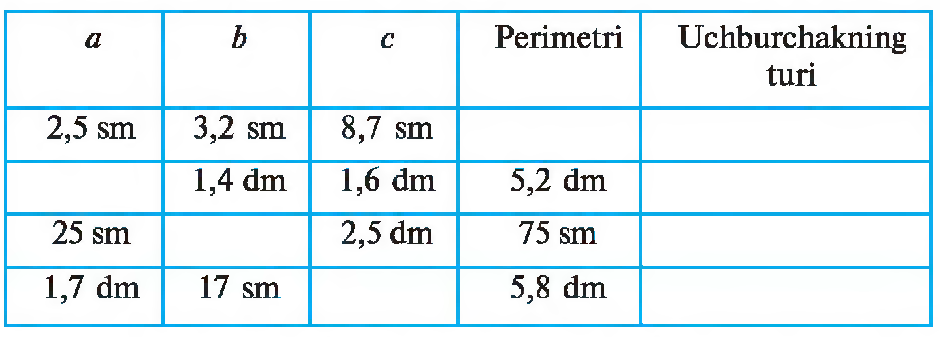
Jadvalni to‘ldiring
mavjud emas
$2,2$ dm
turli tomonli
$25$ sm
teng tomonli
$2,4$ dm
teng yonli

Slide 6
Masalalar yechish
$ABC$ uchburchakning $AC$ tomoniga parallel to‘g‘ri chiziq $AB$ va $BC$ tomonlarni mos ravishda $E$ va $F$ nuqtalarda kesib o‘tadi. Agar $∠BEF=65°$ va $∠EFC=135°$ bo‘lsa, $ABC$ uchburchak burchaklarini toping.
$$AC∥EF,$$
$$∠BEF=65°,$$
$$∠EFC=135°$$
$$B$$
$∠A=?,$
$∠B=?,$
$∠C=?$
$$∠EFB=180°−135°=45°$$
$$70°$$
$$AC∥EF=>\left[\begin{aligned}∠A=∠BEF \\ ∠C=∠EFB\end{aligned}\right.=>\left[\begin{aligned}∠A=65° \\ ∠C=45°\end{aligned}\right.$$
$$65°$$
$$45°$$
$$E$$
$$F$$
$$135°$$
$$∠B=180°−∠A−∠C$$
$$65°$$
$$45°$$
$$∠B=180°−65°−45°=70°$$
$$A$$
$$C$$
$$∠A=65°,∠B=70°,∠C=45°$$

Slide 7
Uchburchak medianasi
$$B$$
Uchburchakning biror uchini shu uch qarshisidagi tomonning o‘rtasi bilan tutashtiruvchi kesma uchburchakning medianasi deb ataladi.
$$E$$
$$F$$
mediana
Mediana $m$ bilan belgilanadi.
$$A$$
$$D$$
$$C$$
Uchburchakning uchta medianasi mavjud va ular bir nuqtada kesishadi.

Slide 8
Uchburchak bissektrisasi
$$B$$
Uchburchakning biror uchidan chiqib, shu chiqqan burchakni teng ikkiga bo‘luvchi nur uchburchakning bissektrisasi deb ataladi.
$$E$$
$$F$$
bissektrisa
Bissektrisa $l$ bilan belgilanadi.
$$A$$
$$D$$
$$C$$
Uchburchakning uchta bissektrisasi mavjud va ular bir nuqtada kesishadi.

Slide 9
Uchburchak balandligi
$$B$$
Uchburchakning uchidan shu uch qarshisidagi tomon yotgan to‘g‘ri chiziqqa tushirilgan perpendikulyar uchburchakning balandligi deb ataladi.
$$∟$$
$$F$$
$$E$$
$$∟$$
balandlik
Balandlik $h$ bilan belgilanadi.
$$∟$$
$$A$$
$$D$$
$$C$$
Uchburchakning uchta balandligi mavjud. O‘tkir burchakli uchburchakda ular bir nuqtada kesishadi.

Slide 10
Uchburchak balandligi
$$B$$
To‘g‘ri burchakli uchburchakning katetlari uning ham balandliklari bo‘ladi. Uchta balandlik uchburchakning uchida kesishadi.
$$F$$
$$∟$$
$$B$$
$$∟$$
$$F$$
$$A$$
$$C$$
$$∟$$
$$∟$$
$$C$$
O‘tmas burchakli uchburchakning o‘tkir burchaklaridan chiqqan balandliklar uchburchakning tashqi sohasida yotadi.
$$E$$
$$A$$
$$∟$$
$$D$$

Slide 11
Masalalar yechish
Teng yonli uchburchakning yon tomoniga tushirilgan balandligi bilan ikkinchi yon tomoni orasidagi burchak $20°$ ga teng. Teng yonli uchburchakning asosidagi burchagini toping.
$$B$$
$$AB=BC, ∠BAD=20°$$
$$∠A=∠C=?$$
$$∟$$
$$D$$
$$∆ABD => ∠B=90°−20°=70°$$
$$∠A+∠B+∠C=180°$$
$$∠A+∠A+70°=180°$$
$$A$$
$$C$$
$$2∙∠A=110°$$
$$∠A=55°$$

Slide 12
Masalalar yechish
$ABC$ uchburchakning balandliklari $H$ nuqtada kesishadi. Agar $∠A=50°$ va $∠B=60°$ bo‘lsa, $AHB, BHC$ va $CHA$ burchaklarni toping.
$$∠C=180°−50°−60°=70°$$
$$C$$
$$C$$
$$∠BCD=90°−60°=30°, ∠ACD=40°$$
$$70°$$
$$∠ABF=90°−50°=40°, ∠CBF=20°$$
$$40°$$
$$F$$
$$30°$$
$$∟$$
$$E$$
$$∠CAE=90°−70°=20°, ∠EAB=30°$$
$$∟$$
$$H$$
$$H$$
$$∠AHB=180°−30°−40°=110°$$
$$20°$$
$$20°$$
$$60°$$
$$50°$$
$$∠BHC=180°−30°−20°=130°$$
$$40°$$
$$∟$$
$$30°$$
$$B$$
$$A$$
$$B$$
$$D$$
$$A$$
$$∠AHC=180°−20°−40°=120°$$

Slide 13
Trigonometrik funksiyalar
$$\cos{α}=\frac{b}{c}$$
$$\sin{α}=\frac{a}{c}$$
$$ctgα=\frac{b}{a}$$
$$tgα=\frac{a}{b}$$
$$c$$
$$a$$
$$tgα=\frac{\sin{α}}{\cos{α}}$$
$$ctgα=\frac{\cos{α}}{\sin{α}}$$
$$α$$
$$∟$$
$$b$$

Slide 14
Masalalar yechish
$ABC$ uchburchakda $∠C=90°, AB=10 cm, BC=8 cm, AC=6 cm$. $A$ burchakning trigonometrik funksiyalari qiymatlarini toping.
$$B$$
$$\sin{A}=\frac{BC}{AB}=\frac{8}{10}=0,8$$
$$\cos{A}=\frac{AC}{AB}=\frac{6}{10}=0,6$$
$$c=10 cm$$
$$a=8 cm$$
$$tgA=\frac{BC}{AC}=\frac{8}{6}=\frac{4}{3}=1\frac{1}{3}$$
$$∟$$
$$C$$
$$A$$
$$ctgA=\frac{AC}{BC}=\frac{6}{8}=\frac{3}{4}$$
$$b=6 cm$$

Slide 15
Masalalar yechish
$ABC$ uchburchakda $∠C=90°$ ga teng. Agar $BC=4 cm$ va $\sin{A}=0,25$ bo‘lsa, $AB$ gipotenuzani hisoblang.
$$B$$
$$\sin{A}=\frac{BC}{AB}$$
$$0,25=\frac{4}{AB}$$
$$AB=\frac{4}{0,25}=\frac{400}{25}=16$$
$$∟$$
$$C$$
$$A$$

Slide 16
Trigonometrik ayniyatlar
$$\sin^{2}{α}+\cos^{2}{α}=1$$
$$tgα∙ctgα=1$$
$$1+{tg}^{2}{α}=\frac{1}{\cos^{2}{α}}$$
$$c$$
$$a$$
$$1+{ctg}^{2}{α}=\frac{1}{\sin^{2}{α}}$$
$$α$$
$$\sin{α}=\sqrt{1−\cos^{2}{α}}$$
$$∟$$
$$b$$
$$\cos{α}=\sqrt{1−\sin^{2}{α}}$$

Slide 17
Masalalar yechish
Agar $\cos{α=\frac{2}{3}}$ bo‘lsa, $\sin{α}$, $\operatorname{tg}{α}$, $\operatorname{ctg}{α}$ ning qiymatlarini hisoblang.
$$\sin{α}=\sqrt{1−{\left(\frac{2}{3}\right)}^{2}}=\sqrt{1−\frac{4}{9}}=\sqrt{\frac{5}{9}}=\frac{\sqrt{5}}{3}$$
$$\sin{α}=\sqrt{1−\cos^{2}{α}}$$
$$tgα=\frac{\sqrt{5}}{3}:\frac{2}{3}=\frac{\sqrt{5}}{3}∙\frac{3}{2}=\frac{\sqrt{5}}{2}$$
$$tgα=\frac{\sin{α}}{\cos{α}}$$
$$ctgα=\frac{2}{3}:\frac{\sqrt{5}}{3}=\frac{2}{3}∙\frac{3}{\sqrt{5}}=\frac{2}{\sqrt{5}}=\frac{2\sqrt{5}}{5}$$
$$ctgα=\frac{\cos{α}}{\sin{α}}$$

Slide 18
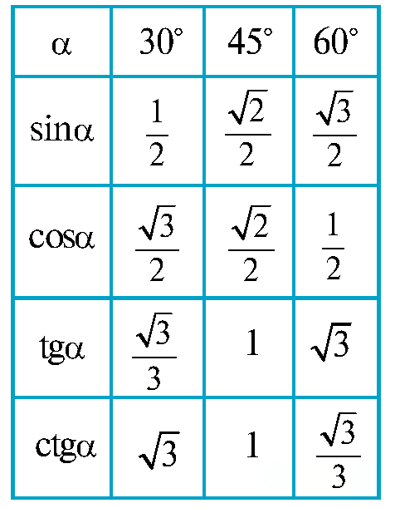
Trigonometrik funksiyalar
$$c$$
$$a$$
$$α$$
$$∟$$
$$b$$

Slide 19
Masalalar yechish
To‘g‘ri burchakli $ABC$ uchburchakning$AB$ gipotenuzasi $4\sqrt{3}$ cm va $∠A=60°$. Shu uchburchakning katetlarini toping.
$$\sin{A}=\frac{BC}{AB}$$
$$\sin{60°}=\frac{BC}{4\sqrt{3}}$$
$$\frac{\sqrt{3}}{2}=\frac{BC}{4\sqrt{3}}$$
$$B$$
$$BC=\frac{\sqrt{3}∙4\sqrt{3}}{2}=6$$
$$4\sqrt{3} cm$$
$6$ cm
$$\cos{A}=\frac{AC}{AB}$$
$$\cos{60°}=\frac{AC}{4\sqrt{3}}$$
$$\frac{1}{2}=\frac{AC}{4\sqrt{3}}$$
$$60°$$
$$AC=\frac{1∙4\sqrt{3}}{2}=2\sqrt{3}$$
$$∟$$
$$C$$
$$A$$
$2\sqrt{3}$ cm

Slide 20
Mustaqil bajarish uchun topshiriqlar
Darslikning
7 betidagi 5, 7, 8, 9, 11 mashqlar;

Slide 21
E’TIBORINGIZ UCHUN RAHMAT!
ARALASHMAGA OID MASALALAR

