Slide 1
Algebra
9-sinf
Mavzu:
Misollar yechish

Slide 2
Mustaqil bajarish uchun berilgan mashqlarni tekshirish
404-mashq. Agar geometrik progressiyada: 2) $S_{n}=635,$ $q=2$, $b_{1}=5$ bo‘lsa, uning hadlari sonini toping.
$$S_{n}=\frac{b_{1}(1−q^{n})}{(1−q)}$$
$$635=\frac{5\left(1−2^{n}\right)}{1−2}$$
$$−635=5\left(1−2^{n}\right)$$
$$−127=1−2^{n}$$
$$2^{n}=2^{7}$$
$$n=7$$

Slide 3
Mustaqil bajarish uchun berilgan mashqlarni tekshirish
405-mashq. Agar geometrik progressiyada: 2) $S_{n}=4088,$ $q=2$, $b_{1}=8$ bo‘lsa, $n$ va $b_{n}$ ni toping.
$$S_{n}=\frac{b_{1}(1−q^{n})}{(1−q)}$$
$$4088=\frac{8\left(1−2^{n}\right)}{1−2}$$
$$−4088=8\left(1−2^{n}\right)$$
$$−511=1−2^{n}$$
$$2^{n}=512$$
$b_{8}=b_{1}∙q^{7}=8∙128=1024$
$$n=8$$
$$2^{n}=2^{8}$$

Slide 4
Mustaqil bajarish uchun berilgan mashqlarni tekshirish
406-mashq. Agar sonlar yig‘indisining qo‘shiluvchilari geometrik progressiyaning ketma-ket hadlari bo‘lsa, shu yig‘indini toping. $2) 1+3+9+…+243$
$$b_{1}=1$$
$$b_{2}=3$$
$$b_{n}=243$$
$$b_{n}=b_{1}∙q^{n−1}$$
$$q=3$$
$$243=1∙3^{n−1}$$
$$3^{5}=3^{n−1}$$
$$n−1=5$$
$$n=6$$
$$S_{n}=\frac{b_{1}(1−q^{n})}{(1−q)}=\frac{1(1−3^{6})}{(1−3)}=364$$

Slide 5
Misollar yechish
1-misol. Teng yonli uchburchakning uchidagi burchagining tangensi $2\sqrt{2}$ ga teng. Shu burchakning kosinusini toping.
$$Yechish:$$
$$y$$
$$tgα$$
$$α$$
$${90}^{0}$$
$$\cos^{2}α=\frac{1}{{tg}^{2}α+1}$$
$$tgα=2\sqrt{2}$$
$$−$$
$$+$$
$${180}^{0}$$
$$0^{0}$$
$$x$$
$$\cos^{2}α=\frac{1}{{tg}^{2}α+1}=\frac{1}{8+1}=\frac{1}{9}$$
$$+$$
$$−$$
$${360}^{0}$$
$$cosα=\sqrt{\frac{1}{9}}=\frac{1}{3}$$
$${270}^{0}$$

Slide 6
Misollar yechish
2-misol. $Agar sinα−cosα=0.8$bo‘lsa, $sinαcosα$ ning qiymatini toping.
$$Yechish:$$
$${(a−b)}^{2}=a^{2}−2ab+b^{2}$$
$${(sinα−cosα)}^{2}=\sin^{2}α−2sinαcosα+\cos^{2}α$$
$${(0.8)}^{2}=1−2sinαcosα$$
$2sinαcosα=1−0.64$ $sinαcosα=0.$16

Slide 7
Misollar yechish
3-misol. Ifodani soddalashtiring:
$$1) tg\left(−α\right)cosα+sinα; 3)\frac{\cos\left(−α\right)+sin⁡(−α)}{\cos^{2}α−\sin^{2}α}.$$
$$Yechish:$$
$$1) tg\left(−α\right)cosα+sinα=−tgα∙cosα+sinα=−\frac{sinα}{cosα}∙cosα+sinα==−sinα+sinα=0$$
$$3)\frac{\cos\left(−α\right)+sin⁡(−α)}{\cos^{2}α−\sin^{2}α}=\frac{cosα−sinα}{(cosα+sinα)(cosα−sinα)}==\frac{1}{(cosα+sinα)}$$

Slide 8
Misollar yechish
4-misol. Ifodani soddalashtiring: $\frac{sinαcosα}{1−2\sin^{2}α}$
$\frac{sinαcosα}{1−2\sin^{2}α}=\frac{sinαcosα}{\sin^{2}α+\cos^{2}α−2\sin^{2}α}=\frac{sinαcosα}{\cos^{2}α−\sin^{2}α}= \frac{2sinαcosα}{2\left(\cos^{2}α−\sin^{2}α\right)}= =\frac{sin2α}{2cos2α}=\frac{1}{2}tg2α$
5-misol. Agar $tgα=\frac{1}{2}$ bo‘lsa, $tg2α$ ni hisoblang.
$$tg2α=\frac{2tgα}{1−{tg}^{2}α}=\frac{2∙\frac{1}{2}}{1−{\left(\frac{1}{2}\right)}^{2}}=\frac{1}{1−\frac{1}{4}}=\frac{1}{\frac{3}{4}}=\frac{4}{3}=1\frac{1}{3}$$

Slide 9
Misollar yechish
6-misol. Uchburchakning ikkita burchagi yig‘indisining sinusi uchinchi burchagining sinusiga tengligini isbotlang.
Yechish.
$$α$$
$$\sin\left(α+β\right)=sinγ$$
$$α+β+γ={180}^{0}$$
$$α+β={180}^{0}−γ$$
$$β$$
$$γ$$
$$sin(α+β)=sin({180}^{0}−γ)$$
$$\sin\left({180}^{0}−γ \right)=sinγ$$
$$sin(α+β)=sinγ$$

Slide 10
Misollar yechish
7-misol. Sonli ketma-ketlik $b_{n+2}=b_{n+1}+b_{n }$rekkurent formula va $b_{1}=1$, $b_{2}=3$shartlar yordamida berilgan.
Bu ketma-ketlikning oltinchi hadini toping.
Yechish.
$$b_{3}=b_{2}+b_{1}=3+1=4.$$
$$b_{4}=b_{3}+b_{2}=4+3=7.$$
$$b_{5}=b_{4}+b_{3}=7+4=11.$$
$$b_{6}=b_{5}+b_{4}=11+7=18.$$
Javob:${ b}_{6}=18$

Slide 11
Mustaqil bajarish uchun topshiriqlar
Darslikning 170-sahifasidagi
405-406-mashqlarning 4-tartibdagi misollarini yechish.

Slide 12
Algebra
10-sinf
Mavzu:
Misollar yechish

Slide 13
Mustaqil bajarish uchun berilgan mashqlarni tekshirish
183-mashq. Tengsizlikni yeching:
$8) 3∙5^{x+3}−5^{x+2}−{2∙5}^{x+1}<68$; ${12) 3}^{x^{2}−4x}<3^{2(x^{2}−15)}$
$${ 3}^{x^{2}−4x}<3^{2(x^{2}−15)}$$
$$x^{2}−4x<{2(x}^{2}−15)$$
$$x^{2}−{2x}^{2}−4x+30<0$$
$$−x^{2}−4x+30<0$$
$$x^{2}+4x−30>0$$
$$\left(x+2−\sqrt{34}\right)\left(x+2+\sqrt{34}\right)>0$$
$$3∙5^{x+3}−5^{x+2}−{2∙5}^{x+1}<68$$
$${3∙5}^{x}∙5^{3}−5^{x}∙5^{2}−2∙5^{x}∙5<68$$
$$5^{x}∙\left(3∙125−25−10\right)<68$$
$$5^{x}∙340<68$$
$5^{x}<\frac{1}{5} 5^{x}5^{−1}$
$$x<−1$$
$$Javob:xε\left(−∞;−1\right)$$
$$Javob:xε\left(−∞;−2−\sqrt{34}\right)∪\left(−2+\sqrt{34};+∞\right)$$

Slide 14
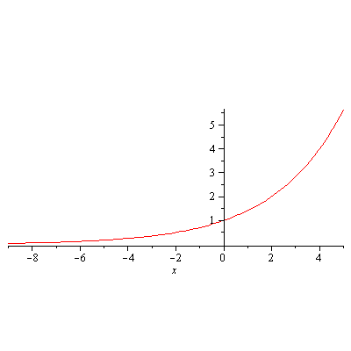
Misollar yechish
1-misol. Funksiyaning o‘suvchi yoki kamayuvchi ekanligini aniqlang: $y={\left(\sqrt{2}\right)}^{x}$
$$\sqrt{2}≈1,41$$
Demak, $a=1,41$ va $y={1,41}^{x} −$ o‘suvchi

Slide 15
Misollar yechish
2-misol. Tengsizlikni yeching:
$1) 9^{x}+3^{x}−6≤84;$ $2) {25}^{x}+5^{x}−30>0.$
$$1) 9^{x}+3^{x}−6≤84$$
$$3^{2x}+3^{x}−90≤0$$
$$3^{x}=t$$
$$t^{2}+t−90≤0$$
$t_{1}=9 t_{2}=−10$
$$3^{x}≤9 3^{x}≥−10$$
$$3^{x}≤3^{2}$$
$$x≤2$$
$$2) {25}^{x}+5^{x}−30>0$$
$$5^{2x}+5^{x}−30>0$$
$$5^{x}=a$$
$$a^{2}+a−30>0$$
$a_{1}=5 a_{2}=−$6
$5^{x}>5 5^{x}<−6$
$$5^{x}>5^{1}$$
$$x>1$$
Javob: $x∈(−∞;2]$
$$\text{Javob}\text{:} x∈\left(1;+∞\right)$$

Slide 16
Misollar yechish
3-misol. Tengsizlikni yeching:
$$\frac{3−x}{\sqrt{15−x}}<1$$
Yechish.
$$\sqrt{15−x}=t, t>0$$
$$\left\{\begin{aligned}t^{2}−t−12<0 \\ t>0\end{aligned}\right.$$
$x ni topamiz:$
$$0<\sqrt{15−x}<4$$
$$x=15−t^{2}$$
$$\left\{\begin{aligned}\frac{3−(15−t^{2}\text{)}}{t}<1 \\ t>0\end{aligned}\right.$$
$$\left\{\begin{aligned}\left(t−4\right)(t+3)<0 \\ t>0\end{aligned}\right.$$
$$0<15−x<16$$
$$−1<x<15$$
$$0<t<4$$
Javob: $x∈(−1;15)$

Slide 17
Bir o‘zgaruvchili irratsional tengsizliklar
Misollar yechish
4-misol. Agar $f\left(x\right)=3x−x^{2}+2$ bo‘lsa, quydagi qiymatlarni toping:
$A)f\left(0\right);$ $B)f\left(3\right);$ $C)f\left(−3\right);$ $D)f\left(−7\right);$
Yechish.
$$A) f\left(0\right)=3∙0−0^{2}+2=0+2=2$$
B$) f\left(3\right)=3∙3−3^{2}+2=9−9+2=0+2=2$
C$) f\left(−3\right)=3∙(−3)−(−{3)}^{2}+2=−9−9+2=−16$
D$) f\left(−7\right)=3∙(−7)−(−{7)}^{2}+2=−21−49+2=−68$

Slide 18
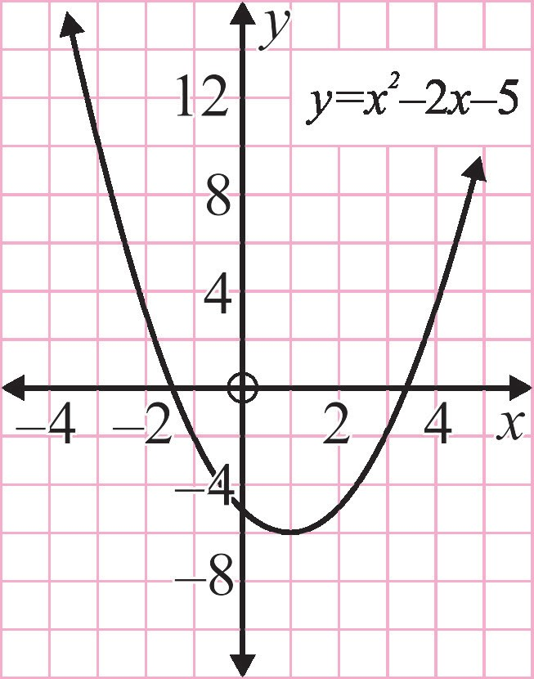
Misollar yechish
5-misol. $y=x^{2}−2x−5$kvadrat funksiya grafigini yasang.
Yechish
Funksiyaning bitta nuqtadagi, masalan $x=−3$ nuqtasidagi qiymatini topaylik:
$f={(−3)}^{2}−2∙\left(−3\right)−5=10$.
Funksiyaning bir nechta nuqtadagi qiymatini topib, jadvalni tuzamiz:
x | −3 | −2 | −1 | 0 | 1 | 2 | 3
y | 10 | 3 | −2 | −5 | −6 | −5 | −2

Slide 19
Bir o‘zgaruvchili irratsional tengsizliklar
Misollar yechish
6-misol. Moddiy nuqtaning koordinatalari parametrik ko‘rinishda berilgan. Bu moddiy nuqta harakati davomida chizgan chiziqning (moddiy nuqta trayektoriyasining) formulasini toping.
$$\left\{\begin{aligned}x=3t+1 \\ y=4t+8\end{aligned}\right.$$
Tenglamalardan $t$ parametrni topamiz:$t=\frac{x−1}{3} va t=\frac{y−8}{4}$
$$\frac{x−1}{3}=\frac{y−8}{4}$$
$$t=t$$
$$4x−4=3y−24$$
$$y=\frac{4}{3}x+\frac{20}{3}$$
$$4x−3y+20=0$$
$$3y=4x+20$$

Slide 20
Mustaqil yechish uchun topshiriqlar
Darslik II qismining 56-sahifasidagi 183-184-mashqning 2,4-tartibli misollarini yechish

