Slide 1
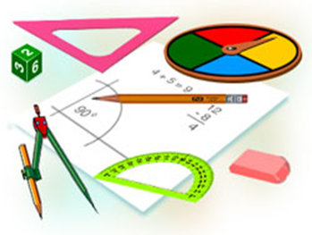
Algebra
9-sinf
Mavzu:
Keltirish formulalari

Slide 2
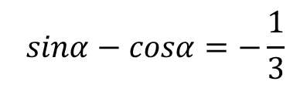
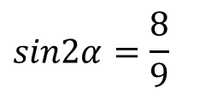


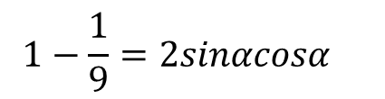

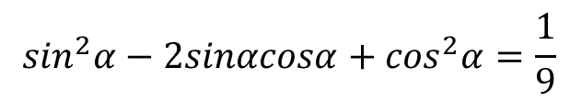
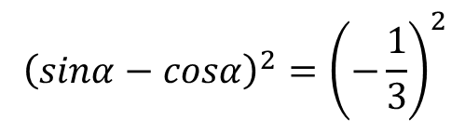
Mustaqil bajarish uchun berilgan mashqlarni tekshirish
299-mashq. Ayniyatni isbotlang.
$$2) {\left(sinα−cosα\right)}^{2}=1−sin2α\text{;}$$
Yechish.
$$2) {\left(sinα−cosα\right)}^{2}=1−sin2α\text{;}$$
$$1−2sinαcosα=1−sin2α$$
$$\sin^{2}α−2sinαcosα+\cos^{2}α=1−sin2α$$
$$1−sin2α=1−sin2α$$
300-mashq. Agar $sinα−cosα=−\frac{1}{3}$ bo‘lsa, $sin2α$ ni hisoblang.
Yechish.
$$\sin^{2}α−2sinαcosα+\cos^{2}α=\frac{1}{9}$$
$$sinα−cosα=−\frac{1}{3}$$
$$1−\frac{1}{9}=2sinαcosα$$
$${\left(sinα−cosα\right)}^{2}={\left(−\frac{1}{3}\right)}^{2}$$
$$sin2α=\frac{8}{9}$$

Slide 3
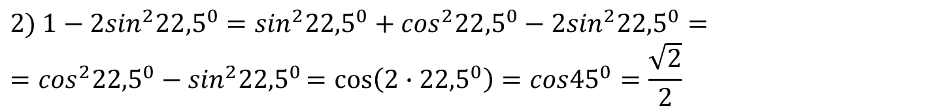





Mustaqil bajarish uchun berilgan mashqlarni tekshirish
301-mashq. Ayniyatni isbotlang.
$2) 1−cos2α={2sin}^{2}α$.
Yechish.
$$2) 1−cos2α={2sin}^{2}α$$
$$\cos^{2}α+\sin^{2}α−\cos^{2}α+\sin^{2}α={2sin}^{2}α$$
$$1−{(cos}^{2}α−\sin^{2}α)={2sin}^{2}α$$
$$2\sin^{2}α={2sin}^{2}α$$
302-mashq. Hisoblang.
$$2) 1−{2sin}^{2}{22,5}^{0}$$
Yechish.
$$2) 1−{2sin}^{2}{22,5}^{0}=\sin^{2}{22,5}^{0}+\cos^{2}{22,5}^{0}−{2sin}^{2}{22,5}^{0}==\cos^{2}{22,5}^{0}−\sin^{2}{22,5}^{0}=cos\left(2∙{22,5}^{0}\right)=cos{45}^{0}=\frac{\sqrt{2}}{2}$$

Slide 4












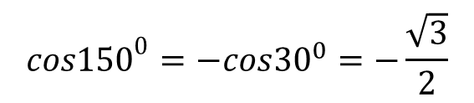


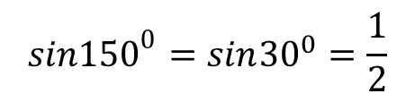






Keltirish formulalari
1-misol. $sin{870}^{0}va cos{870}^{0}$ ni hisoblang.
Yechish.
$${870}^{0}=2∙{360}^{0}+{150}^{0}$$
$${sin150}^{0}=sin{30}^{0}=\frac{1}{2}$$
$${sin{870}^{0}=sin150}^{0}$$
$${cos{870}^{0}=cos150}^{0}$$
$${cos150}^{0}=−cos{30}^{0}=−\frac{\sqrt{3}}{2}$$
$$y$$
$$y_{1}=y_{2}$$
$$y$$
$$M_{1}$$
$$x_{1}=−x_{2}$$
$$M_{1}$$
$$M_{2}$$
$${150}^{0}$$
$${150}^{0}$$
$$P(1;0)$$
$$x$$
$$P(1;0)$$
$$x$$
$${30}^{0}$$
$${30}^{0}$$
$$O$$
$${870}^{0}$$

Slide 5






Keltirish formulalari
1-misolni yechishda quyidagi tengliklardan foydalaniladi:
$${sin{870}^{0}=sin⁡(2∙{360}^{0}+150}^{0})=sin{150}^{0}$$
$$(1)$$
$${cos{870}^{0}=cos⁡(2∙{360}^{0}+150}^{0})=cos{150}^{0}$$
$${sin⁡({180}^{0}−30}^{0})=sin{30}^{0}$$
$$(2)$$
$${cos⁡({180}^{0}−30}^{0})=−cos{30}^{0}$$
$sin⁡(α+2πk)=sinα$, $\cos\left(α+2πk\right)=cosα, kεZ$ (3)
$$k=1$$
$sin⁡(α+2π)=sinα$, $\cos\left(α+2π\right)=cosα$

Slide 6

Keltirish formulalari
(2) tenglik quyidagi formulaning xususiy holi hisoblanadi.
$sin⁡(π−α)=sinα$, $\cos\left(π−α\right)=−cosα,$ (4)
$sin⁡(π−α)=sinα$ va $cos\left(π−α\right)=−cosα$
formulalarni isbot qilamiz.
$$sin⁡(π−α)=sinπcosα−cosπsinα=0∙cosα−(−1)∙sinα=sinα$$
$$cos\left(π−α\right)=cosπsinα−cosαsinπ=−1∙cosα−0∙sinα=−cosα$$
(4) tenglik formulalar keltirish formulalari deyiladi.

Slide 7
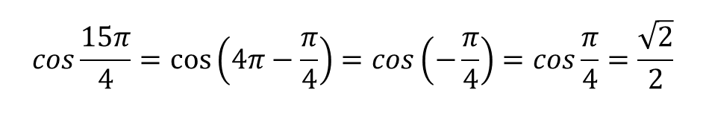


Keltirish formulalari
2-misol. $sin{930}^{0}$ ni hisoblang.
Yechish.
(3) formulaga ko‘ra: ${sin{930}^{0}=sin⁡(3∙{360}^{0}−150}^{0})=sin{(−150}^{0})$
$$\sin\left(−α\right)=−sinα$$
$$sin{(−150}^{0})=−sin{150}^{0}$$
(4) formulaga bo‘yicha: $−sin{150}^{0}=−\sin\left({180}^{0}−{30}^{0}\right)=−sin{30}^{0}=−\frac{1}{2}$
3-misol. $cos\frac{15π}{4}$ ni hisoblang.
Yechish.
$$cos\frac{15π}{4}=\cos\left(4π−\frac{π}{4}\right)=cos\left(−\frac{π}{4}\right)=cos\frac{π}{4}=\frac{\sqrt{2}}{2}$$

Slide 8
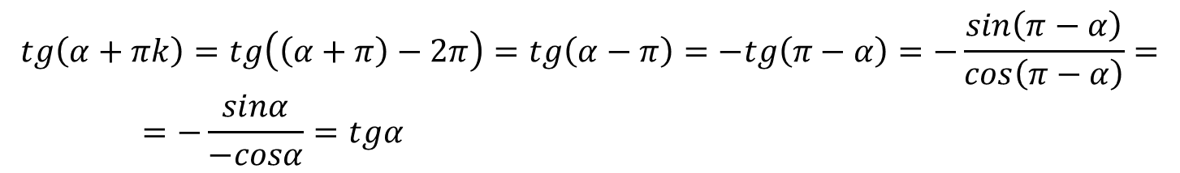
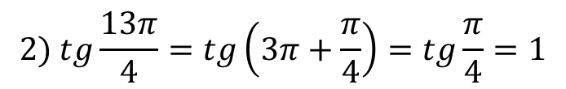
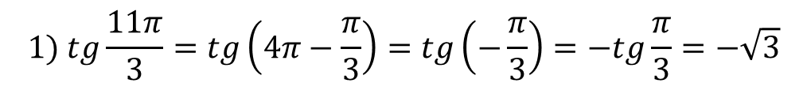


Keltirish formulalari
$tg⁡(α+πk)=tgα$, $\operatorname{ctg}\left(α+πk\right)=ctgα, kεZ$ (5)
$$\operatorname{tg}\left(α+πk\right)=tg\left(\left(α+π\right)−2π\right)=tg\left(α−π\right)=−tg\left(π−α\right)=−\frac{sin\left(π−α\right)}{cos\left(π−α\right)}==−\frac{sinα}{−cosα}=tgα$$
4-misol. Hisoblang:
$$1) tg\frac{11π}{3};$$
$$2) tg\frac{13π}{4}.$$
$$1) tg\frac{11π}{3}=tg\left(4π−\frac{π}{3}\right)=tg\left(−\frac{π}{3}\right)=−tg\frac{π}{3}=−\sqrt{3}$$
$$2) tg\frac{13π}{4}=tg\left(3π+\frac{π}{4}\right)=tg\frac{π}{4}=1$$

Slide 9

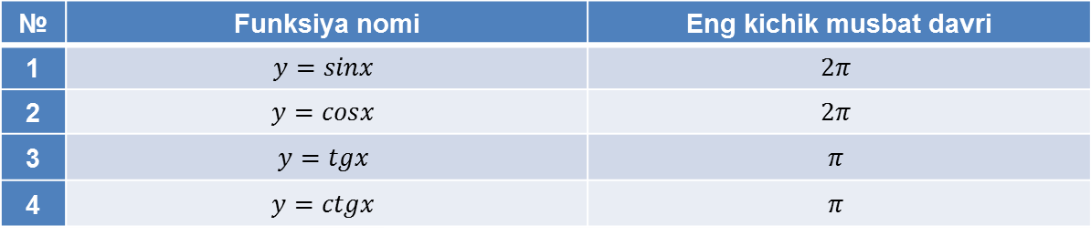
Keltirish formulalari
$sin⁡(α+2πk)=sinα$, $\cos\left(α+2πk\right)=cosα, kεZ$ (3)
$sin⁡(π−α)=sinα$, $\cos\left(π−α\right)=−cosα,$ (4)
$tg⁡(α+πk)=tgα$, $\operatorname{ctg}\left(α+πk\right)=ctgα, kεZ$ (5)
$sin\left(\frac{π}{2}−α\right)=cosα$, $\cos\left(\frac{π}{2}−α\right)=sinα$
Yodda saqlang!
№ | Funksiya nomi | Eng kichik musbat davri
1 | $$y=sinx$$ | $$2π$$
2 | $$y=cosx$$ | $$2π$$
3 | $$y=tgx$$ | $$π$$
4 | $$y=ctgx$$ | $$π$$

Slide 10
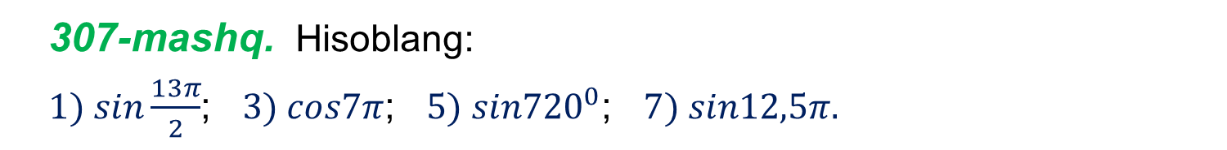
Misollar yechish
307-mashq. Hisoblang:
$1) sin\frac{13π}{2}$; $3) cos7π$; $5) sin{720}^{0}$; $7) sin12,5π.$
Yechish.
$$1) sin\frac{13π}{2}=\sin\left(3∙2π+\frac{π}{2}\right)=sin\frac{π}{2}=1$$
$3) cos7π=\cos\left(3∙2π+π\right)=cosπ=−1$
$5) sin{720}^{0}=\sin\left(2∙{360}^{0}+0^{0}\right)=sin0^{0}=0$
$$7) sin12,5π=sin\left(12∙2π+\frac{π}{2}\right)=sin\frac{π}{2}=1$$

Slide 11
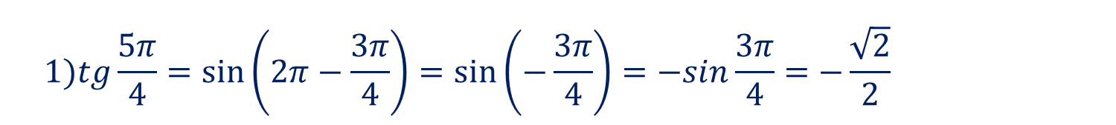
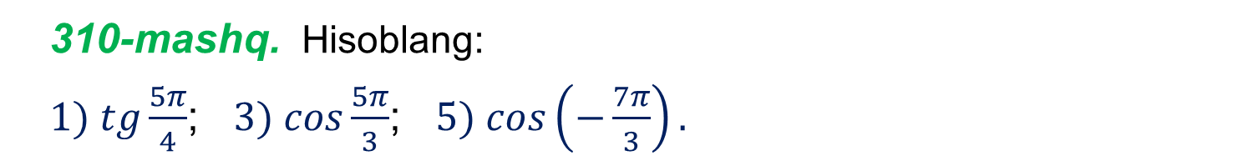
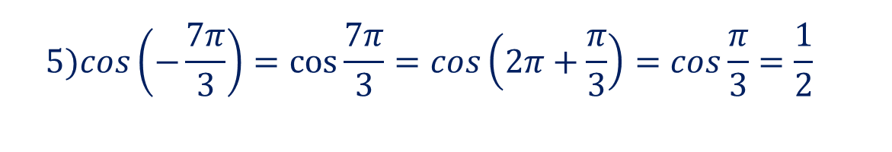
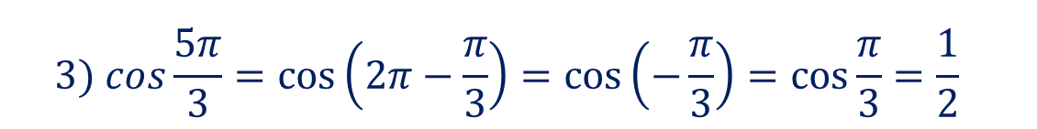
Misollar yechish
310-mashq. Hisoblang:
$1) tg\frac{5π}{4}$; $3) cos\frac{5π}{3}$; $5) cos\left(−\frac{7π}{3}\right).$
Yechish.
$$1)tg\frac{5π}{4}=\sin\left(2π−\frac{3π}{4}\right)=\sin\left(−\frac{3π}{4}\right)=−sin\frac{3π}{4}=−\frac{\sqrt{2}}{2}$$
$$3) cos\frac{5π}{3}=\cos\left(2π−\frac{π}{3}\right)=\cos\left(−\frac{π}{3}\right)=\cos{\frac{π}{3}}=\frac{1}{2}$$
$$5)cos\left(−\frac{7π}{3}\right)=cos\frac{7π}{3}=cos\left(2π+\frac{π}{3}\right)=cos\frac{π}{3}=\frac{1}{2}$$

Slide 12


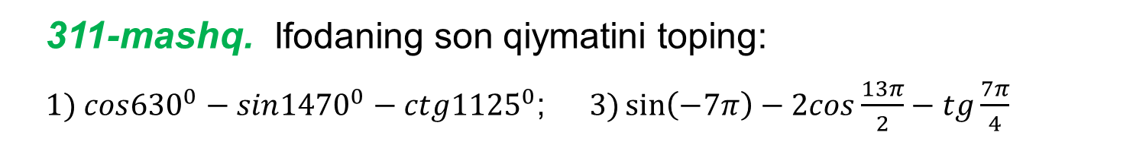
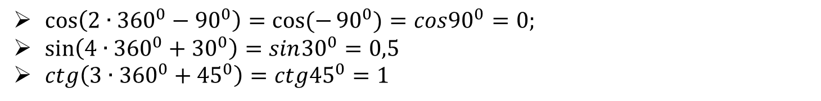
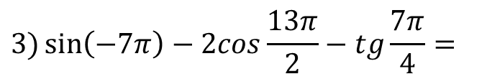
Misollar yechish
311-mashq. Ifodaning son qiymatini toping:
$1) cos{630}^{0}−sin{1470}^{0}−ctg{1125}^{0}$; $3)\sin\left(−7π\right)−2cos\frac{13π}{2}−tg\frac{7π}{4}$
Yechish.
$$1) cos{630}^{0}−sin{1470}^{0}−ctg{1125}^{0}=$$
$$0−0,5−1=−1,5$$
$\cos\left(2∙{360}^{0}−{90}^{0}\right)=cos⁡(−{90}^{0})=cos{90}^{0}=0;$
$\sin\left(4∙{360}^{0}+{30}^{0}\right)=sin{30}^{0}=0,5$
$ctg\left(3∙{360}^{0}+{45}^{0}\right)=ctg{45}^{0}=1$
$$3)\sin\left(−7π\right)−2cos\frac{13π}{2}−tg\frac{7π}{4}=$$
$$0−2∙0−\left(−1\right)=1$$
$\sin\left(−7π\right)=−sin7π=−\sin\left(3∙2π+π\right)=−sinπ=0$
$cos\frac{13π}{2}=\cos\left(3∙2π+\frac{π}{2}\right)=cos\frac{π}{2}=0;$ $tg\frac{7π}{4}=tg\left(2π−\frac{π}{4}\right)=tg\left(−\frac{π}{4}\right)=−1$

Slide 13

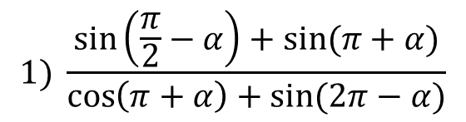
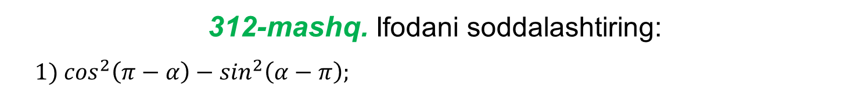

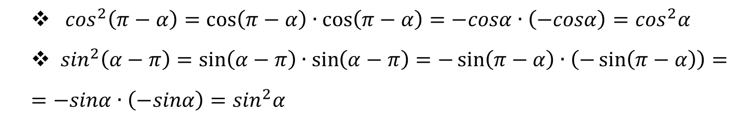
Misollar yechish
312-mashq. Ifodani soddalashtiring:
$$1) \cos^{2}\left(π−α\right)−\sin^{2}\left(α−π\right);$$
Yechish.
$$1) \cos^{2}\left(π−α\right)−\sin^{2}\left(α−π\right)$$
$$= \cos^{2}α−\sin^{2}α=cos2α$$
$\cos^{2}\left(π−α\right)=\cos\left(π−α\right)∙\cos\left(π−α\right)=−cosα∙\left(−cosα\right)=\cos^{2}α$
$\sin^{2}\left(α−π\right)=\sin\left(α−π\right)∙\sin\left(α−π\right)=−\sin\left(π−α\right)∙\left(−\sin\left(π−α\right)\right)=$
$$=−sinα∙\left(−sinα\right)=\sin^{2}α$$
314-mashq. Ifodani soddalashtiring:
$$1) \frac{\sin\left(\frac{π}{2}−α\right)+sin⁡(π+α)}{\cos\left(π+α\right)+sin⁡(2π−α)}$$

Slide 14
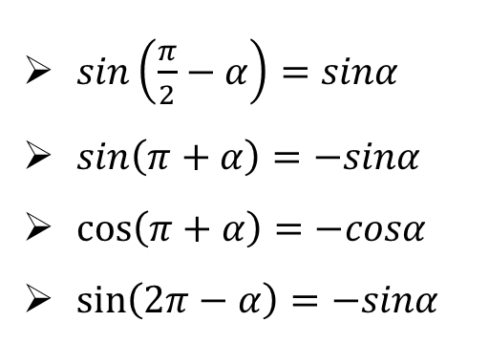
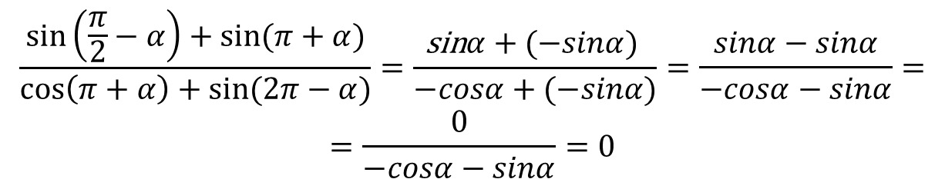
Misollar yechish
314-mashqning yechimi
$\sin\left(\frac{π}{2}−α\right)=sinα$
$\sin\left(π+α\right)=−sinα$
$\cos\left(π+α\right)=−cosα$
$\sin\left(2π−α\right)=−sinα$
$$\frac{\sin\left(\frac{π}{2}−α\right)+sin⁡(π+α)}{\cos\left(π+α\right)+sin⁡(2π−α)}=\frac{\text{sin}α+(−sinα) }{−cosα+(−sinα)}=\frac{sinα−sinα}{−cosα−sinα}=$$
$$=\frac{0}{−cosα−sinα}=0$$

Slide 15







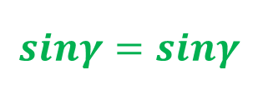
Misollar yechish
315-mashq. Uchburchakning ikkita burchagi yig‘indisining sinusi uchinchi burchagining sinusiga tengligini isbotlang.
Yechish.
$$α$$
$$\sin\left(α+β\right)=sinγ$$
$$α+β+γ={180}^{0}$$
$$α+β={180}^{0}−γ$$
$$β$$
$$γ$$
$$\sin\left({180}^{0}−γ \right)=sinγ$$
$$sinγ=sinγ$$

Slide 16

Mustaqil bajarish uchun topshiriqlar
Darslikning 133-sahifasidagi
307, 308, 309-mashqning 2-4-tartibdagi misollarini yechish.

