Slide 1

Fizika
9-sinf
Mavzu: Masalalar yechish.
O‘qituvchi:
Toshkent shahar Uchtepa tumani 287-maktab fizika fani o‘qituvchisi
Xo‘jayeva Maxtuma Ziyatovna.

Slide 2
$F=σl⇒σ=\frac{F}{l}$
𝐹=𝜎𝑙⇒𝜎=𝐹/𝑙
$$W=σS pufakda: W=2σS$$
𝑊=𝜎𝑆 𝑝𝑢𝑓𝑎𝑘𝑑𝑎: 𝑊=2𝜎𝑆
$h=\frac{2σ}{ρ_{s}gr}$
ℎ=2𝜎/(𝜌_𝑠 𝑔𝑟)

Slide 3

20-mashq 1-masala
Suv kapillyarda 14 mm ga ko‘tarilgan bo‘lsa, uning diametri qanday bo‘lgan?
$g=10 m/s^{2}$, $ρ_{s}={10}^{3}\frac{kg}{m^{3}},$ $σ=73∙{10}^{−3 }N/m$.

Slide 4
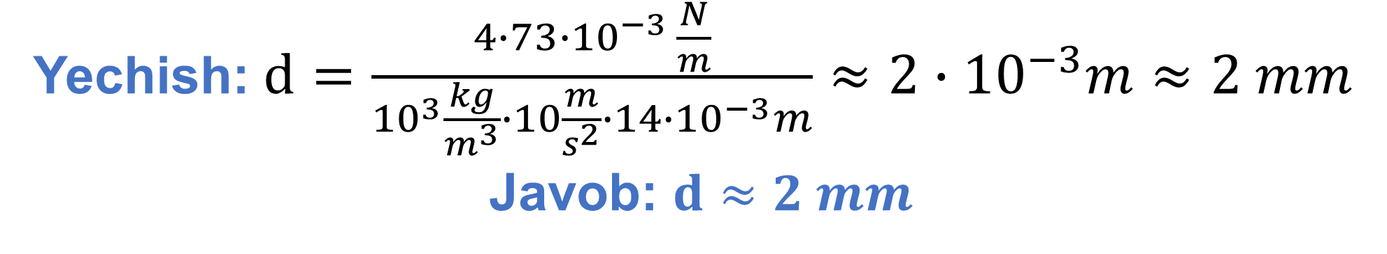
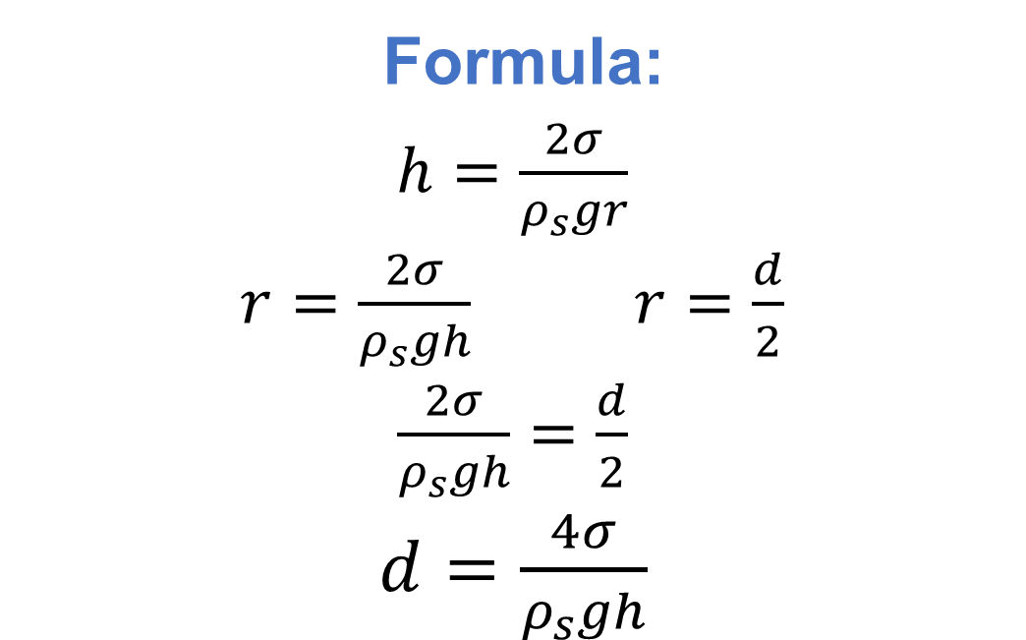
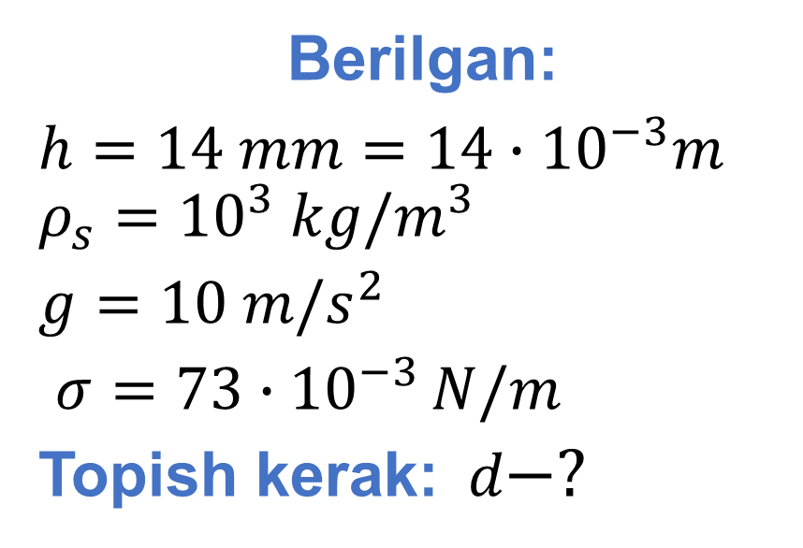
Berilgan:
$h=14 mm=14∙{10}^{−3}m$ $ρ_{s}={10}^{3} kg/m^{3}$
$g=10 m/s^{2}$
$σ=73∙{10}^{−3 }N/m$
Topish kerak:$d−?$
Formula:
$h=\frac{2σ}{ρ_{s}gr}$
$r=\frac{2σ}{ρ_{s}gh}$ $r=\frac{d}{2}$
$\frac{2σ}{ρ_{s}gh}=\frac{d}{2}$
$d=\frac{4σ}{ρ_{s}gh}$
Yechish: $d=\frac{4∙73∙{10}^{−3 }\frac{N}{m}}{{10}^{3}\frac{kg}{m^{3}}∙10\frac{m}{s^{2}}∙14∙{10}^{−3}m}≈2∙{10}^{−3}m≈2 mm$
Javob: $d≈2 mm$

Slide 5
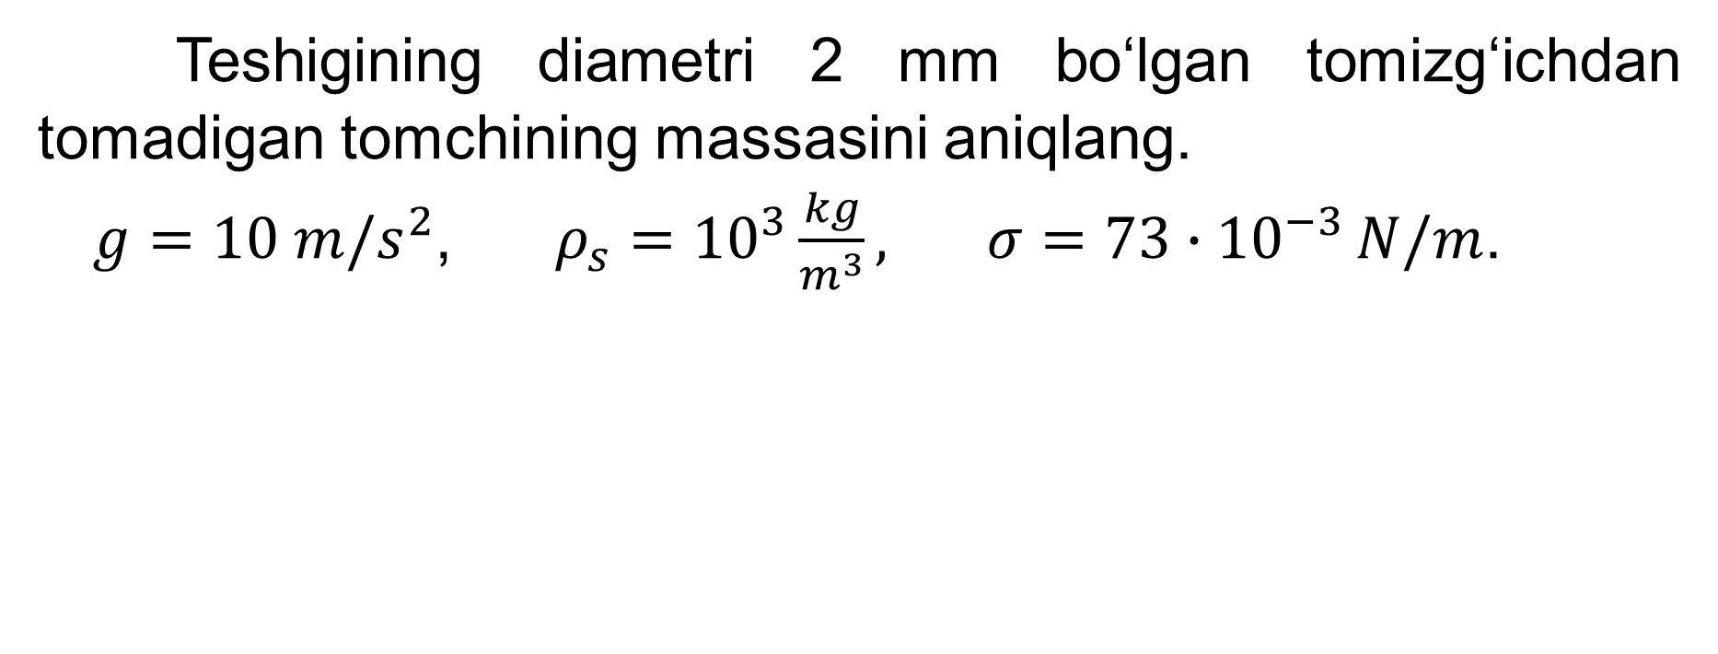
20-mashq 4-masala
Teshigining diametri 2 mm bo‘lgan tomizg‘ichdan tomadigan tomchining massasini aniqlang.
$g=10 m/s^{2}$, $ρ_{s}={10}^{3}\frac{kg}{m^{3}}, σ=73∙{10}^{−3 }N/m$.

Slide 6
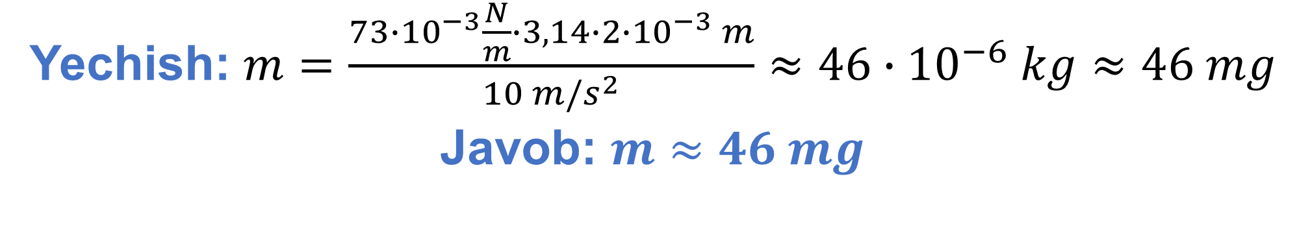
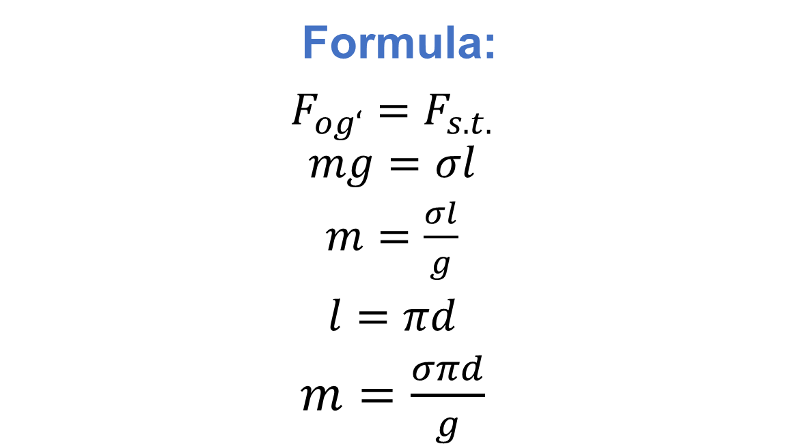
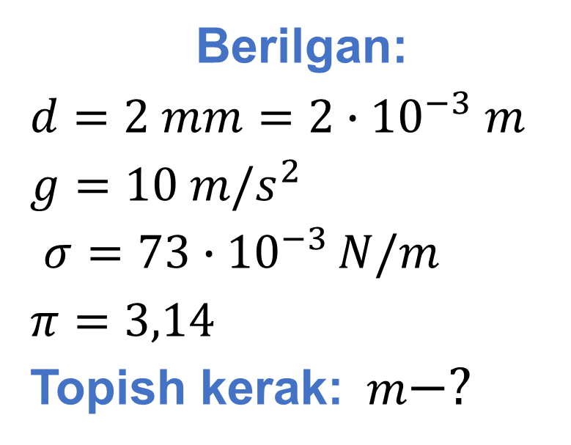
Berilgan:
$d=2 mm=2∙{10}^{−3} m$
$g=10 m/s^{2}$
$σ=73∙{10}^{−3 }N/m$
$π=3,14$
Topish kerak:$m−?$
Formula:
$F_{og‘}=F_{s.t.}$
$$mg=σl$$
$m=\frac{σl}{g}$
$l=πd$
$m=\frac{σπd}{g}$
Yechish: $m=\frac{73∙{10}^{−3}\frac{N}{m}∙3,14∙2∙{10}^{−3} m}{10 m/s^{2}}≈46∙{10}^{−6} kg≈46 mg$
Javob: $m≈46 mg$

Slide 7

20-mashq 6-masala
Zichligi $0,9 g/{cm}^{3}$ bo‘lgan suyuqlik diametri 1,5 mm bo‘lgan kapillyar naydagi ko‘tarilish balandligi 10 mm bo‘lsa, shu suyuqlikning sirt taranglik koeffitsiyentini aniqlang.

Slide 8
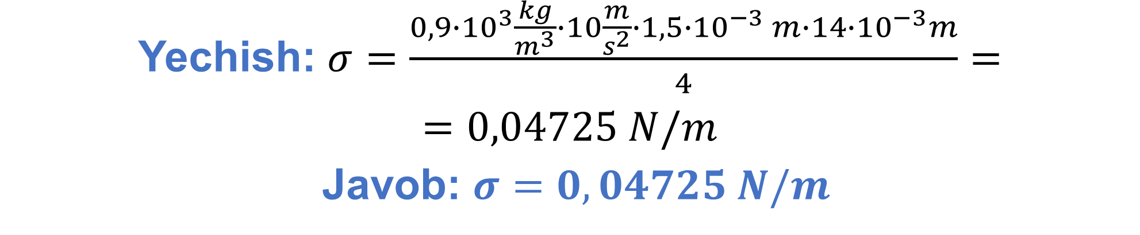
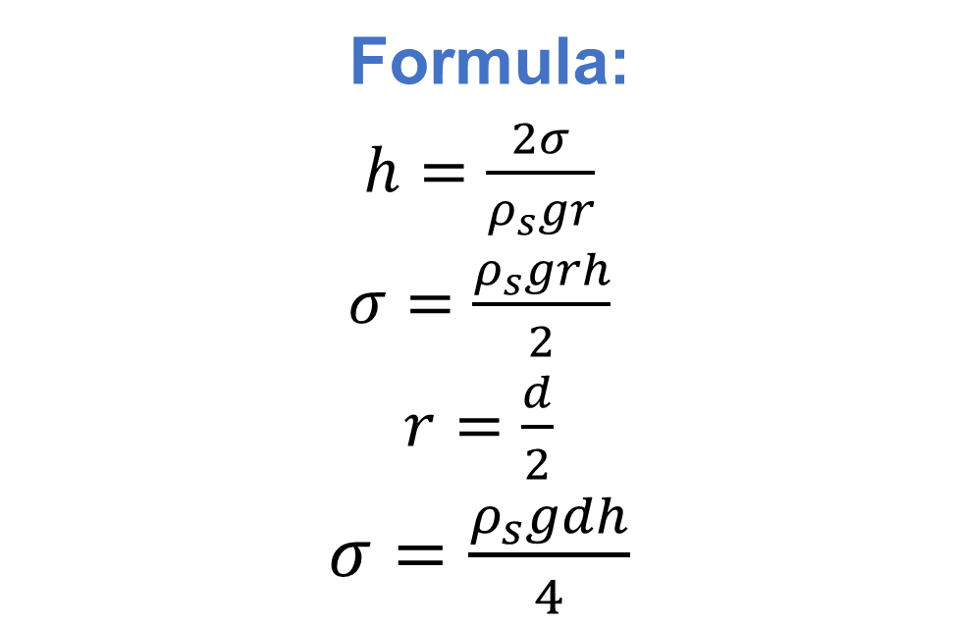
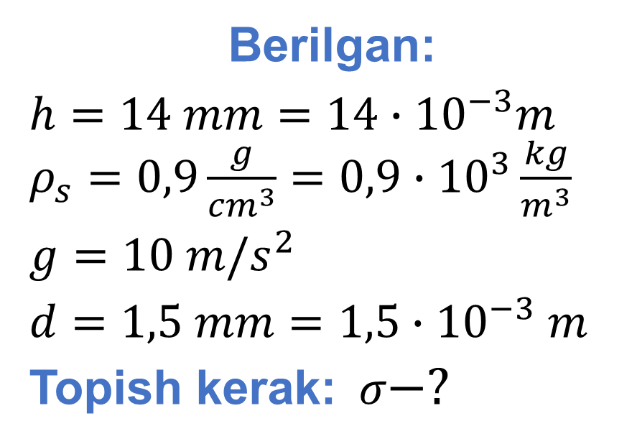
Berilgan:
$h=14 mm=14∙{10}^{−3}m$ $ρ_{s}=0,9\frac{g}{{cm}^{3}}={0,9∙10}^{3}\frac{kg}{m^{3}}$
$g=10 m/s^{2}$
$d=1,5 mm=1,5∙{10}^{−3} m$
Topish kerak:$σ−?$
Formula:
$h=\frac{2σ}{ρ_{s}gr}$
$σ=\frac{ρ_{s}grh}{2}$
$r=\frac{d}{2}$
$σ=\frac{ρ_{s}gdh}{4}$
Yechish: $σ=\frac{{0,9∙10}^{3}\frac{kg}{m^{3}}∙10\frac{m}{s^{2}}∙1,5∙{10}^{−3} m∙14∙{10}^{−3}m}{4}=$
$=0,04725 N/m$
Javob: $σ=0,04725 N/m$

Slide 9
20-mashq 8-masala
Yer sirtidagi kapillyarda suv 15 mm ga ko‘tariladi. Agar Oyda erkin tushish tezlanishi Yerdagidan 6 marta kichik ekanligi ma’lum bo‘lsa, Oyda shu kapillyarda suv qanday balandlikka ko‘tariladi?

Slide 10

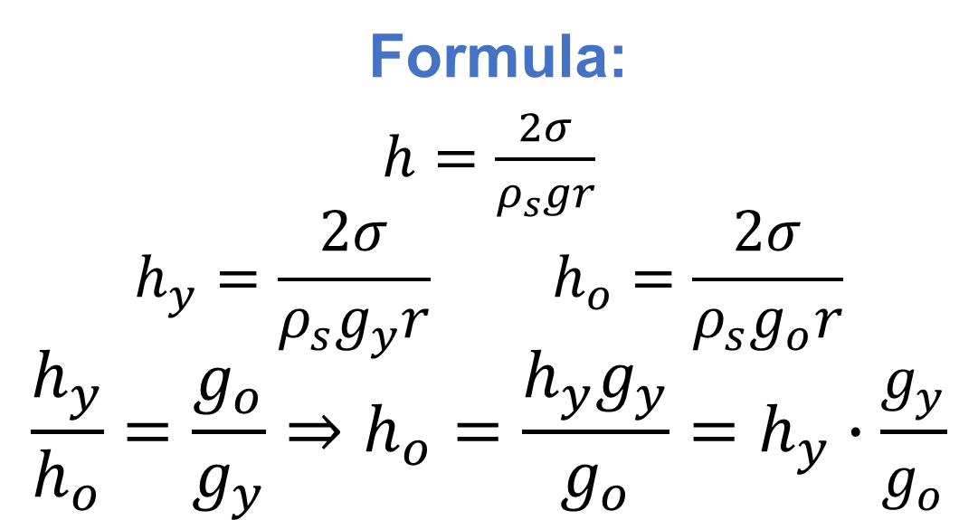
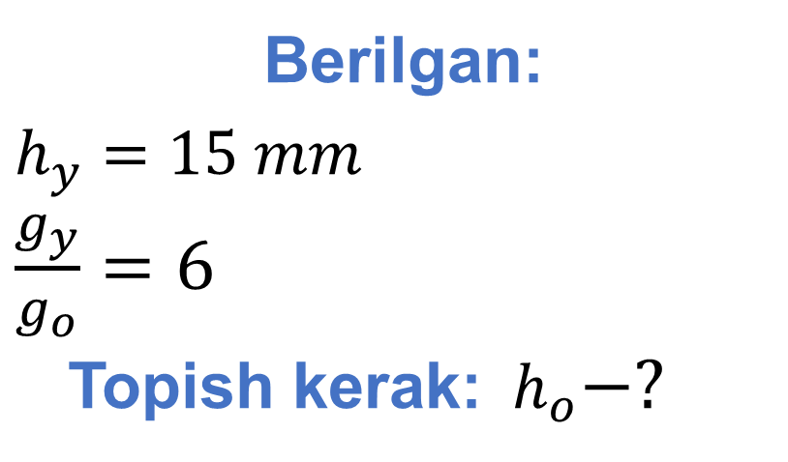
Berilgan:
$h_{y}=15 mm$
$\frac{g_{y}}{g_{o}}=6$
Topish kerak:$h_{o}−?$
Formula:
$h=\frac{2σ}{ρ_{s}gr}$
$${h_{y}=\frac{2σ}{ρ_{s}g_{y}r} h}_{o}=\frac{2σ}{ρ_{s}g_{o}r}$$
$$\frac{h_{y}}{h_{o}}=\frac{g_{o}}{g_{y}}⇒h_{o}=\frac{h_{y}g_{y}}{g_{o}}=h_{y}∙\frac{g_{y}}{g_{o}}$$
Yechish: $h_{o}=15 mm∙6=90 mm$
Javob: $h_{o}=90 mm$

Slide 11

20-mashq 9-masala
Sovun puvakchasining sirt yuzasi $12 {cm}^{2}$ ga ortganda sirt energiyasi qanchaga o‘zgaradi? $σ=0,04 \frac{N}{m}.$

Slide 12
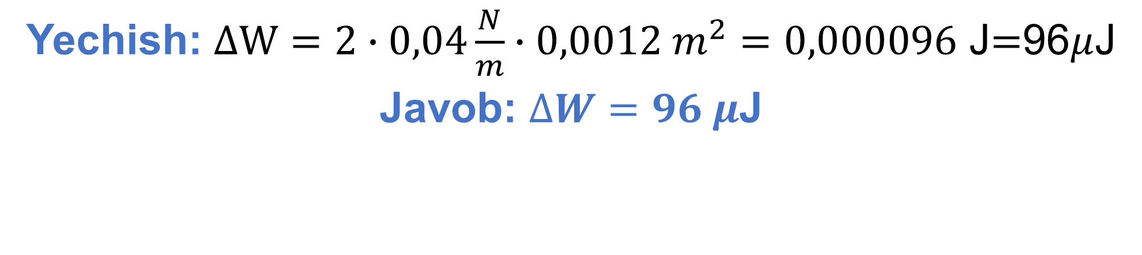

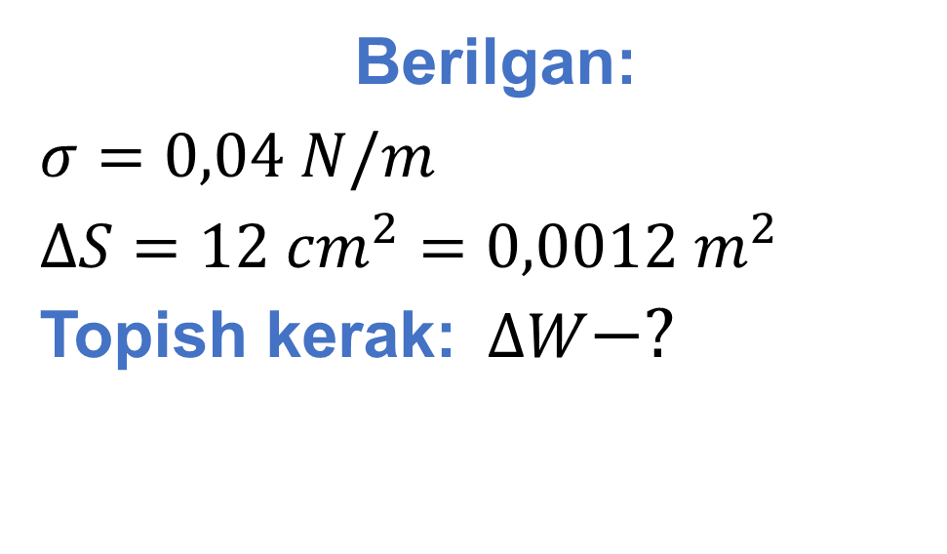
Berilgan:
$σ=0,04 N/m$
$∆S=12 {cm}^{2}=0,0012 m^{2}$
Topish kerak:$∆W−?$
Formula:
$$∆W=2σ∆S$$
Yechish: $∆W=2∙0,04\frac{N}{m}∙0,0012 m^{2}=0,000096$ J$=$96$μ$J
Javob: $∆W=96 μ$J

Slide 13
Mustaqil bajarish uchun topshiriqlar
102-bet 2, 3, 5, 7-masalalarni yechish.

