Slide 1
Fizika
9-sinf
Mavzu: Umumtakrordars
O‘qituvchi:
Toshkent shahar Uchtepa tumani 287-maktab fizika fani o‘qituvchisi
Xo‘jayeva Maxtuma Ziyatovna.

Slide 2
Issiqlik miqdori va issiqlik balans tenglamasiga doir masala
22$℃$haroratni ko‘rsatib turgan termometr suvga tushirilgandan so‘ng 70$℃$ ni ko‘rsatadi.
Termometr tushirilgunga qadar suvning harorati ($℃)$ qanchaga teng bo‘lgan?
Suvning massasi 40 g, suvning solishtirma issiqlik sig‘imi 4200 $\frac{J}{kg∙℃}$, Termometrning issiqlik sig‘imi esa 7 $\frac{J}{℃}$.

Slide 3
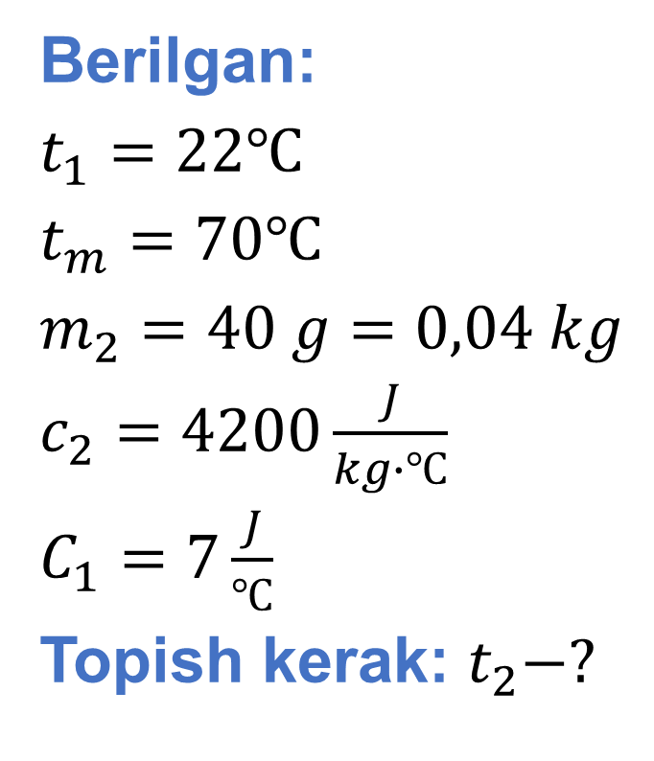
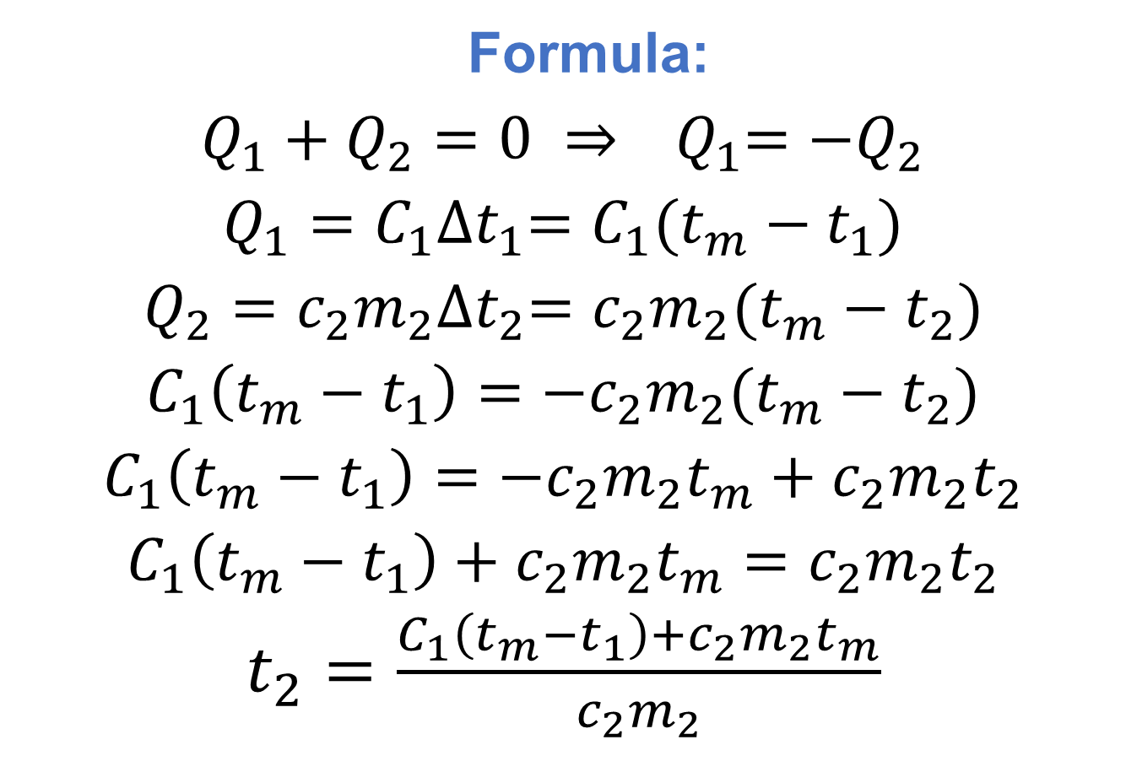
Berilgan:
$t_{1}=22℃$
$t_{m}=70℃$
$m_{2}=40 g=0,04 kg$
$c_{2}=4200\frac{J}{kg∙℃}$
$C_{1}=7\frac{J}{℃}$
Topish kerak: $t_{2}−?$
Formula:
$Q_{1}+Q_{2}=0 ⇒{ Q}_{1}=−Q_{2}$
$Q_{1}=C_{1}{∆t}_{1}=C_{1}(t_{m}−t_{1})$
$Q_{2}=c_{2}m_{2}{∆t}_{2}=c_{2}m_{2}(t_{m}−t_{2})$
$C_{1}\left(t_{m}−t_{1}\right)={−c}_{2}m_{2}(t_{m}−t_{2})$
$C_{1}\left(t_{m}−t_{1}\right)=−c_{2}m_{2}t_{m}+c_{2}m_{2}t_{2}$
$C_{1}\left(t_{m}−t_{1}\right)+c_{2}m_{2}t_{m}=c_{2}m_{2}t_{2}$
$t_{2}=\frac{C_{1}\left(t_{m}−t_{1}\right)+c_{2}m_{2}t_{m}}{c_{2}m_{2}}$

Slide 4
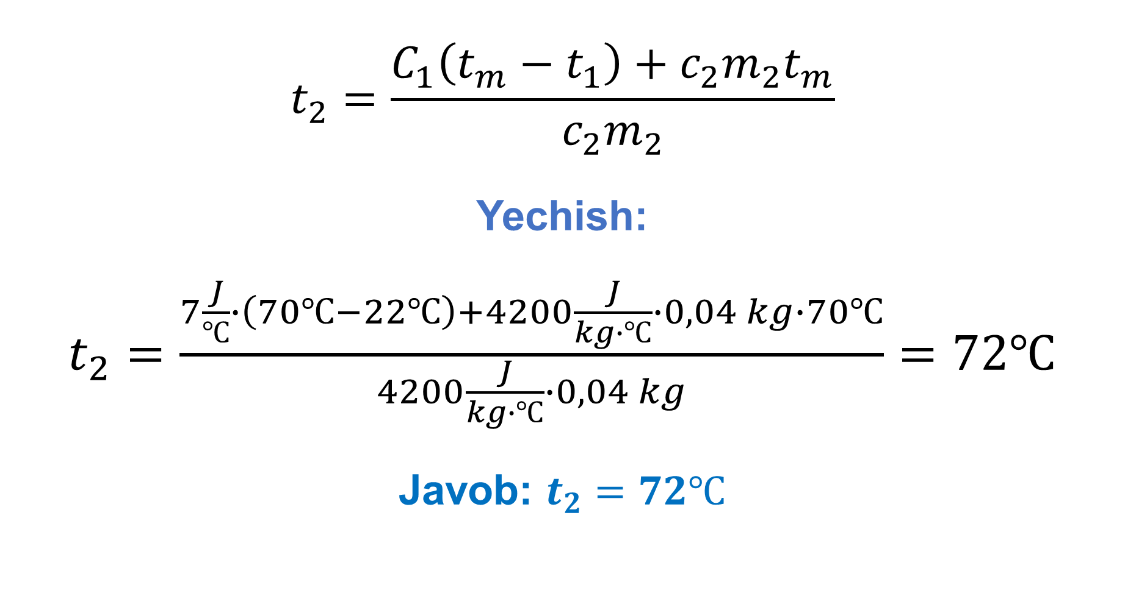
$$t_{2}=\frac{C_{1}\left(t_{m}−t_{1}\right)+c_{2}m_{2}t_{m}}{c_{2}m_{2}}$$
Yechish:
$t_{2}=\frac{7\frac{J}{℃}∙\left(70℃−22℃\right)+4200\frac{J}{kg∙℃}∙0,04 kg∙70℃}{4200\frac{J}{kg∙℃}∙0,04 kg}=72℃$
Javob: $t_{2}=72℃$

Slide 5
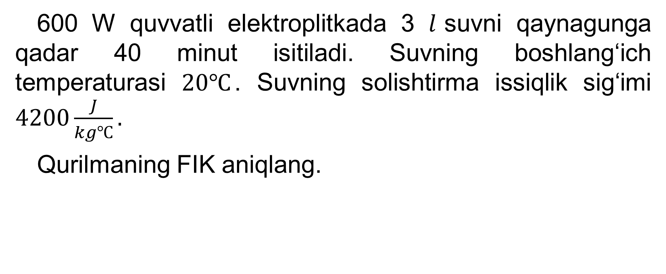
Issiqlik miqdori va foydali ish koeffitsiyentiga doir masala
600 W quvvatli elektroplitkada 3 $l$suvni qaynagunga qadar 40 minut isitiladi. Suvning boshlang‘ich temperaturasi $20℃$. Suvning solishtirma issiqlik sig‘imi $4200\frac{J}{kg℃}.$
Qurilmaning FIK aniqlang.

Slide 6
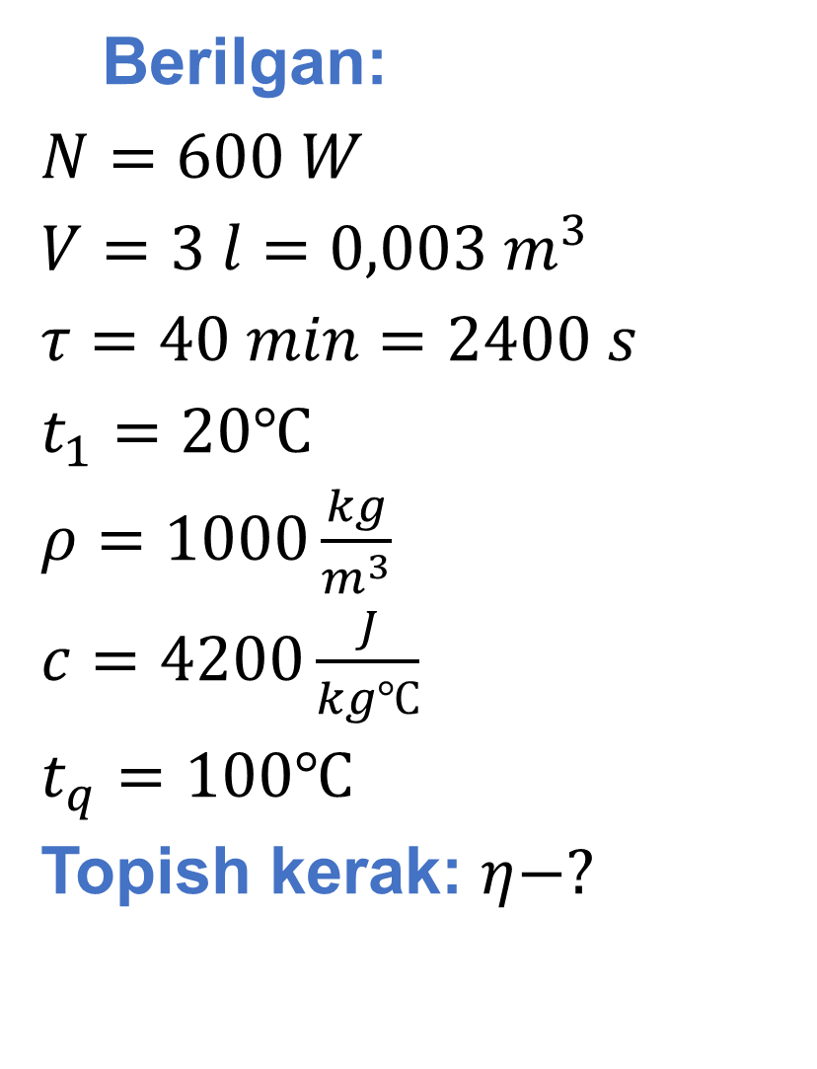
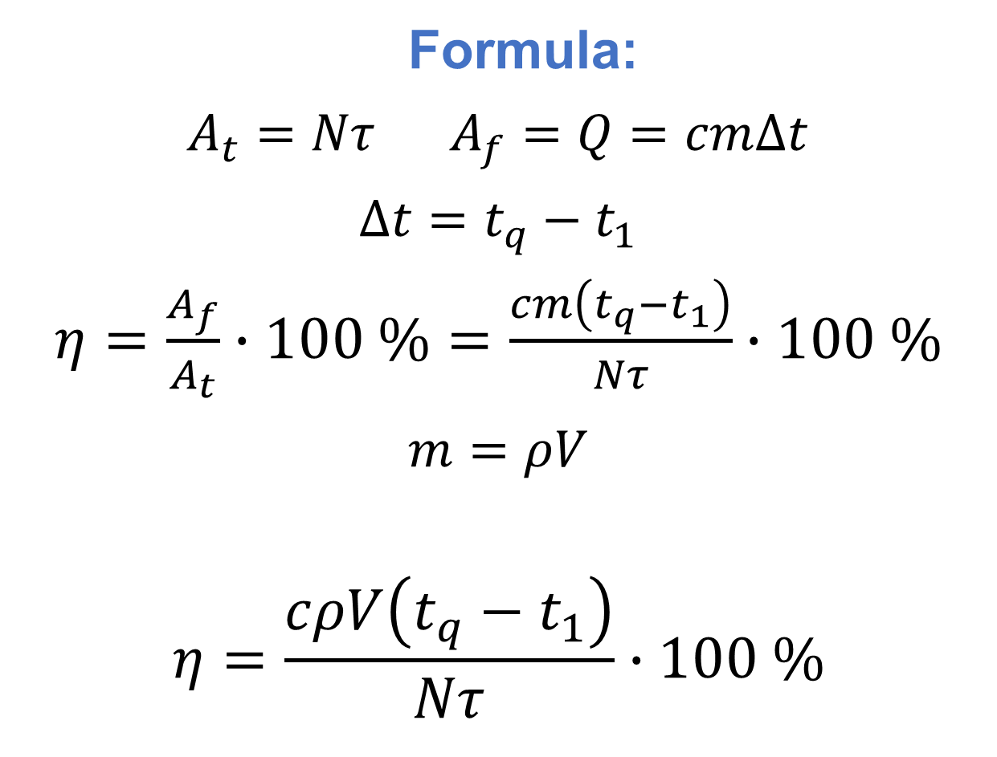
Berilgan:
$N=600 W$
$V=3 l=0,003 m^{3}$
$τ=40 min=2400 s$
$t_{1}=20℃$
$ρ=1000\frac{kg}{m^{3}}$
$c=4200\frac{J}{kg℃}$
$t_{q}=100℃$
Topish kerak: $η−?$
Formula:
$A_{t}=Nτ$ $A_{f}=Q=cm∆t$
$∆t=t_{q}−t_{1}$
$η=\frac{A_{f}}{A_{t}}∙100 \%=\frac{cm\left(t_{q}−t_{1}\right)}{Nτ}∙100 \%$
$m=ρV$
$$η=\frac{cρV\left(t_{q}−t_{1}\right)}{Nτ}∙100 \%$$

Slide 7
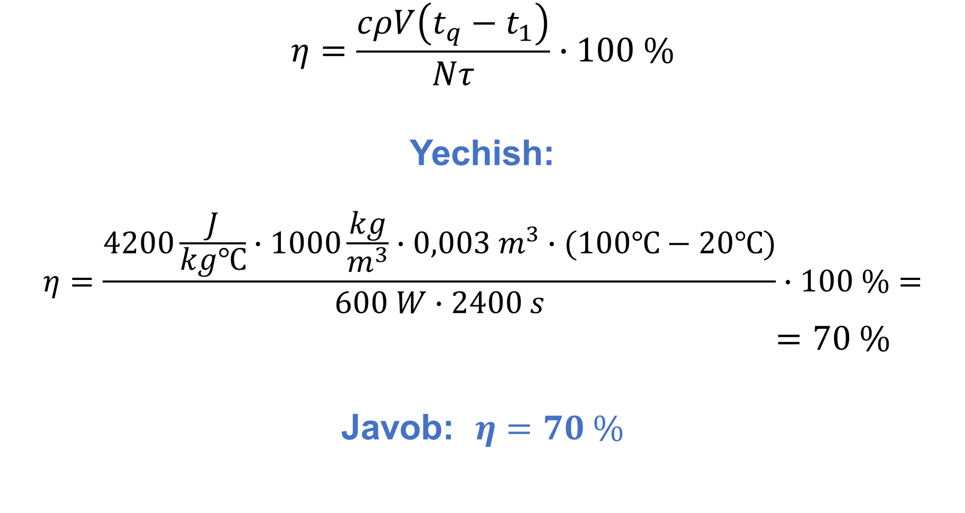
$$η=\frac{cρV\left(t_{q}−t_{1}\right)}{Nτ}∙100 \%$$
Yechish:
$$η=\frac{4200\frac{J}{kg℃}∙1000\frac{kg}{m^{3}}∙0,003 m^{3}∙(100℃−20℃)}{600 W∙2400 s}∙100 \%=$$
$=70 \%$
Javob: $η=70 \%$

Slide 8
Yoqilg‘ining solishtirma yonish issiqligi va issiqlik mashinalariga doir masala.
FIK 20 % bo‘lgan reaktiv samolyotning dvigateli 1800 km/h tezlik bilan uchishda 86 kN tortishish kuchiga erishadi.
Parvozning 1 soatdagi kerosin sarfini (tonnada) aniqlang. Kerosinning yonish issiqligi 43 MJ/kg.

Slide 9
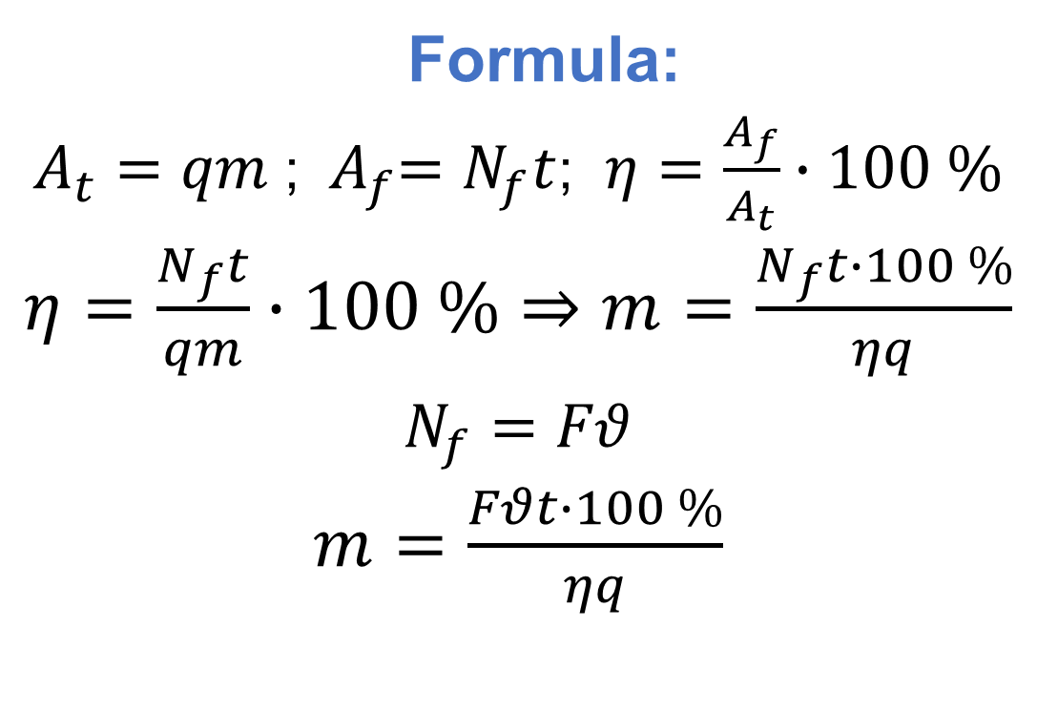
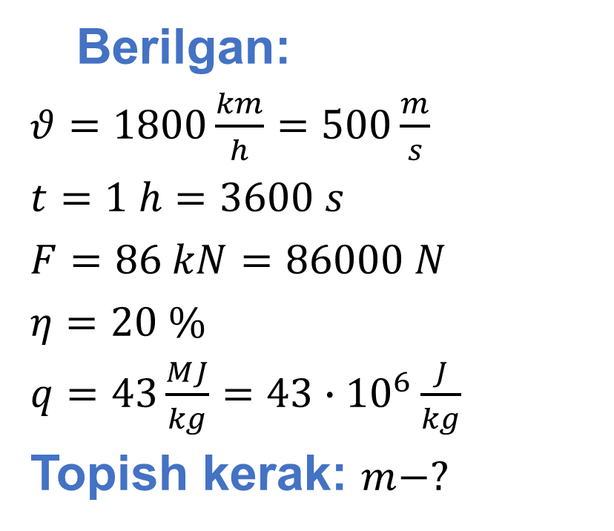
Berilgan:
$θ=1800\frac{km}{h}=500\frac{m}{s}$
$t=1 h=3600 s$
$F=86 kN=86000 N$
$η=20 \%$
$q=43\frac{MJ}{kg}=43∙{10}^{6}\frac{J}{kg}$
Topish kerak: $m−?$
Formula:
$A_{t}=qm$ ; ${ A}_{f}=N_{f}t$; $η=\frac{A_{f}}{A_{t}}∙100 \%$
$η=\frac{N_{f}t}{qm}∙100 \%⇒m=\frac{N_{f}t∙100 \%}{ηq}$
$N_{f}=Fθ$
$m=\frac{Fθt∙100 \%}{ηq}$
Yechish: $m=\frac{86000 N ∙ 500\frac{m}{s} ∙ 3600 s ∙100 \%}{20 \% ∙ 43 ∙{ 10}^{6}\frac{J}{kg}}=18000 kg=18 t$
Javob: $m=18 t$

Slide 10

Termodinamikaning 1-qonuniga doir masala
Agar 0,5 mol gazga 290 J issiqlik miqdori berilib, haroratini izobar ravishda $27℃$ dan $47℃$ gacha oshirilsa, uning ichki energiyasi qanchaga o‘zgaradi?
Universal gaz doimiysi $8,3\frac{J}{℃∙mol}$.

Slide 11
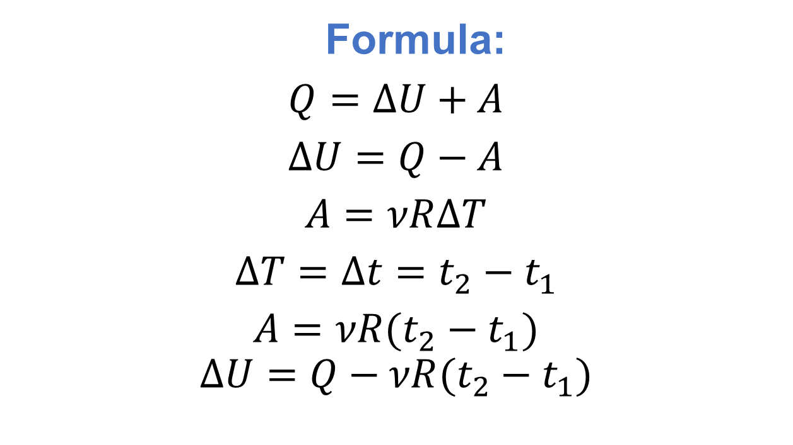
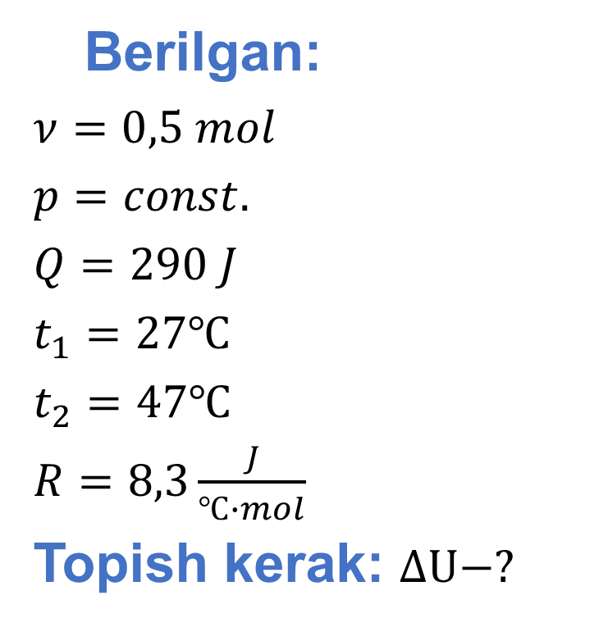
Berilgan:
$ν=0,5 mol$
$p=const.$
$Q=290 J$
$t_{1}=27℃$
$t_{2}=47℃$
$R=8,3\frac{J}{℃∙mol}$
Topish kerak: $∆U−?$
Formula:
$Q=∆U+A$
$∆U=Q−A$
$A=νR∆T$
$∆T=∆t=t_{2}−t_{1}$
$A=νR(t_{2}−t_{1})$
$$∆U=Q−νR(t_{2}−t_{1})$$
Yechish: $∆U=290 J−0,5 mol∙8,3\frac{J}{℃∙mol}∙\left(47℃−27℃\right)=207 J$
Javob: $∆U=207$ J

Slide 12
Ichki yonuv dvigatellariga doir masala
Ideal issiqlik mashinasi isitkichdan olingan issiqlikning 80% ini sovitkichga uzatadi.
Agar sovitkichning harorati 248 K bo‘lsa, isitkichning haroratini (K) toping.

Slide 13
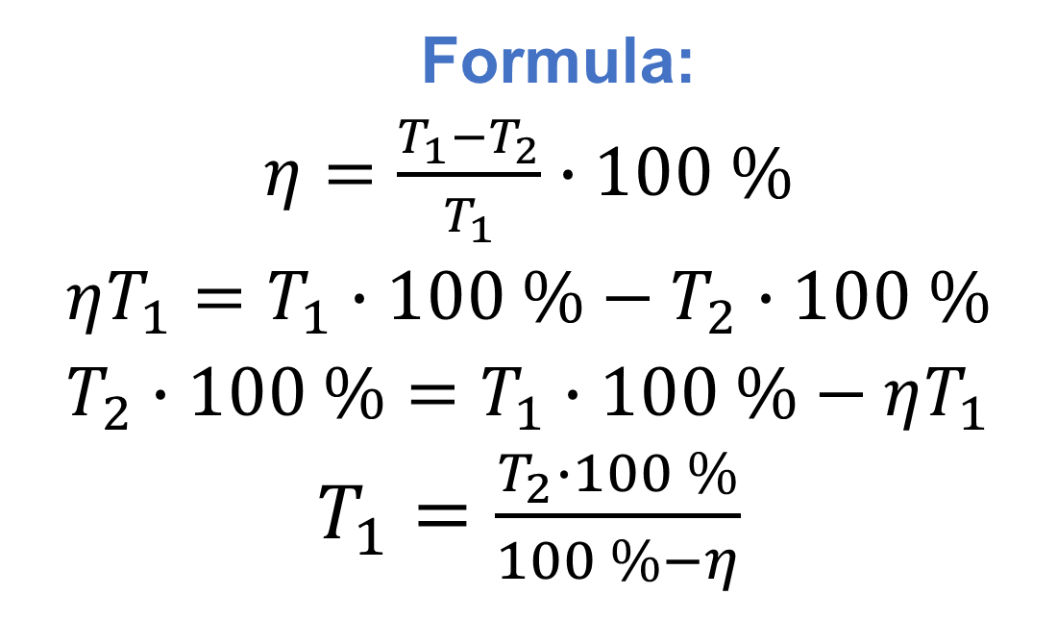
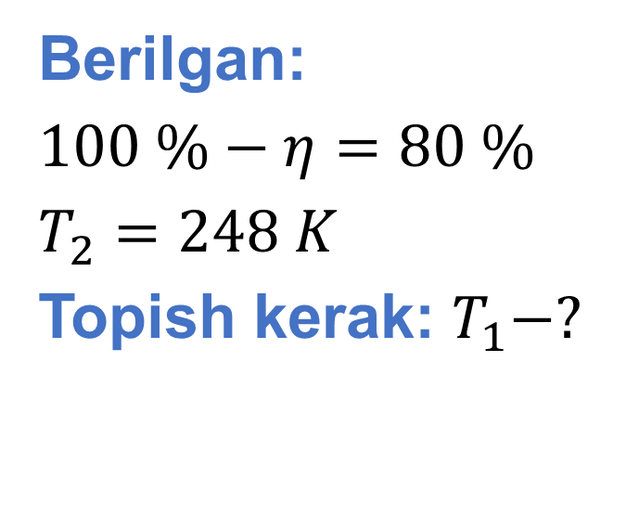
Berilgan:
$100 \%−η=80 \%$
$T_{2}=248 K$
Topish kerak: $T_{1}−?$
Formula:
$η=\frac{T_{1}−T_{2}}{T_{1}}∙100 \%$
$ηT_{1}=T_{1}∙100 \%−T_{2}∙100 \%$
$T_{2}∙100 \%=T_{1}∙100 \%−ηT_{1}$
$T_{1}=\frac{T_{2}∙100 \%}{100 \%−η}$
Yechish:$η=100 \%−80 \%=20 \%$
$T_{1}=\frac{248 K∙100 \%}{100 \%−20 \%}=310 K$
Javob: $T_{1}=310 K$

Slide 14
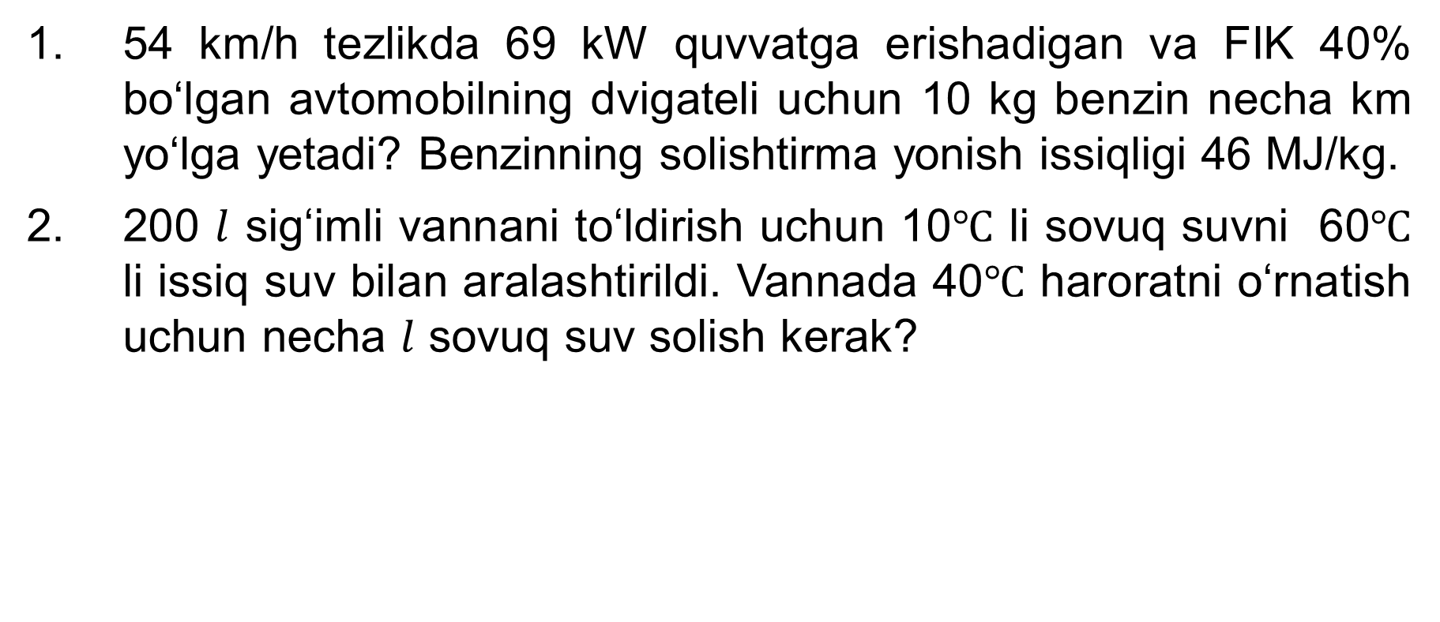
Mustaqil bajarish uchun topshiriqlar
54 km/h tezlikda 69 kW quvvatga erishadigan va FIK 40% bo‘lgan avtomobilning dvigateli uchun 10 kg benzin necha km yo‘lga yetadi? Benzinning solishtirma yonish issiqligi 46 MJ/kg.
200 $l$ sig‘imli vannani to‘ldirish uchun 10$℃$ li sovuq suvni 60$℃$ li issiq suv bilan aralashtirildi. Vannada 40$℃$ haroratni o‘rnatish uchun necha $l$ sovuq suv solish kerak?

Slide 15
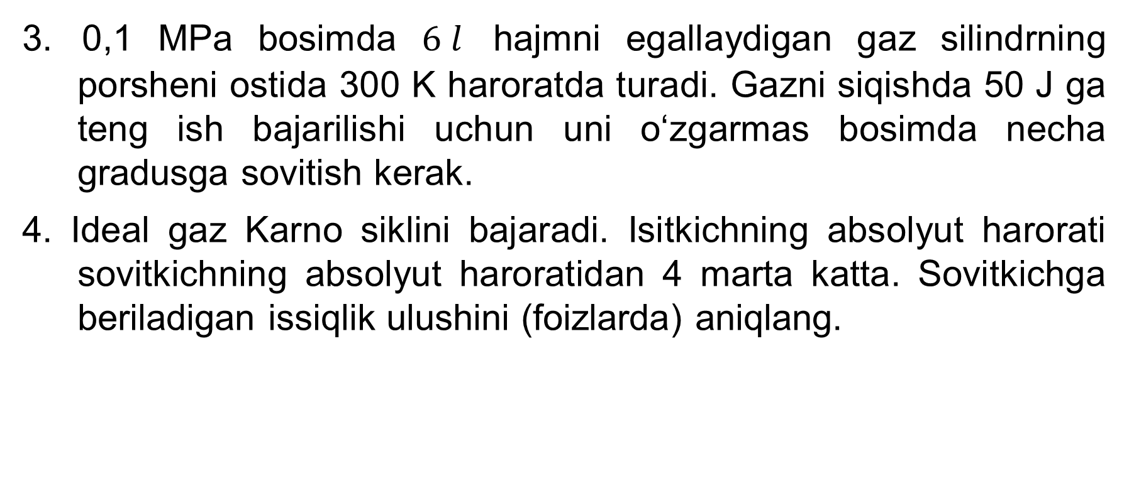
Mustaqil bajarish uchun topshiriqlar
3. 0,1 MPa bosimda $6 l$ hajmni egallaydigan gaz silindrning porsheni ostida 300 K haroratda turаdi. Gazni siqishda 50 J ga teng ish bajarilishi uchun uni o‘zgarmas bosimda necha gradusga sovitish kerak.
4. Ideal gaz Karno siklini bajaradi. Isitkichning absolyut harorati sovitkichning absolyut haroratidan 4 marta katta. Sovitkichga beriladigan issiqlik ulushini (foizlarda) aniqlang.

