Slide 1
Fizika
9-sinf
Mavzu:
Masalalar yechish.
O‘qituvchi:
Toshkent shahar Uchtepa tumani 287-maktab fizika fani o‘qituvchisi
Xo‘jayeva Maxtuma Ziyatovna.

Slide 2
$A_{foy.}=Q_{1}−Q_{2}$
𝐴_(𝑓𝑜𝑦.)=𝑄_1−𝑄_2
$η=\frac{A_{foy.}}{Q_{1}}∙100 \%=\frac{Q_{1}−Q_{2}}{Q_{1}}∙100 \%$
𝜂=𝐴_(𝑓𝑜𝑦.)/𝑄_1 ∙100 %=(𝑄_1−𝑄_2)/𝑄_1 ∙100 %
$η=\frac{T_{1}−T_{2}}{T_{1}}∙100 \%$
𝜂=(𝑇_1−𝑇_2)/𝑇_1 ∙100 %

Slide 3
Test
Karno sikli qanday jarayonlardan tashkil topgan?
A) Izotermik, izobarik, izoxorik va adiabatik.
B) 2 ta izotermik va 2 ta adiabatik.
C) 2 ta izotermik va 2 ta izobarik.
D) 2 ta adiabatik va 2 ta izoxorik.
To‘g‘I javob: B) 2 ta izotermik va 2 ta adiabatik.

Slide 4

18-mashq 2-masala
Isitkichning temperaturasi 477$℃,$ sovitkichniki 27$℃$ bo‘lgan issiqlik mashinasining maksimal FIK ni hisoblang.

Slide 5
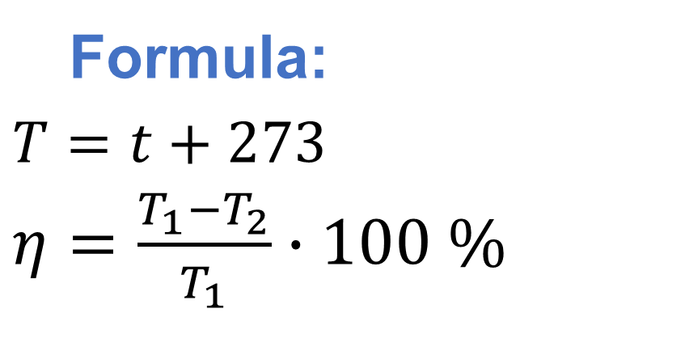
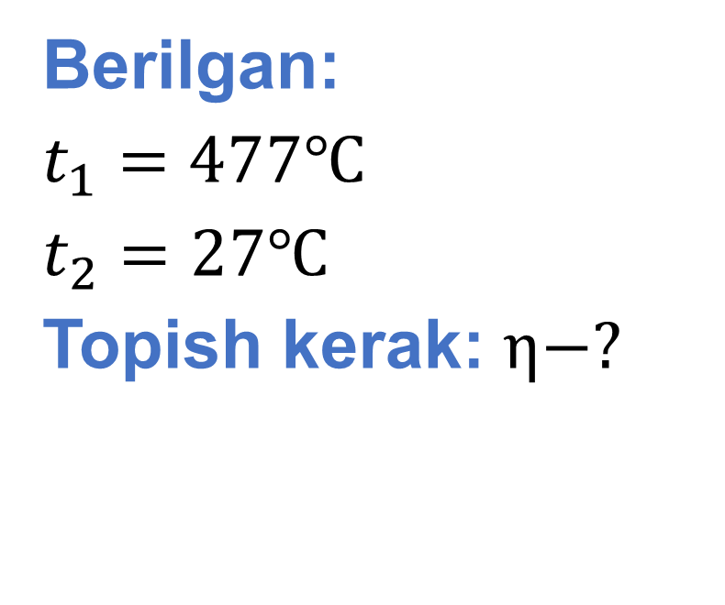
Berilgan:
$t_{1}=477℃$
$t_{2}=27℃$
Topish kerak: $η−?$
Formula:
$T=t+273$
$η=\frac{T_{1}−T_{2}}{T_{1}}∙100 \%$
Yechish: $T_{1}=477℃+273=750$ K
${ T}_{2}=27℃+273=300$K
$η=\frac{750 K−300 K}{750 K}∙100 \%=60$%
Javob: $η=60 \%$

Slide 6
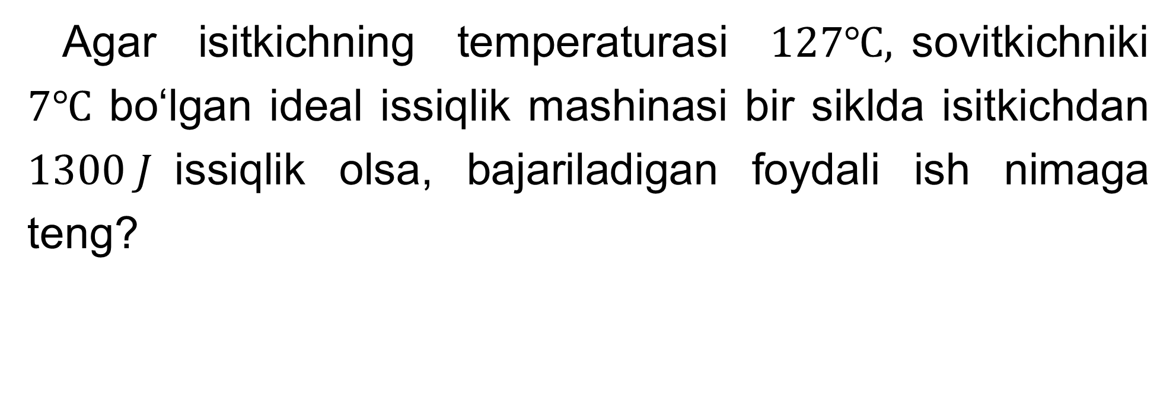
18-mashq 4-masala
Agar isitkichning temperaturasi $127℃,$sovitkichniki $7℃$ bo‘lgan ideal issiqlik mashinasi bir siklda isitkichdan $1300 J$issiqlik olsa, bajariladigan foydali ish nimaga teng?

Slide 7
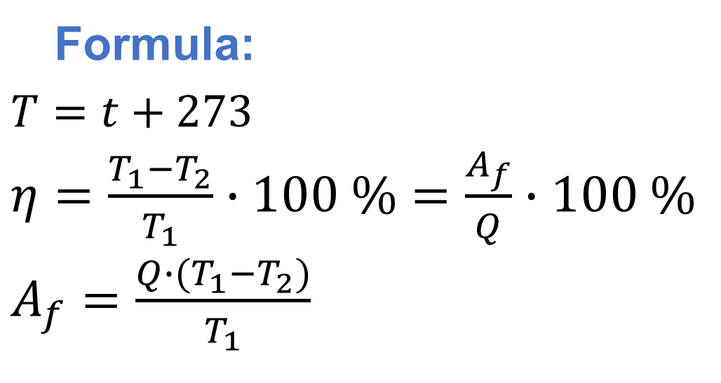
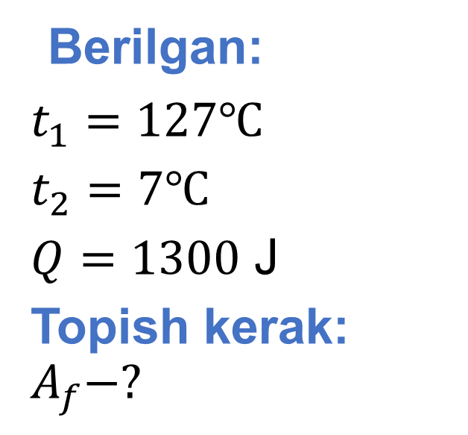
Berilgan:
$t_{1}=127℃$
$t_{2}=7℃$
$Q=1300$ J
Topish kerak: $A_{f}−?$
Formula:
$T=t+273$
$η=\frac{T_{1}−T_{2}}{T_{1}}∙100 \%=\frac{A_{f}}{Q}∙100 \%$
$A_{f}=\frac{Q∙(T_{1}−T_{2})}{T_{1}}$
Yechish: $T_{1}=127℃+273=400$ K
${ T}_{2}=7℃+273=280$ K
${ A}_{f}=\frac{1300 J∙(400 K−280 K)}{400 K}=390$ J
Javob: $A_{f}=390$ J

Slide 8

18-mashq 6-masala
Ideal issiqlik dvigatelida sovitkichning temperaturasi 62$℃$, issiqlik dvigatelining FIK 50 % bo‘lsa, isitkich bilan sovitkich temperaturalari orasidagi farq qanday?

Slide 9
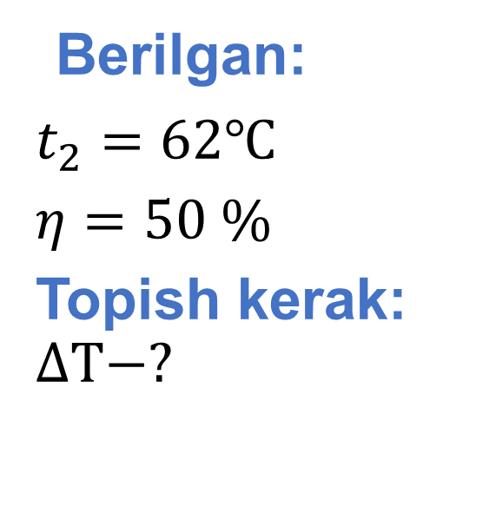
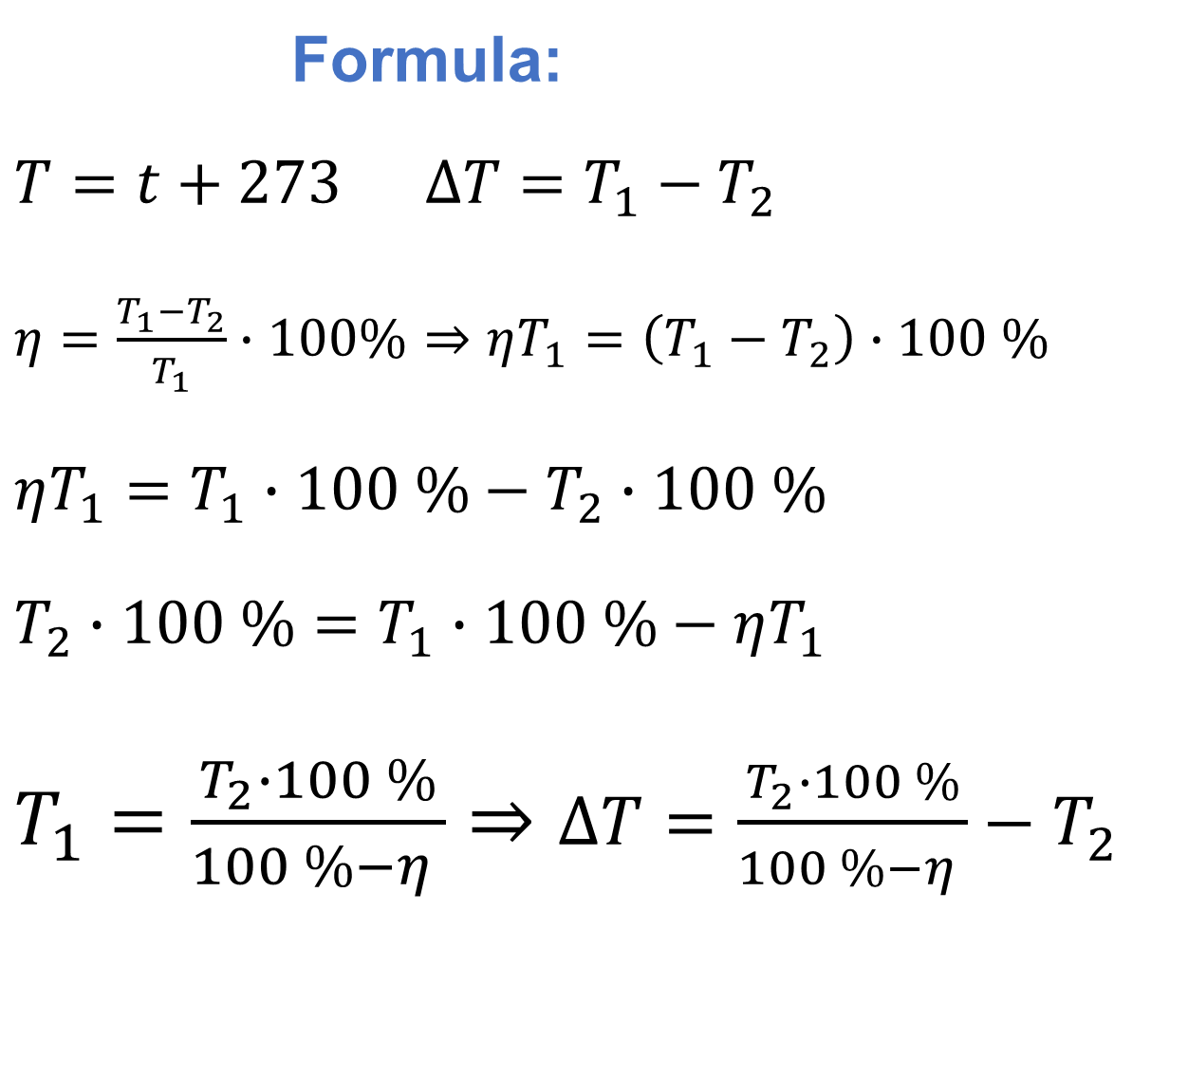
Berilgan:
$t_{2}=62℃$
$η=50 \%$
Topish kerak: $∆T−?$
Formula:
$T=t+273$ $∆T=T_{1}−T_{2}$
$η=\frac{T_{1}−T_{2}}{T_{1}}∙100\%⇒ηT_{1}=\left(T_{1}−T_{2}\right)∙100 \%$
$ηT_{1}=T_{1}∙100 \%−T_{2}∙100 \%$
$T_{2}∙100 \%=T_{1}∙100 \%−ηT_{1}$
$T_{1}=\frac{T_{2}∙100 \%}{100 \%−η }⇒∆T=\frac{T_{2}∙100 \%}{100 \%−η }−T_{2}$

Slide 10
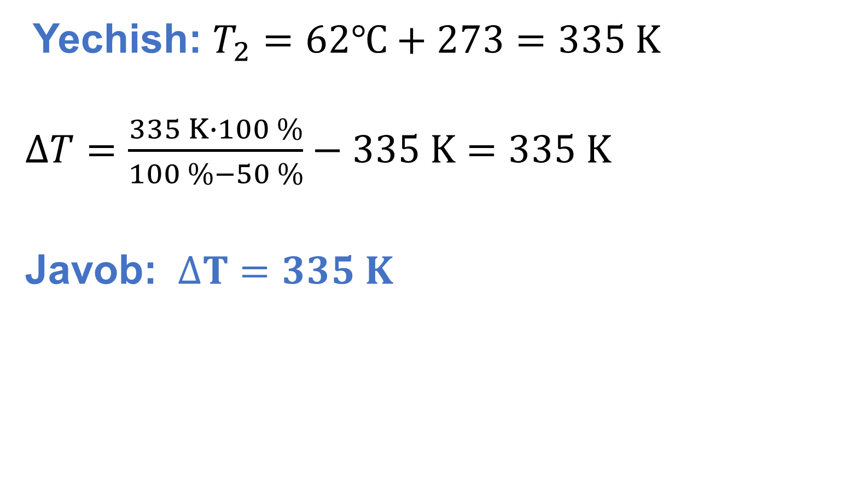
Yechish: $T_{2}=62℃+273=335 K$
$∆T=\frac{335 K∙100 \%}{100 \%−50 \%}−335 K=335 K$
Javob: $∆T=335 K$

Slide 11
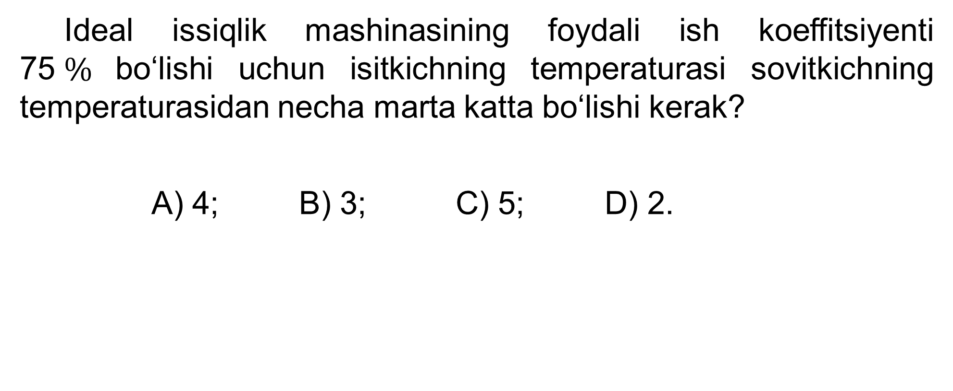
5-test 91-bet
Ideal issiqlik mashinasining foydali ish koeffitsiyenti 75$\%$bo‘lishi uchun isitkichning temperaturasi sovitkichning temperaturasidan necha marta katta bo‘lishi kerak?
A) 4; B) 3; C) 5; D) 2.

Slide 12
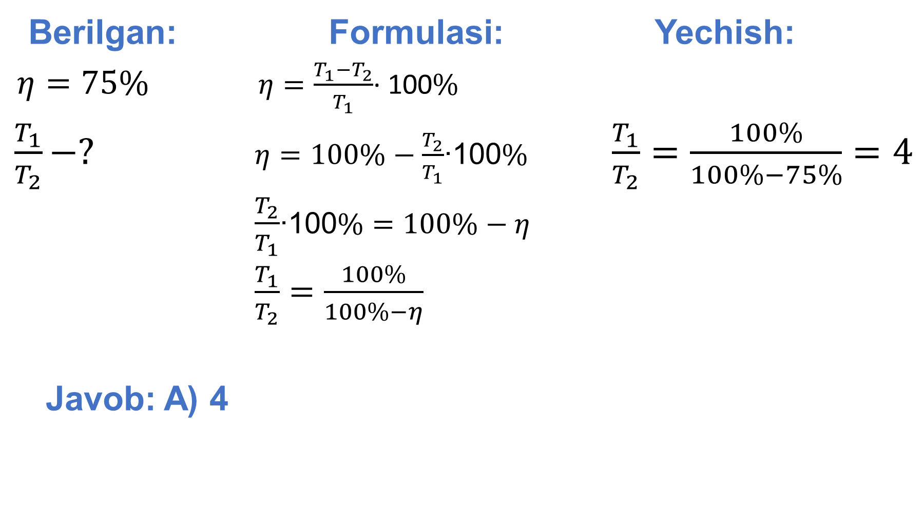
Berilgan: Formulasi: Yechish:
$η=75\%$ $η=\frac{T_{1}−T_{2}}{T_{1}}$∙ 100$\%$
$\frac{T_{1}}{T_{2}}−?$ $η=100\%−\frac{T_{2}}{T_{1}}$∙100$\%$ $\frac{T_{1}}{T_{2}}$ $=\frac{100\%}{100\%−75\%}=4$
$\frac{T_{2}}{T_{1}}$∙100$\%=$ $100\%−$ $η$
$\frac{T_{1}}{T_{2}}=\frac{100\%}{100\%−η}$
Javob: A) 4

Slide 13
Mustaqil bajarish uchun topshiriqlar
18-mashqning 3, 5, 7, 8- masalalarini yechish. 87-bet.

