Slide 1

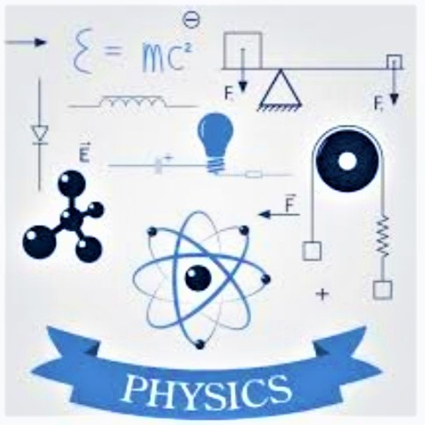
Fizika
9-sinf
Mavzu:
Masalalar yechish.
O‘qituvchi:
Toshkent shahar Uchtepa tumani 287-maktab fizika fani o‘qituvchisi
Xo‘jayeva Maxtuma Ziyatovna.

Slide 2
Yoqilg‘ining solishtirma yonish issiqligi.
$q=\frac{Q}{m}⇒1 \frac{J}{kg}$
𝑞=𝑄/𝑚⇒1 𝐽/𝑘𝑔
$Q=qm$
𝑄=𝑞𝑚

Slide 3
Termodinamikaning birinchi qonuni
Izobarik jarayonda: $Q=∆U+A$
Izobarik jarayonda: 𝑄=∆𝑈+𝐴
$Q=∆U+A$
𝑄=∆𝑈+𝐴

Slide 4
Izoxorik jarayonda:$V=const.$ $Q=∆U$
Izoxorik jarayonda: 𝑉=𝑐𝑜𝑛𝑠𝑡. 𝑄=∆𝑈
Adiabatik jarayonda: $Q=0,$ $A=−∆U$
Adiabatik jarayonda: 𝑄=0, A=−∆𝑈
Izotermik jarayonda: $T=const.$ $Q=A$
Izotermik jarayonda: 𝑇=𝑐𝑜𝑛𝑠𝑡. 𝑄=𝐴

Slide 5
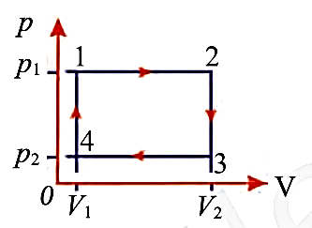
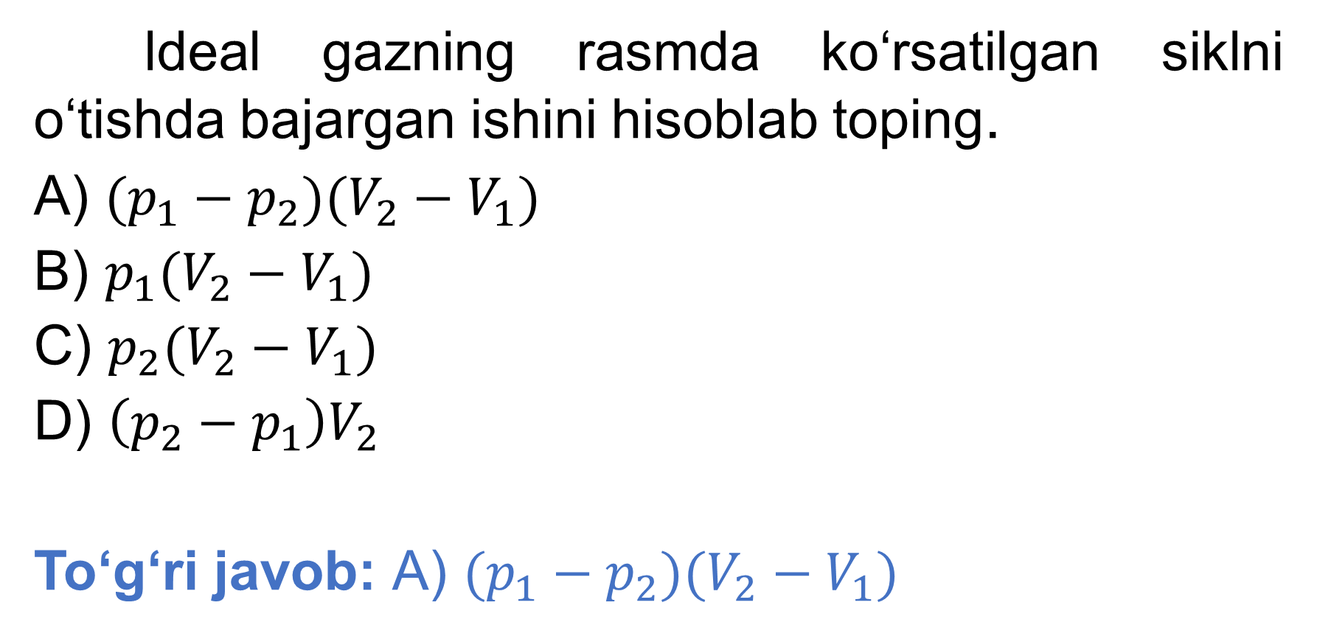
17-test 76-bet
ldeal gazning rasmda ko‘rsatilgan siklni o‘tishda bajargan ishini hisoblab toping.
A) $(p_{1}−p_{2})(V_{2}−V_{1})$
B) $p_{1}(V_{2}−V_{1})$
C) $p_{2}(V_{2}−V_{1})$
D) $\left(p_{2}−p_{1}\right)V_{2}$
To‘g‘ri javob: A) $(p_{1}−p_{2})(V_{2}−V_{1})$

Slide 6
17-mashq 1-masala
Izotermik jarayonda gazga 5 kJ issiqlik berilgan bo‘lsa, gaz ustida qancha ish bajarilgan bo‘ladi?

Slide 7
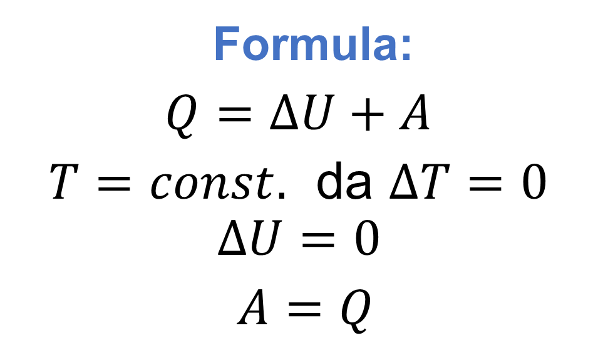
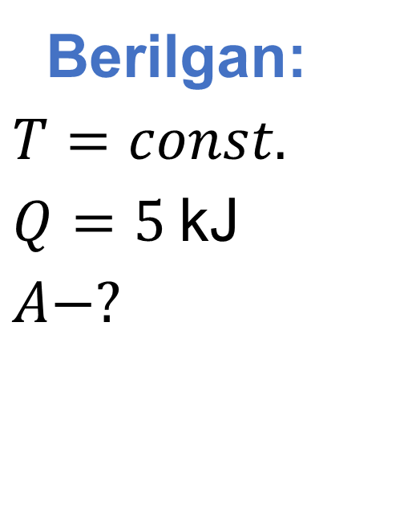
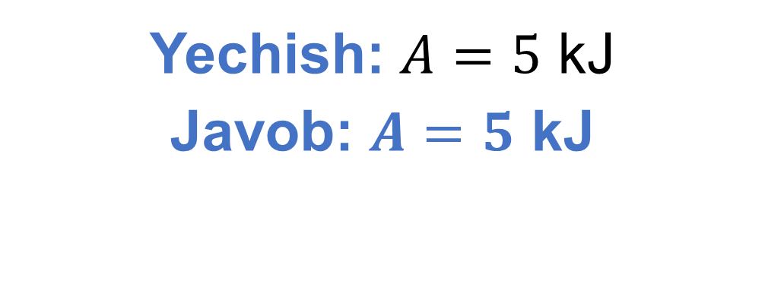
Berilgan:
$T=const.$
$Q=5$ kJ
$A−?$
Formula:
$Q=∆U+A$
$T=const.$ da $∆T=0$
$$∆U=0$$
$A=Q$
Yechish: $A=5$ kJ
Javob: $A=5$ kJ

Slide 8

17-mashq 4-masala
Normal sharoitda bir atomli ideal gazga issiqlik berilganda gaz izobarik ravishda $0,05 m^{3}$ ga kengayadi. Gazning ichki energiyasi qanday o‘zgaradi?

Slide 9
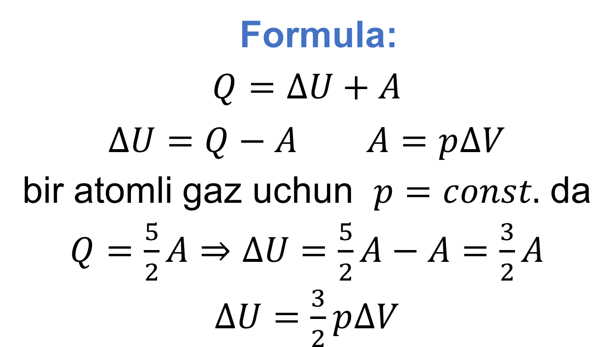
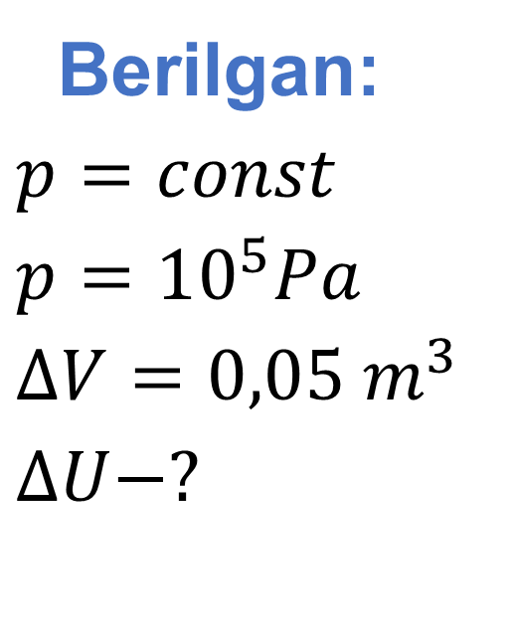
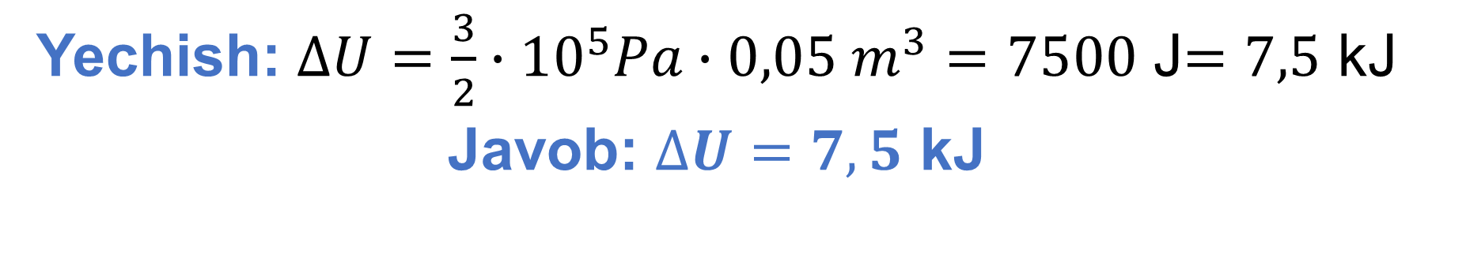
Berilgan:
$p=const$
$p={10}^{5}Pa$
$∆V=0,05 m^{3}$
$∆U−?$
Formula:
$Q=∆U+A$
$∆U=Q−A$ $A=p∆V$
bir atomli gaz uchun $p=const.$ da
$Q=\frac{5}{2}A⇒∆U=\frac{5}{2}A−A=\frac{3}{2}A$
$∆U=\frac{3}{2}p∆V$
Yechish: $∆U=\frac{3}{2}∙{10}^{5}Pa∙0,05 m^{3}=7500$ J$=7,5$ kJ
Javob: $∆U=7,5$ kJ

Slide 10
17-mashq 5-masala
Metall ballondagi 25 mol bir atomli ideal gazning temperaturasini 20 K ga orttirish uchun unga qancha issiqlik berish kerak?

Slide 11
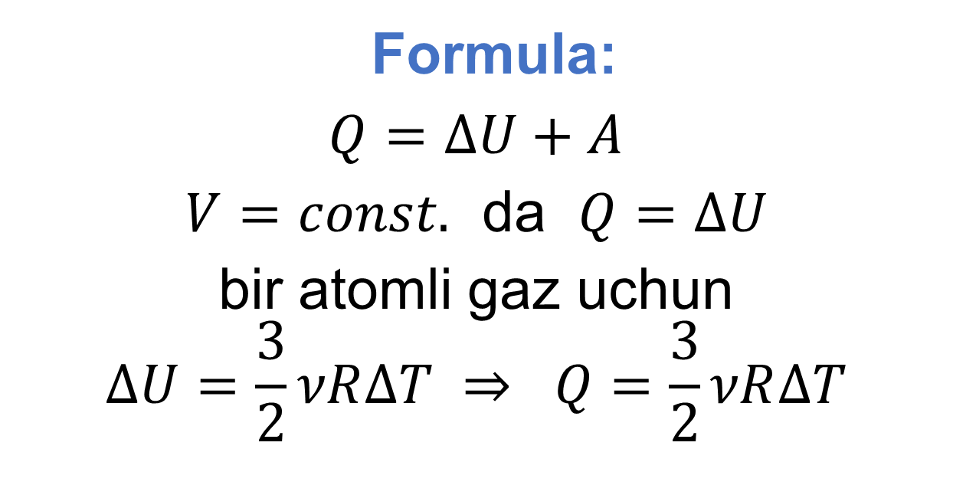
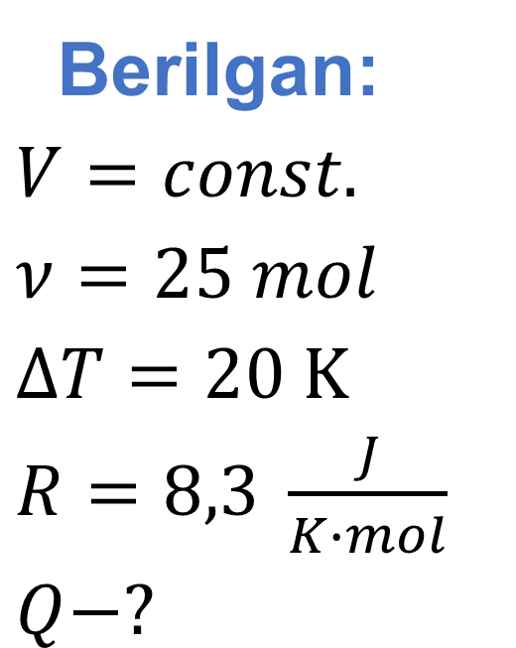
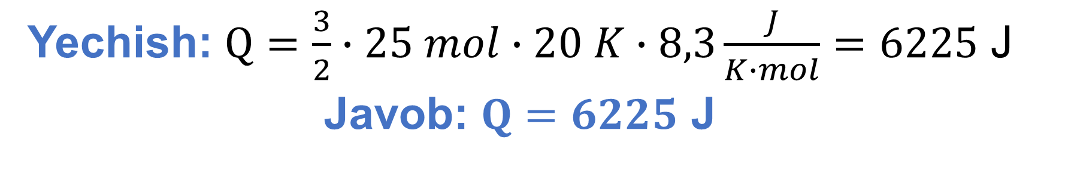
Berilgan:
$V=const.$
$ν=25 mol$
$∆T=20 K$
$R=8,3 \frac{J}{K∙mol}$
$Q−?$
Formula:
$Q=∆U+A$
$V=const.$ da $Q=∆U$
bir atomli gaz uchun
$$∆U=\frac{3}{2}νR∆T ⇒ Q=\frac{3}{2}νR∆T$$
Yechish: $Q=\frac{3}{2}∙25 mol∙20 K∙8,3\frac{J}{K∙mol}=6225$ J
Javob: $Q=6225$ J

Slide 12
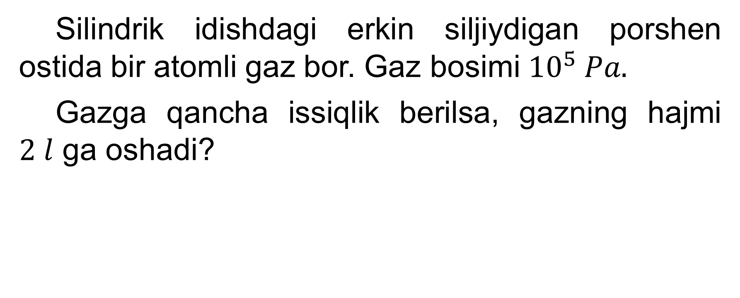
17-mashq 6-masala
Silindrik idishdagi erkin siljiydigan porshen ostida bir atomli gaz bor. Gaz bosimi ${10}^{5} Pa.$
Gazga qancha issiqlik berilsa, gazning hajmi
$2 l$ ga oshadi?

Slide 13
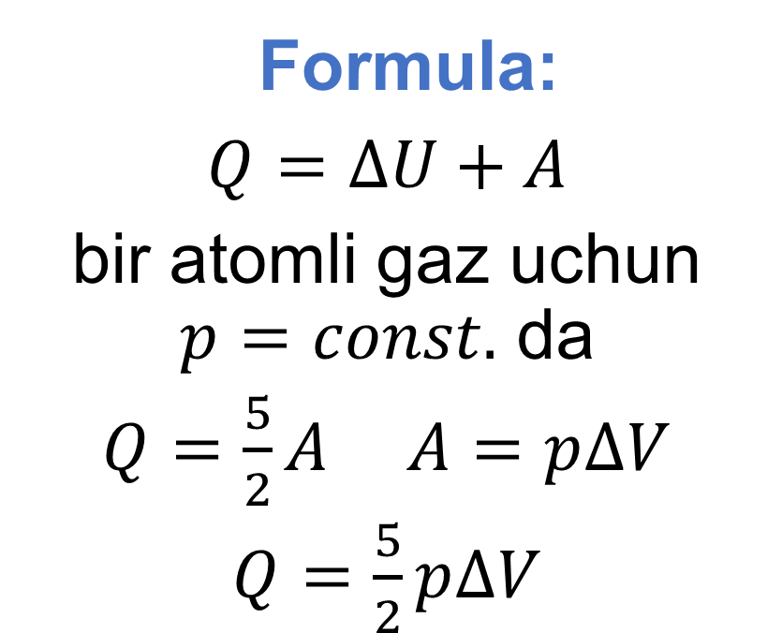
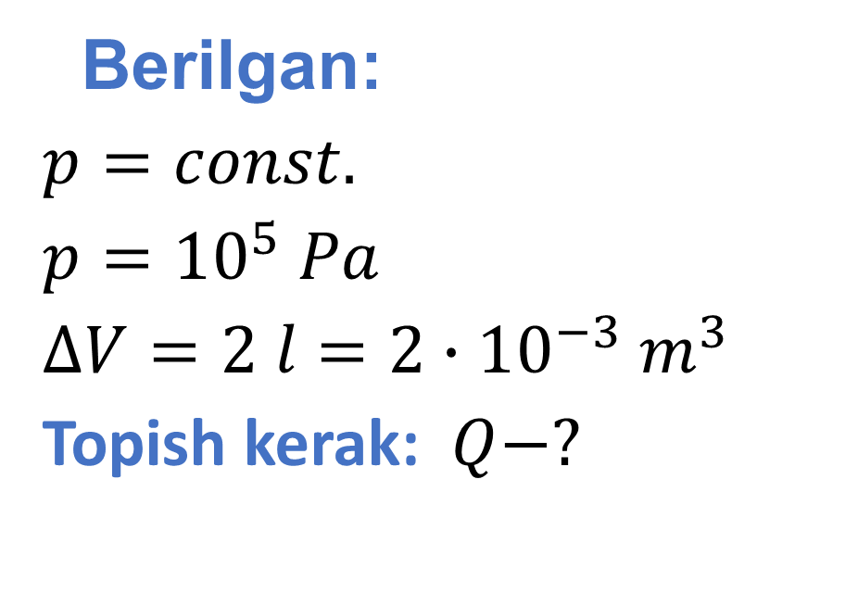
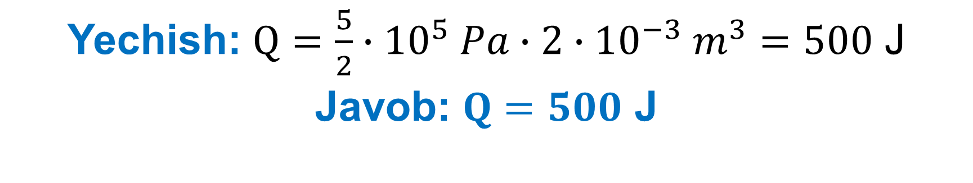
Berilgan:
$p=const.$
$p={10}^{5} Pa$
$∆V=2 l=2∙{10}^{−3} m^{3}$
Topish kerak: $Q−?$
Formula:
$Q=∆U+A$
bir atomli gaz uchun $p=const.$ da
$Q=\frac{5}{2}A$ $A=p∆V$
$Q=\frac{5}{2}p∆V$
Yechish: $Q=\frac{5}{2}∙{10}^{5} Pa∙2∙{10}^{−3} m^{3}=500$ J
Javob: $Q=500$ J

Slide 14
Mustaqil bajarish uchun topshiriqlar
1. 17-mashq 2, 3, 7-masalalarni yechish. (71-bet)
2. 77-bet 21-dan 29-gacha bo‘lgan testlarni yechish.

