Slide 1

Fizika
9
sinf
MAVZU: Masalalar yechish
O‘qituvchi:
Toshkent shahar Uchtepa tumani 287-maktab fizika fani o‘qituvchisi
Xo‘jayeva Maxtuma Ziyatovna.

Slide 2
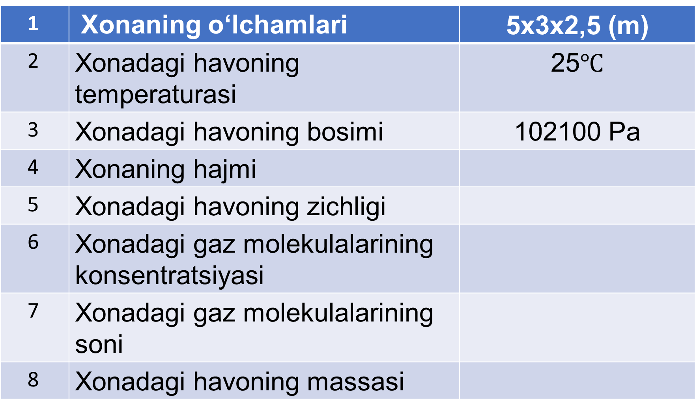
1 | Xonaning o‘lchamlari | 5x3x2,5 (m)
2 | Xonadagi havoning temperaturasi | 25$℃$
3 | Xonadagi havoning bosimi | 102100 Pa
4 | Xonaning hajmi
5 | Xonadagi havoning zichligi
6 | Xonadagi gaz molekulalarining konsentratsiyasi
7 | Xonadagi gaz molekulalarining soni
8 | Xonadagi havoning massasi

Slide 3
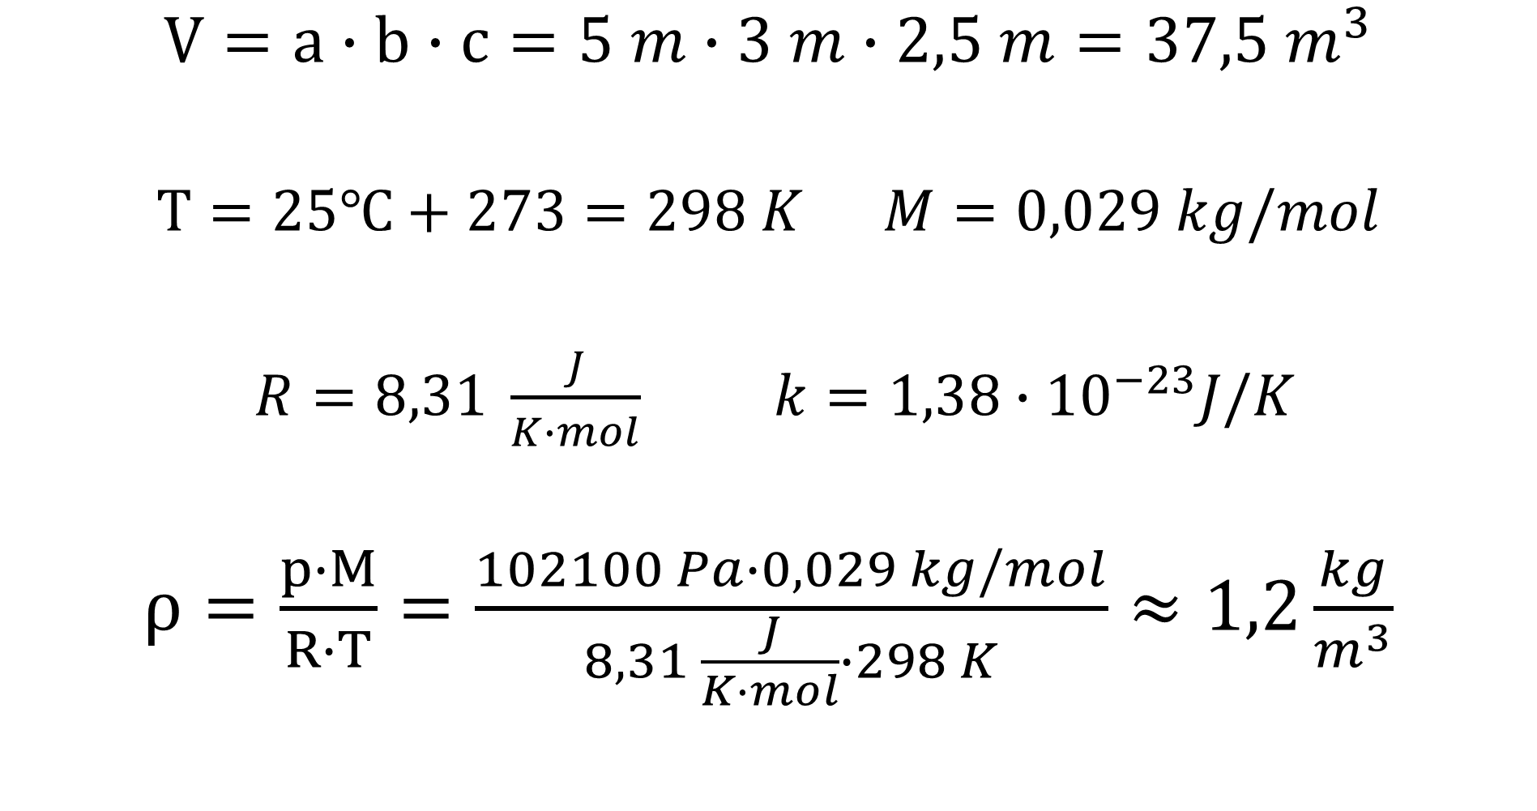
$V=a∙b∙c=5 m∙3 m∙2,5 m=37,5 m^{3}$
$T=25℃+273=298 K$ $M=0,029 kg/mol$
$R=8,31 \frac{J}{K∙mol}$ $k=1,38∙{10}^{−23}J/K$
$ρ=\frac{p∙M}{R∙T}=\frac{102100 Pa∙0,029 kg/mol}{8,31 \frac{J}{K∙mol}∙298 K}≈1,2\frac{kg}{m^{3}}$

Slide 4
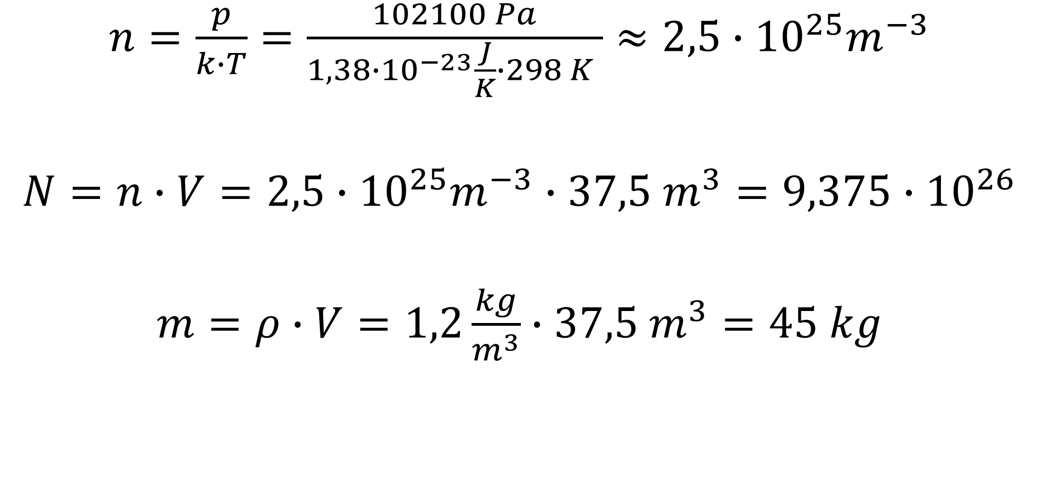
$n=\frac{p}{k∙T}=\frac{102100 Pa}{1,38∙{10}^{−23}\frac{J}{K}∙298 K }≈2,5∙{10}^{25}m^{−3}$
$N=n∙V=2,5∙{10}^{25}m^{−3}∙37,5 m^{3}=9,375∙{10}^{26}$
$m=ρ∙V=1,2\frac{kg}{m^{3}}∙37,5 m^{3}=45 kg$

Slide 5
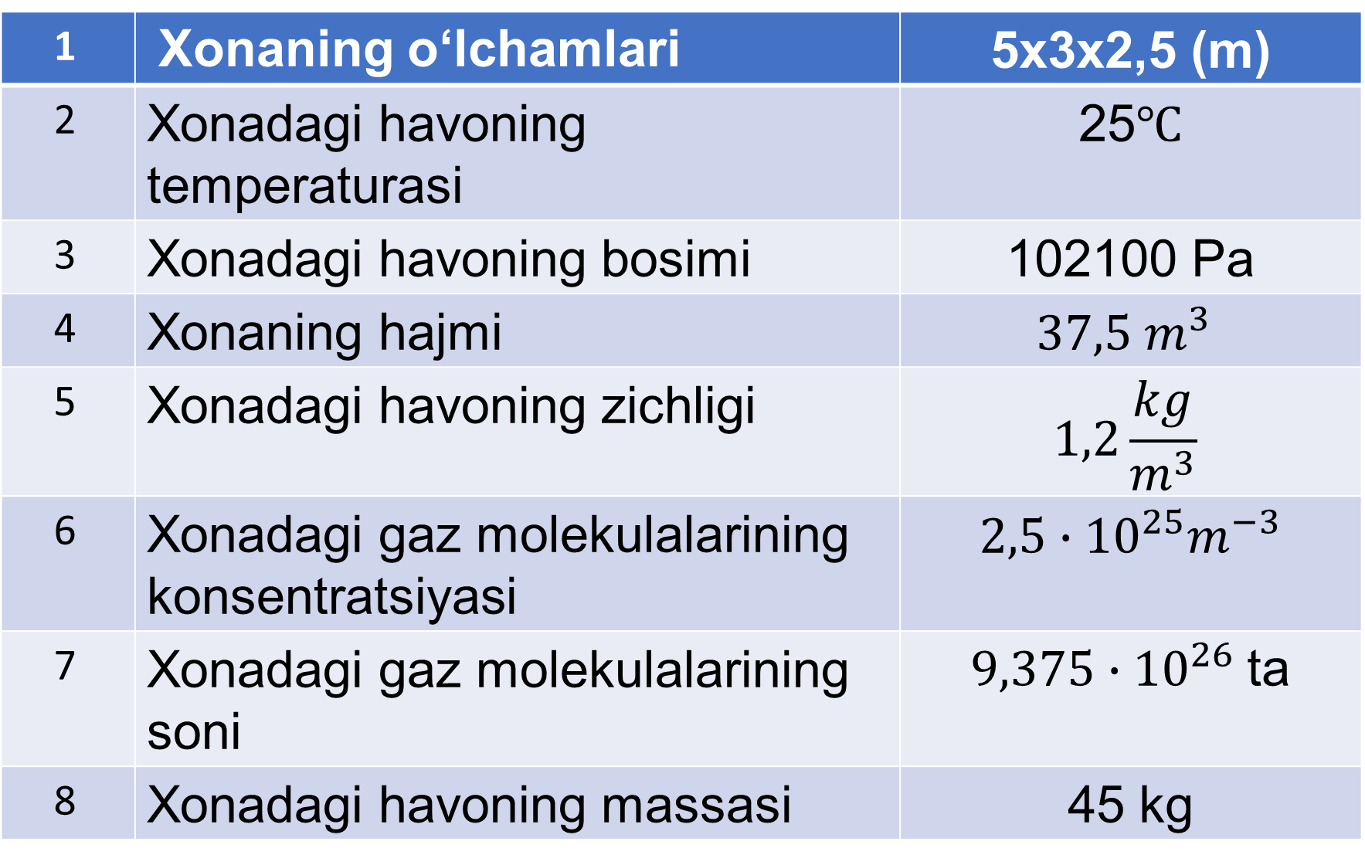
1 | Xonaning o‘lchamlari | 5x3x2,5 (m)
2 | Xonadagi havoning temperaturasi | 25$℃$
3 | Xonadagi havoning bosimi | 102100 Pa
4 | Xonaning hajmi | $$37,5 m^{3}$$
5 | Xonadagi havoning zichligi | $$1,2\frac{kg}{m^{3}}$$
6 | Xonadagi gaz molekulalarining konsentratsiyasi | $2,5∙{10}^{25}m^{−3}$
7 | Xonadagi gaz molekulalarining soni | $9,375∙{10}^{26}$ ta
8 | Xonadagi havoning massasi | 45 kg

Slide 6
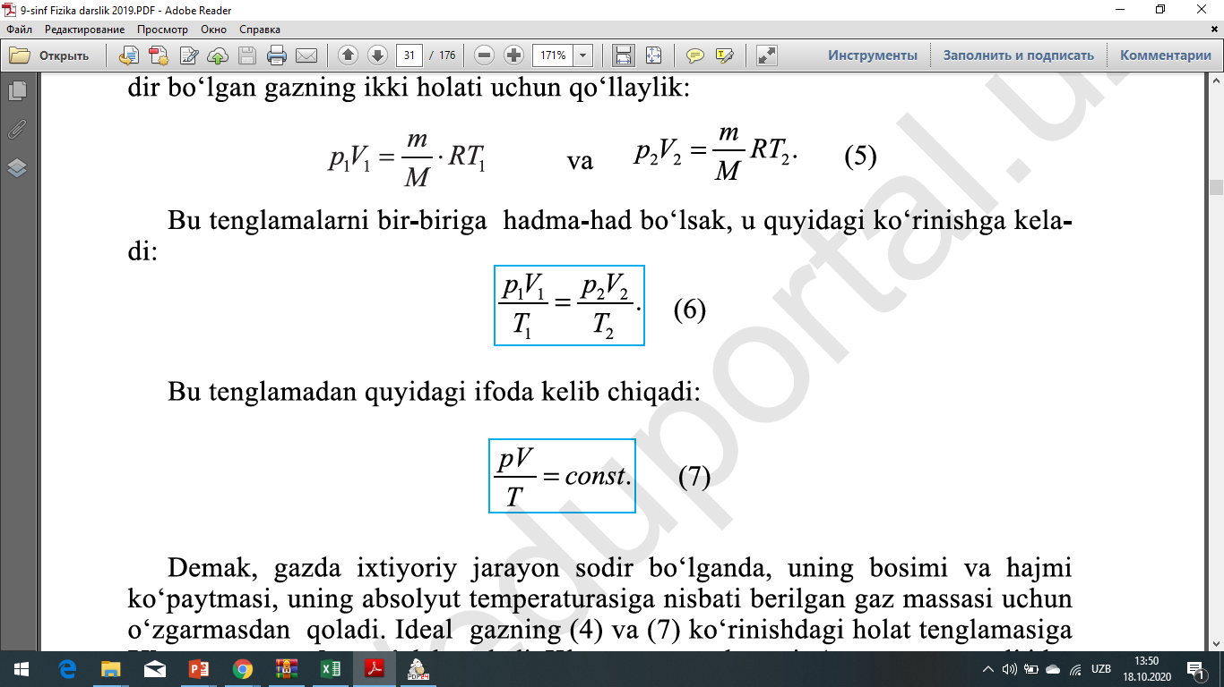
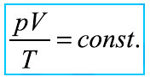
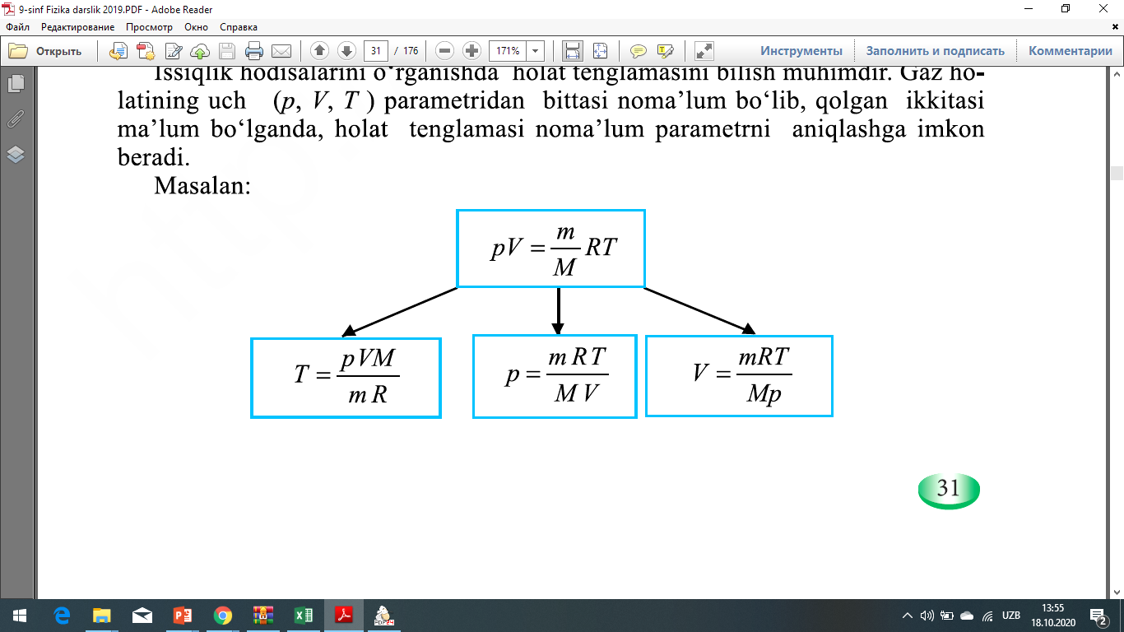
Ideal gaz holat tenglamasi

Slide 7
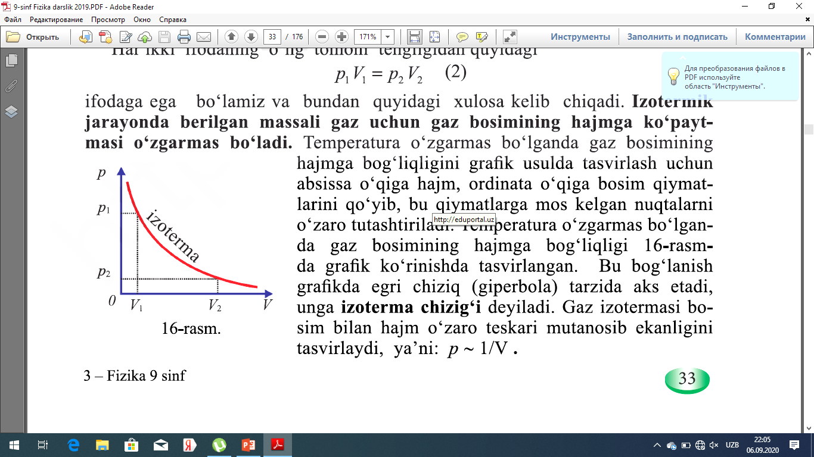

Izotermik jarayon
$T=const.$
$p∙V=const.$
$$p_{1}∙V_{1}=p_{2}∙V_{2}$$
$\frac{p_{1}}{p_{2}}=\frac{V_{2}}{V_{1}}$

Slide 8
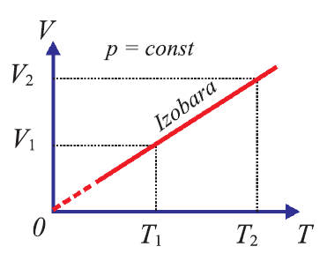

Izobarikik jarayon
$p=const.$
$\frac{V}{T}=const.$
$\frac{V_{1}}{V_{2}}=\frac{T_{1}}{T_{2}}$

Slide 9
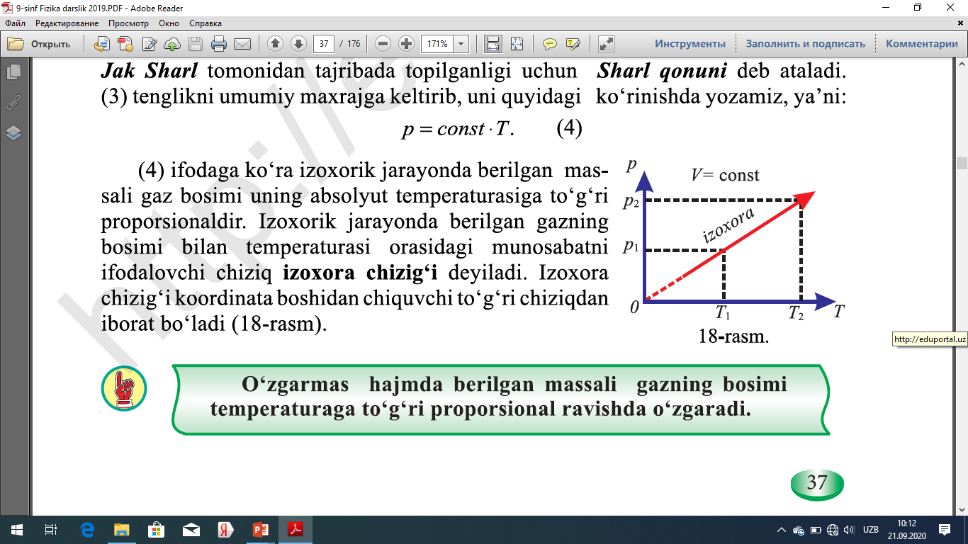

Izoxorik jarayon
$V=const.$
$\frac{P}{T}=const.$
$\frac{p_{1}}{p_{2}}=\frac{T_{1}}{T_{2}}$

Slide 10
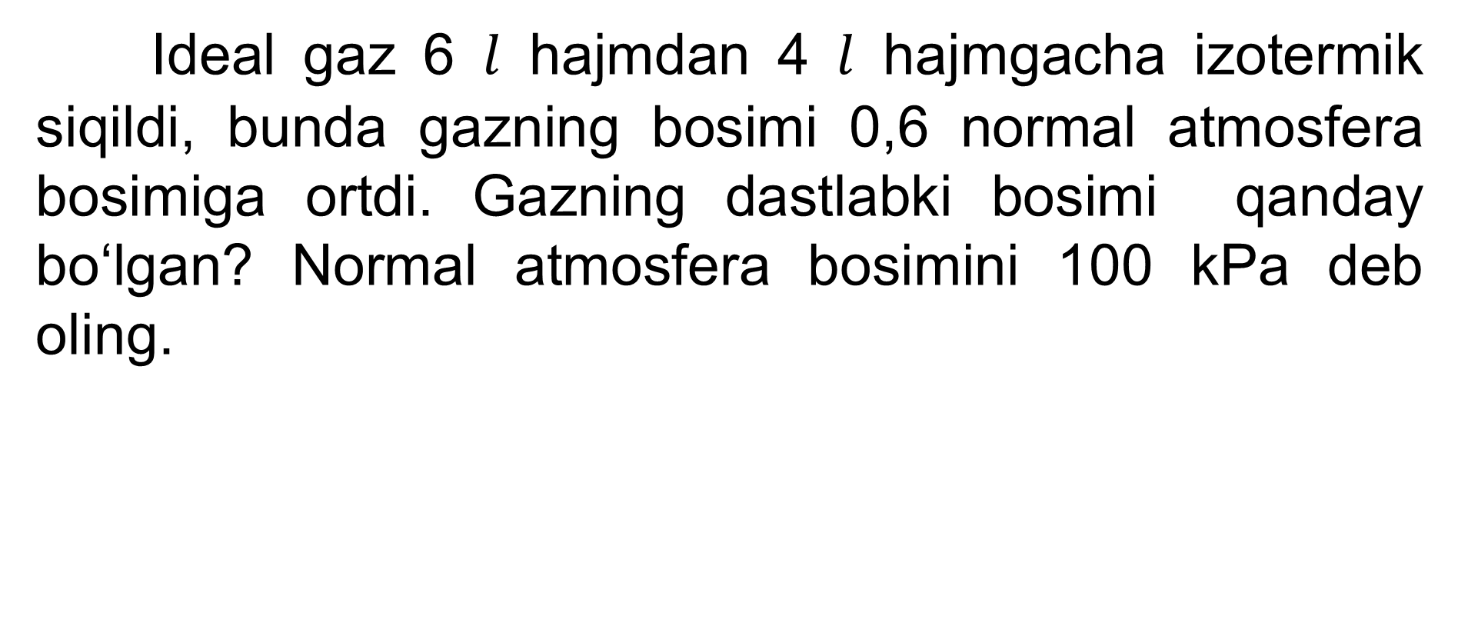
1-masala
Ideal gaz 6 $l$ hajmdan 4 $l$ hajmgacha izotermik siqildi, bunda gazning bosimi 0,6 normal atmosfera bosimiga ortdi. Gazning dastlabki bosimi qanday bo‘lgan? Normal atmosfera bosimini 100 kPa deb oling.

Slide 11
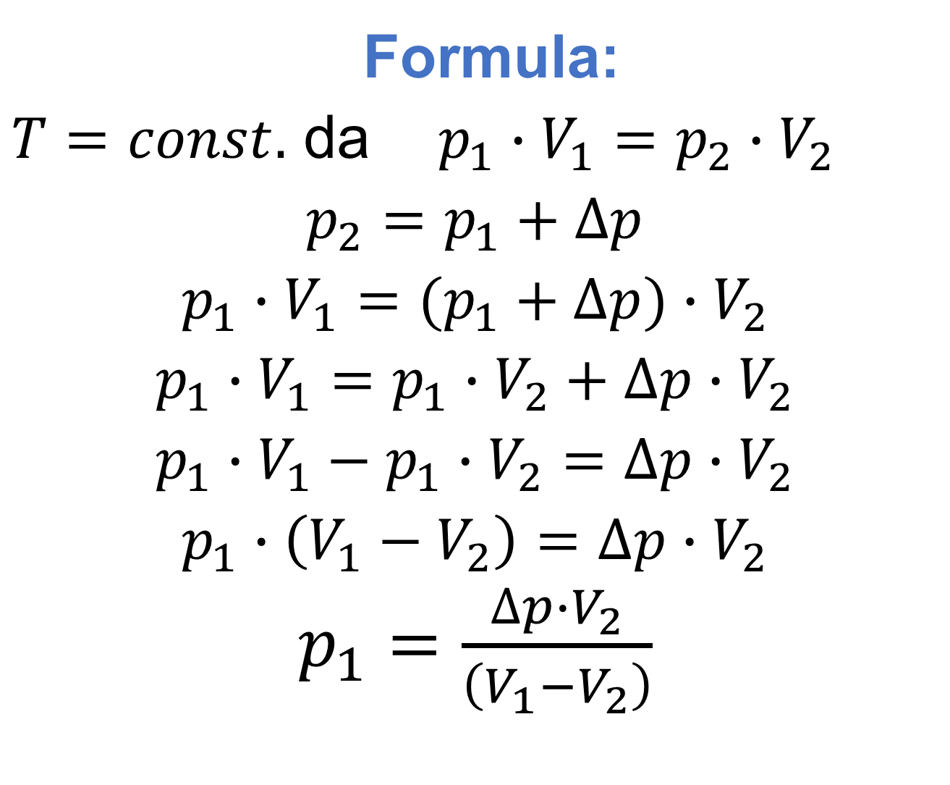
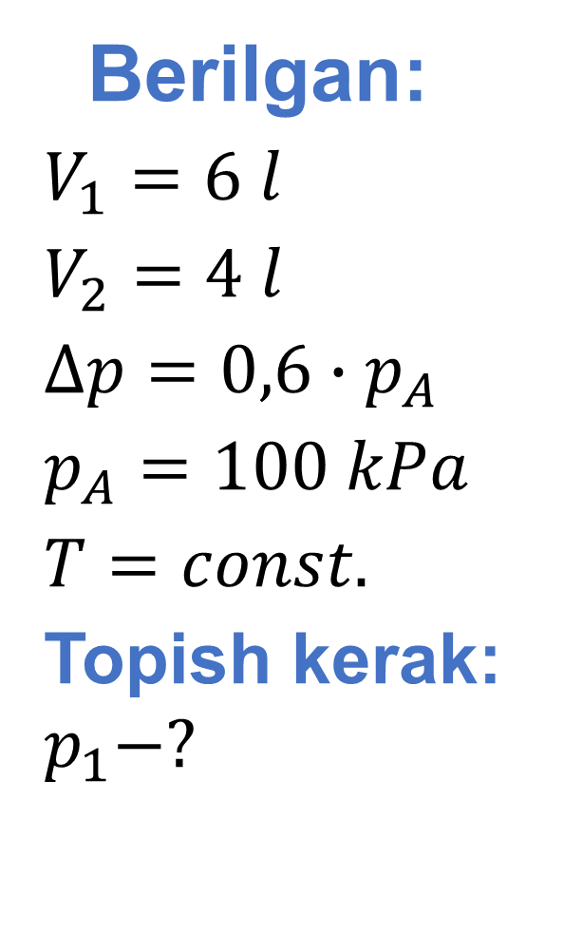
Berilgan:
$V_{1}=6 l$
$V_{2}=4 l$
$∆p=0,6∙p_{A}$
$p_{A}=100 kPa$
$T=const.$
Topish kerak: $p_{1}−?$
Formula:
$T=const.$ da $p_{1}∙V_{1}=p_{2}∙V_{2}$
$p_{2}=p_{1}+∆p$
$p_{1}∙V_{1}=(p_{1}+∆p)∙V_{2}$
$p_{1}∙V_{1}=p_{1}∙V_{2}+∆p∙V_{2}$
$p_{1}∙V_{1}−p_{1}∙V_{2}=∆p∙V_{2}$
$p_{1}∙\left(V_{1}−V_{2}\right)=∆p∙V_{2}$
$p_{1}=\frac{∆p∙V_{2}}{\left(V_{1}−V_{2}\right)}$

Slide 12
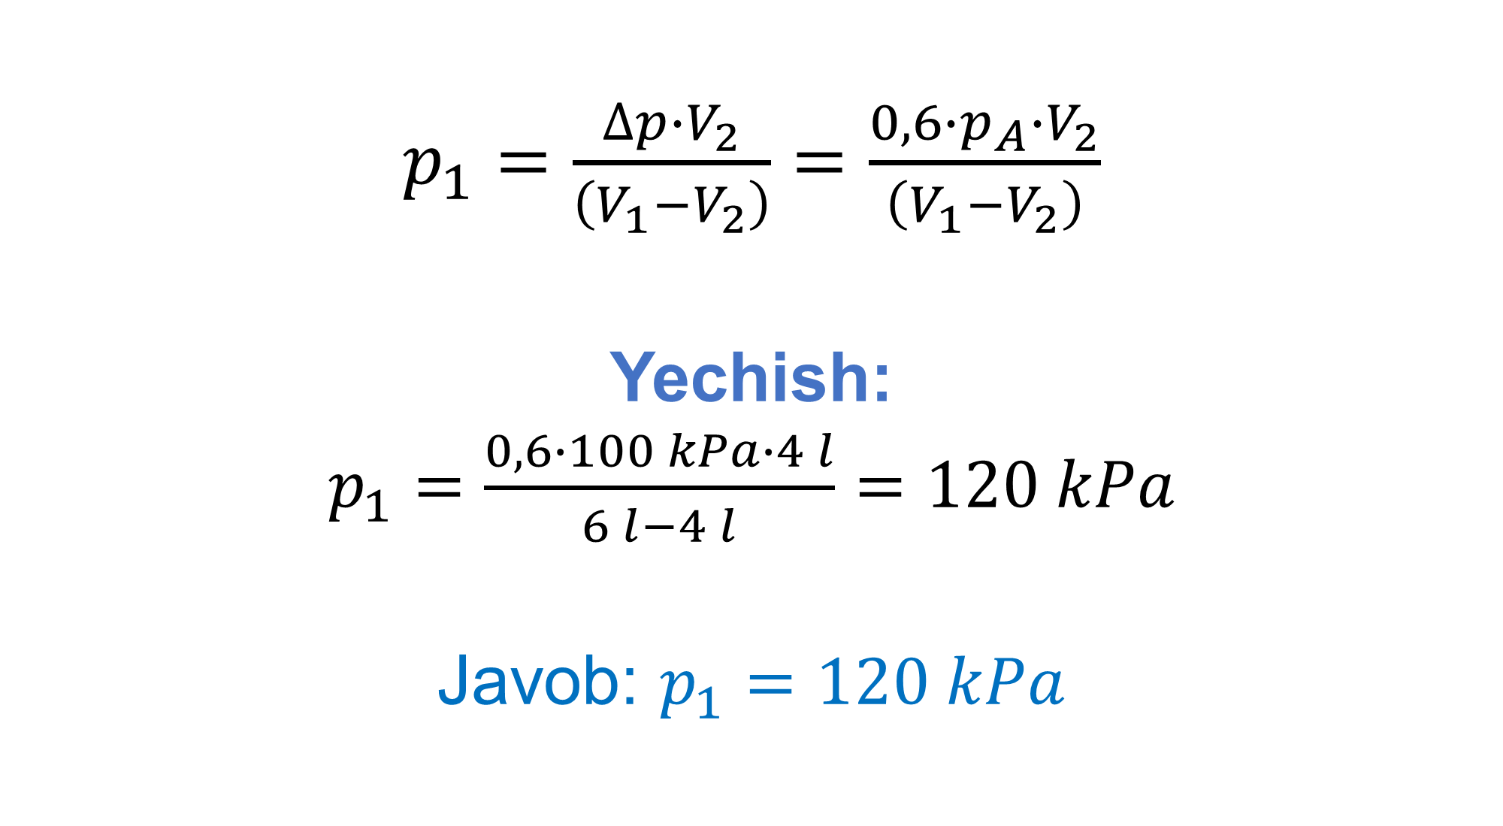
$p_{1}=\frac{∆p∙V_{2}}{\left(V_{1}−V_{2}\right)}=\frac{0,6∙p_{A}∙V_{2}}{\left(V_{1}−V_{2}\right)}$
Yechish:
$p_{1}=\frac{0,6∙100 kPa∙4 l}{6 l−4 l}=120 kPa$
Javob: $p_{1}=120 kPa$

Slide 13
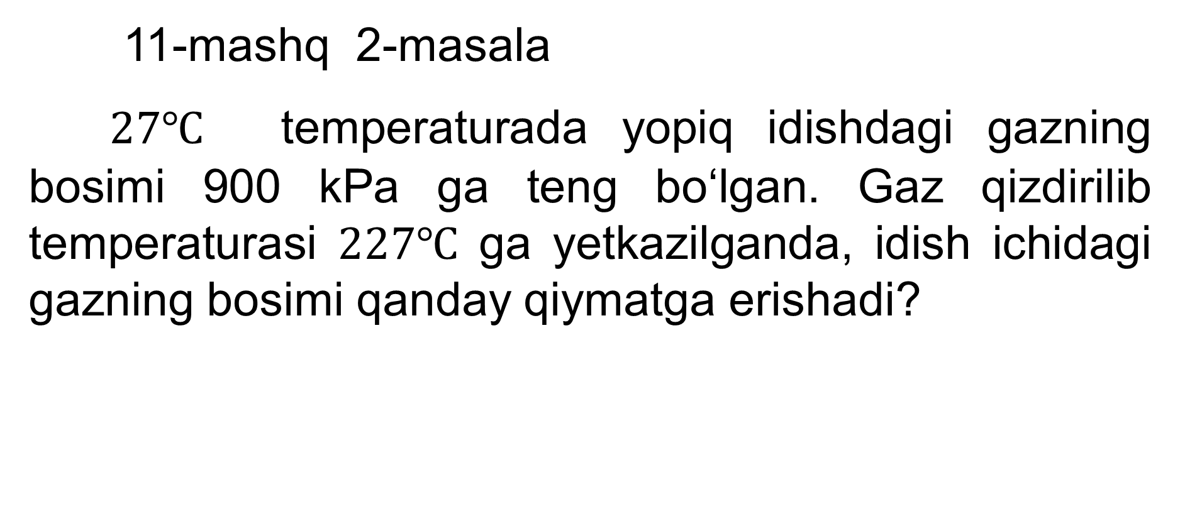
2- masala
11-mashq 2-masala
$27℃$ temperaturada yopiq idishdagi gazning bosimi 900 kPa ga teng bo‘lgan. Gaz qizdirilib temperaturasi $227℃$ ga yetkazilganda, idish ichidagi gazning bosimi qanday qiymatga erishadi?

Slide 14
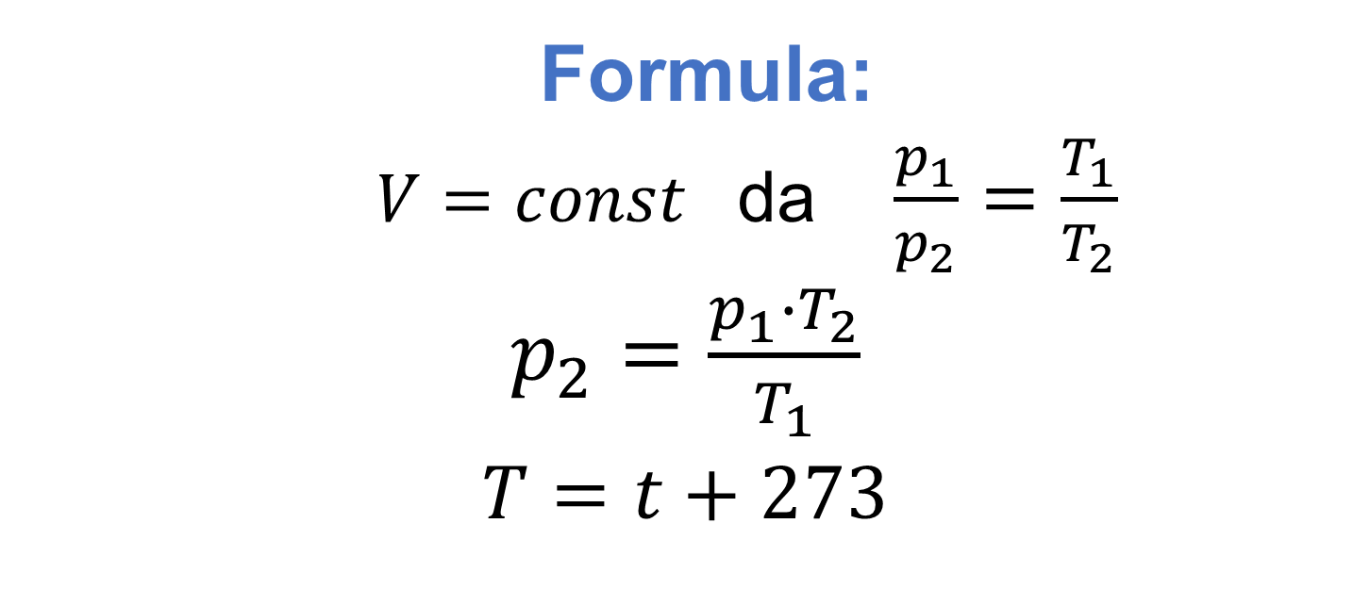

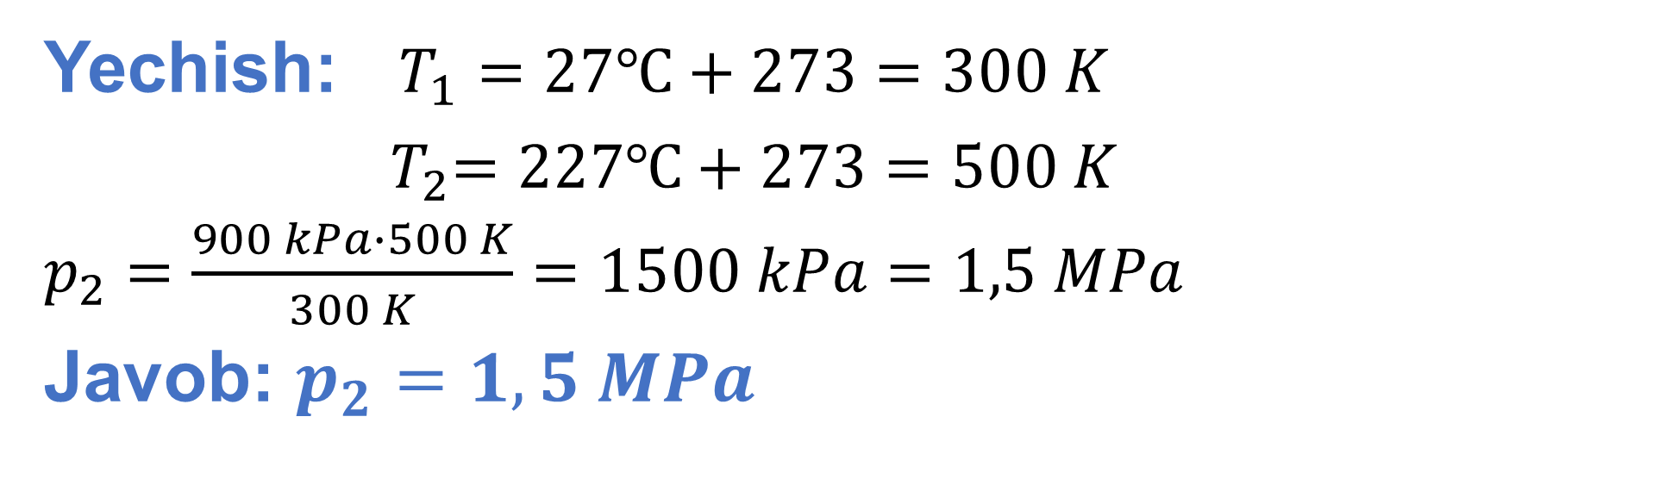
Berilgan:
$t_{1}=27℃$
$V=const.$
$p_{1}=900 kPa$
$t_{2}=227℃$
Topish kerak: $p_{2}−?$
Formula:
$V=const$ da $\frac{p_{1}}{p_{2}}=\frac{T_{1}}{T_{2}}$
$p_{2}=\frac{p_{1}∙T_{2}}{T_{1}}$
$T=t+273$
Yechish: $T_{1}=27℃+273=300 K$
${ T}_{2}=227℃+273=500 K$
$p_{2}=\frac{900 kPa∙500 K}{300 K}=1500 kPa=1,5 MPa$
Javob: $p_{2}=1,5 MPa$

Slide 15
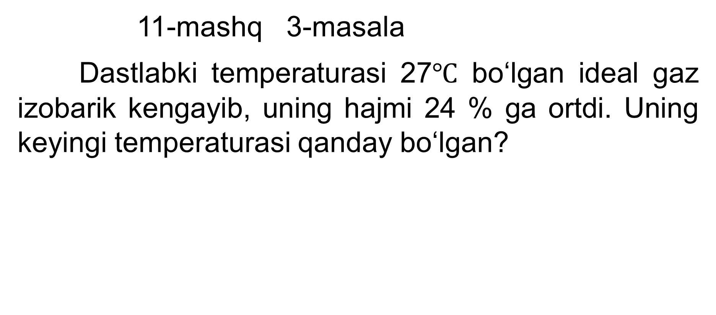
3-masala
11-mashq 3-masala
Dastlabki temperaturasi 27$℃$ bo‘lgan ideal gaz izobarik kengayib, uning hajmi 24 % ga ortdi. Uning keyingi temperaturasi qanday bo‘lgan?

Slide 16
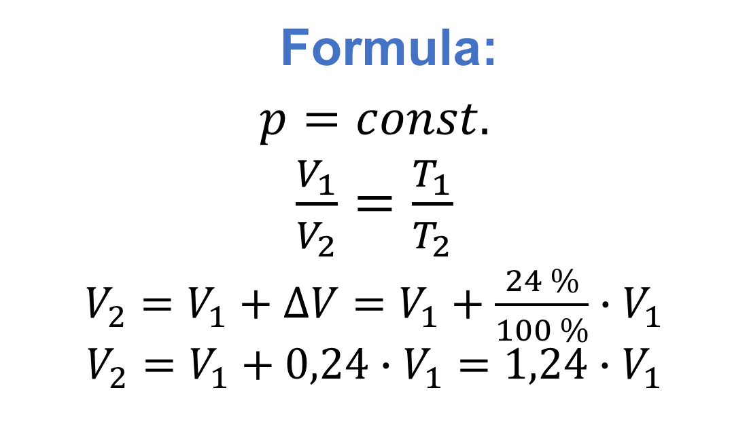
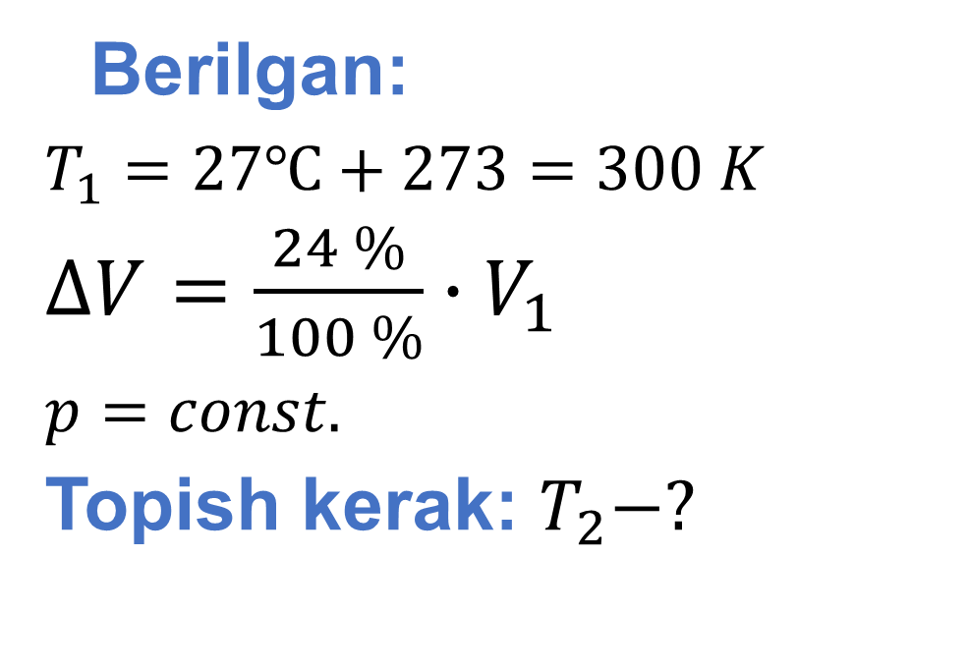
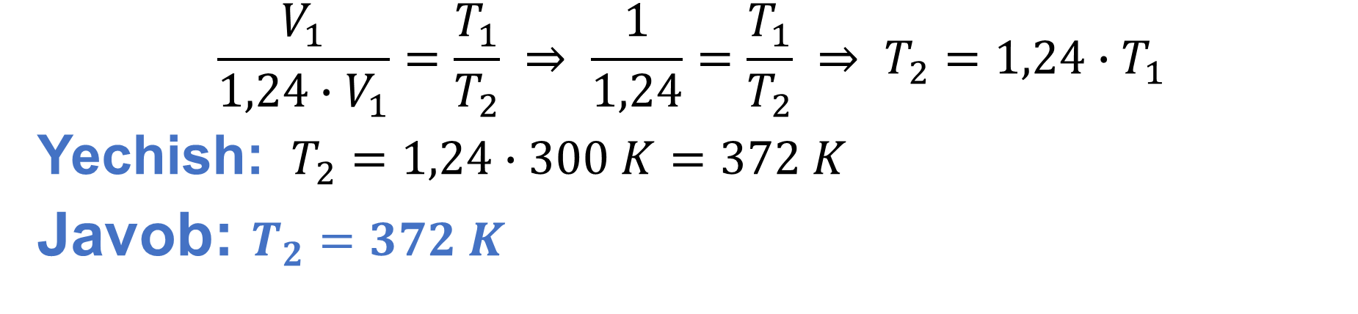
Formula:
$p=const.$
$\frac{V_{1}}{V_{2}}=\frac{T_{1}}{T_{2}}$
$V_{2}=V_{1}+∆V=V_{1}+\frac{24 \%}{100 \%}∙V_{1}$
$$V_{2}=V_{1}+0,24∙V_{1}=1,24∙V_{1}$$
Berilgan:
$T_{1}=27℃+273=300 K$
$∆V=\frac{24 \%}{100 \%}∙V_{1}$
$p=const.$
Topish kerak: $T_{2}−?$
$$\frac{V_{1}}{1,24∙V_{1}}=\frac{T_{1}}{T_{2}} ⇒ \frac{1}{1,24}=\frac{T_{1}}{T_{2}} ⇒ T_{2}=1,24∙T_{1}$$
Yechish: $T_{2}=1,24∙300 K=372 K$
Javob: $T_{2}=372 K$

Slide 17
5-masala
11-mashq 5-masala
Havo puffakchasi suv havzasining tubidan yuziga chiqquncha 3,5 marta kattalshadi. Suv havzasining chuqurligi qanday? Suvning ustki va pastki qismida temperaturalar bir xil deb hisoblang.

Slide 18
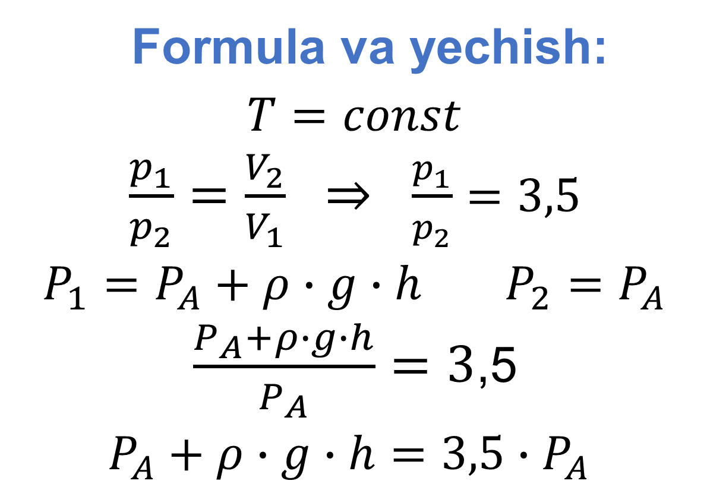
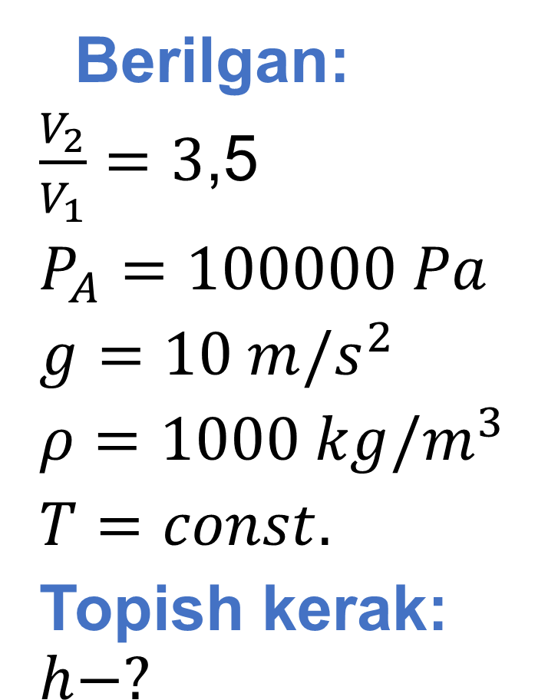

Berilgan:
$\frac{V_{2}}{V_{1}}=3$,5
$P_{A}=100000 Pa$
$g=10 m/s^{2}$
$ρ=1000 kg/m^{3}$
$T=const.$
Topish kerak: $h−?$
Formula va yechish:
$T=const$
$\frac{p_{1}}{p_{2}}=\frac{V_{2}}{V_{1}} ⇒ \frac{p_{1}}{p_{2}}=3,5$
$P_{1}=P_{A}+ρ∙g∙h$ $P_{2}=P_{A}$
$\frac{P_{A}+ρ∙g∙h}{P_{A}}=3$,5
$P_{A}+ρ∙g∙h=3,5∙P_{A}$
$ρ∙g∙h=2,5∙P_{A}$ $h=\frac{2,5∙P_{A}}{ρ∙g}$

Slide 19
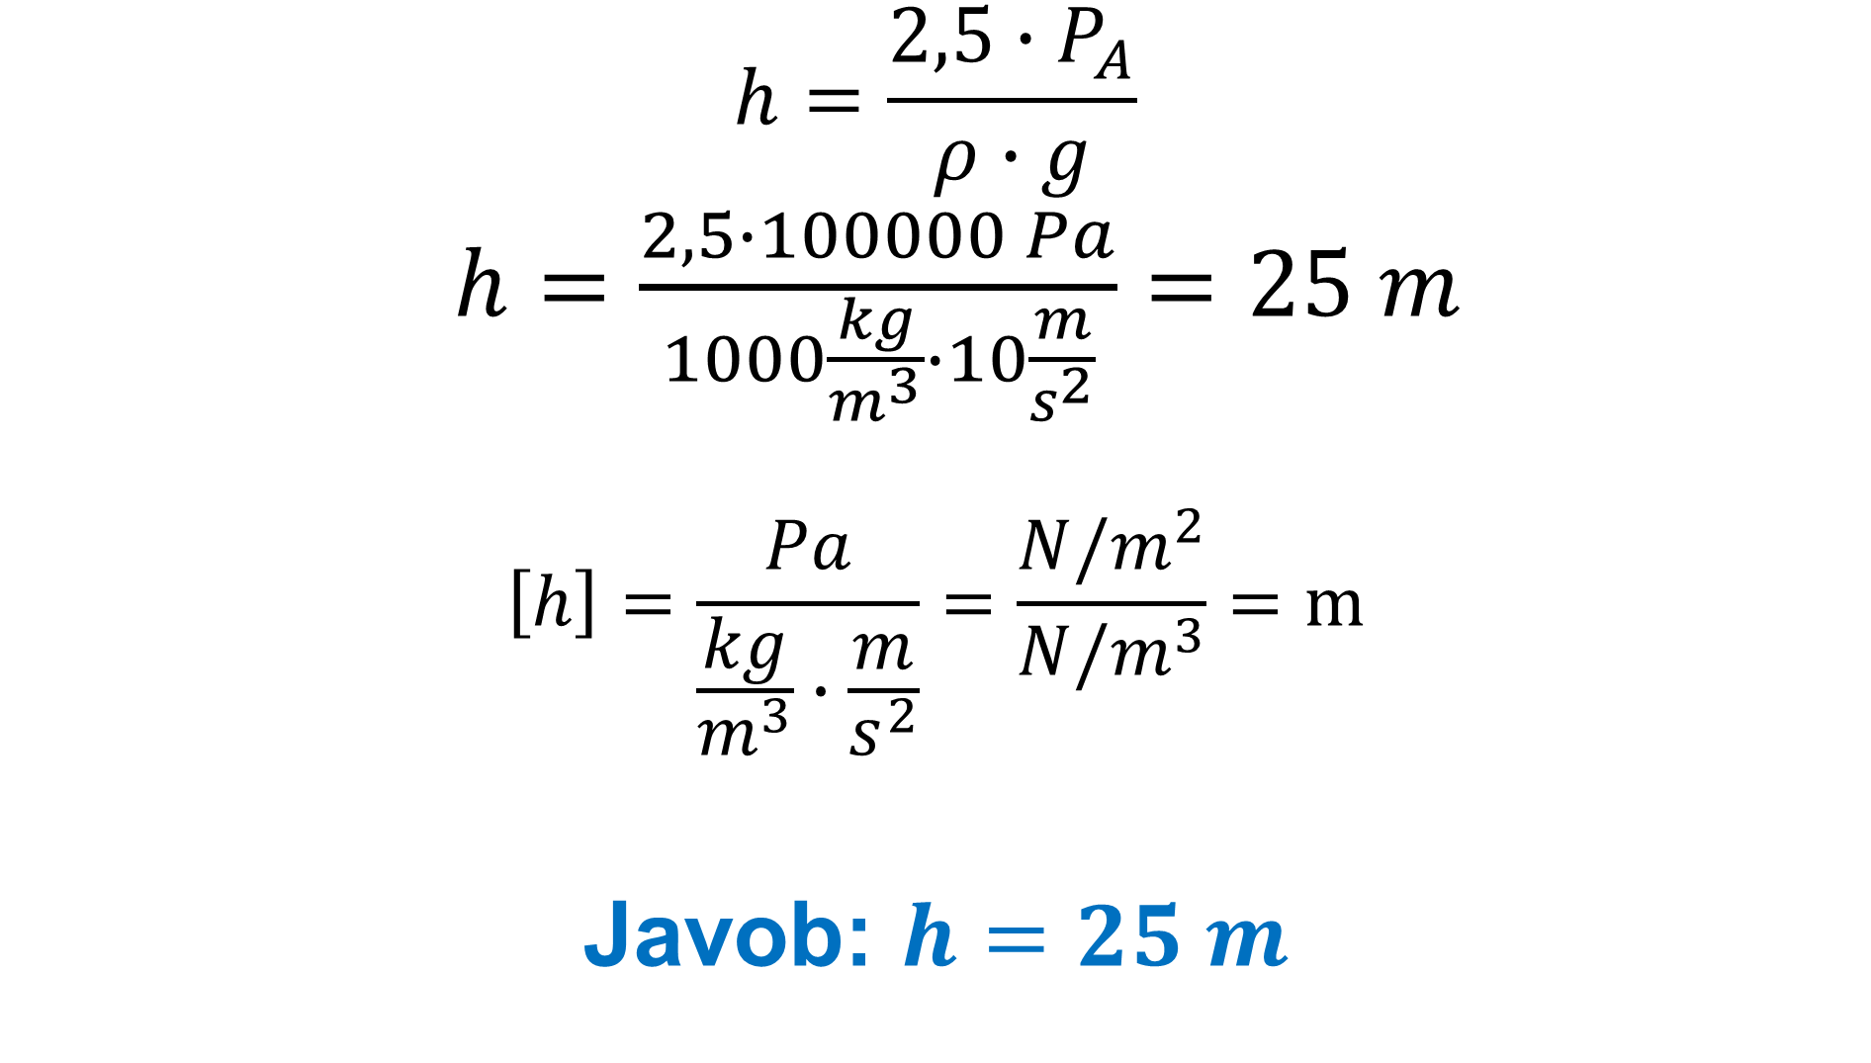
$$h=\frac{2,5∙P_{A}}{ρ∙g}$$
$h=\frac{2,5∙100000 Pa}{1000\frac{kg}{m^{3}}∙10\frac{m}{s^{2}}}=25 m$
$$\left[h\right]=\frac{Pa}{\frac{kg}{m^{3}}∙\frac{m}{s^{2}}}=\frac{N/m^{2}}{N/m^{3}}=m$$
Javob: $h=25 m$

Slide 20
Mustaqil bajarish uchun topshiriqlar
11-mashqning 2,4,6-masalalarini yechish.

