Slide 1

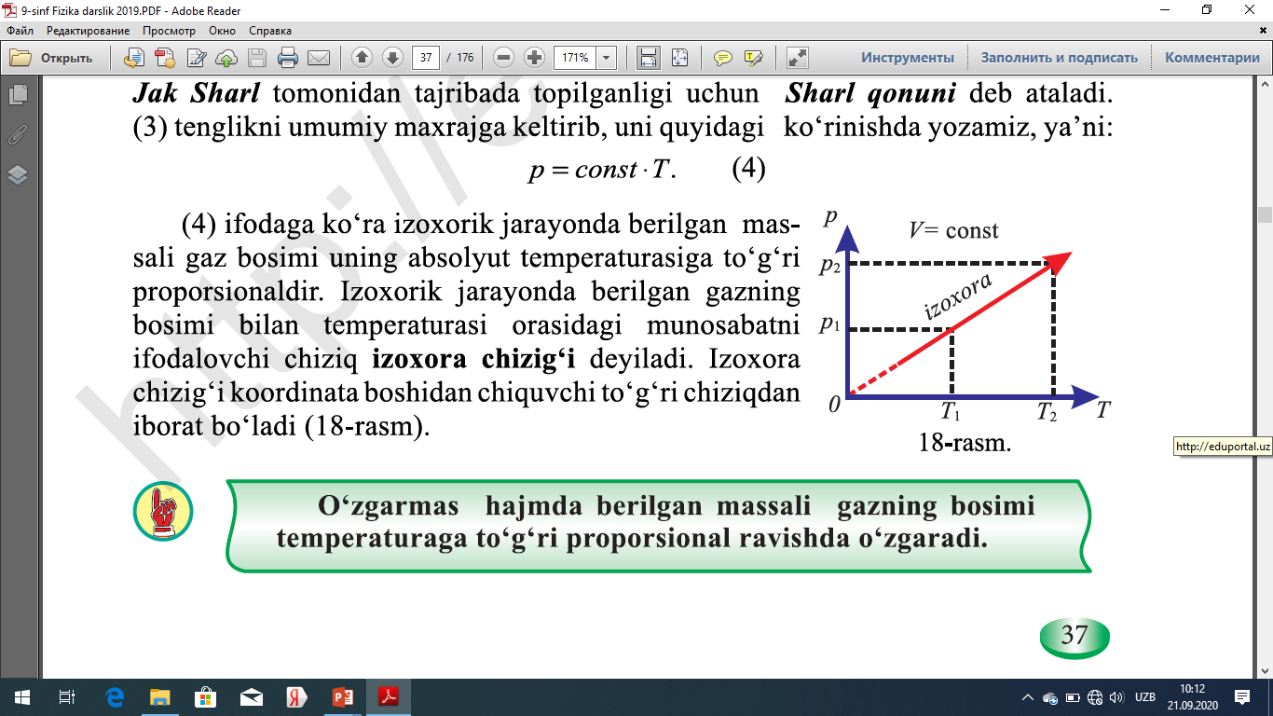
Fizika
9
sinf
MAVzu: Izoxorik jarayon
O‘qituvchi:
Toshkent shahar Uchtepa tumani 287-maktab fizika fani o‘qituvchisi
Xo‘jayeva Maxtuma Ziyatovna.

Slide 2
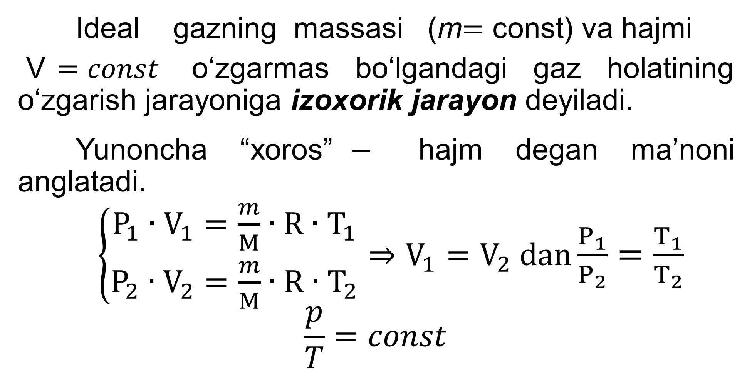
Ideal gazning massasi (m$=\text{const}$) va hajmi
V$=const$ o‘zgarmas bo‘lgandagi gaz holatining o‘zgarish jarayoniga izoxorik jarayon deyiladi.
Yunoncha “xoros”$−$ hajm degan ma’noni anglatadi.
$\left\{\begin{aligned}P_{1}∙V_{1}=\frac{m}{M}∙R∙T_{1} \\ P_{2}∙V_{2}=\frac{m}{M}∙R∙T_{2}\end{aligned}\right.⇒V_{1}=V_{2} dan$ $\frac{P_{1}}{P_{2}}=\frac{T_{1}}{T_{2}}$
$$\frac{p}{T}=const$$

Slide 3
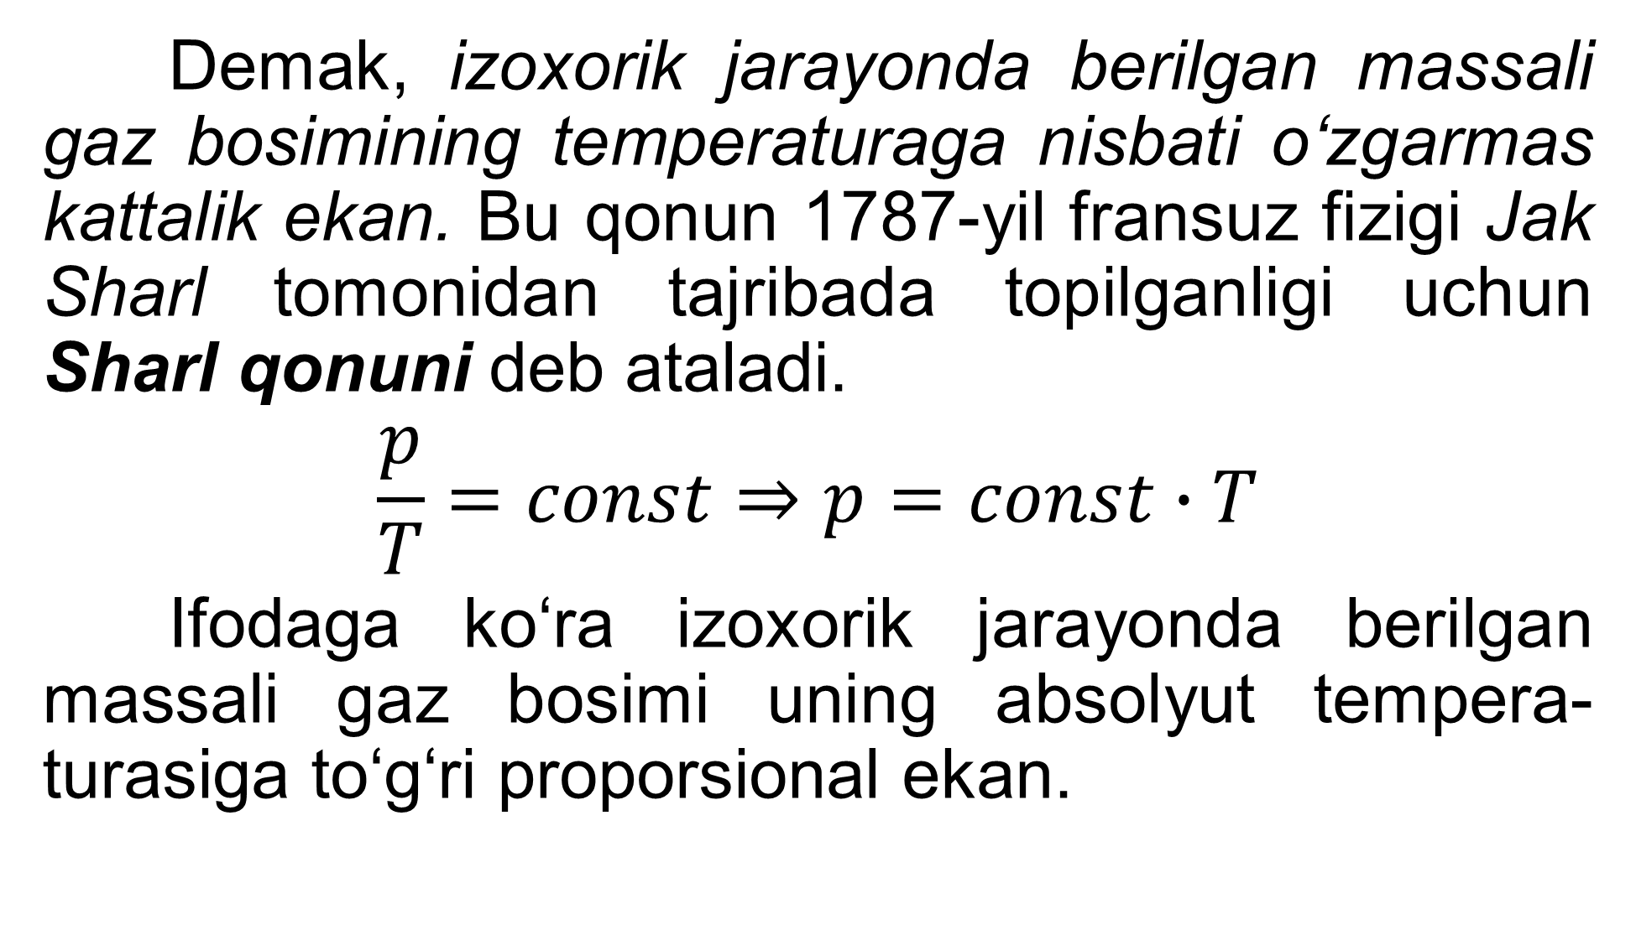
Demak, izoxorik jarayonda berilgan massali gaz bosimining temperaturaga nisbati o‘zgarmas kattalik ekan. Bu qonun 1787-yil fransuz fizigi Jak Sharl tomonidan tajribada topilganligi uchun Sharl qonuni deb ataladi.
$$\frac{p}{T}=const⇒p=const∙T$$
Ifodaga ko‘ra izoxorik jarayonda berilgan massali gaz bosimi uning absolyut tempera-turasiga to‘g‘ri proporsional ekan.

Slide 4
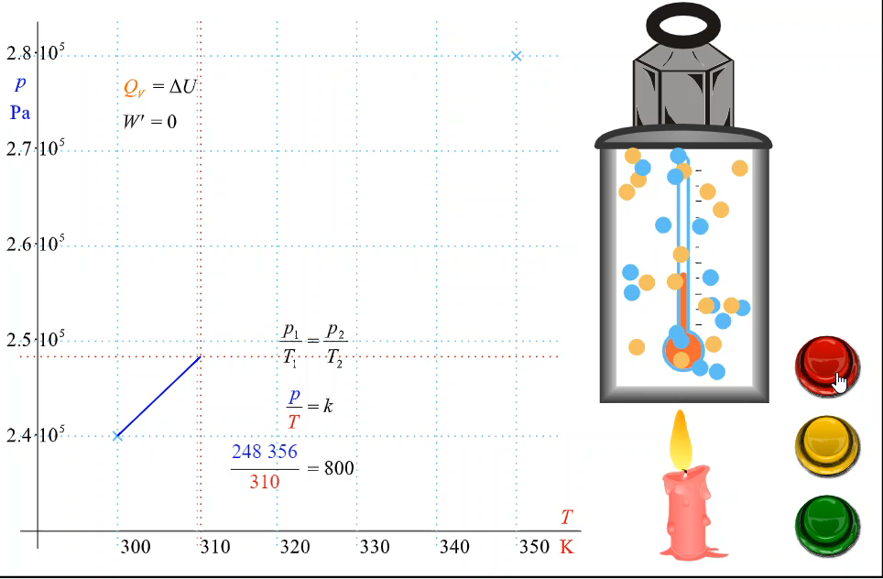

Slide 5
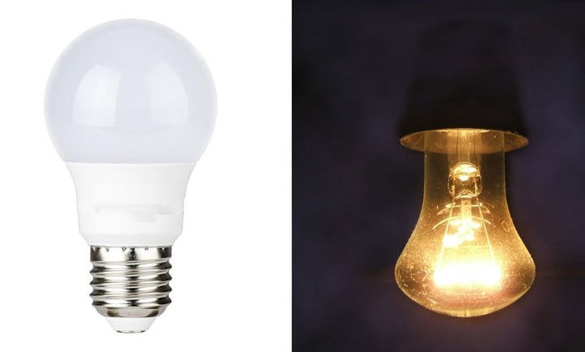
O‘zgarmas hajmda berilgan massali gaz bosimi temperaturaga to‘g‘ri proporsional ravishda o‘zgaradi.
Har qanday germetik yopiq idish yoki elektr lampochkasida isitilgan gaz bosimining ortishi izoxorik jarayon hisoblanadi.

Slide 6
Masala yechish namunasi
Gaz 280 K dan 540 K gacha izoxorik qizdirilganda uning bosimi 39 kPa ga ortdi. Gaz dastlab qanday bosimda bo‘lgan.

Slide 7
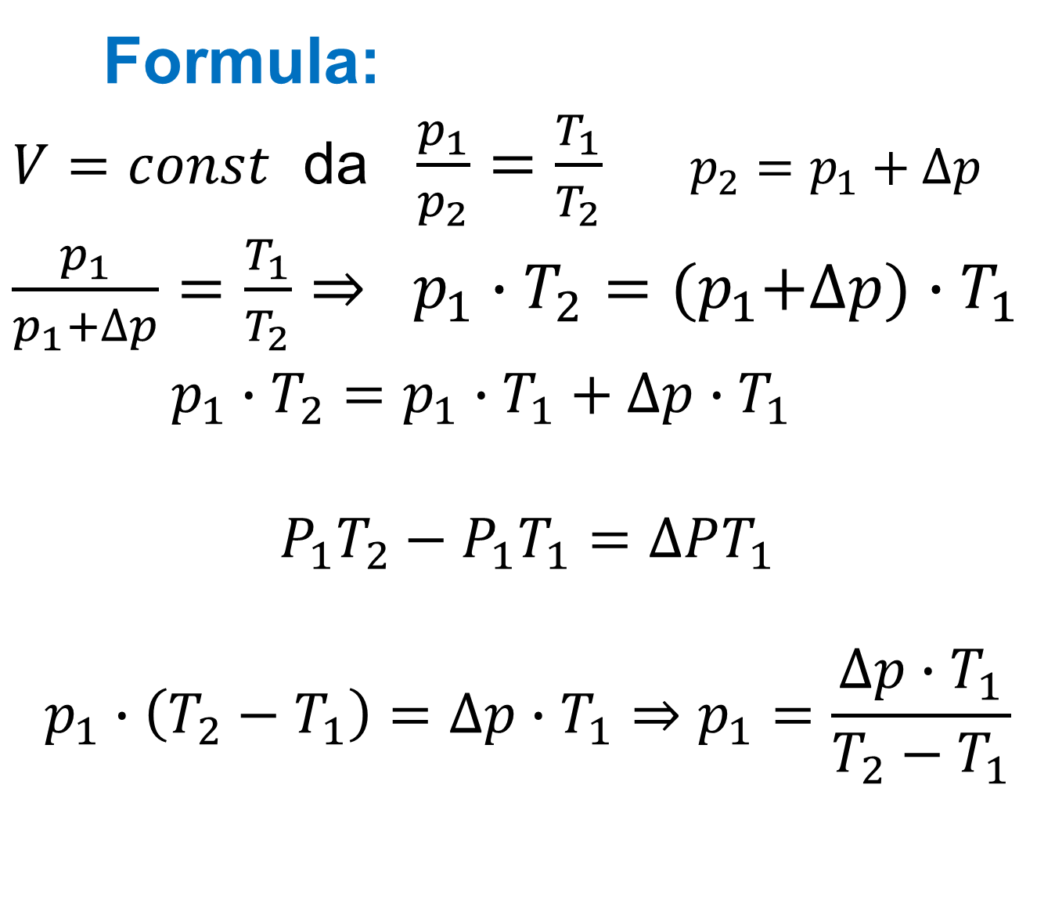
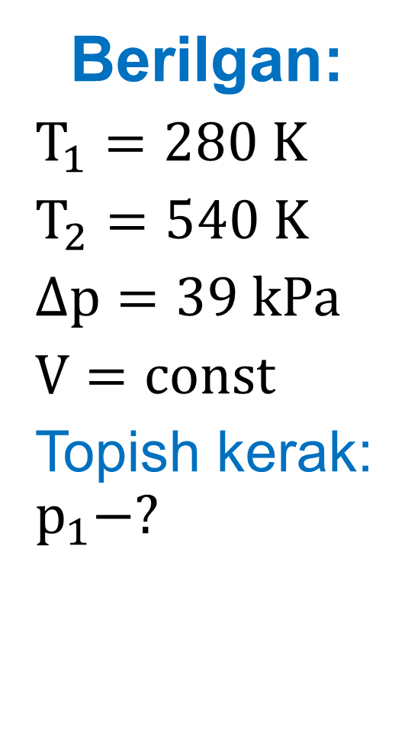
Berilgan:
$T_{1}=280 K$
$T_{2}=540 K$
$∆p=39 kPa$
$V=const$
Topish kerak: $p_{1}−?$
Formula:
$V=const$ da $\frac{p_{1}}{p_{2}}=\frac{T_{1}}{T_{2}}$ $p_{2}=p_{1}+∆p$
$\frac{p_{1}}{p_{1}+∆p}=\frac{T_{1}}{T_{2}}⇒ p_{1}∙T_{2}={(p}_{1}+∆p)∙T_{1}$
$p_{1}∙T_{2}=p_{1}∙T_{1}+∆p∙T_{1}$
$$P_{1}T_{2}−P_{1}T_{1}=∆PT_{1}$$
$$p_{1}∙\left(T_{2}−T_{1}\right)=∆p∙T_{1}⇒p_{1}=\frac{∆p∙T_{1}}{T_{2}−T_{1}}$$

Slide 8

Yechish: $P_{1}=\frac{39kPa∙280K}{540K−280K}=42kPa$
Javob: $P_{1}=42kPa$

Slide 9

10-mashq 1-masala
Ballondagi gaz 17$℃$ temperaturada $1,45∙{10}^{5}$ Pa bosimga ega bo‘lsa, qanday temperaturada uning bosimi $2∙{10}^{5}$ Pa bo‘ladi?

Slide 10
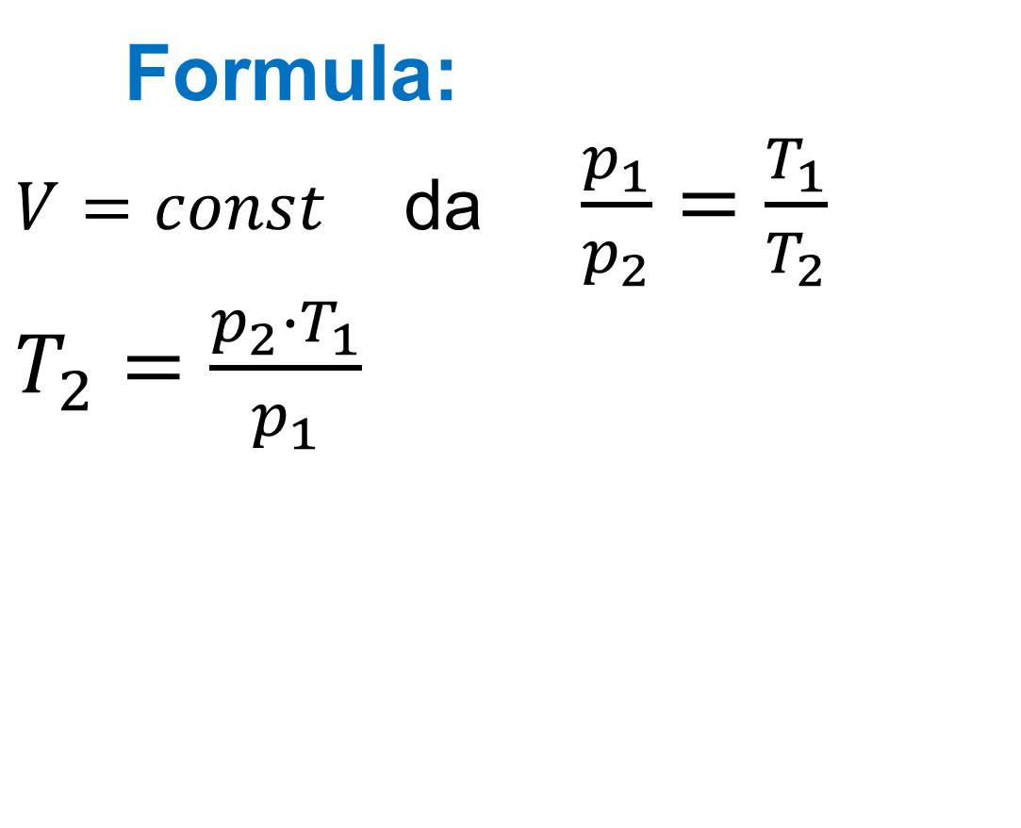
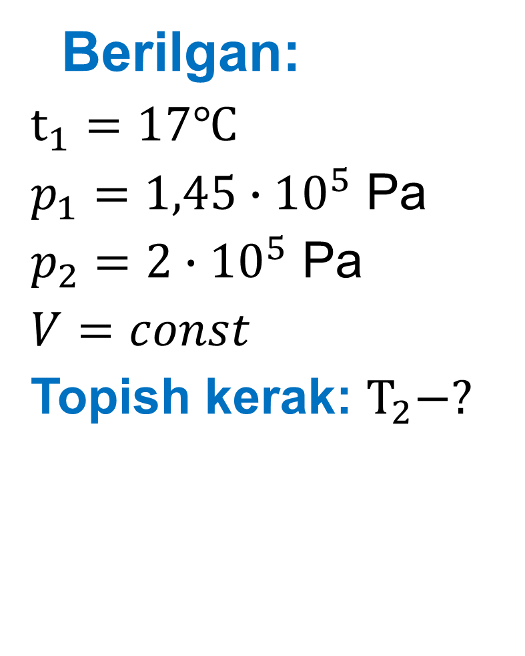
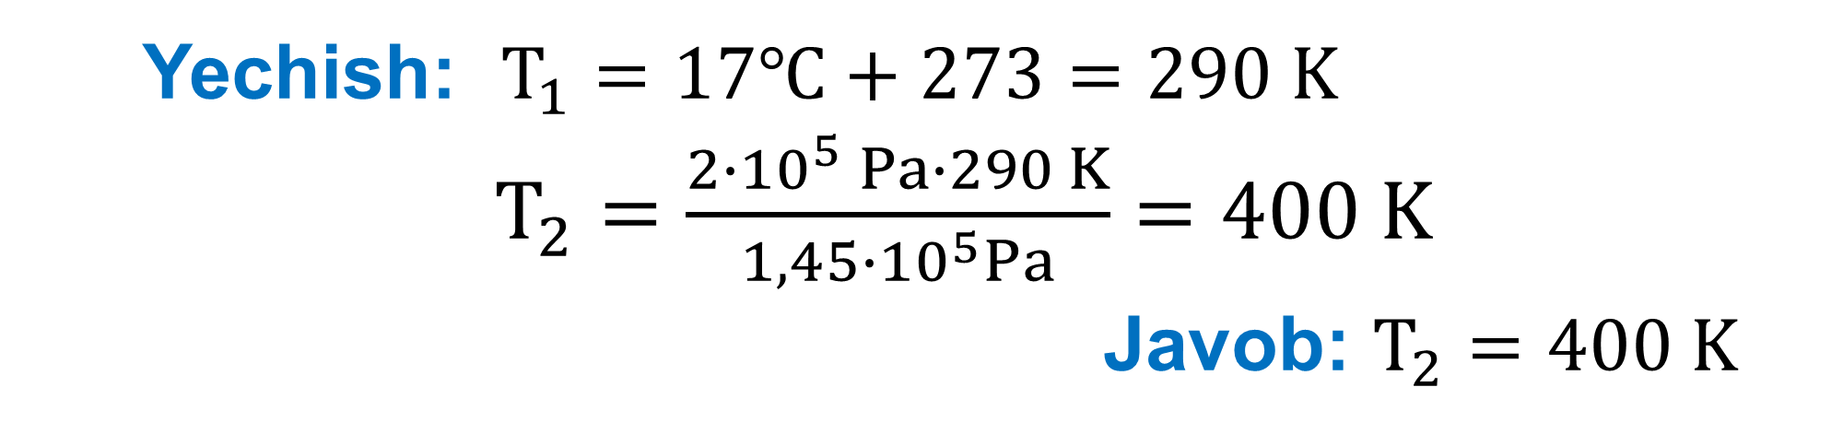
Berilgan:
$t_{1}=17℃$
$p_{1}=1,45∙{10}^{5}$ Pa
$p_{2}=2∙{10}^{5}$ Pa
$V=const$
Topish kerak: $T_{2}−?$
Formula:
$V=const$ da $\frac{p_{1}}{p_{2}}=\frac{T_{1}}{T_{2}}$
$T_{2}=\frac{p_{2}∙T_{1}}{p_{1}}$
Yechish: $T_{1}=17℃+273=290 K$
$T_{2}=\frac{2∙{10}^{5} Pa∙290 K}{1,45∙{10}^{5}Pa}=400 K$
Javob: $T_{2}=400 K$

Slide 11

24-test (46-bet)
Yopiq idishdagi temperaturasi $− 96℃$ bo‘lgan ideal gazni $81℃$ gacha qizdirganda uning bosimi necha marta ortadi?
A) 3 B) 2 C) 1,18 D) 2,21

Slide 12
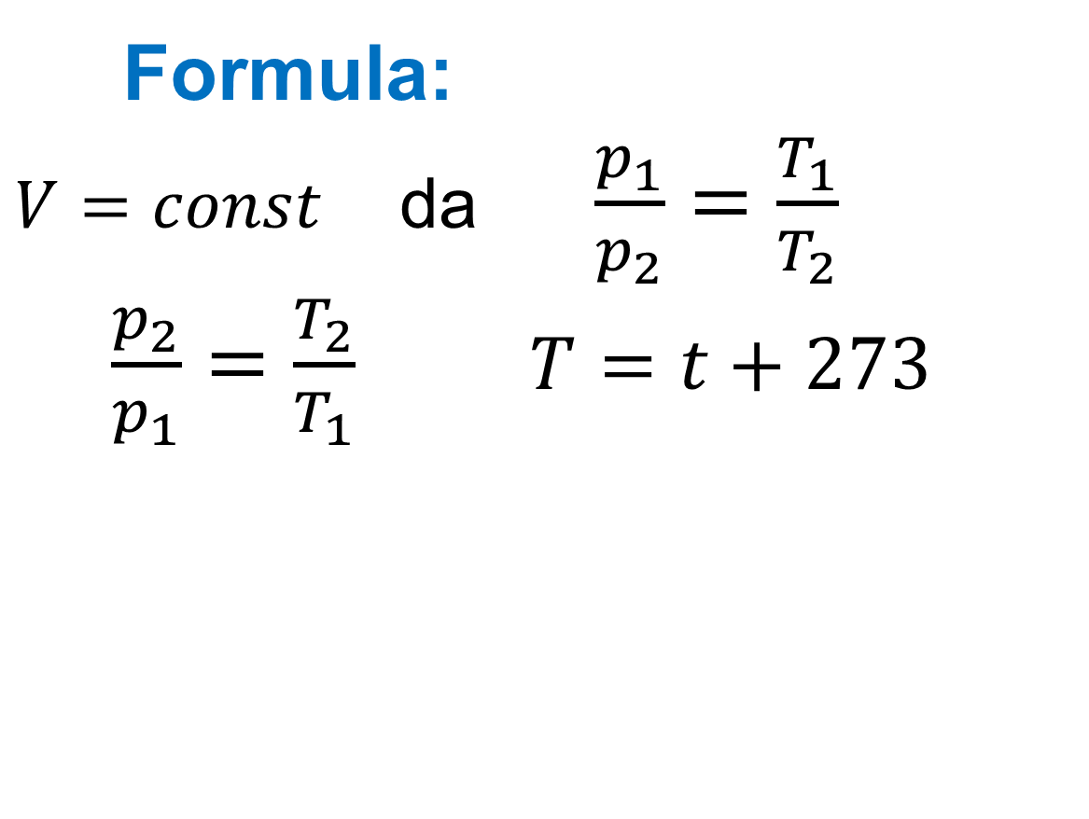

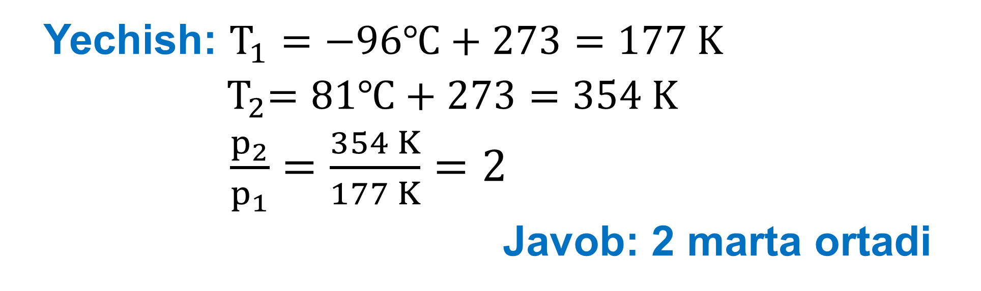
Berilgan:
$t_{1}=−96℃$
$t_{2}=81℃$
$V=const$
Topish kerak: $\frac{p_{2}}{p_{1}}−?$
Formula:
$V=const$ da $\frac{p_{1}}{p_{2}}=\frac{T_{1}}{T_{2}}$
$\frac{p_{2}}{p_{1}}=\frac{T_{2}}{T_{1}}$ $T=t+273$
Yechish: $T_{1}=−96℃+273=177 K$
${ T}_{2}=81℃+273=354 K$
$\frac{p_{2}}{p_{1}}=\frac{354 K}{177 K}=2$
Javob: 2 marta ortadi

Slide 13
Masala
Ballondagi gaz temperaturasi 400 K ga teng bo‘lib, uning bosimi 3 marta ortgan bo‘lsa, gazning oxirgi temperaturasini aniqlang (K).
A) 450 B) 1200 C) 750 D) 600

Slide 14
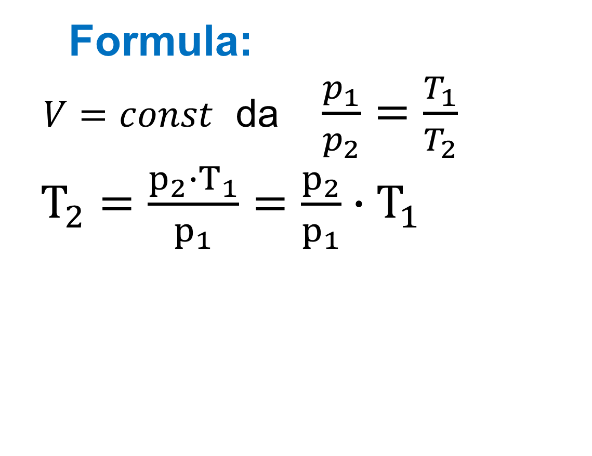
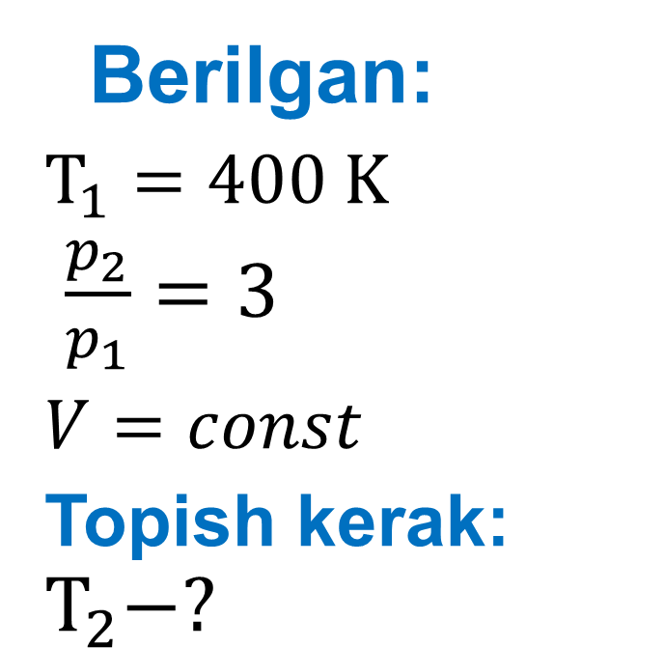

Berilgan:
$T_{1}=400 K$
$\frac{p_{2}}{p_{1}}=3$
$V=const$
Topish kerak: $T_{2}−?$
Formula:
$V=const$ da $\frac{p_{1}}{p_{2}}=\frac{T_{1}}{T_{2}}$
$T_{2}=\frac{p_{2}∙T_{1}}{p_{1}}=\frac{p_{2}}{p_{1}}∙T_{1}$
Yechish: ${ T}_{2}=3∙400 K=1200 K$
Javob: $T_{2}=1200 K$

Slide 15
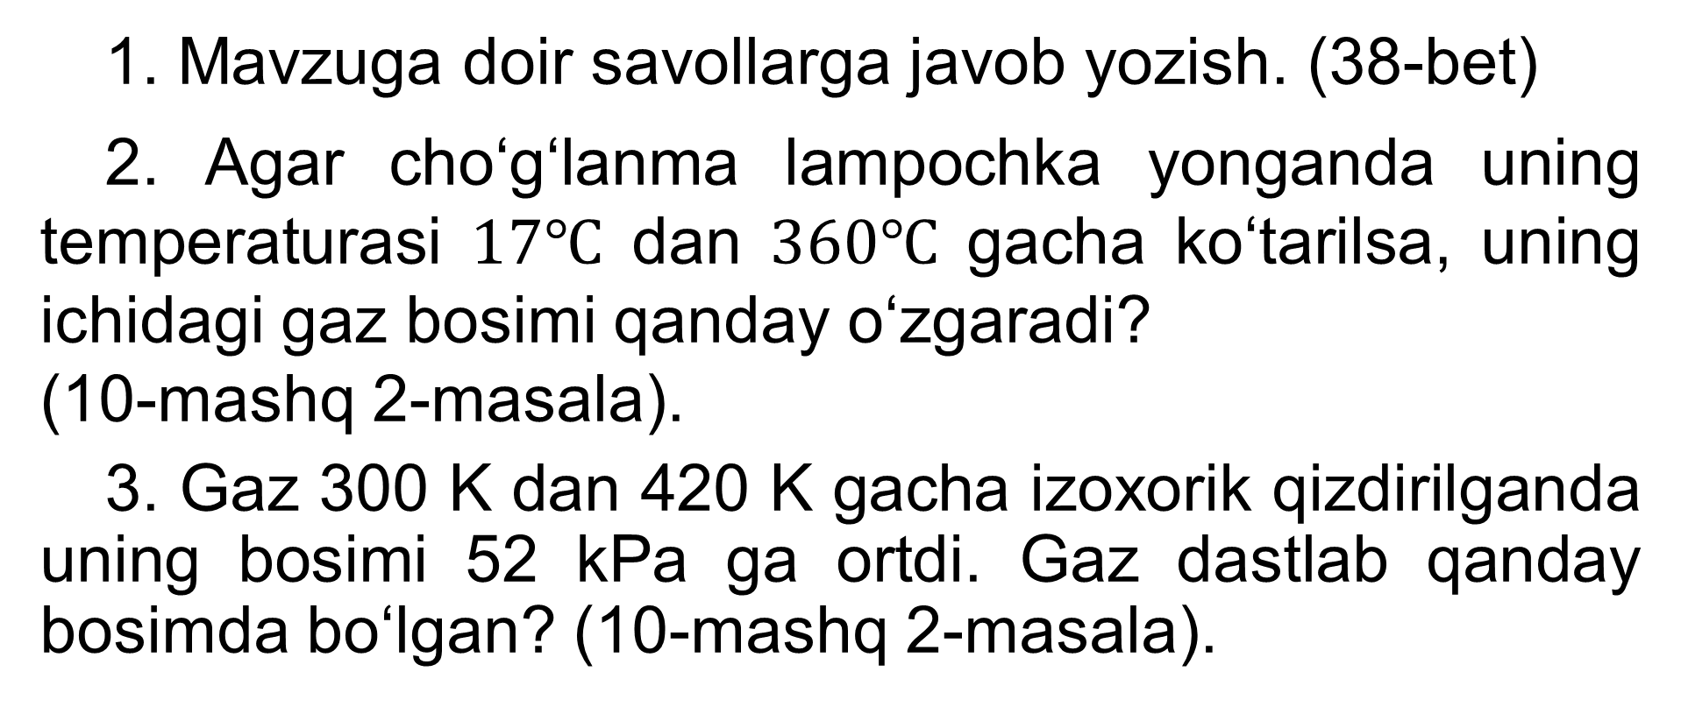
Mustaqil bajarish uchun topshiriqlar
1. Mavzuga doir savollarga javob yozish. (38-bet)
2. Agar cho‘g‘lanma lampochka yonganda uning temperaturasi $17℃$ dan $360℃$ gacha ko‘tarilsa, uning ichidagi gaz bosimi qanday o‘zgaradi?
(10-mashq 2-masala).
3. Gaz 300 K dan 420 K gacha izoxorik qizdirilganda uning bosimi 52 kPa ga ortdi. Gaz dastlab qanday bosimda bo‘lgan? (10-mashq 2-masala).

