Slide 1

Fizika
9
sinf
MAVZU: Masalalar yechish
O‘qituvchi:
Toshkent shahar Uchtepa tumani 287-maktab fizika fani o‘qituvchisi
Xo‘jayeva Maxtuma Ziyatovna.

Slide 2
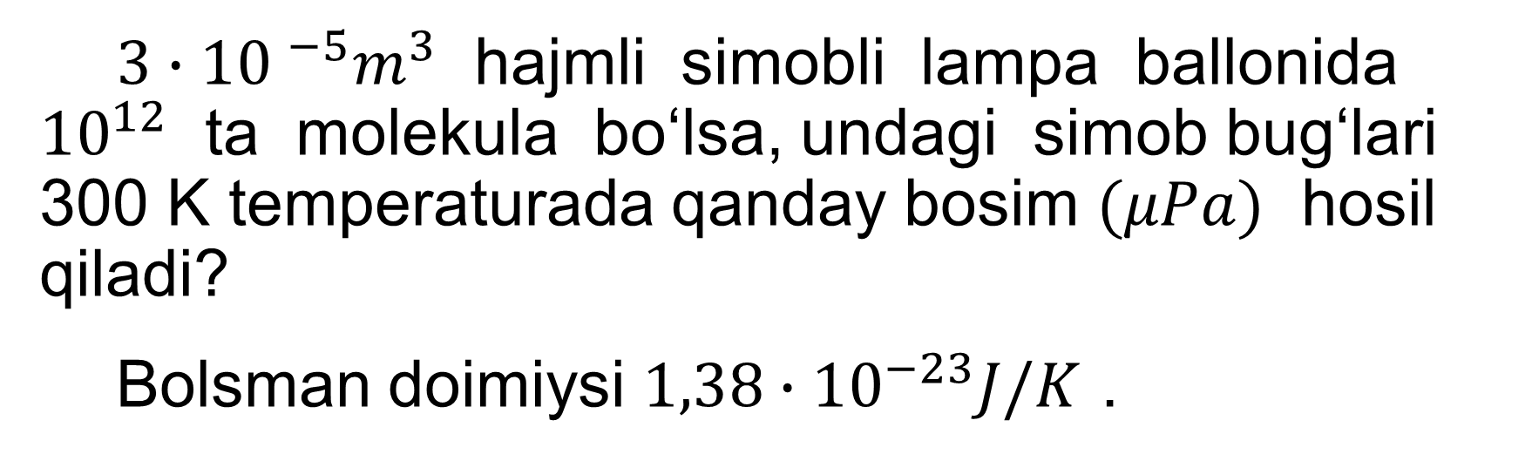
1-namunaviy masala
$3∙{10 }^{−5}m^{3}$ hajmli simobli lampa ballonida ${10}^{12}$ ta molekula bo‘lsa, undagi simob bug‘lari 300 K temperaturada qanday bosim $(μPa)$ hosil qiladi?
Bolsman doimiysi $1,38∙{10}^{−23}J/K$ .

Slide 3
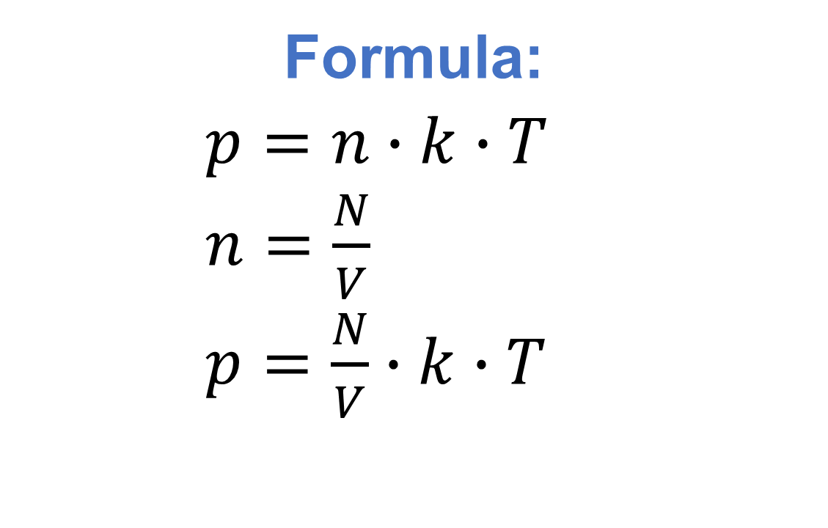
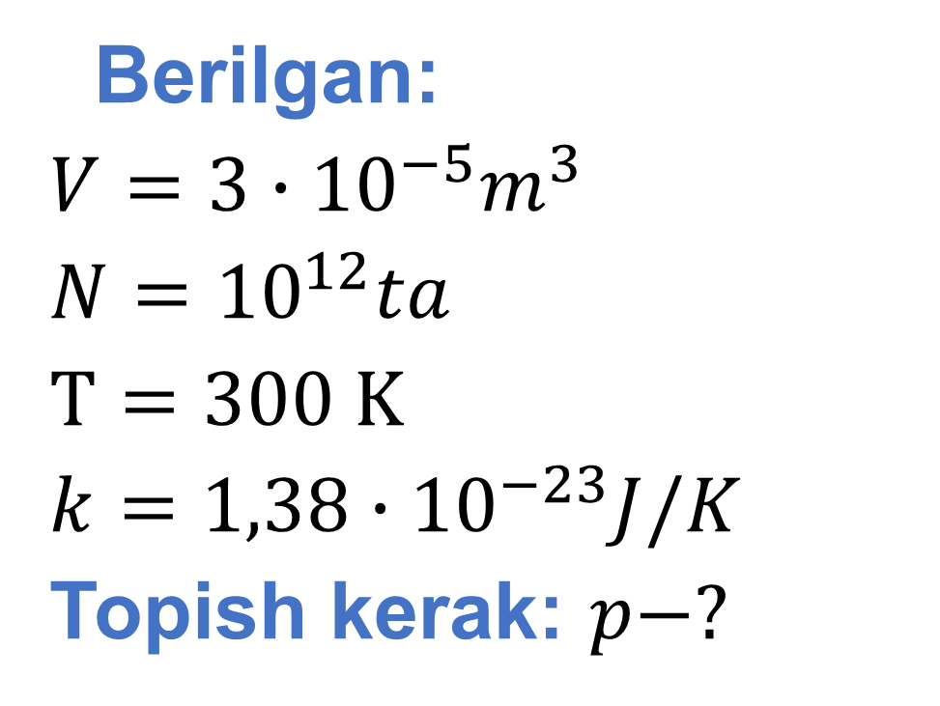
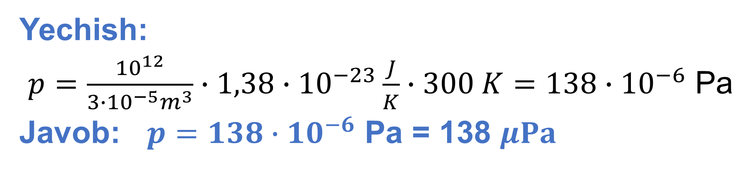
Berilgan:
$V=3∙{10}^{−5}m^{3}$
$N={10}^{12}ta$
$T=300 K$
$k=1,38∙{10}^{−23}J/K$
Topish kerak: $p−?$
Formula:
$p=n∙k∙T$
$n=\frac{N}{V}$
$p=\frac{N}{V}∙k∙T$
Yechish:
$p=\frac{{10}^{12}}{3∙{10}^{−5}m^{3}}∙1,38∙{10}^{−23}\frac{J}{K}∙300 K=138∙{10}^{−6}$ Pa
Javob: $p=138∙{10}^{−6} \text{Pa}\text{ = }\text{138 }μPa$

Slide 4
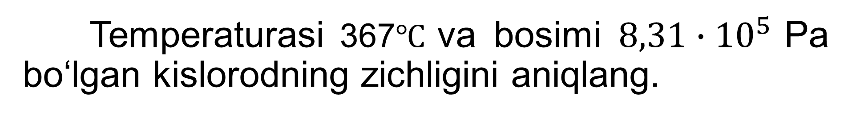
2-namunaviy masala
Temperaturasi 367$℃$ va bosimi $8,31∙{10}^{5}$ Pa bo‘lgan kislorodning zichligini aniqlang.

Slide 5
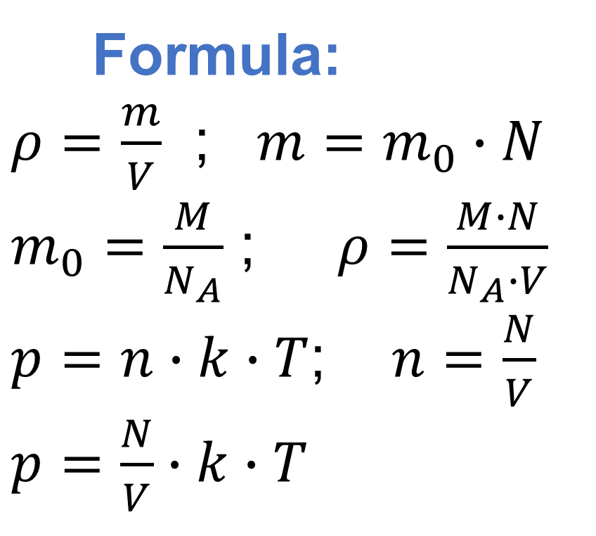
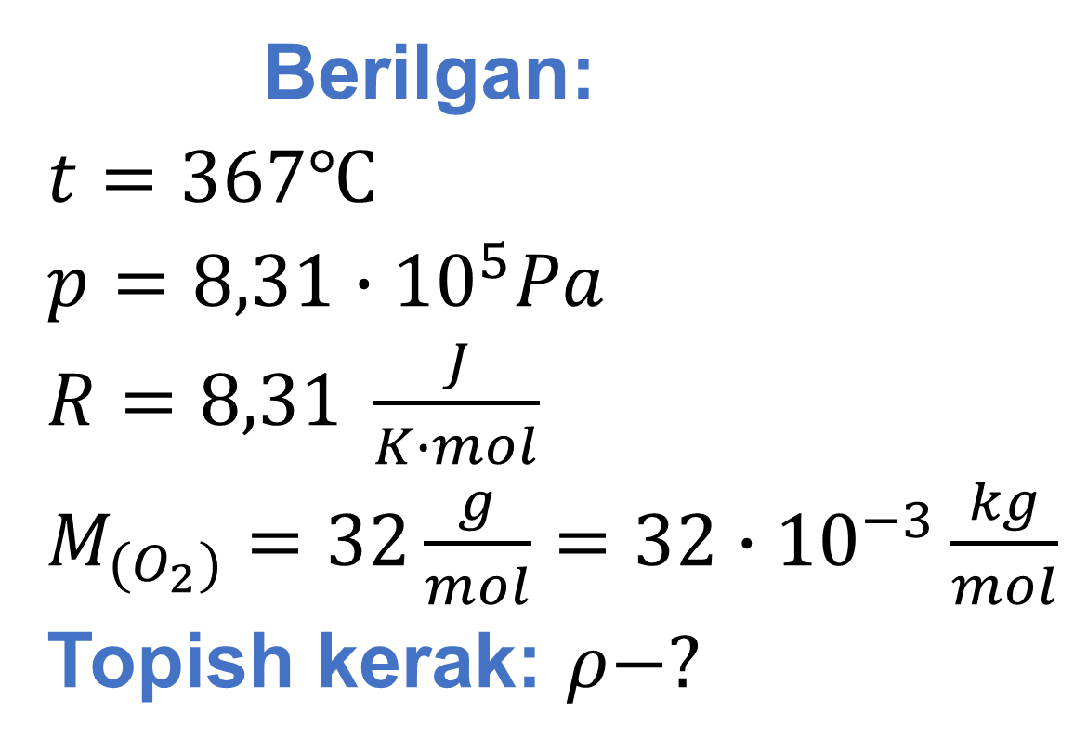
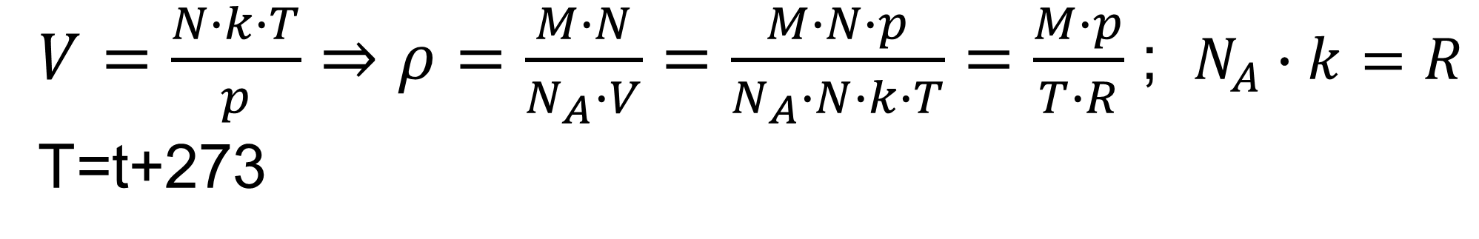
Berilgan:
$t=367℃$
$p=8,31∙{10}^{5}Pa$
$R=8,31 \frac{J}{K∙mol}$
$M_{(O_{2})}=32\frac{g}{mol}=32∙{10}^{−3}\frac{kg}{mol}$
Topish kerak: $ρ−?$
Formula:
$ρ=\frac{m}{V}$ ; $m=m_{0}∙N$
$m_{0}=\frac{M}{N_{A}}$ ; $ρ=\frac{M∙N}{N_{A}∙V}$
$p=n∙k∙T$; $n=\frac{N}{V}$
$p=\frac{N}{V}∙k∙T$
$V=\frac{N∙k∙T}{p}⇒ρ=\frac{M∙N}{N_{A}∙V}=\frac{M∙N∙p}{N_{A}∙N∙k∙T}=\frac{M∙p}{T∙R}$ ; $N_{A}∙k=R$
T=t+273

Slide 6
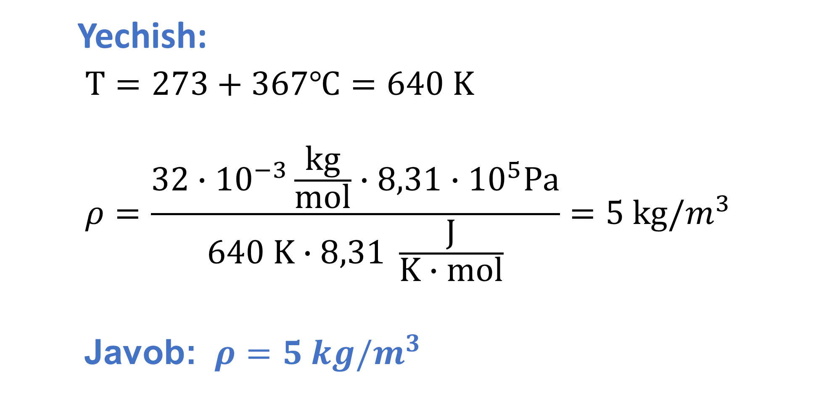
Yechish:
$T=273+367℃=640 K$
$$ρ=\frac{32∙{10}^{−3}\frac{kg}{mol}∙8,31∙{10}^{5}Pa}{640 K∙8,31 \frac{J}{K∙mol}}=5 kg/m^{3}$$
Javob: $ρ=5 kg/m^{3}$

Slide 7
3-namunaviy masala
3 g vodoroddagi molekulalar soni 9 g suvdagiga qaraganda necha marta ko‘p?

Slide 8
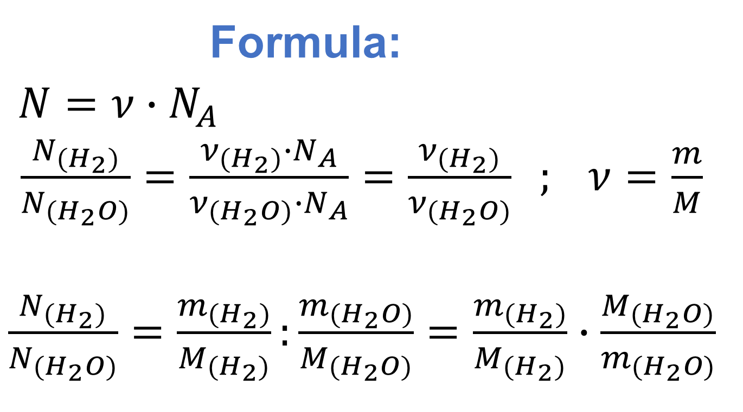
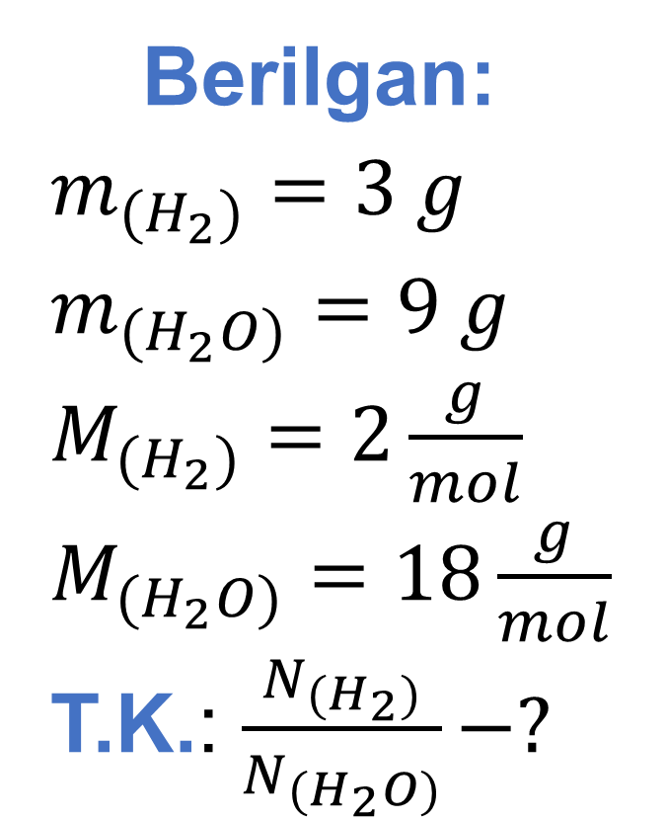
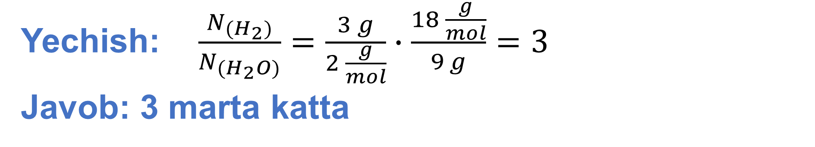
Berilgan:
$m_{(H_{2})}=3 g$
$m_{(H_{2}O)}=9 g$
$M_{(H_{2})}=2\frac{g}{mol}$
$M_{(H_{2}O)}=18\frac{g}{mol}$
T.K.: $\frac{N_{(H_{2})}}{N_{(H_{2}O)}}−?$
Formula:
$N=ν∙N_{A}$
$\frac{N_{(H_{2})}}{N_{(H_{2}O)}}=\frac{ν_{(H_{2})}∙N_{A}}{ν_{(H_{2}O)}∙N_{A}}=\frac{ν_{(H_{2})}}{ν_{(H_{2}O)}} ; ν=\frac{m}{M}$
$\frac{N_{(H_{2})}}{N_{(H_{2}O)}}=\frac{m_{(H_{2})}}{M_{(H_{2})}}:\frac{m_{(H_{2}O)}}{M_{(H_{2}O)}}=\frac{m_{(H_{2})}}{M_{(H_{2})}}∙\frac{M_{(H_{2}O)}}{m_{(H_{2}O)}}$
Yechish: $\frac{N_{(H_{2})}}{N_{(H_{2}O)}}=\frac{3 g}{2 \frac{g}{mol}}∙\frac{18 \frac{g}{mol}}{9 g}=3$
Javob: 3 marta katta

Slide 9
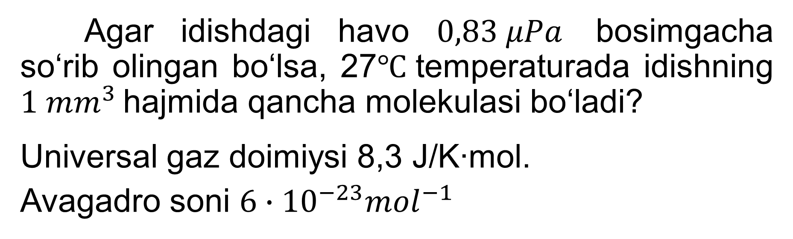
4-namunaviy masala
Agar idishdagi havo $0,83 μPa$ bosimgacha so‘rib olingan bo‘lsa, 27$℃$ temperaturada idishning $1 {mm}^{3}$ hajmida qancha molekulasi bo‘ladi?
Universal gaz doimiysi 8,3 J/K∙mol.
Avagadro soni $6∙{10}^{−23}{mol}^{−1}$

Slide 10
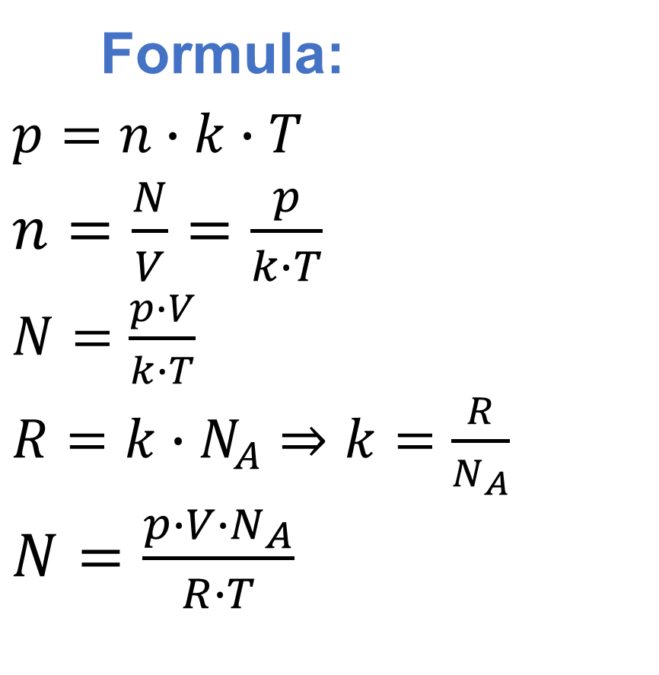
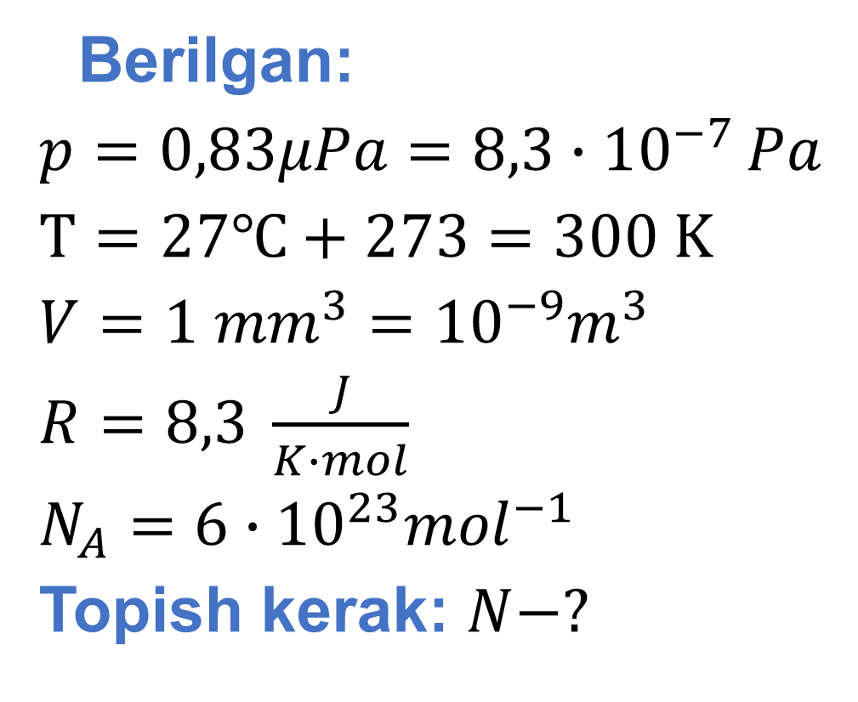
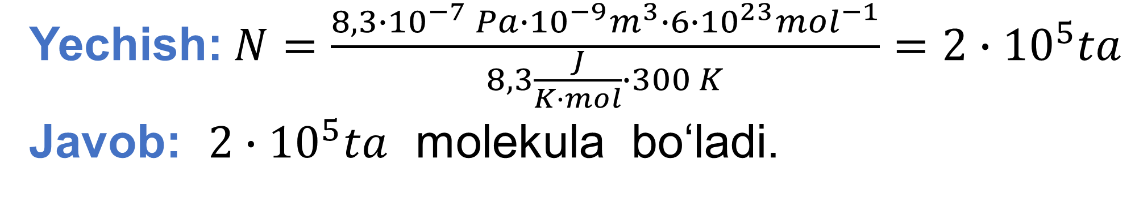
Berilgan:
$p=0,83μPa=8,3∙{10}^{−7 }Pa$
$T=27℃+273=300 K$
$V=1 {mm}^{3}={10}^{−9}m^{3}$
$R=8,3 \frac{J}{K∙mol}$
$N_{A}=6∙{10}^{23}{mol}^{−1}$
Topish kerak: $N−?$
Formula:
$p=n∙k∙T$
$n=\frac{N}{V}=\frac{p}{k∙T}$
$N=\frac{p∙V}{k∙T}$
$R=k∙N_{A}⇒k=\frac{R}{N_{A}}$
$N=\frac{p∙V∙N_{A}}{R∙T}$
Yechish:$N=\frac{8,3∙{10}^{−7} Pa∙{10}^{−9}m^{3}∙6∙{10}^{23}{mol}^{−1}}{8,3\frac{J}{K∙mol}∙300 K}=2∙{10}^{5}ta$
Javob: $2∙{10}^{5}ta$ molekula bo‘ladi.

Slide 11
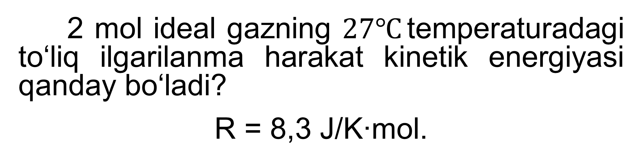
5-namunaviy masala
2 mol ideal gazning $27℃$ temperaturadagi to‘liq ilgarilanma harakat kinetik energiyasi qanday bo‘ladi?
R = 8,3 J/K∙mol.

Slide 12
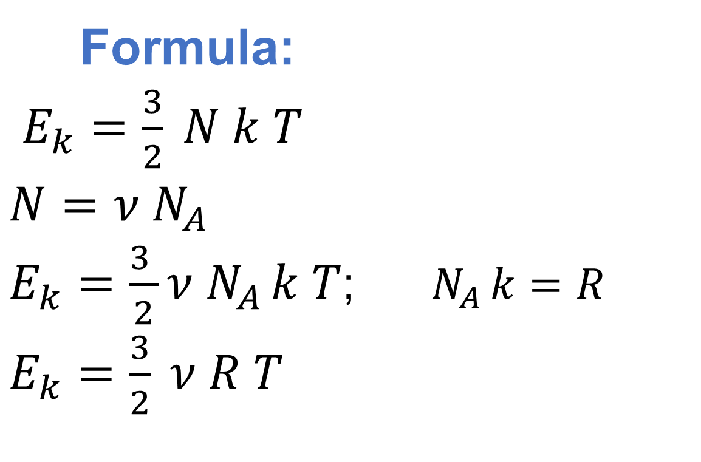
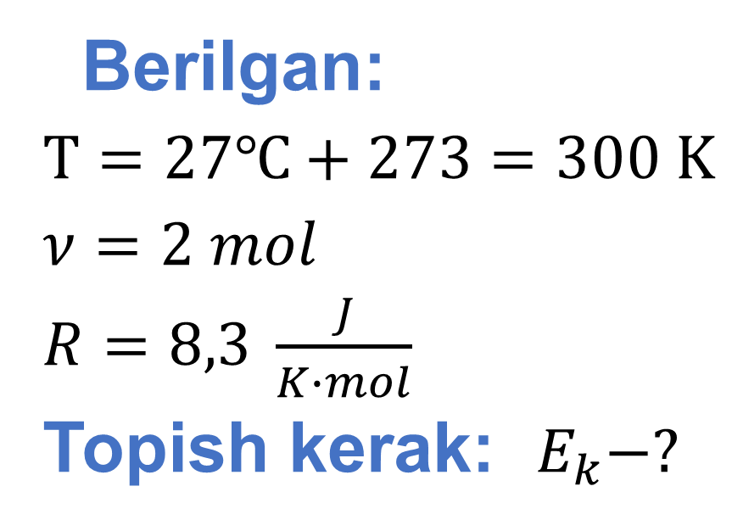
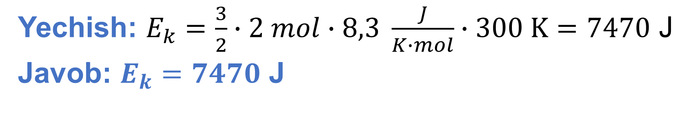
Berilgan:
$T=27℃+273=300 K$
$ν=2 mol$
$R=8,3 \frac{J}{K∙mol}$
Topish kerak: $E_{k}−?$
Formula:
$E_{k}=\frac{3}{2} N k T$
$N=ν N_{A}$
$E_{k}=\frac{3 }{2}ν{ N}_{A }k T$; $N_{A }k=R$
$E_{k}=\frac{3}{2} ν R T$
Yechish: $E_{k}=\frac{3}{2}∙2 mol∙8,3 \frac{J}{K∙mol}∙300 K=7470$ J
Javob: $E_{k}=7470$ J

Slide 13
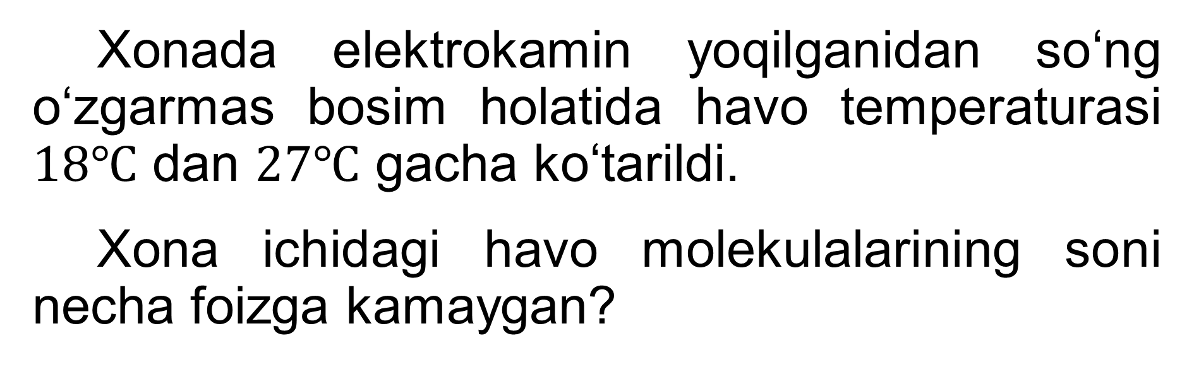
6-namunaviy masala
Xonada elektrokamin yoqilganidan so‘ng o‘zgarmas bosim holatida havo temperaturasi $18℃$ dan $27℃$ gacha ko‘tarildi.
Xona ichidagi havo molekulalarining soni necha foizga kamaygan?

Slide 14
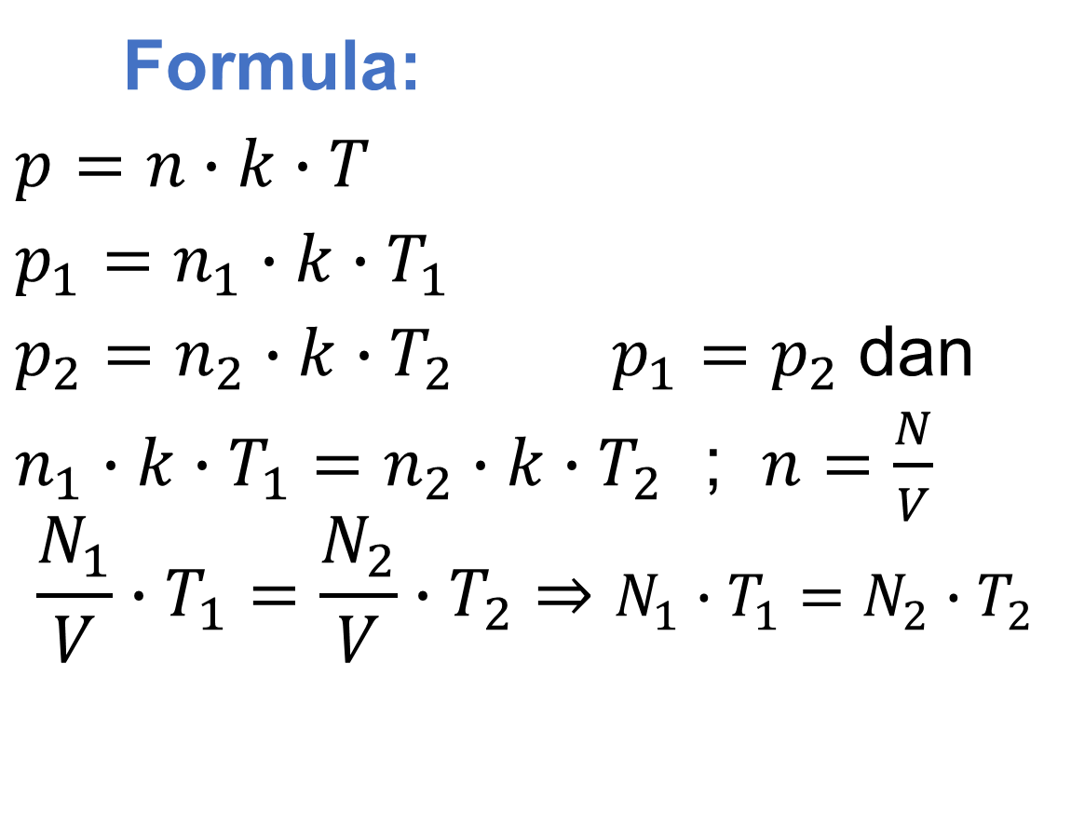
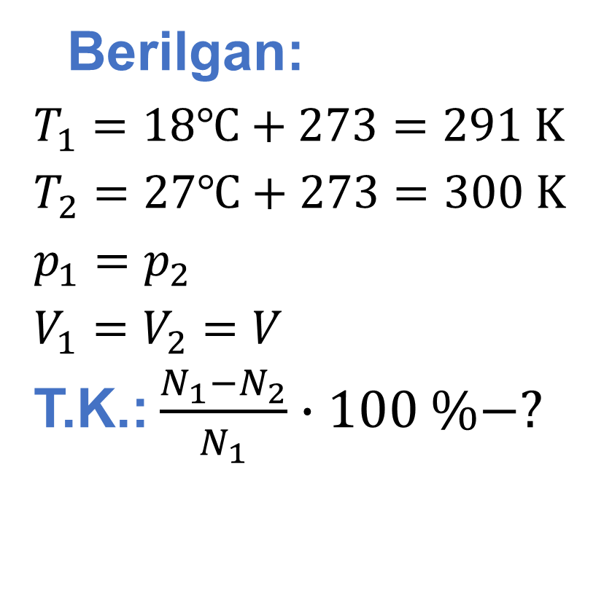
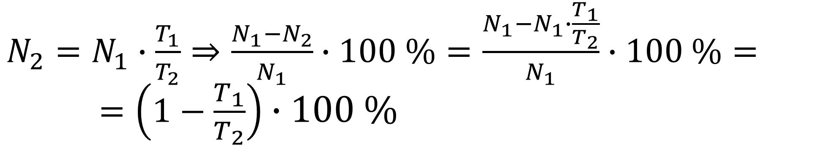
Berilgan:
$T_{1}=18℃+273=291 K$
$T_{2}=27℃+273=300 K$
$p_{1}=p_{2}$
$V_{1}=V_{2}=V$
T.K.: $\frac{N_{1}−N_{2}}{N_{1}}∙100 \%−?$
Formula:
$p=n∙k∙T$
$p_{1}=n_{1}∙k∙T_{1}$
$p_{2}=n_{2}∙k∙T_{2}$ $p_{1}=p_{2}$ dan
$n_{1}∙k∙T_{1}=n_{2}∙k∙T_{2}$ ; $n=\frac{N}{V}$
$$\frac{N_{1}}{V}∙T_{1}=\frac{N_{2}}{V}∙T_{2}⇒N_{1}∙T_{1}=N_{2}∙T_{2}$$
$N_{2}=N_{1}∙\frac{T_{1}}{T_{2}}⇒\frac{N_{1}−N_{2}}{N_{1}}∙100 \%=\frac{N_{1}−N_{1}∙\frac{T_{1}}{T_{2}}}{N_{1}}∙100 \%= =\left(1−\frac{T_{1}}{T_{2}}\right)∙100 \%$

Slide 15
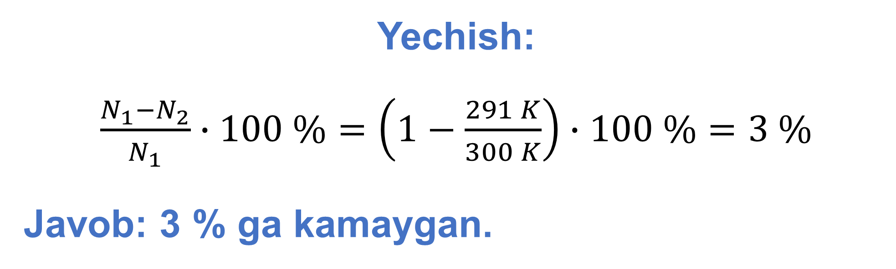
Yechish:
$\frac{N_{1}−N_{2}}{N_{1}}∙100 \%=\left(1−\frac{291 K}{300 K}\right)∙100 \%=3 \%$
Javob: 3 % ga kamaygan.

Slide 16
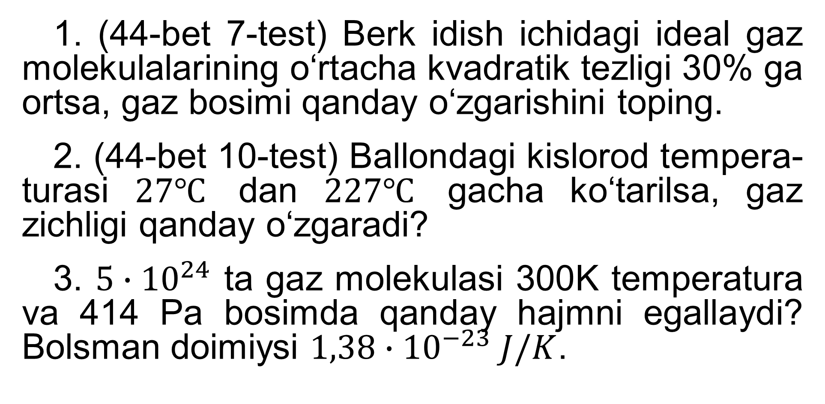
Mustaqil bajarish uchun topshiriqlar
1. (44-bet 7-test) Berk idish ichidagi ideal gaz molekulalarining o‘rtacha kvadratik tezligi 30% ga ortsa, gaz bosimi qanday o‘zgarishini toping.
2. (44-bet 10-test) Ballondagi kislorod tempera-turasi $27℃$ dan $227℃$ gacha ko‘tarilsa, gaz zichligi qanday o‘zgaradi?
3. $5∙{10}^{24}$ ta gaz molekulasi 300K temperatura va 414 Pa bosimda qanday hajmni egallaydi? Bolsman doimiysi $1,38∙{10}^{−23} J/K$.

