Slide 1

Fizika
9
sinf
MAVZU: Masalalar yechish
O‘qituvchi:
Toshkent shahar Uchtepa tumani 287-maktab fizika fani o‘qituvchisi Xo‘jayeva Maxtuma Ziyatovna.

Slide 2
Modda miqdori
Moddadagi molekulalar (atomlar) sonining 12 g ugleroddagi atomlari soniga nisbati.
$$ν=\frac{m}{M}=\frac{N}{N_{A}}$$
𝜈=𝑚/𝑀=𝑁/𝑁_𝐴

Slide 3
Avogadro qonuni
Har qanday moddaning 1 molida $6∙{10}^{23}$ ta molekula (atom) mavjud.
Har qanday moddaning 1 molida 6∙〖10〗^23 ta molekula (atom) mavjud.
Har qanday gazning 1 moli normal sharoitda 22,4 l hajmni egallaydi.

Slide 4
Molyar massa
Miqdori 1 mol bo‘lgan moddaning massasi
$$M=m_{0}∙N_{A}$$
Mendeleyev davriy sistemasiga asosan aniqlanadi.
𝑀=𝑚_0∙𝑁_𝐴
Mendeleyev davriy sistemasiga asosan aniqlanadi.

Slide 5
Molyar konsentratsiya.
Hajm birligidagi molekulalar soni.
$$n=\frac{N}{V}$$
𝑛=𝑁/𝑉

Slide 6
$$m=m_{0}∙N$$
𝑚=𝑚_0∙𝑁
$$N=\frac{m}{M}∙N_{A}$$
𝑁=𝑚/𝑀∙𝑁_𝐴
$$m=\frac{M}{N_{A}}∙N$$
𝑚=𝑀/𝑁_𝐴 ∙𝑁

Slide 7
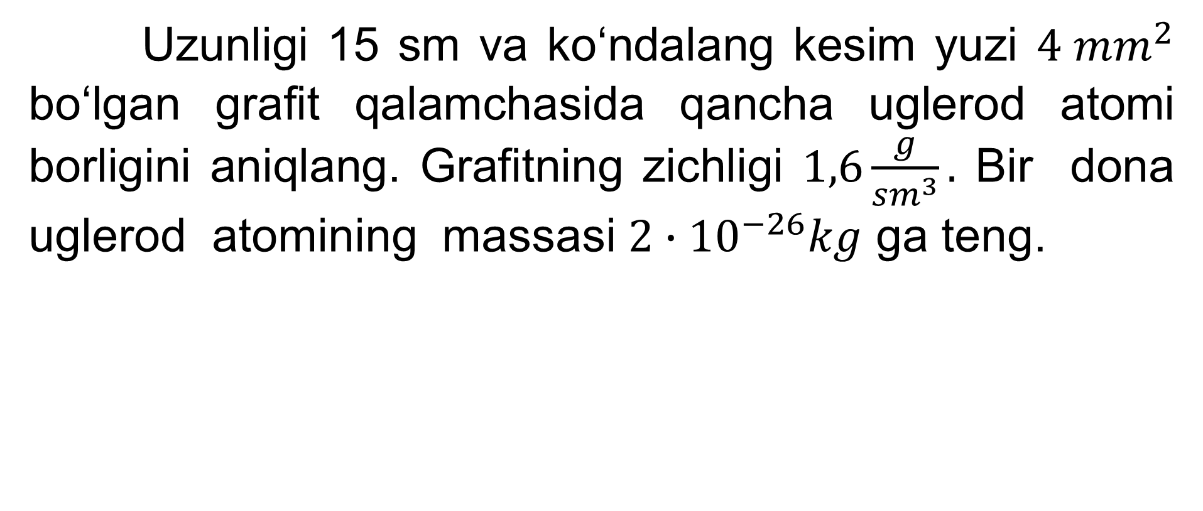
1-namunaviy masala
Uzunligi 15 sm va ko‘ndalang kesim yuzi $4 {mm}^{2}$ bo‘lgan grafit qalamchasida qancha uglerod atomi borligini aniqlang. Grafitning zichligi $1,6\frac{g}{{sm}^{3}}.$ Bir dona uglerod atomining massasi $2∙{10}^{−26}kg$ ga teng.

Slide 8
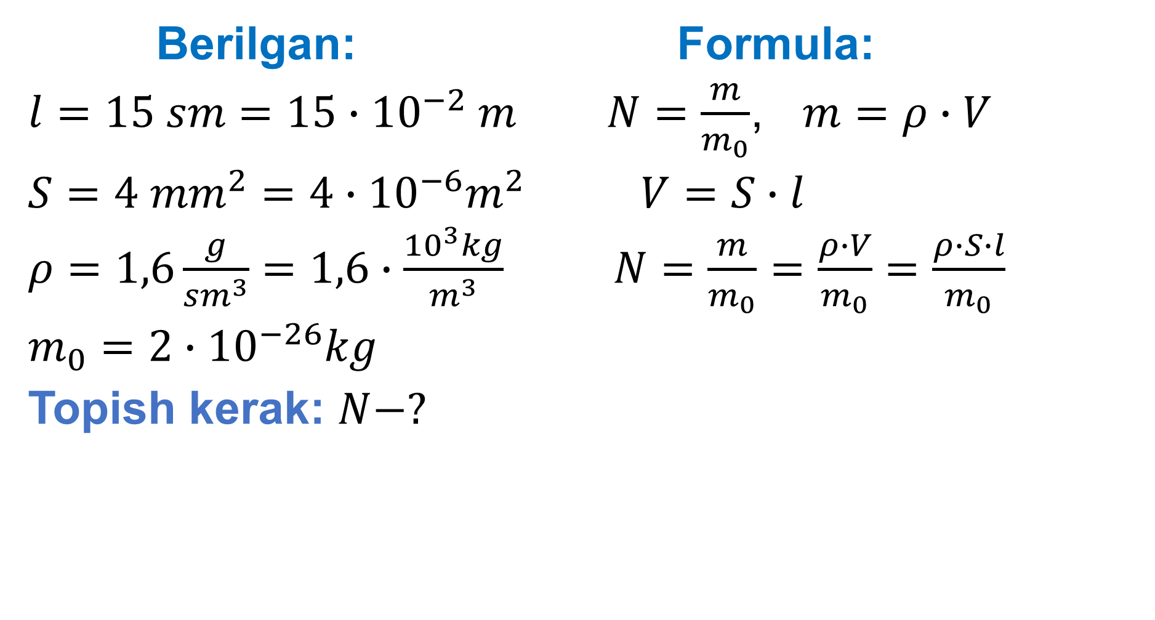
Berilgan: Formula:
$l=15 sm=15∙{10}^{−2} m$ $N=\frac{m}{m_{0}}$, $m=ρ∙V$
$S=4 {mm}^{2}=4∙{10}^{−6}m^{2}$ $V=S∙l$
$ρ=1,6\frac{g}{{sm}^{3}}=1,6∙\frac{{10}^{3}kg}{m^{3}}$ $N=\frac{m}{m_{0}}=\frac{ρ∙V}{m_{0}}=\frac{ρ∙S∙l}{m_{0}}$
$m_{0}=2∙{10}^{−26}kg$
Topish kerak: $N−?$

Slide 9

Yechish:
N= $\frac{1,6∙\frac{{10}^{3}kg}{m^{3}}∙4∙{10}^{−6}m^{2}∙15∙{10}^{−2} m}{ 2∙{10}^{−26}kg}$ =4,8∙${10}^{22}ta$
Javob: N= 4,8∙${10}^{22}ta$

Slide 10
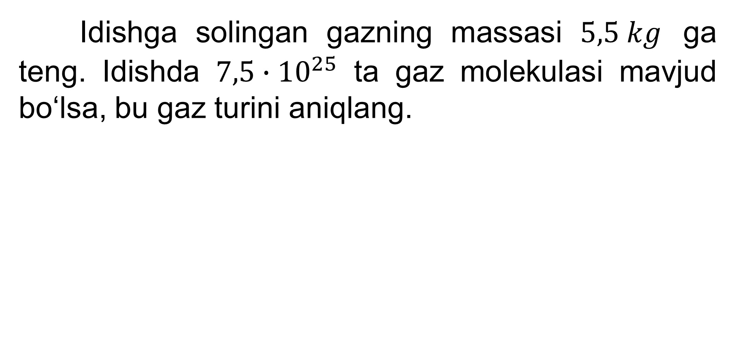
3-mashq 3-masala
Idishga solingan gazning massasi $5,5 kg$ ga teng. Idishda $7,5∙{10}^{25}$ ta gaz molekulasi mavjud bo‘lsa, bu gaz turini aniqlang.

Slide 11
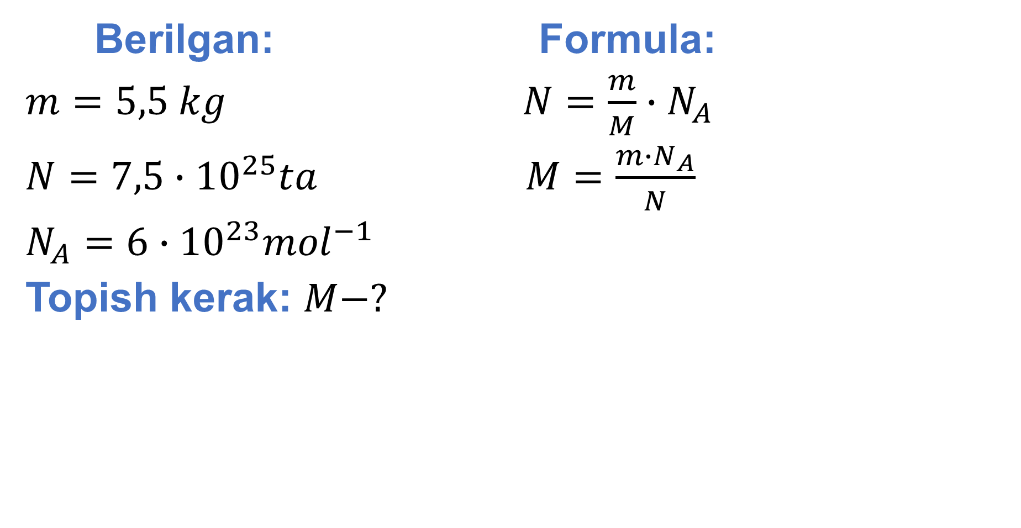
Berilgan: Formula:
$m=5,5 kg$ $N=\frac{m}{M}∙N_{A}$
$N=7,5∙{10}^{25}ta$ $M=\frac{m∙N_{A}}{N}$
$N_{A}=6∙{10}^{23}{mol}^{−1}$
Topish kerak: $M−?$

Slide 12
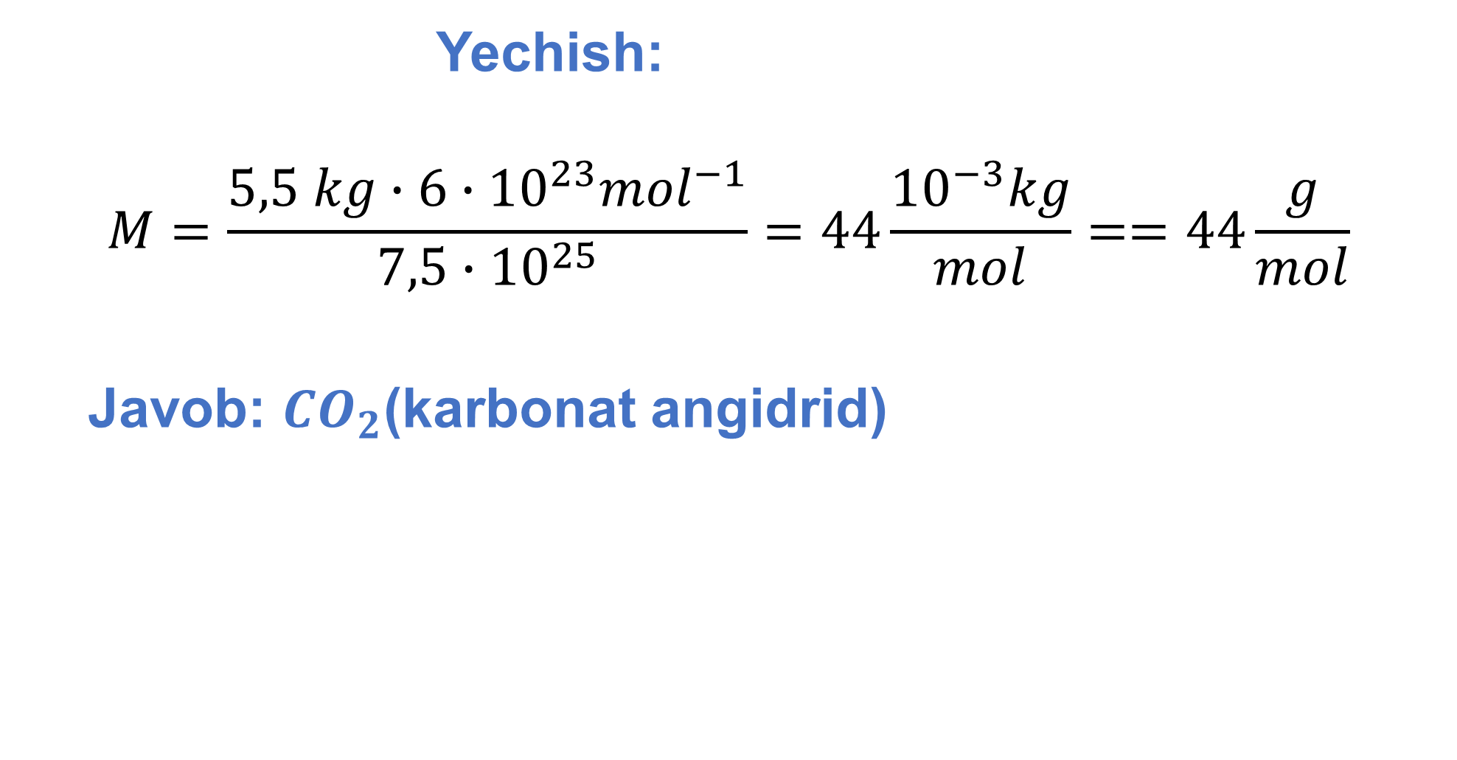
Yechish:
$$M=\frac{5,5 kg∙6∙{10}^{23}{mol}^{−1}}{7,5∙{10}^{25}}=44\frac{{10}^{−3}kg}{mol}==44\frac{g}{mol}$$
Javob: ${CO}_{2}$(karbonat angidrid)

Slide 13
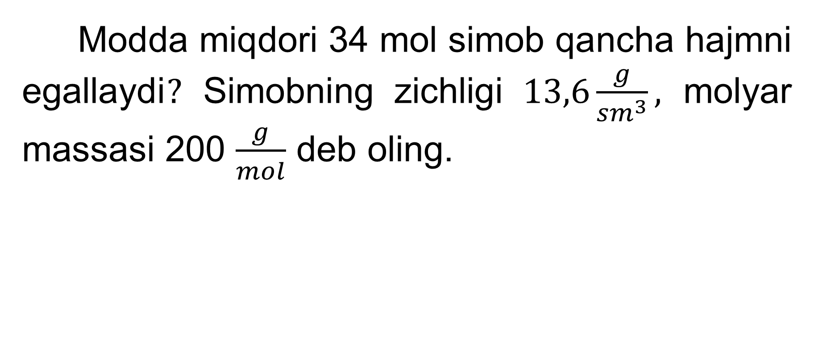
3-mashq 8-masala
Modda miqdori 34 mol simob qancha hajmni egallaydi$?$ Simobning zichligi $13,6\frac{g}{{sm}^{3}},$ molyar massasi 200 $\frac{g}{mol}$ deb oling.

Slide 14
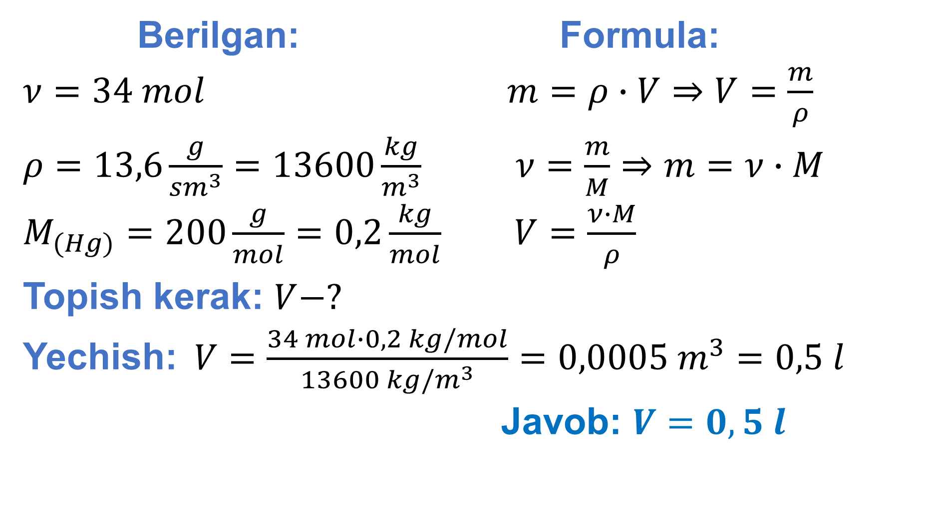
Berilgan: Formula:
$ν=34 mol$ $m=ρ∙V⇒V=\frac{m}{ρ}$
$ρ=13,6\frac{g}{{sm}^{3}}=13600\frac{kg}{m^{3}}$ $ν=\frac{m}{M}⇒m=ν∙M$
$M_{(Hg)}=200\frac{g}{mol}=0,2\frac{kg}{mol}$ $V=\frac{ν∙M}{ρ}$
Topish kerak: $V−?$
Yechish:$V=\frac{34 mol∙0,2 kg/mol}{13600 kg/m^{3}}=0,0005 m^{3}=0,5 l$
Javob: $V=0,5 l$

Slide 15
Mustaqil bajarish uchun topshiriqlar
3-mashq (17-bet) 1,2,5,6-masalalarni yechish.

