Slide 1
Fizika
9
sinf
MAVZU: Modda miqdori. Molyar massa.
O‘qituvchi: Toshkent shahar Uchtepa tumani 287-maktab fizika fani o‘qituvchisi Xo‘jayeva Maxtuma Ziyatovna.

Slide 2
Modda miqdori
Moddadagi molekula yoki atomlar sonining 12 g (${}_{6}^{12}C$) ugleroddagi atomlar soniga nisbati modda miqdori deyiladi.
$ν \left(nyu\right)−1 \left[mol\right]$ ( XBS da asosiy birlik).
$$1 kmol=1000 mol={10}^{3} mol$$
1 mol — moddaning shunday miqdoriki, undagi molekulalar soni 12 g ugleroddagi atomlar soniga teng.

Slide 3
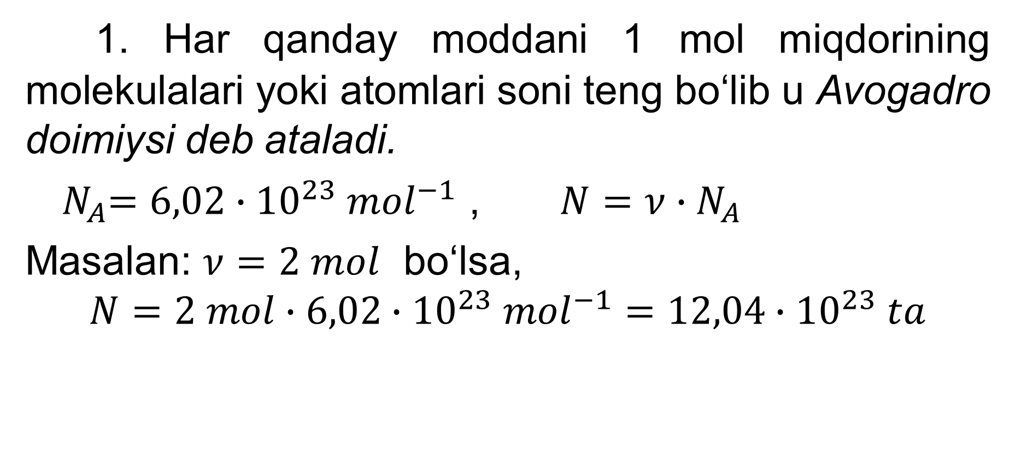
Avogadro qonuni
1. Har qanday moddani 1 mol miqdorining molekulalari yoki atomlari soni teng bo‘lib u Avogadro doimiysi deb ataladi.
${ N}_{A}=6,02∙{10}^{23} {mol}^{−1}$ , $N=ν∙N_{A}$
Masalan: $ν=2 mol$ bo‘lsa,
$$N=2 mol∙{6,02∙10}^{23} {mol}^{−1}=12,04∙{10}^{23} ta$$

Slide 4
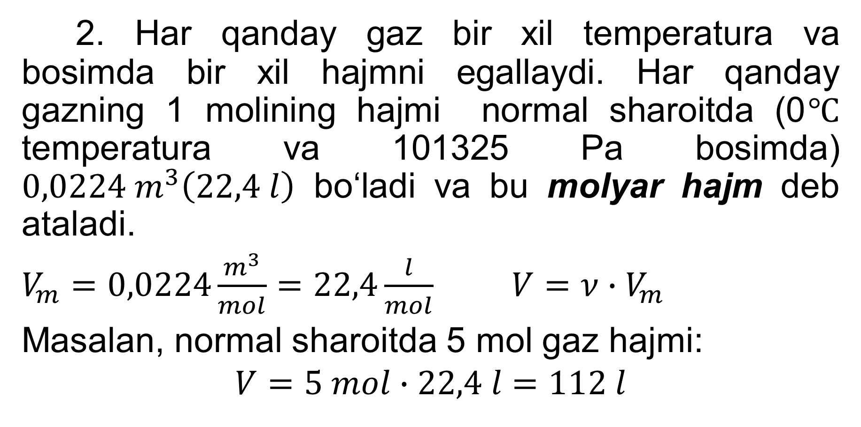
Avogadro qonuni
2. Har qanday gaz bir xil temperatura va bosimda bir xil hajmni egallaydi. Har qanday gazning 1 molining hajmi normal sharoitda (0$℃$ temperatura va 101325 Pa bosimda) $0,0224 m^{3}\left(22,4 l\right)$ bo‘ladi va bu molyar hajm deb ataladi.
$V_{m}=0,0224\frac{m^{3}}{mol}=22,4\frac{l}{mol}$ $V={ν∙V}_{m}$
Masalan, normal sharoitda 5 mol gaz hajmi:
$$V=5 mol∙22,4 l=112 l$$

Slide 5
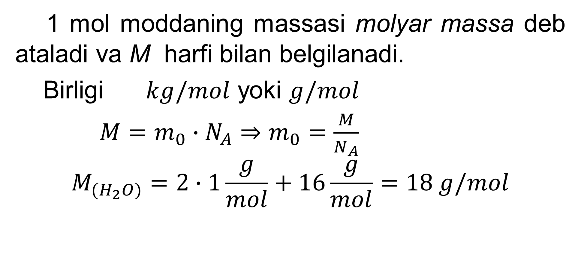
Molyar massa
1 mol moddaning massasi molyar massa deb ataladi va M harfi bilan belgilanadi.
Birligi $kg/mol$ yoki $g/mol$
$M=m_{0}∙N_{A}⇒m_{0}=\frac{M}{N_{A}}$
$$M_{{(H}_{2}O)}=2∙1\frac{g}{mol}+16\frac{g}{mol}=18 g/mol$$

Slide 6
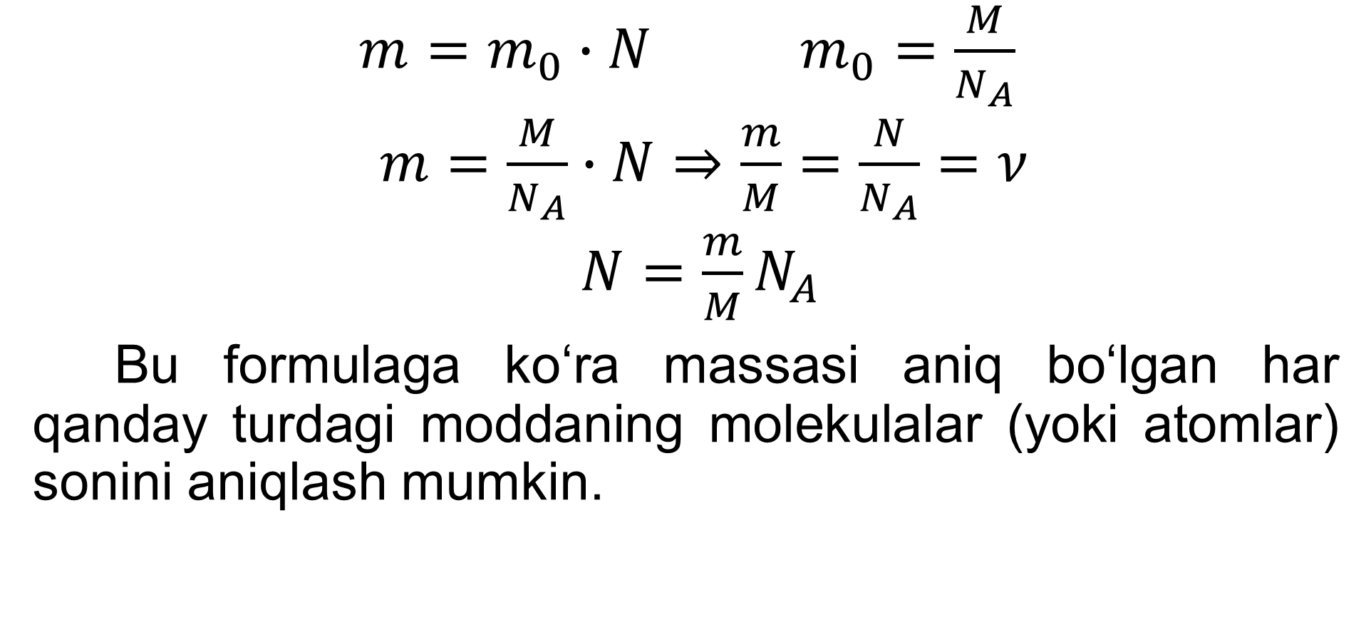
Molekulalar soni
$m=m_{0}∙N$ $m_{0}=\frac{M}{N_{A}}$
$m=\frac{M}{N_{A}}∙N⇒\frac{m}{M}=\frac{N}{N_{A}}=ν$
$N=\frac{m}{M}N_{A}$
Bu formulaga ko‘ra massasi aniq bo‘lgan har qanday turdagi moddaning molekulalar (yoki atomlar) sonini aniqlash mumkin.

Slide 7
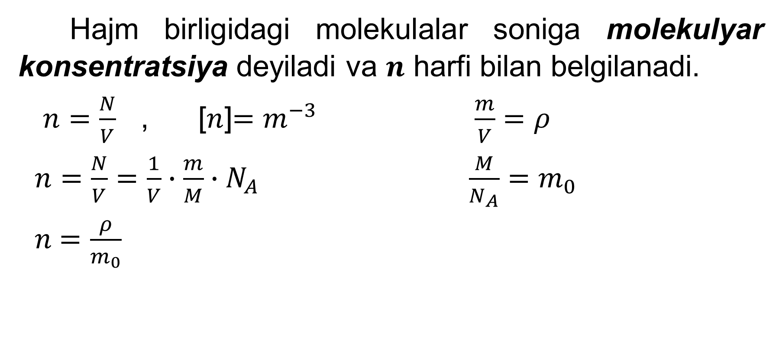
Molekulyar konsentratsiya
Hajm birligidagi molekulalar soniga molekulyar konsentratsiya deyiladi va $n$ harfi bilan belgilanadi.
$n=\frac{N}{V}$ , [$n$]$=m^{−3}$ $\frac{m}{V}=ρ$
$n=\frac{N}{V}=\frac{1}{V}∙\frac{m}{M}∙N_{A}$ $\frac{M}{N_{A}}=m_{0}$
$n$ $=\frac{ρ}{m_{0}}$

Slide 8
2-mashq 1-masala
Massasi 270 g bo‘lgan suvdagi modda miqdorini aniqlang.

Slide 9
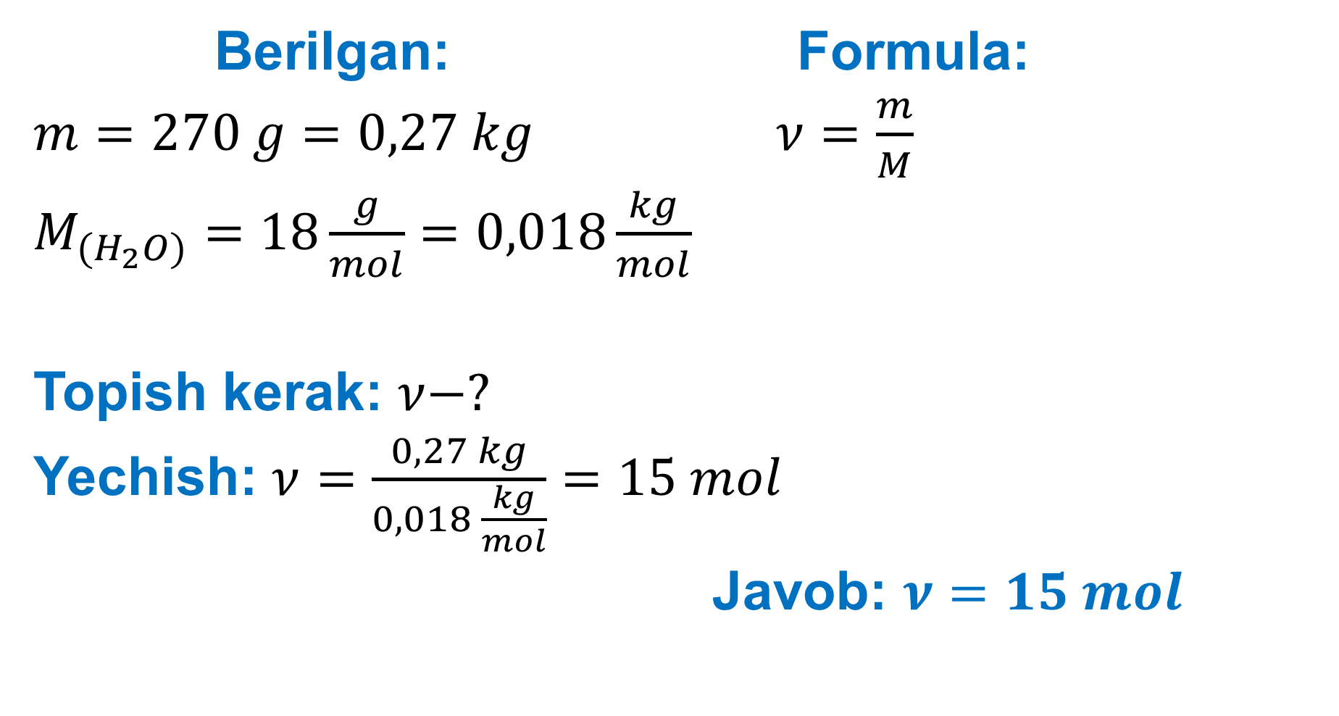
Berilgan: Formula:
$m=270 g=0,27 kg$ $ν=\frac{m}{M}$
$M_{{(H}_{2}O)}=18\frac{g}{mol}=0,018\frac{kg}{mol}$
Topish kerak: $ν−?$
Yechish: $ν=\frac{0,27 kg}{0,018 \frac{kg}{mol}}=15 mol$
Javob: $ν=15 mol$

Slide 10
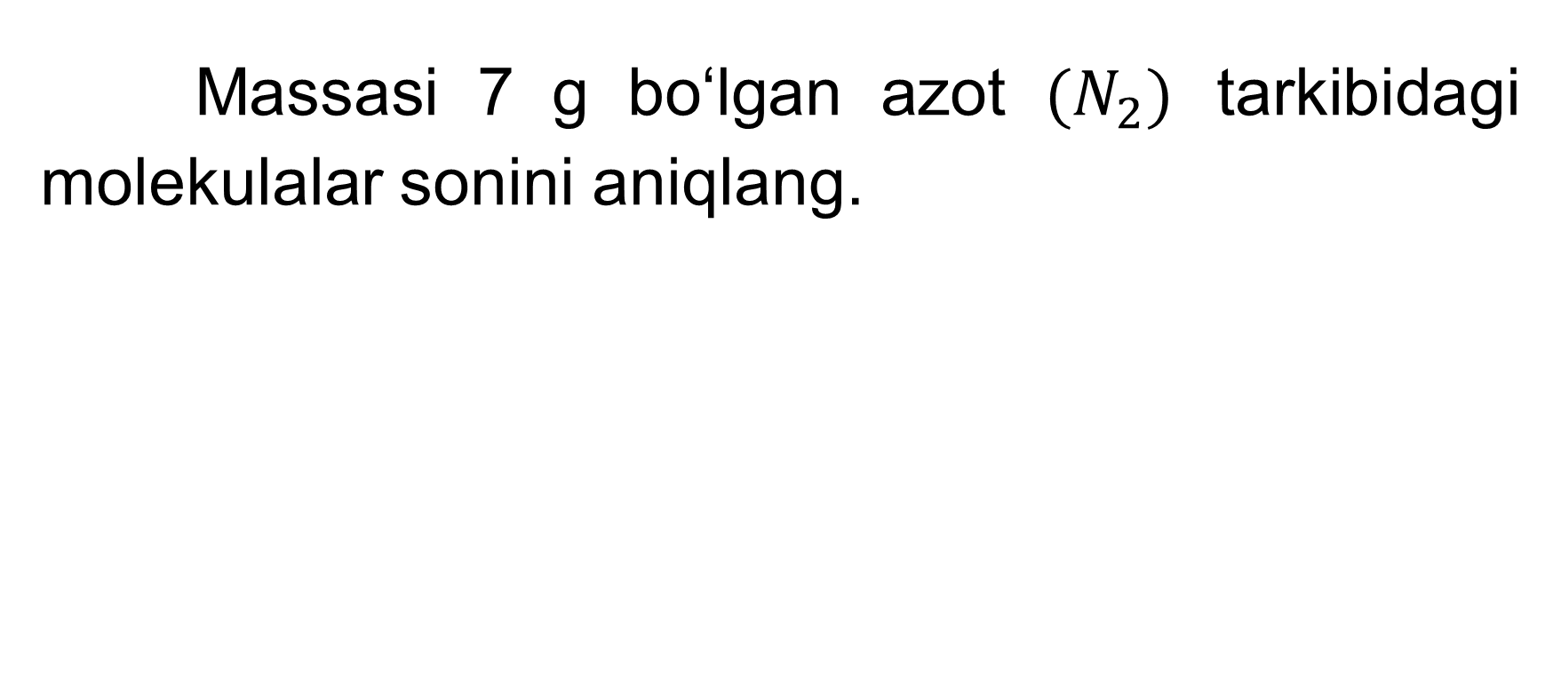
2-mashq 3-masala
Massasi 7 g bo‘lgan azot $(N_{2})$ tarkibidagi molekulalar sonini aniqlang.

Slide 11
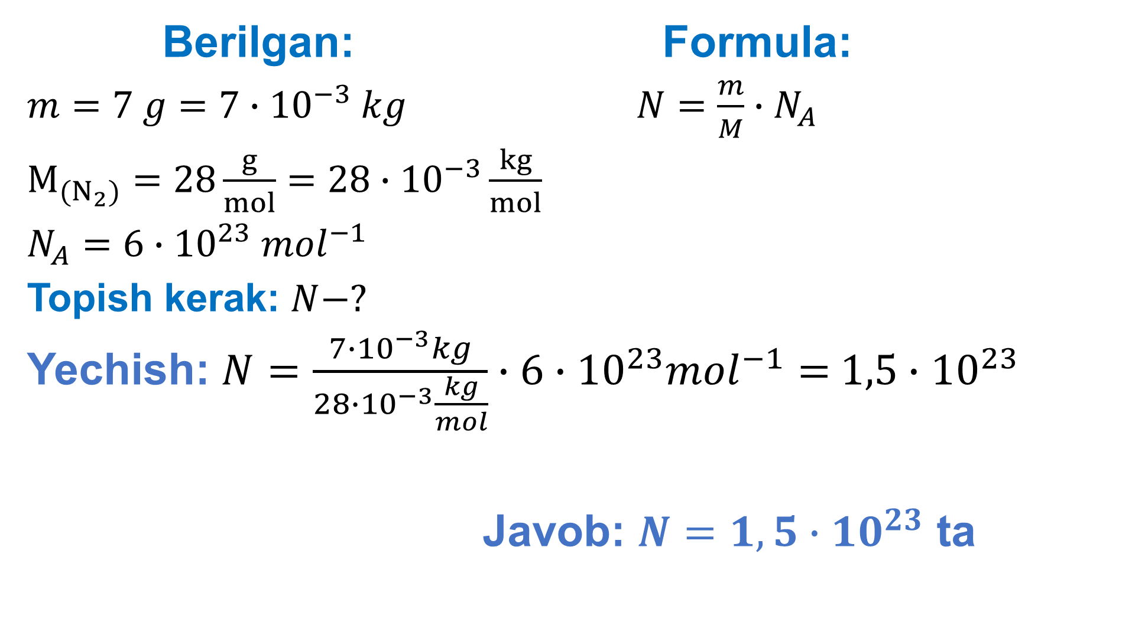
Berilgan: Formula:
$m=7 g=7∙{10}^{−3} kg$ $N=\frac{m}{M}∙N_{A}$
$M_{(N_{2})}=28\frac{g}{mol}=28∙{10}^{−3}\frac{kg}{mol}$
$N_{A}=6∙{10}^{23} {mol}^{−1}$
Topish kerak: $N−?$
Yechish: $N=\frac{7∙{10}^{−3}kg}{28∙{10}^{−3}\frac{kg}{mol}}∙6∙{10}^{23}{mol}^{−1}=$ $1,5∙$ ${10}^{23}$
Javob: $N=1,5∙{10}^{23}$ ta

Slide 12
Mustaqil bajarish uchun topshiriqlar
1. 2-mashq (15-sahifa), 2-va 4-masalalarni yechish.
2. Mavzuga doir savollarga javob yozish. (15-bet).

