Slide 1
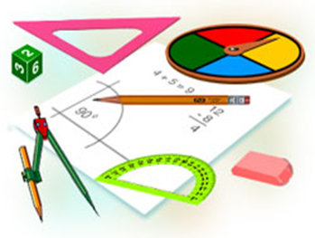
Algebra
9-sinf
Mavzu:
Misollar yechish

Slide 2


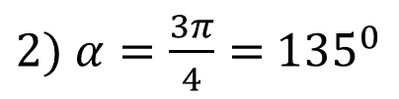


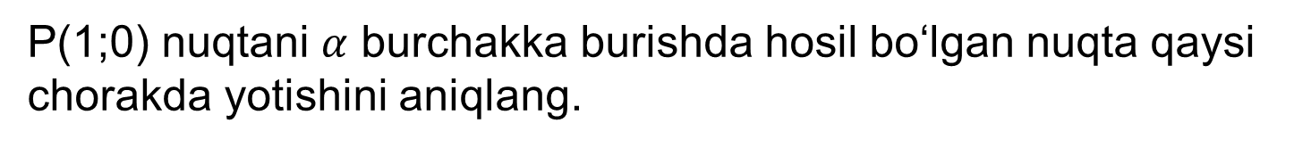
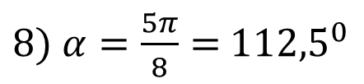

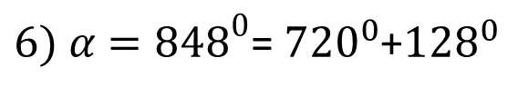




Mustaqil bajarish uchun berilgan mashqlarni tekshirish
242-mashq.
P(1;0) nuqtani $α$ burchakka burishda hosil bo‘lgan nuqta qaysi chorakda yotishini aniqlang.
$$y$$
$2) α=\frac{3π}{4}=$ ${135}^{0}$
$6) α={848}^{0}$= ${720}^{0}$+${128}^{0}$
$${90}^{0}$$
$$4) α={−210}^{0}$$
$8) α=\frac{5π}{8}=$ ${112,5}^{0}$
$${180}^{0}$$
$$0^{0}$$
$$x$$
$$Yechish:$$
$${360}^{0}$$
2) II chorakda
6) II chorakda
$${270}^{0}$$
4) II chorakda
8) II chorakda

Slide 3


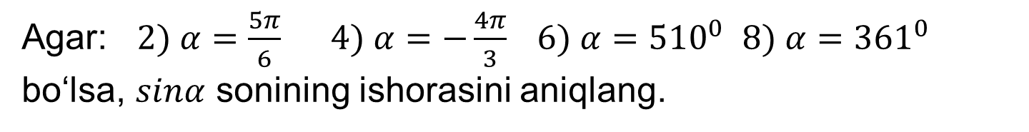
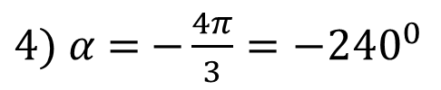


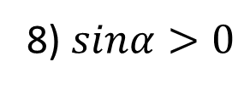

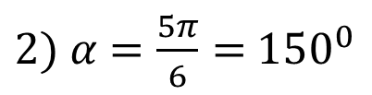



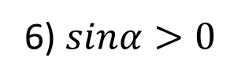


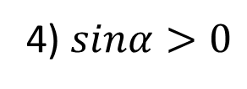


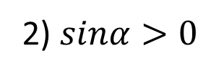


Mustaqil bajarish uchun berilgan mashqlarni tekshirish
243-mashq.
Agar: $2) α=\frac{5π}{6}$ $4) α=−\frac{4π}{3}$ $6) α={510}^{0}$ $8) α={361}^{0}$ bo‘lsa, $sinα$ sonining ishorasini aniqlang.
$$y$$
$$Yechish:$$
$${90}^{0}$$
$2) α=\frac{5π}{6}=$ ${150}^{0}$
$4) α=$ $−\frac{4π}{3}={−240}^{0}$
$$+$$
$$+$$
$${180}^{0}$$
$$0^{0}$$
$$x$$
$$6) α={510}^{0}$$
$8) α=$ ${361}^{0}$
$$−$$
$$−$$
$${360}^{0}$$
2) $sinα>0$
4) $sinα>0$
6) $sinα>0$
8) $sinα>0$
$${270}^{0}$$

Slide 4
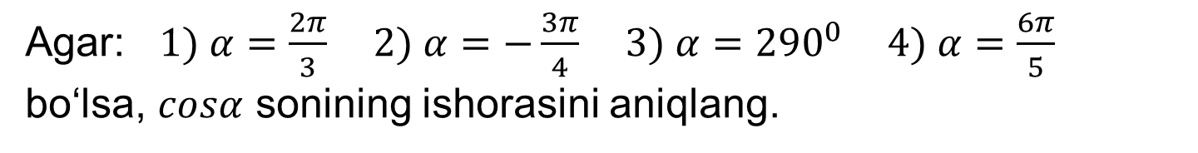
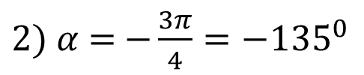

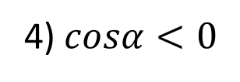
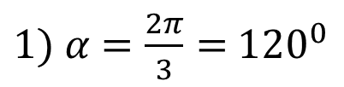

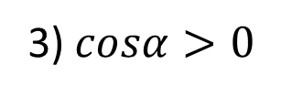

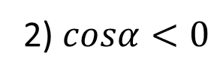


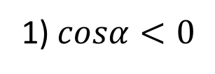

Misollar yechish
1-mashq.
Agar: $1) α=\frac{2π}{3}$ $2) α=−\frac{3π}{4}$ $3) α={290}^{0}$ $4) α=\frac{6π}{5}$ bo‘lsa, $cosα$ sonining ishorasini aniqlang.
$$y$$
$$Yechish:$$
$${90}^{0}$$
$1) α=\frac{2π}{3}=$ ${120}^{0}$
$2) α=$ $−\frac{3π}{4}={−135}^{0}$
$$−$$
$$+$$
$${180}^{0}$$
$$0^{0}$$
$$x$$
$$3) α={290}^{0}$$
$4) α=$ ${216}^{0}$
$$−$$
$$+$$
$${360}^{0}$$
1)$cosα<0$
2) $cosα<0$
$${270}^{0}$$
3)$cosα>0$
4)$cosα<0$

Slide 5
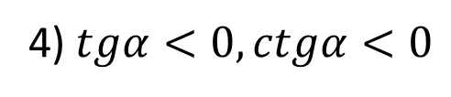
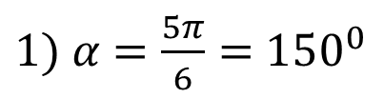
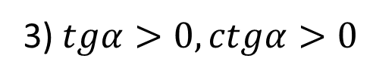


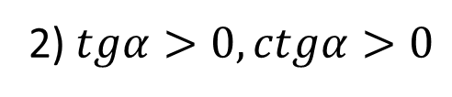

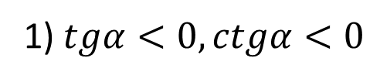
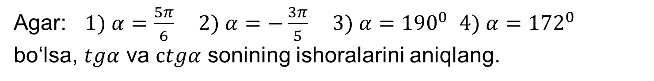
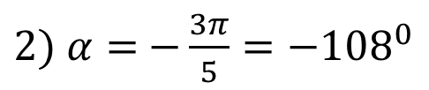

Misollar yechish
2-mashq.
Agar: $1) α=\frac{5π}{6}$ $2) α=−\frac{3π}{5}$ $3) α={190}^{0}$ $4) α={172}^{0}$ bo‘lsa, $tgα$ va $ctgα$ sonining ishoralarini aniqlang.
$$y$$
$$Yechish:$$
$${90}^{0}$$
$1) α=\frac{5π}{6}=$ ${150}^{0}$
$2) α=$ $−\frac{3π}{5}={−108}^{0}$
$$−$$
$$+$$
$${180}^{0}$$
$$0^{0}$$
$$x$$
$$3) α={190}^{0}$$
$4) α=$ ${172}^{0}$
$$+$$
$$−$$
$${360}^{0}$$
1)$tgα<0,ctgα<0$
2)$tgα>0,ctgα>0$
$${270}^{0}$$
3)$tgα>0,ctgα>0$
4)$tgα<0,ctgα<0$

Slide 6


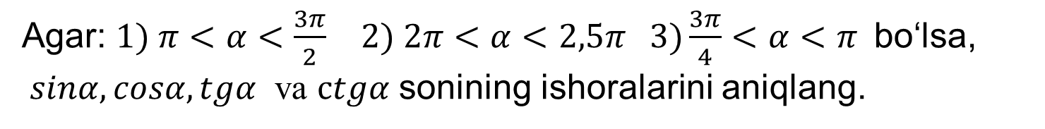





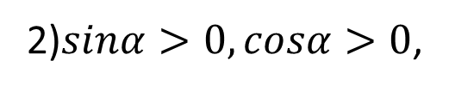
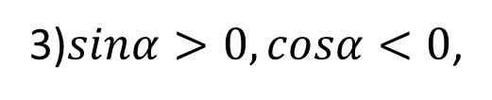

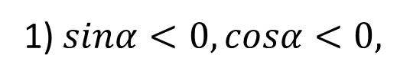


Misollar yechish
3-mashq.
Agar: $1) π<α<\frac{3π}{2}$ $2) 2π<α<2,5π 3)\frac{3π}{4}<α<π$ bo‘lsa, $sinα,cosα,tgα$ va $ctgα$ sonining ishoralarini aniqlang.
$$y$$
$$Yechish:$$
$${90}^{0}$$
1)$sinα<0,cosα<0,$
$$tgα>0,ctgα>0$$
$${180}^{0}$$
$$0^{0}$$
$$x$$
2)$sinα>0,cosα>0$,
$$tgα>0,ctgα>0$$
$${360}^{0}$$
3)$sinα>0,cosα<0$,
$$tgα<0,ctgα<0$$
$${270}^{0}$$

Slide 7

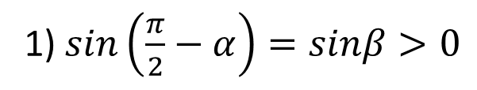


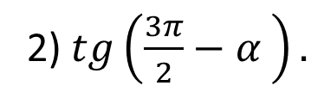

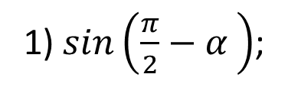
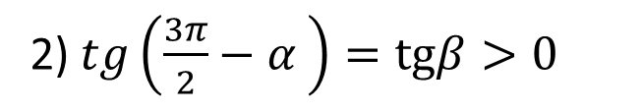
Misollar yechish
4-mashq.
Agar: $0<α<\frac{π}{2}$ bo‘lsa, sonining ishorasini aniqlang.
1)$sin\left(\frac{π}{2}−α \right)$;
2)$tg\left(\frac{3π}{2}−α \right).$
$$y$$
$${90}^{0}$$
$$Yechish:$$
1)$sin\left(\frac{π}{2}−α\right)=sinβ>0$
$${180}^{0}$$
$$0^{0}$$
$$x$$
$${360}^{0}$$
$$β$$
2)$tg\left(\frac{3π}{2}−α \right)=tgβ>0$
$${270}^{0}$$
$$β$$

Slide 8

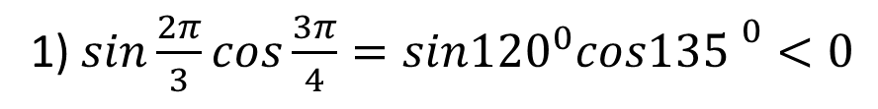




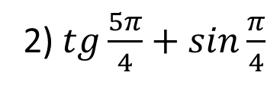
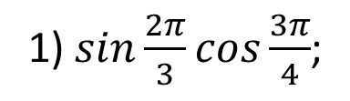
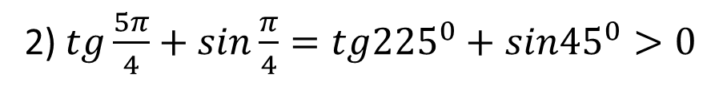
Misollar yechish
5-mashq.
Sonining ishorasini aniqlang.
1)$sin\frac{2π}{3}cos\frac{3π}{4}$;
2)$tg\frac{5π}{4}+sin\frac{π}{4}$
$$y$$
$$Yechish:$$
$${90}^{0}$$
1)$sin\frac{2π}{3}cos\frac{3π}{4}=sin{120}^{0}cos{135 }^{0}<0$
$${180}^{0}$$
$$0^{0}$$
$$+$$
$$−$$
$${360}^{0}$$
2)$tg\frac{5π}{4}+sin\frac{π}{4}=tg{225}^{0}+sin{45}^{0}>0$
$$+$$
$$+$$
$${270}^{0}$$

Slide 9




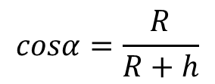







Misollar yechish
6-mashq.(Beruniy masalasi.)
Tog‘ning balandligi h –BC va $α−∠ABD$ burchak ma’lum bo‘lsa, Yer radiusi R ni toping.
$$Yechish:$$
B
D
$$β={90}^{0}−α$$
$$α$$
h
$$x$$
R+h
$$β+x={90}^{0}$$
R
C
$$β$$
$${90}^{0}−α+x={90}^{0}$$
R
$$cosα=\frac{R}{R+h}$$
$$−α+x=0$$
$$x=α$$
Javob: $R=\frac{hcosα}{1−cosα}$

Slide 10

Mustaqil yechish uchun topshiriqlar
Darslikning 111-sahifasidagi
244 va 245-mashqning 2, 4, 6, 8-tartibdagi misollari hamda 112-sahifasidagi 249-mashqni yechish.

