Slide 1
Algebra
9-sinf
Mavzu:
Nuqtani koordinatalar boshi atrofida burish

Slide 2
Mustaqil bajarilgan topshiriqni tekshirish
$$213$$
Graduslarda ifodalangan burchaklarning radian o‘lchovini toping.
$$α=\frac{π}{180°}∙α°$$
$$α=\frac{π}{180°}∙40°=\frac{2π}{9}$$
$$α=\frac{π}{180°}∙105°=\frac{7π}{12}$$
$$1) 40°$$
3$) 105°$
$$α=\frac{π}{180°}∙120°=\frac{2π}{3}$$
$$α=\frac{π}{180°}∙150°=\frac{5π}{6}$$
2$) 120°$
4$) 150°$

Slide 3
Mustaqil bajarilgan topshiriqni tekshirish
$$214$$
Radianlarda ifodalangan burchaklarning gradus o‘lchovini toping.
$$α°=\frac{180°}{π}∙α$$
$$1) \frac{π}{6}$$
$$α=\frac{{180}^{0}}{π}∙\frac{π}{6}={30}^{0}$$
$$3) \frac{2π}{3}$$
$$α=\frac{{180}^{0}}{π}∙\frac{2π}{3}={120}^{0}$$
$$α=\frac{{180}^{0}}{π}∙\frac{π}{9}={20}^{0}$$
$$α=\frac{{180}^{0}}{π}∙\frac{3π}{4}={135}^{0}$$
2$) \frac{π}{9}$
4$) \frac{3π}{4}$

Slide 4
Birlik aylana
Koordinata tekisligida radiusi 1 ga teng va markazi koordinata boshida bo‘lgan aylanani qaraymiz. Bu birlik aylana deyiladi.
y
x
P(1;0)

Slide 5
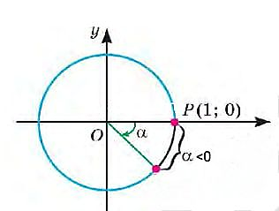
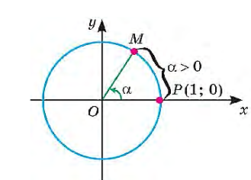
P nuqtani koordinata boshi atrofida $α$burchakka burish
1. Aytaylik, $α>0$bo‘lsin.
2. Aytaylik, $α<0$ bo‘lsin.

Slide 6
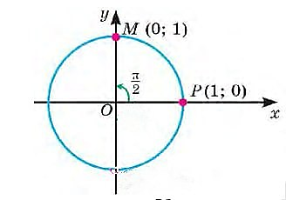
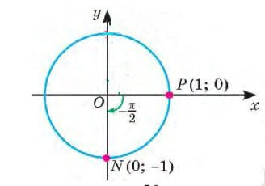
Misollar
1) P(1;0), $α=\frac{π}{2}$ bo‘lsin.
2) P(1;0), $α=−\frac{π}{2}$ bo‘lsin.

Slide 7
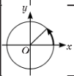
Ba’zi burchaklarni burishning radian va gradus o‘lchovlari jadvali
$${30}^{0}$$ | $${45}^{0}$$ | $${60}^{0}$$ | $${90}^{0}$$ | $${180}^{0}$$ | $${270}^{0}$$ | $${360}^{0}$$ | $${−90}^{0}$$ | $${−180}^{0}$$
$$\frac{π}{6}$$ | $$\frac{π}{4}$$ | $$\frac{π}{3}$$ | $$\frac{π}{2}$$ | $$π$$ | $$\frac{3π}{2}$$ | $$2π$$ | $$−\frac{π}{2}$$ | $$−π$$

Slide 8
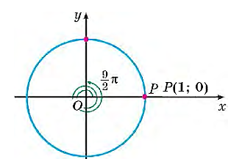
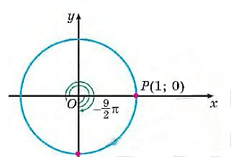
Endi nuqtani $2π$ dan katta burchakka va $−2π$ dan kichik burchakka burishga oid misollarni qaraymiz.
Masalan, $\frac{9π}{2}$ va - $\frac{9π}{2}$
$$\frac{9π}{2}=2∙2π+\frac{π}{2}$$
- $\frac{9π}{2}=−2∙2π−\frac{π}{2}$

Slide 9
Masalalar
1-m a s a l a. P(1;0) nuqtani:
1) $7π$; 2)$\frac{5π}{2}$ burchakka burishdan hosil bo‘lgan nuqtaning koordinatalarini toping.
1) $7π=3∙2π+π$ bo‘lgani uchun $7π$ ga burishda $π$ga burishdagi nuqtaning o‘zi, ya’ni (-1;0) koordinatali nuqtali hosil bo‘ladi.
$2) −\frac{5π}{2}=−\frac{π}{2}−2π$ bo‘lgani uchun $−\frac{5π}{2}$ ga burishda $−\frac{π}{2}$ga burishdagi nuqtaning o‘zi, ya’ni (0;-1) koordinatali nuqtali hosil bo‘ladi.

Slide 10
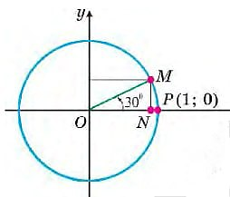
Masalalar
2-m a s a l a.
$\left(\frac{\sqrt{3}}{2};\frac{1}{2}\right)$ nuqtani hosil qilish uchun (1;0) nuqtani burish kerak bo‘lgan barcha burchaklarni yozing.
$α=\frac{π}{6}+2πk$
$k=0;±1;±2;±3;…$

Slide 11
Masalalar
3-m a s a l a. Birlik aylanada P(1;0) nuqtani $α$burchakka burish natijasida hosil bo‘lgan nuqta joylashgan koordinatalar choragini aniqlaymiz.
y
1) $α=\frac{π}{4}$
3) $α=\frac{3π}{4}$
P
P
x
2) $α=−\frac{π}{4}$
4) $α=−\frac{3π}{4}$
P
o
P
P

Slide 12
Masalalar
4-m a s a l a.
$\left(\frac{1}{2};\frac{\sqrt{3}}{2}\right)$ nuqtani hosil qilish uchun (1;0) nuqtani burish kerak bo‘lgan barcha burchaklarni yozing.
$α=\frac{π}{3}+2πk$
$${60}^{0}$$
$k=0;±1;±2;±3;…$
P

Slide 13
Masalalar
5-m a s a l a.
$\left(\frac{\sqrt{2}}{2};\frac{\sqrt{2}}{2}\right)$ nuqtani hosil qilish uchun (1;0) nuqtani burish kerak bo‘lgan barcha burchaklarni yozing.
$α=\frac{π}{4}+2πk$
$${45}^{0}$$
$k=0;±1;±2;±3;…$
P

Slide 14
Mustaqil yechish uchun topshiriqlar
Darslikning 102-sahifasidagi
222, 223, 225, 226-mashqlar.

