Slide 1
Algebra
9-sinf
Mavzu:
Burchakning radian o‘lchovi
Komilov Mirodil Xosiljonovich X.T.V. tasarrufidagi AFIDUM matematika fani o‘qituvchisi.

Slide 2
Mustaqil bajarilgan topshiriqni tekshirish
9-test. Tenglamalar sistemasini yeching:
$$\left\{\begin{aligned}\sqrt{\frac{x−2}{y+5}}−\sqrt{\frac{y+5}{x−2}}=\frac{5}{6} \\ x−y=12\end{aligned}\right.$$
$$\sqrt{\frac{x−2}{y+5}}=t$$
$$t_{1}=−\frac{2}{3}; t_{2}=\frac{3}{2}$$
$$t−\frac{1}{t}=\frac{5}{6}$$
$$\sqrt{\frac{x−2}{y+5}}=\frac{3}{2}$$
$$6t^{2}−5t−6=0$$

Slide 3
Mustaqil bajarilgan topshiriqni tekshirish
$$\left\{\begin{aligned}\sqrt{\frac{x−2}{y+5}}−\sqrt{\frac{y+5}{x−2}}=\frac{5}{6} \\ x−y=12\end{aligned}\right.$$
$$\sqrt{\frac{x−2}{y+5}}=\frac{3}{2}$$
$$\frac{x−2}{y+5}=\frac{9}{4}$$
$$4x−8=9y+45$$
$$4x−9y=53$$
$$\left\{\begin{aligned}4x−9y=53 \\ x−y=12\end{aligned}\right.$$
$$\left\{\begin{aligned}4x−9y=53 \\ 9x−9y=108\end{aligned}\right.$$
$$−5x=−55 ⟹x=11$$
$$y=11−12=−1$$
Javob: $\left(11;−1\right)$

Slide 4
Mustaqil bajarilgan topshiriqni tekshirish
10-test. Tengsizliklar sistemasini yeching:
$$\left\{\begin{aligned}3x^{2}+10x−8<0 \\ 2x+9≥0\end{aligned}\right.$$
$$x_{1}=\frac{−10−14}{6}=−4;$$
$$x_{2}=\frac{−10+14}{6}=\frac{4}{6}=\frac{2}{3}$$
$$3x^{2}+10x−8<0$$
$$2x+9≥0 ⟹x≥−4,5$$
$$+$$
$$−$$
$$+$$
$$−4,5$$
$$−4$$
$$\frac{2}{3}$$
Javob: $\left(−4;\frac{2}{3}\right)$

Slide 5
Mustaqil bajarilgan topshiriqni tekshirish
11-test. Tengsizlikni yeching:
$$\left|x^{2}+x−1\right|≤1$$
$$−1≤x^{2}+x−1≤1$$
$$x^{2}+x−1≥−1$$
$$x^{2}+x−1≤1$$
$$x^{2}+x≥0$$
$$x_{1}=−1; x_{2}=0$$
$$x^{2}+x−2≤0$$
$$x_{1}=−2; x_{2}=1$$
$$+$$
$$−$$
$$+$$
$$+$$
$$−$$
$$+$$
$$−1$$
$$0$$
$$−2$$
$$1$$
Javob: $x∈[−2;−1]⋃[0;1]$
$$−2$$
$$−1$$
$$0$$
$$1$$

Slide 6
Burchak
Bir nuqtadan chiquvchi ikki nurdan iborat shaklga burchak deyiladi.
α

Slide 7
Burchakning radian o‘lchovi
1 radian deb uzunligi aylana radiusiga teng bo‘lgan yoyga tiralgan markaziy burchakka aytiladi.

Slide 8
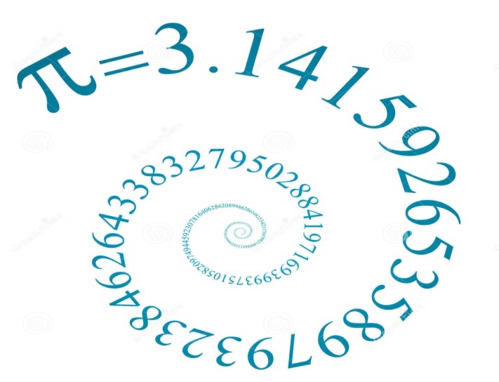
Pi soni $π$ – matematik o‘zgarmas qiymat, aylana uzunligini uning diametriga nisbatini ifodalovchi son.

Slide 9
180°
radian
=
Burchak o‘lchov
birliklari
π radian
gradus
Notes:
Задание: из предложенных слов составить кластер

Slide 10
Gradus o‘lchovdan radian
o‘lchovga o‘tish
π radian=180°
π
180
⇓

Slide 11
Gradus o‘lchovdan radian
o‘lchovga o‘tish
π радиан=180°
π
180
⇓

Slide 12
Mashqlar yechish
π radian=180°
π
π
π
180
180
180

Slide 13
Mashqlar yechish
1.
2.

Slide 14
Radian o‘lchovdan gradus o‘lchovga o‘tish
$α−$ radian o‘lchovi
$α°−$ gradus o‘lchovi
$$α°=\frac{180°}{π}∙α$$
$$\frac{π}{2} rad.=\frac{180°}{π}∙\frac{π}{2}=90°$$
$$\frac{4π}{3} rad.=\frac{180°}{π}∙\frac{4π}{3}=240°$$

Slide 15
Radian o‘lchovini toping
45°
180°
240°
10°
270°
150°
2π
330°
36°
360°

Slide 16
Gradus o‘lchovini toping

Slide 17
Bazi burchaklarning gradus va radian o‘lchovi
$α−$ radian o‘lchovi
$α°−$ gradus o‘lchovi
$$α°=\frac{180°}{π}∙α$$
$$α=\frac{π}{180°}∙α°$$

Slide 18
Mashqlar yechish
Shahar kurantlari minut milining uchi radiusi
$R≈0,8 m$ bo‘lgan aylana bo‘ylab harakat qiladi.
Bu milning uchi 15 min davomida qancha yo‘lni
bosib o‘tadi?
$$l=αR$$
1 min $− 6°$
15 min $−15∙6°=90°$
$$90°=\frac{π}{180}∙90=\frac{π}{2}$$
$$l=\frac{π}{2}∙0,8=\frac{3,14∙0,8}{2}≈1,3 m$$
Javob: $1,3 m$

Slide 19
Mashqlar yechish
Doiraviy sektor yoyini $\frac{3π}{4}$ rad li burchak tortib
turadi. Agar doiraning radiusi 1 cm ga teng bo‘lsa,
sektorning yuzini toping.
$$S=\frac{R^{2}}{2}α$$
$$S=\frac{1^{2}}{2}∙\frac{3π}{4}=\frac{3π}{8}≈1,18 {cm}^{2}$$
Javob:$1,18 {cm}^{2}$

Slide 20
Mustaqil yechish uchun topshiriq
Darslikning 96-betidagi 213, 214, 218, 219, 221- mashqlar.

