Slide 1
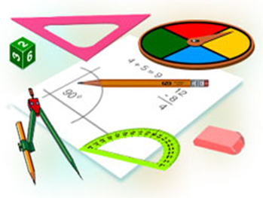
Algebra
10-sinf
Mavzu:
Sodda ratsional tengsizliklar sistemasi

Slide 2
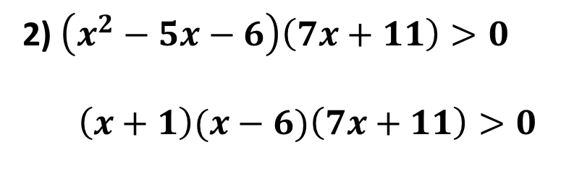
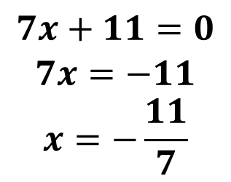


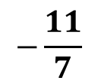
Mustaqil bajarilgan topshiriqni tekshirish
53. Tengsizlikni yeching:
2) $\left(x^{2}−5x−6\right)\left(7x+11\right)>0$
$\left(x+1\right)(x−6)\left(7x+11\right)>0$
$$7x+11=0$$
$$7x=−11$$
$$x=−\frac{11}{7}$$
$$x+1=0$$
$$x=−1$$
$$x−6=0$$
$$x=6$$
$$−$$
$$+$$
$$−$$
$$+$$
$$−\frac{11}{7}$$
$$−1$$
$$6$$
Javob: $x∈\left(−\frac{11}{7};−1\right)⋃\left(6;+∞\right)$

Slide 3
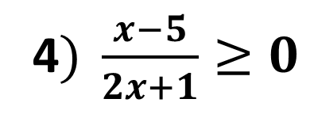
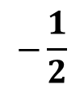
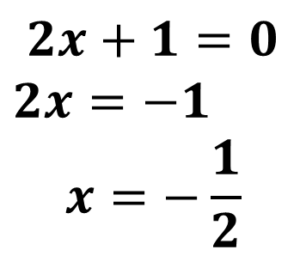
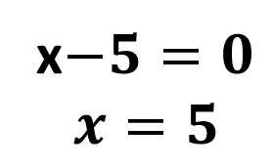
Mustaqil bajarilgan topshiriqni tekshirish
53. Tengsizlikni yeching:
4$) \frac{x−5}{2x+1}≥0$
$$2x+1=0$$
$2x=−1$
$$x=−\frac{1}{2}$$
x$−5=0$
$$x=5$$
$$+$$
$$−$$
$$+$$
$$−\frac{1}{2}$$
Javob: $x∈\left(−∞;−\frac{1}{2}\right)⋃[5;+∞$)
$$5$$

Slide 4
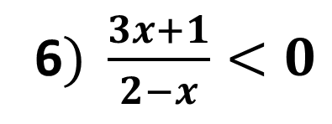
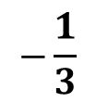
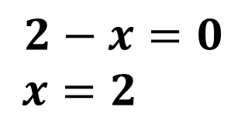
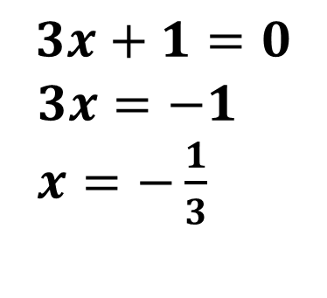
Mustaqil bajarilgan topshiriqni tekshirish
53. Tengsizlikni yeching:
6$) \frac{3x+1}{2−x}<0$
$$3x+1=0$$
$3x=−1$
$x=−\frac{1}{3}$
$$2−x=0$$
$x=2$
$$−$$
$$+$$
$$−$$
$$−\frac{1}{3}$$
Javob: $x∈\left(−∞;−\frac{1}{3}\right)⋃(2;+∞$)
$$2$$

Slide 5
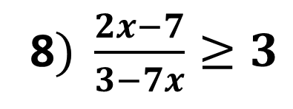
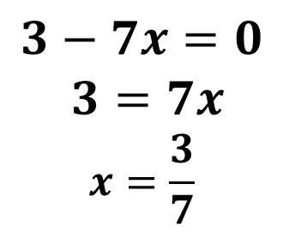
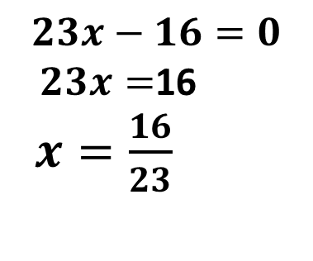
Mustaqil bajarilgan topshiriqni tekshirish
53. Tengsizlikni yeching:
8$) \frac{2x−7}{3−7x}≥3$
=> $\frac{2x−7}{3−7x}−3≥0$
=> $\frac{23x−16}{3−7x}≥0$
$$23x−16=0$$
$23x=$16
$x=\frac{16}{23}$
$$3−7x=0$$
$$3=7x$$
$$x=\frac{3}{7}$$
$$−$$
$$+$$
$$−$$
Javob: $x∈ (\frac{3}{7}; \left.\frac{16}{23}\right]$
$$\frac{3}{7}$$
$$\frac{16}{23}$$

Slide 6
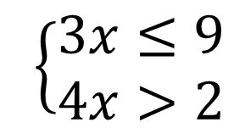
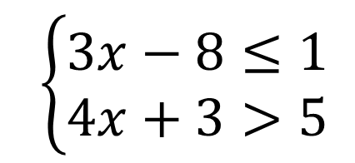
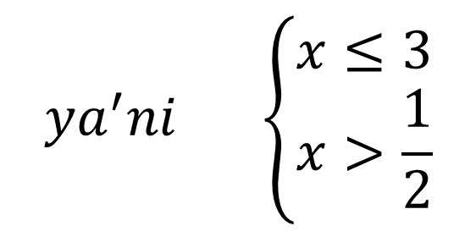
Sodda ratsional tengsizliklar sistemasi
1-misol. Tengsizliklar sistemasini yeching:
$$\left\{\begin{aligned}3x−8≤1 \\ 4x+3>5\end{aligned}\right.$$
$$=> \left\{\begin{aligned}3x≤1+8 \\ 4x>5−3\end{aligned}\right.$$
$$ya^{′}ni \left\{\begin{aligned}x≤3 \\ x>\frac{1}{2}\end{aligned}\right.$$
$$\left\{\begin{aligned}3x≤9 \\ 4x>2\end{aligned}\right.$$
Javob: $x∈\left(\frac{1}{2}\right.;3]$
$$\frac{1}{2}$$
$$3$$

Slide 7
Misollar yechish
2-misol. Tengsizliklar sistemasini yeching:
$$\left\{\begin{aligned}(3−x)(4+x)≥0, \\ \left(2+x\right)\left(5−x\right)<0.\end{aligned}\right.$$
$$\left(3−x\right)\left(4+x\right)≥0$$
$$x=3, x=−4$$
$$\left(2+x\right)\left(5−x\right)<0$$
$$x=−2, x=5$$
$$−$$
$$−$$
$$+$$
$$+$$
$$−$$
$$−$$
$$−4$$
$$−2$$
$$3$$
$$5$$
Javob: $x∈[−4;−2)$

Slide 8
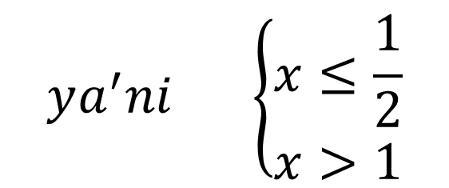
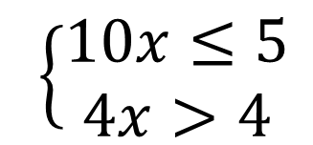
Misollar yechish
54-misol. Tengsizliklar sistemasini yeching:
$$1) \left\{\begin{aligned}3x−5≤7x, \\ 2x+1>−2x+3.\end{aligned}\right.$$
$$=> \left\{\begin{aligned}3x+7x≤5 \\ 2x+2x>3+1\end{aligned}\right.$$
$$ya^{′}ni \left\{\begin{aligned}x≤\frac{1}{2} \\ x>1\end{aligned}\right.$$
$$\left\{\begin{aligned}10x≤5 \\ 4x>4\end{aligned}\right.$$
$$\frac{1}{2}$$
$$1$$
Javob: Sistema yechimga ega emas!

Slide 9
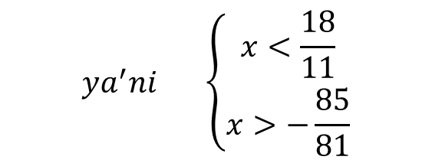
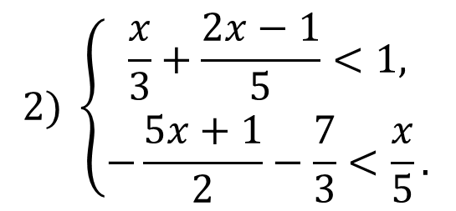

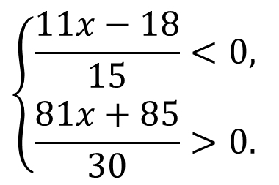
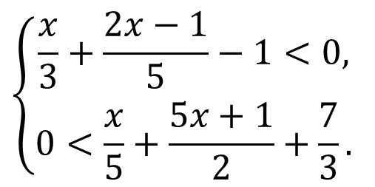
Misollar yechish
54-misol. Tengsizliklar sistemasini yeching:
$$2) \left\{\begin{aligned}\frac{x}{3}+\frac{2x−1}{5}<1, \\ −\frac{5x+1}{2}−\frac{7}{3}<\frac{x}{5}.\end{aligned}\right.$$
$$\left\{\begin{aligned}\frac{x}{3}+\frac{2x−1}{5}−1<0, \\ 0<\frac{x}{5}+\frac{5x+1}{2}+\frac{7}{3}.\end{aligned}\right.$$
$$\left\{\begin{aligned}\frac{11x−18}{15}<0, \\ \frac{81x+85}{30}>0.\end{aligned}\right.$$
$$ya^{′}ni \left\{\begin{aligned}x<\frac{18}{11} \\ x>−\frac{85}{81}\end{aligned}\right.$$
$$\left\{\begin{aligned}11x<18 \\ 81x>−85\end{aligned}\right.$$
$$\frac{18}{11}$$
Javob:$\left(−\frac{85}{81};\frac{18}{11} \right)$
$$−\frac{85}{81}$$

Slide 10
Mustaqil yechish uchun topshiriq
Darslikning 79-sahifasidagi
55-mashqning misollarini yechish

