Slide 1

Algebra
10-sinf
Mavzu:
Sodda ratsional tengsizliklar
(1-qism)
Komilov Mirodil Xosiljonovich X.T.V. tasarrufidagi AFIDUM matematika fani o‘qituvchisi.

Slide 2
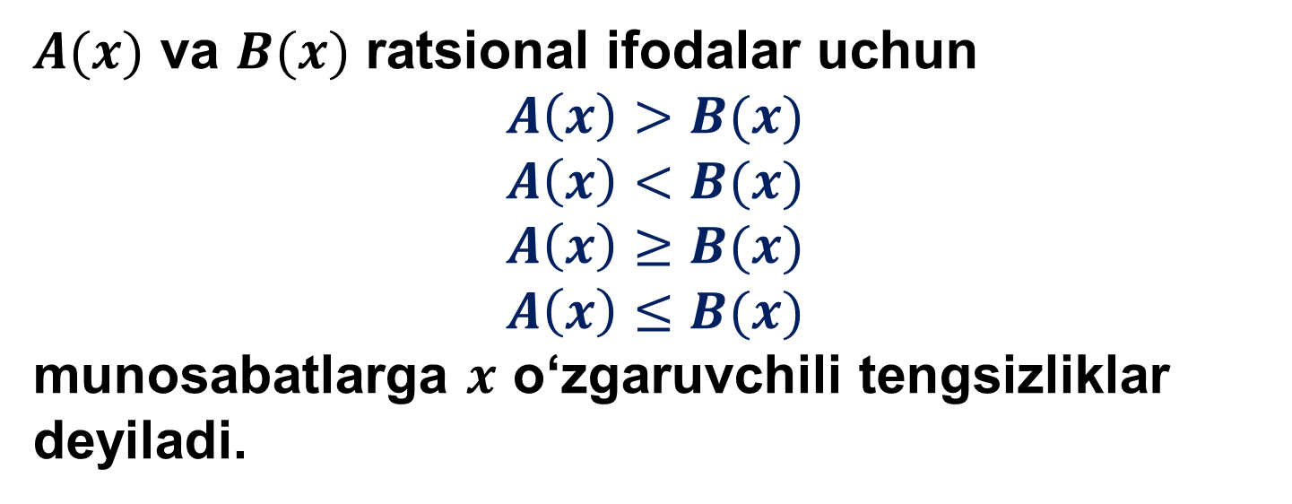
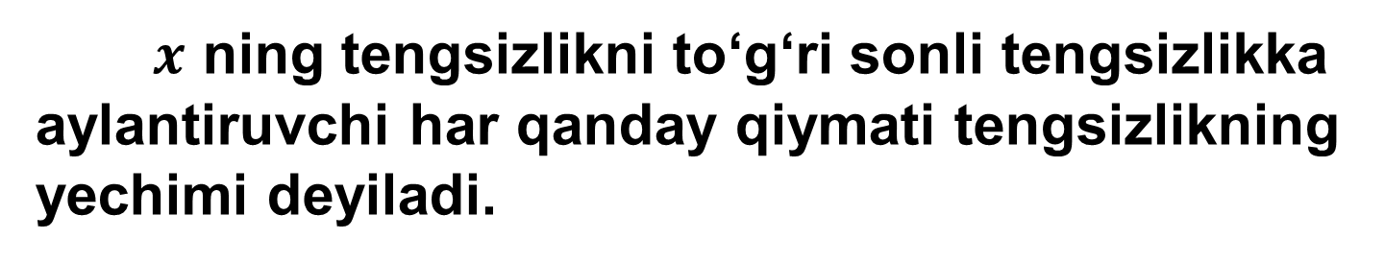
Bir o‘zgaruvchili ratsional tengsizliklar
$A(x)$ va $B(x)$ ratsional ifodalar uchun
$$A\left(x\right)>B(x)$$
$$A\left(x\right)<B(x)$$
$$A\left(x\right)≥B(x)$$
$$A\left(x\right)≤B(x)$$
munosabatlarga $x$ o‘zgaruvchili tengsizliklar deyiladi.
$x$ ning tengsizlikni to‘g‘ri sonli tengsizlikka aylantiruvchi har qanday qiymati tengsizlikning yechimi deyiladi.

Slide 3

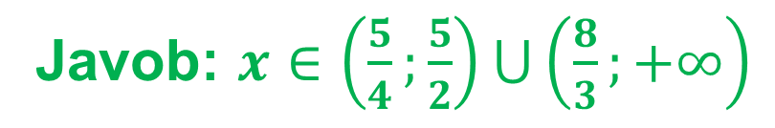


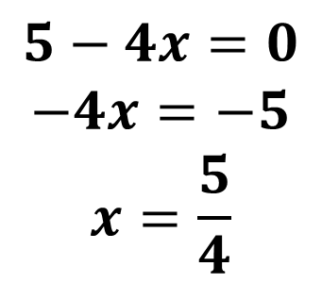

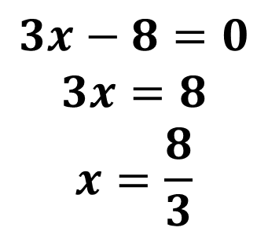

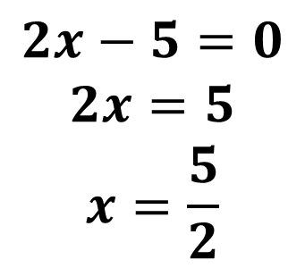

Mashqlar yechish
Tengsizlikni yeching:
$$2\left(2x−5\right)\left(3x−8\right)\left(5−4x\right)<0$$
$$2x−5=0$$
$$2x=5$$
$$x=\frac{5}{2}$$
$$3x−8=0$$
$$3x=8$$
$$x=\frac{8}{3}$$
$$5−4x=0$$
$$−4x=−5$$
$$x=\frac{5}{4}$$
$$+$$
$$−$$
$$+$$
$$−$$
$$\frac{5}{4}$$
$$\frac{5}{2}$$
$$\frac{8}{3}$$
Javob: $x∈\left(\frac{5}{4};\frac{5}{2}\right)⋃\left(\frac{8}{3};+∞\right)$

Slide 4



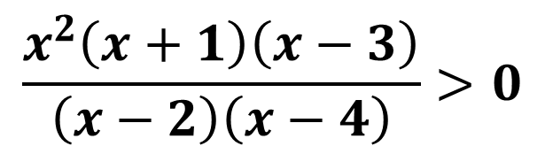



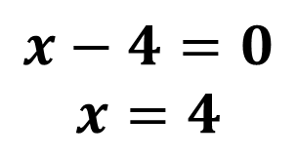

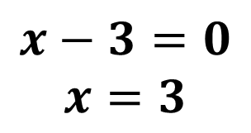

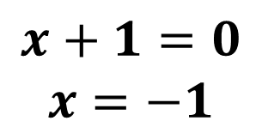
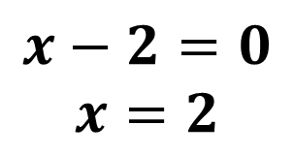


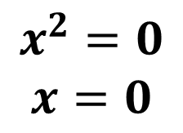

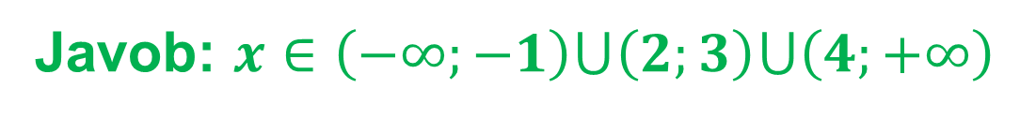
Mashqlar yechish
Tengsizlikni yeching:
$$\frac{x^{2}\left(x+1\right)\left(x−3\right)}{\left(x−2\right)\left(x−4\right)}>0$$
$$x^{2}=0$$
$$x=0$$
$$x+1=0$$
$$x=−1$$
$$x−3=0$$
$$x=3$$
$$x−2=0$$
$$x=2$$
$$x−4=0$$
$$x=4$$
$$+$$
$$−$$
$$−$$
$$+$$
$$−$$
$$+$$
$$−1$$
$$0$$
$$2$$
$$3$$
$$4$$
Javob: $x∈\left(−∞;−1\right)⋃\left(2;3\right)⋃\left(4;+∞\right)$

Slide 5

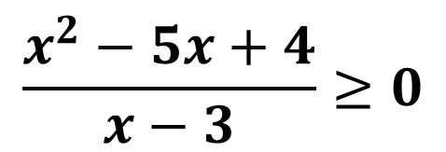

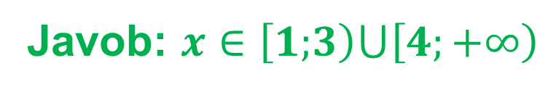


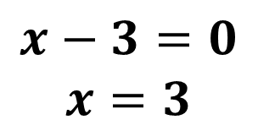

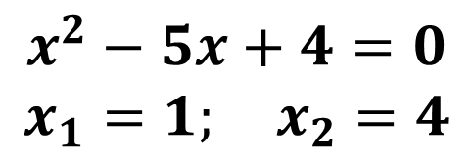
Mashqlar yechish
Tengsizlikni yeching:
$$\frac{x^{2}−5x+4}{x−3}≥0$$
$$x^{2}−5x+4=0$$
$$x_{1}=1; x_{2}=4$$
$$x−3=0$$
$$x=3$$
$$−$$
$$+$$
$$−$$
$$+$$
$$1$$
$$3$$
$$4$$
Javob: $x∈\left[1;\right.\left.3\right)⋃\left[4\right.;\left.+∞\right)$

Slide 6


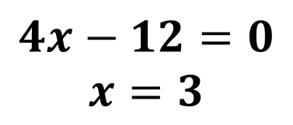

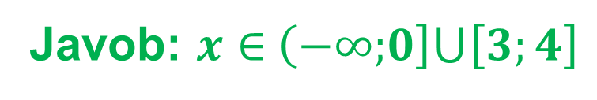

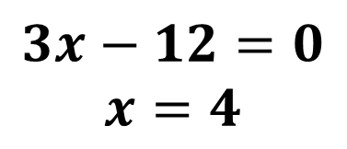




Mashqlar yechish
Tengsizlikni yeching:
$${\left(3x−12\right)}^{2}∙\left(4x−12\right)≥\left(3x−12\right)∙{\left(4x−12\right)}^{2}$$
$${\left(3x−12\right)}^{2}∙\left(4x−12\right)−\left(3x−12\right)∙{\left(4x−12\right)}^{2}≥0$$
$$\left(3x−12\right)∙\left(4x−12\right)∙\left(3x−12−4x+12\right)≥0$$
$$x∙\left(3x−12\right)∙\left(4x−12\right)≤0$$
$$x=0$$
$$3x−12=0$$
$$x=4$$
$$4x−12=0$$
$$x=3$$
$$−$$
$$+$$
$$−$$
$$+$$
$$0$$
$$3$$
$$4$$
Javob: $x∈$ $\left(−∞;\right.\left.0\right]⋃\left[3;4\right]$

Slide 7


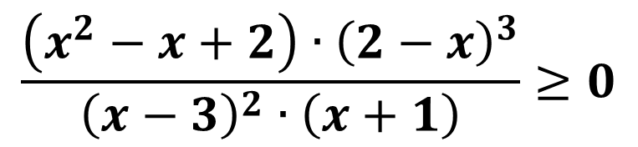
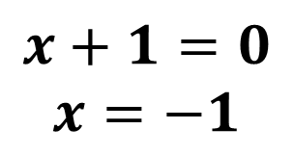

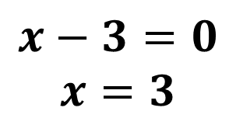

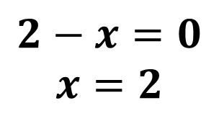


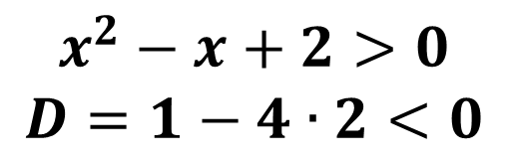

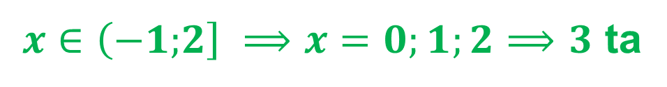
Mashqlar yechish
$$\frac{\left(x^{2}−x+2\right)∙{\left(2−x\right)}^{3}}{{\left(x−3\right)}^{2}∙\left(x+1\right)}≥0$$
tengsizlik nechta butun yechimga ega?
$$x^{2}−x+2>0$$
$$D=1−4∙2<0$$
$$2−x=0$$
$$x=2$$
$$x−3=0$$
$$x=3$$
$$x+1=0$$
$$x=−1$$
$$−$$
$$+$$
$$−$$
$$−$$
$$−1$$
$$2$$
$$3$$
$x∈\left(−1;\right.\left.2\right] ⟹x=0;1;2⟹3$ ta
Javob: $3$ ta

Slide 8


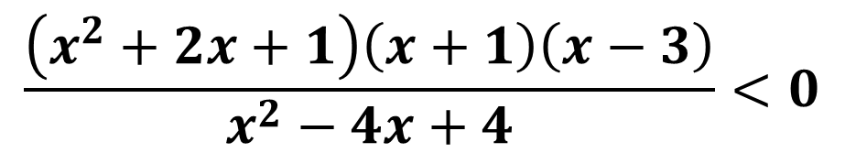
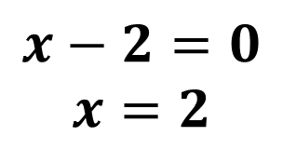

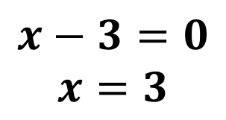

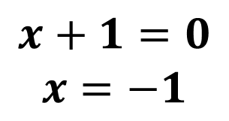
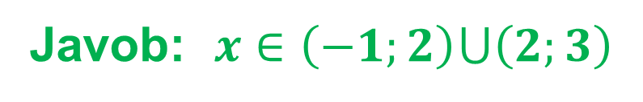

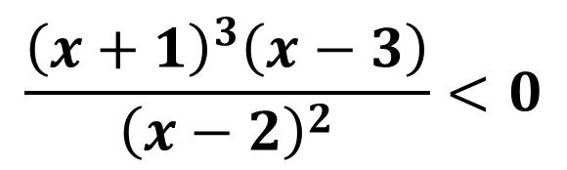


Mashqlar yechish
Tengsizlikni
yeching:
$$\frac{\left(x^{2}+2x+1\right)\left(x+1\right)\left(x−3\right)}{x^{2}−4x+4}<0$$
$$\frac{{\left(x+1\right)}^{3}\left(x−3\right)}{{\left(x−2\right)}^{2}}<0$$
$$x+1=0$$
$$x=−1$$
$$x−3=0$$
$$x=3$$
$$x−2=0$$
$$x=2$$
$$+$$
$$−$$
$$−$$
$$+$$
$$−1$$
$$2$$
$$3$$
Javob: $x∈\left(−1;2\right)⋃\left(2;3\right)$

Slide 9

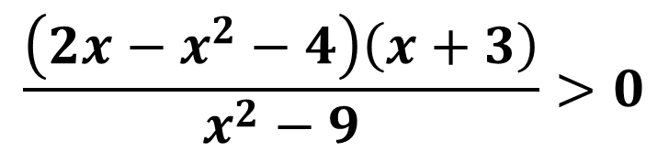

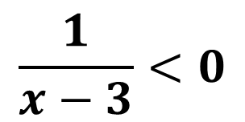
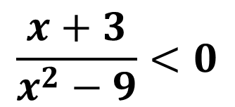
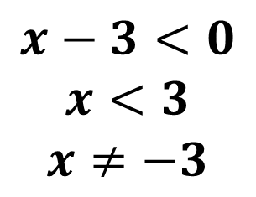
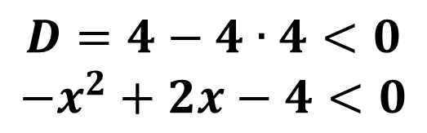
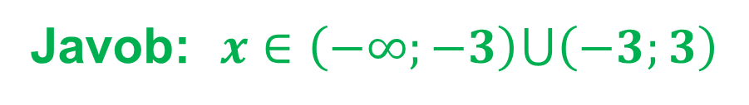
Mashqlar yechish
Tengsizlikni
yeching:
$$\frac{\left(2x−x^{2}−4\right)\left(x+3\right)}{x^{2}−9}>0$$
$$D=4−4∙4<0$$
$$−x^{2}+2x−4<0$$
$$\frac{x+3}{x^{2}−9}<0$$
$$\frac{1}{x−3}<0$$
$$x−3<0$$
$$x<3$$
$$x≠−3$$
$$−3$$
$$3$$
Javob: $x∈\left(−∞;−3\right)⋃\left(−3;3\right)$

Slide 10





Mashqlar yechish
Tengsizlik nechta butun yechimga ega?
$$x^{2}∙\left|x+2\right|+x^{2}+4x+4≤0$$
$$x^{2}∙\left|x+2\right|+{\left|x+2\right|}^{2}≤0$$
$$x^{2}∙\left|x+2\right|+{\left|x+2\right|}^{2}=0$$
$$\left|x+2\right|∙\left(x^{2}+\left|x+2\right|\right)=0$$
$$\left|x+2\right|=0 ⟹x=−2$$
Javob: 1 ta butun yechimga ega

Slide 11

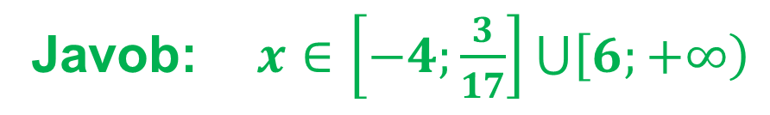

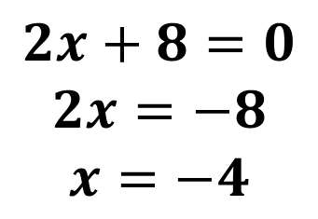
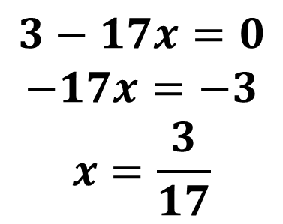
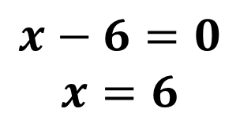

Mashqlar yechish
52. Tengsizlikni yeching:
$$1) \left(x−6\right)\left(3−17x\right)\left(2x+8\right)≤0$$
$$x−6=0$$
$$x=6$$
$$3−17x=0$$
$$−17x=−3$$
$$x=\frac{3}{17}$$
$$2x+8=0$$
$$2x=−8$$
$$x=−4$$
$$+$$
$$−$$
$$+$$
$$−$$
$$−4$$
$$\frac{3}{17}$$
$$6$$
Javob: $x∈\left[−4;\frac{3}{17}\right]⋃\left[6;\left.+∞\right)\right.$

Slide 12



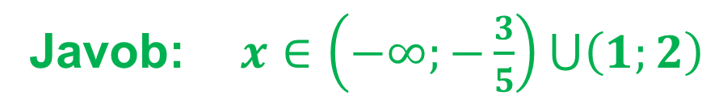

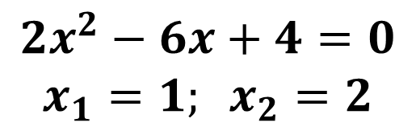
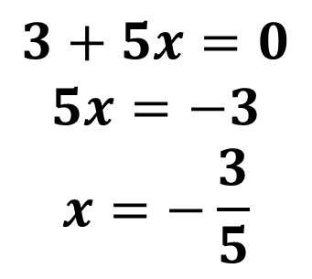
Mashqlar yechish
52. Tengsizlikni yeching:
$$3) \left(3+5x\right)\left(2x^{2}−6x+4\right)<0$$
$$3+5x=0$$
$$5x=−3$$
$$x=−\frac{3}{5}$$
$$2x^{2}−6x+4=0$$
$$x_{1}=1; x_{2}=2$$
$$−$$
$$+$$
$$−$$
$$+$$
$$−\frac{3}{5}$$
$$1$$
$$2$$
Javob: $x∈\left(−∞;−\frac{3}{5}\right)⋃\left(1;2\right)$

Slide 13




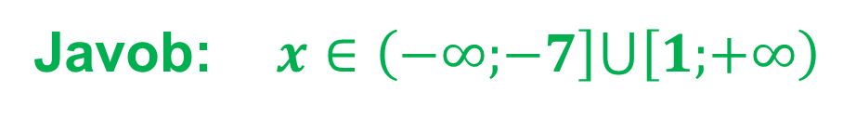
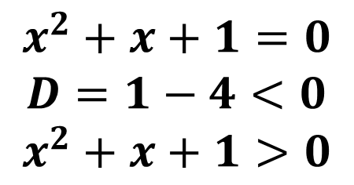

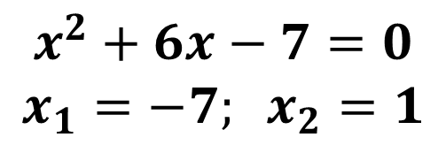
Mashqlar yechish
52. Tengsizlikni yeching:
$$5) \left(x^{2}+6x−7\right)\left(x^{2}+x+1\right)≥0$$
$$x^{2}+x+1=0$$
$$D=1−4<0$$
$$x^{2}+x+1>0$$
$$x^{2}+6x−7=0$$
$$x_{1}=−7; x_{2}=1$$
$$+$$
$$−$$
$$+$$
$$−7$$
$$1$$
Javob: $x∈\left(−∞;\right.\left.−7\right]⋃\left[1;\right.\left.+∞\right)$

Slide 14

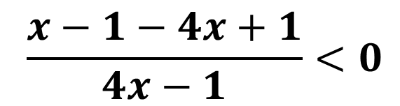
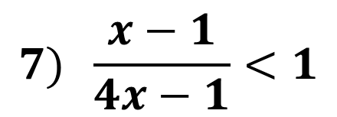








Mashqlar yechish
52. Tengsizlikni yeching:
$$7) \frac{x−1}{4x−1}<1$$
$$\frac{x−1}{4x−1}−1<0$$
$$\frac{x−1−4x+1}{4x−1}<0$$
$$\frac{3x}{4x−1}>0$$
$$3x=0$$
$$x=0$$
$$4x−1=0$$
$$x=\frac{1}{4}$$
$$+$$
$$−$$
$$+$$
$$0$$
$$0,25$$
Javob: $x∈\left(−∞;0\right)⋃\left(0,25;+∞\right)$

Slide 15






Mashqlar yechish
52. Tengsizlikni yeching:
$$9) \frac{x^{2}−5x+11}{x^{2}−7}≤0$$
$$x^{2}−5x+11=0$$
$$D=25−44<0$$
$$x^{2}−5x+11>0$$
$$x^{2}−7=0$$
$$x_{1}=−\sqrt{7}; x_{2}=\sqrt{7}$$
$$+$$
$$−$$
$$+$$
$$−\sqrt{7}$$
$$\sqrt{7}$$
Javob: $x∈\left(−∞;\right.\left.−\sqrt{7}\right]⋃\left[\sqrt{7};\right.\left.+∞\right)$

Slide 16

Mustaqil yechish uchun topshiriq
Darslikning 79-betidagi 52-mashqning 2, 4, 6, 8, 10- tartibdagi misollarini yechish

