Slide 1
Algebra
10
sinf
Mavzu:
To‘plamlar va ular ustida
amallarga doir
masalalar yechish.

Slide 2
To‘plamlar ayirmasi
$A$ va $B$ to‘plamlarning ayirmasi deb, A ning B ga tegishli bo‘lmagan barcha elementlaridan tuzilgan to‘plamga aytiladi.
A va B to‘plamlarning ayirmasi $A\backslash B$kabi
belgilanadi.
$$A=\left\{1, 2, 3, 4, 5, 6, 7, 8, 9, 10\right\}$$
$$B=\left\{1, 3, 5, 7, 9\right\}$$
$$A\backslash B=\left\{2, 4, 6, 8, 10\right\}$$

Slide 3
Masalalar yechish
$$\text{P}\text{= \{30 }\text{ning} \text{natural} \text{bo}\text{‘}\text{luvchilari}\text{\}}$$
$$P\backslash Q=?$$
$$\text{Q}\text{= \{}\text{4}\text{0 }\text{ning} \text{natural} \text{bo}\text{‘}\text{luvchilari}\text{\}}$$
$$\text{30 }\text{ning} \text{natural} \text{bo}\text{‘}\text{luvchilari}=>\text{1,} \text{2,} \text{3,} \text{5,} \text{6,} \text{10,} \text{15,} \text{30}\text{.}$$
$$\text{4}\text{0 }\text{ning} \text{natural} \text{bo}\text{‘}\text{luvchilari}=>\text{1,} \text{2,} \text{4,} \text{5,} \text{8,} \text{10,} \text{20,} \text{40.}$$
$$P=\left\{\text{1, 2, }\text{3,}\text{ 5, }\text{6,}\text{ 10, }\text{15,} \text{30}\right\}$$
$$Q=\left\{\text{1}\text{, }\text{2}\text{, 4, }\text{5}\text{, 8, }\text{10}\text{, 20, 40}\right\}$$
$$P\backslash Q=\left\{3, 6, 15, 30\right\}$$

Slide 4
Masalalar yechish
1. $A=\left\{a, b, c, d, e, f\right\}$ to‘plamning nechta qism to‘plamiga $a$ element tegishli bo‘ladi?
$A) 16$ $B) 8$ $C) 32$ $D) 64$
$C) 32$
$$A=\left\{a_{1},a_{2},a_{3},a_{4},…,a_{n}\right\}$$
$$n\left(A\right)=n$$
Qism to‘plamlar soni - $2^{n}$
$$B=\left\{b, c, d, e, f\right\} => n\left(B\right)=5 => 2^{5}=32$$
Har bir qism to‘plamlar bilan $\left\{a\right\}$ to‘plamni birlashmasi
$A$ to‘plamning ham qism to‘plami bo‘ladi.
Javob: $32$

Slide 5
Masalalar yechish
2. $A=\left\{a, b, c, d, e, f\right\}$ to‘plamning nechta qism to‘plamlarida, $b$ elementi bo‘lib, $c$ elementi qatnashmaydi?
$A) 16$ $B) 32$ $C) 8$ $D) 28$
$A) 16$
$$B=\left\{a, b, d, e, f\right\}$$
$$C=\left\{a, d, e, f\right\} =>n\left(C\right)=4 => 2^{4}=16$$
$C$ to‘plamning har bir qism to‘plamlari bilan $\left\{b\right\}$ to‘plamni
birlashmasi $B$ to‘plamning ham qism to‘plami bo‘ladi.
Javob: $16$

Slide 6
Masalalar yechish
3. $A=\left\{a, b, c, d, e, f\right\}$ to‘plamning elementlari soni
2 ta bo‘lgan nechta qism to‘plami bor?
$A) 15$ $B) 4$ $C) 8$ $D) 16$
$A) 15$
$$C_{n}^{k}=\frac{n!}{k!∙\left(n−k\right)!}$$
$$n=6, k=2$$
$$C_{6}^{2}=\frac{6!}{2!∙\left(6−2\right)!}=\frac{6!}{2!∙4!}=\frac{5∙6}{2}=15$$
Javob: $15$

Slide 7
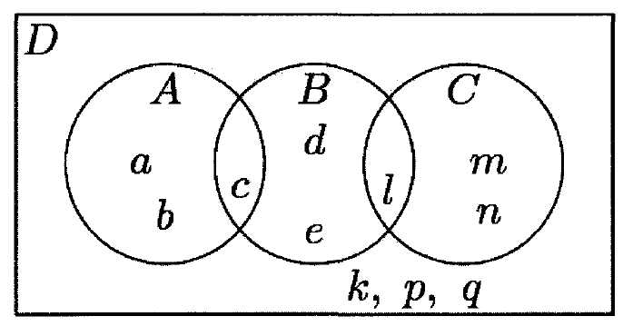
Masalalar yechish
4. Rasmdan foydalanib, $\left(\left(A∩B\right)∪C\right)∩D$ to‘plamning elementlari sonini toping.
$A) 15$ $B) 4$ $C) 8$ $D) 16$
$B) 4$
$$A∩B=\left\{c\right\}$$
$$\left(A∩B\right)∪C=\left\{c, l, m, n\right\}$$
$$(\left(A∩B\right)∪C)∩D=\left\{c, l, m, n\right\}$$
$$n\left(\left(A∩B\right)∪C)∩D\right)=4$$
Javob: $4$

Slide 8
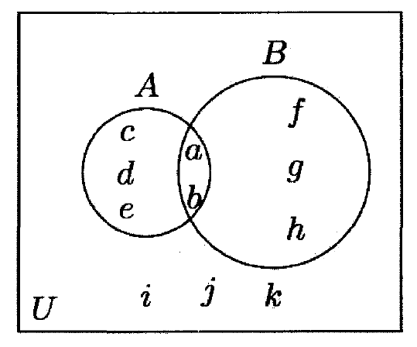
Masalalar yechish
5. Rasmda $A$ va $B$ to‘plamlar va $U$ universal to‘plam tasvirlangan. $\left(A∩B′\right)∪\left(A′∩B\right)$ to‘plamning elementlarini aniqlang.
$$A=\left\{a, b, c, d, e\right\}$$
$$c, d, e$$
$$A∩B′=\left\{c, d, e\right\}$$
$$c, d, e$$
$$f$$
$$B′=\left\{c, d, e, i, j, k\right\}$$
$$c$$
$$a$$
$$d$$
$$g$$
$$f, g, h$$
$$A′=\left\{f, g, h,i, j, k\right\}$$
$$b$$
$$A′∩B=\left\{f, g, h\right\}$$
$$e$$
$$B=\left\{a, b, f, g, h\right\}$$
$$h$$
$$f, g, h$$
$\left(A∩B′\right)∪\left(A^{′}∩B\right)=$
$=\left\{c,d,e\right\}∪\left\{f,g,h\right\}=\left\{c,d,e,f,g,h\right\}$

Slide 9
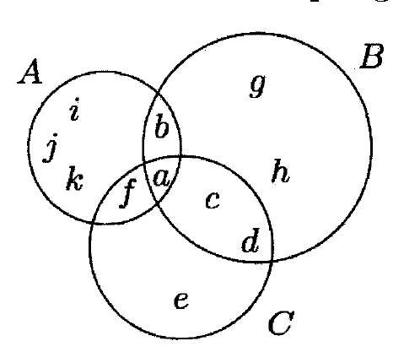
Masalalar yechish
6. Rasmda A, B va C to‘plamlar tasvirlangan.
(A ∪ B) ⋂ C to‘plamning elementlarini aniqlang.
8-Masala
$$A∪B=\left\{a,b,c,d,f,i,j,k,g,h\right\}$$
$$\left(A∪B\right)∩C=\left\{f, a, c, d\right\}$$

Slide 10
Masalalar yechish
7. $A=\left\{x∣x=4n+3, n∈N\right\}$,
$B=\left\{x∣x=6n+5, n∈N\right\}$
bo‘lsa, $A∩B$ to‘plamni aniqlang.
$$23$$
$$A=\left\{7, 11, 15, 19, 23, 27, 31, 35, 39, 43, 47,…\right\}$$
$$11$$
$$35$$
$$47$$
$$23$$
$$B=\left\{11, 17, 23, 29, 35, 41, 47, 53, …\right\}$$
$$11$$
$$35$$
$$47$$
$$A∩B=$$
$$=\left\{11, 23, 35, 47, …\right\}$$
$$A∩B=\left\{x∣x=12n−1, n∈N\right\}$$

Slide 11
Masalalar yechish
8. $A, B$ va $C$ to‘plamlarning elementlari soni mos
ravishda 10; 12 va 15 ta. $A∪B∪C$ to‘plamning
elementlari soni eng kamida nechta bo‘la oladi?
To‘plamlar birlashmasining elementlari soni eng
kam bo‘lishi uchun to‘plamlarning biri
ikkinchisining qism to‘plami bo‘lishi kerak.
$A∪B∪C$ to‘plamning elementlari soni eng kam bo‘lishi uchun $A⊆C, B⊆C$ shart bajarilishi kerak. U holda $A∪B∪C=C =>n\left(A∪B∪C\right)=n\left(C\right)=15$

Slide 12
Masalalar yechish
9. Agar $A$ to‘plamga 1 ta element qo‘shilgandagi qism
to‘plamlar soni $A$ to‘plamdan 1 ta element chiqarilib
tashlangandagi qism to‘plamlari sonidan 24 taga ko‘p
bo‘lsa, $A$ to‘plamning qism to‘plamlar sonini toping.
$$\text{A}\text{=}\left\{a_{1},a_{2},a_{3},a_{4},…,a_{n−1},a_{n}\right\}=>n\left(A\right)=n => 2^{n}$$
$$\text{B}\text{=}\left\{a_{1},a_{2},a_{3},a_{4},…,a_{n},a_{n+1}\right\}=>n\left(B\right)=n+1 => 2^{n+1}$$
$$\text{C}\text{=}\left\{a_{1},a_{2},a_{3},a_{4},…,a_{n−1}\right\}=>n\left(C\right)=n−1 => 2^{n−1}$$
$2^{n}∙\left(2−\frac{1}{2}\right)=24$
$$2^{n+1}−2^{n−1}=24$$
$2^{n}∙\frac{3}{2}=24$
$2^{n}=16$

Slide 13
Masalalar yechish
10. $A=\left\{\left(x,y\right)∣x^{2}+y^{2}=4; x,y∈R\right\}$,
$B=\left\{\left(x,y\right)∣x−y=2; x,y∈R\right\}$ bo‘lsa, $A∩B$ to‘plamni aniqlang.
$$A →O\left(0;0\right), R=2$$
$$B →y=x−2$$
$$\left(2;0\right), \left(0;−2\right)$$
$$A∩B=\left\{\left(2;0\right);\left(0;−2\right)\right\}$$

Slide 14
Masalalar yechish
11. $A=\left\{1, 2, 3, 4\right\}$, $C=\left\{x∣x=2n−1, n∈A\right\}$ bo‘lsa, $A∩C$ to‘plamni aniqlang?
$C$ to‘plamning elementlarini aniqlashtiramiz:
$n∈A =>2n−1=1;3;5;7 =>C=\left\{1, 3, 5, 7\right\}$.
$$A=\left\{1, 2, 3, 4\right\}, C=\left\{1, 3, 5, 7\right\}=>A∩C=\left\{1;3\right\}$$

Slide 15
Masalalar yechish
12. $\left(A∪B\right)∩C=?$
$A=\left[−2;3\right]$
$$−2$$
$$3$$
$$B=\left[−4;0)\right.$$
$$−4$$
$$0$$
$C=\left(−1;5\right)$
$$−1$$
$$5$$
$$A∪B=\left[−4;3\right]$$
$$−4$$
$$−2$$
$$0$$
$$3$$
$$\left(A∪B\right)∩C=\left.(−1;3\right]$$
$$−4$$
$$−1$$
$$3$$
$$5$$

Slide 16
Masalalar yechish
13. $A=\left\{x∣x≥2, x∈Z\right\}$, $B=\left\{x∣x<8, x∈Q\right\}$ bo‘lsa, $A∩B$ to‘plamning elementlari sonini aniqlang.
$A) 6$ $B) 8$ $C) 7$ $D)$cheksiz ko‘p
$A) 6$
$$2$$
$$3$$
$$4$$
$$5$$
$$6$$
$$7$$
$$8$$
$$9$$
$$10$$
$$11$$
$$12$$
$$A∩B=\left\{x∣2≤x<8, x∈Z\right\}$$
$$n\left(A∩B\right)=6$$
Javob: $6$

Slide 17
Masalalar yechish
14. $A=\left\{x∣x^{2}≤64, x∈R\right\}$, $B=\left\{x∣x^{2}>4, x∈R\right\}$ bo‘lsa, $A∩B$ to‘plamni aniqlang.
$A) \left[2;8\right]$ $B) \left\{3;4;5;6;7;8\right\}$
$C) \left\{3;4;5;6;7;8\right\}$ $D)\left[−8;\right.\left.−2\right)∪\left(2;\right.\left.8\right]$
$D)\left[−8;\right.\left.−2\right)∪\left(2;\right.\left.8\right]$
$$A=\left\{−8≤x≤8\right\}$$
$$B=\left\{x<−2, x>2\right\}$$
$$−8$$
$$−2$$
$$2$$
$$8$$
$$A∩B=\left\{x∣−8≤x<−2, 2<x≤8, x∈R\right\}$$
Javob: $\left[−8;\right.\left.−2\right)∪\left(2;\right.\left.8\right]$

Slide 18
Masalalar yechish
15. $B≠∅$ va $B⊆A$. $A$ va $B$ to‘plamlarning elementlari
soni mos ravishda $m$ va $n$ ga teng. Agar $n+3m=18$
bo‘lsa, $A$ to‘plamning elementlari sonini toping.
$A) 3$ $B) 2$ $C) 5$ $D) 4$
$C) 5$
$$B⊆A=>n\left(B\right)<n\left(A\right) =>n<m$$
$$n+3m=18 =>m=1, n=15; m=2, n=12;$$
$m=3, n=9; m=4, n=6; m=5, n=3;$
$m=6, n=0.$
$$m=5, n=3$$
Javob: $5$

Slide 19
Masalalar yechish
16. $A=\left[−\sqrt{3};\sqrt{3}\right], B=\left[−\frac{π}{2};\frac{π}{2}\right]$ va $C=\left[−\sqrt{5};\frac{\sqrt{7}}{2}\right]$ bo‘lsa,
$\left(A∪B\right)∩C$ to‘plamni aniqlang.
$A)\left[−\sqrt{3};\sqrt{3}\right] B)\left[−\sqrt{3};\frac{\sqrt{7}}{2}\right] C)\left[−\frac{π}{2};\frac{π}{2}\right] D)\left[−\sqrt{5};\sqrt{3}\right]$
$−\sqrt{5}<−\sqrt{3}<−\frac{π}{2}$; $\frac{\sqrt{7}}{2}<\frac{π}{2}<\sqrt{3}$
$$A∪B=A$$
$$−\sqrt{5}$$
$$−\sqrt{3}$$
$$−\frac{π}{2}$$
$$\frac{\sqrt{7}}{2}$$
$$\frac{π}{2}$$
$$\sqrt{3}$$
$=\left[−\sqrt{3};\frac{\sqrt{7}}{2}\right]$
$$A∩C$$

Slide 20
Mustaqil bajarish uchun topshiriq
Darslikning
40-betidagi 82, 83, 84-mashqlar.

