Slide 1
Kimyo
11-sinf
Mavzu: Eritma va eruvchanlikka oid testlar, masalalar yechish
O‘qituvchi: Toshkent shahar Yunusobod tumani 258-maktab kimyo fani o‘qituvchisi Boboqulova Lobar Qalandarovna

Slide 2
Test
Qattiq moddalar suvda eritilganda temperatura ko‘tarilgan sari ularning eruvchanligi odatda …, gazsimon moddalarning eruvchanligi esa….
Kamayadi, o‘zgarmaydi
Ortadi, kamayadi
O‘zgarmaydi, kamayadi
Kamayadi, ortadi

Slide 3
Test
Harorat ortishi bilan tuz eruvchanligining ortishi qanday jarayonga bog‘liq?
1. Tuz eriganda issiqlik chiqishi
2. Tuz eriganda issiqlik yutilishi
3. Tuz eriganda haroratning o‘zgarmasligi
A) 1,2 B) 1,3
C) 2,3 D) 2

Slide 4
Test
Qattiq moddalarning eruvchanligi qanday omillarga bog‘liq?
Temperatura 2) Bosim 3) Katalizator 4) Erituvchining tabiati 5) Erigan moddaning tabiati.
1,3,4
1,4,5
2,3,4
3,4,5

Slide 5
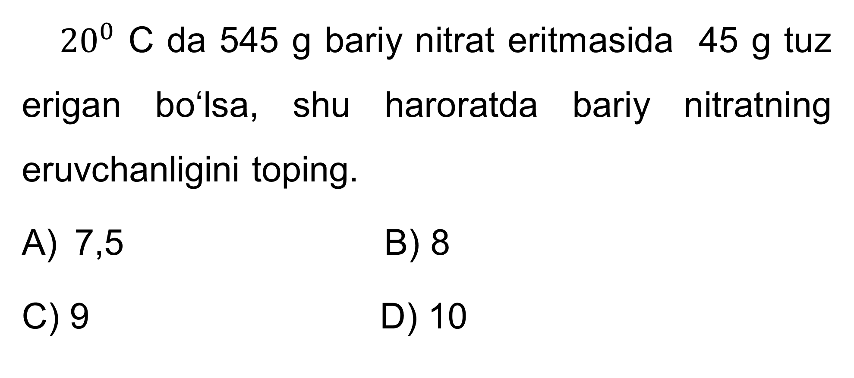
1-masala
${20}^{0}$ C da 545 g bariy nitrat eritmasida 45 g tuz erigan bo‘lsa, shu haroratda bariy nitratning eruvchanligini toping.
7,5 B) 8
C) 9 D) 10

Slide 6
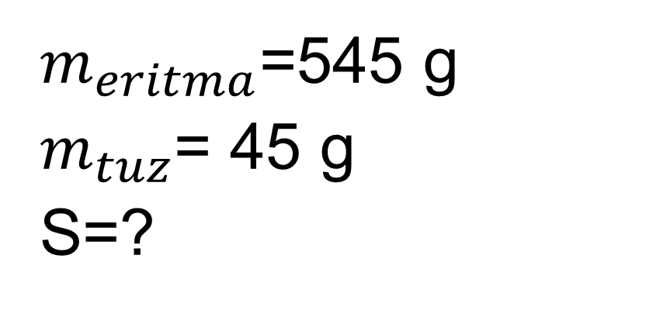
Masalaning yechimi
$m_{eritma}$=545 g
$m_{tuz}$= 45 g
S=?
$m_{suv}$=545-45=500
500 g suvda--------45 g tuz 100 g suvda---------x
x=$\frac{100x45}{500}$ = 9 javob:C

Slide 7
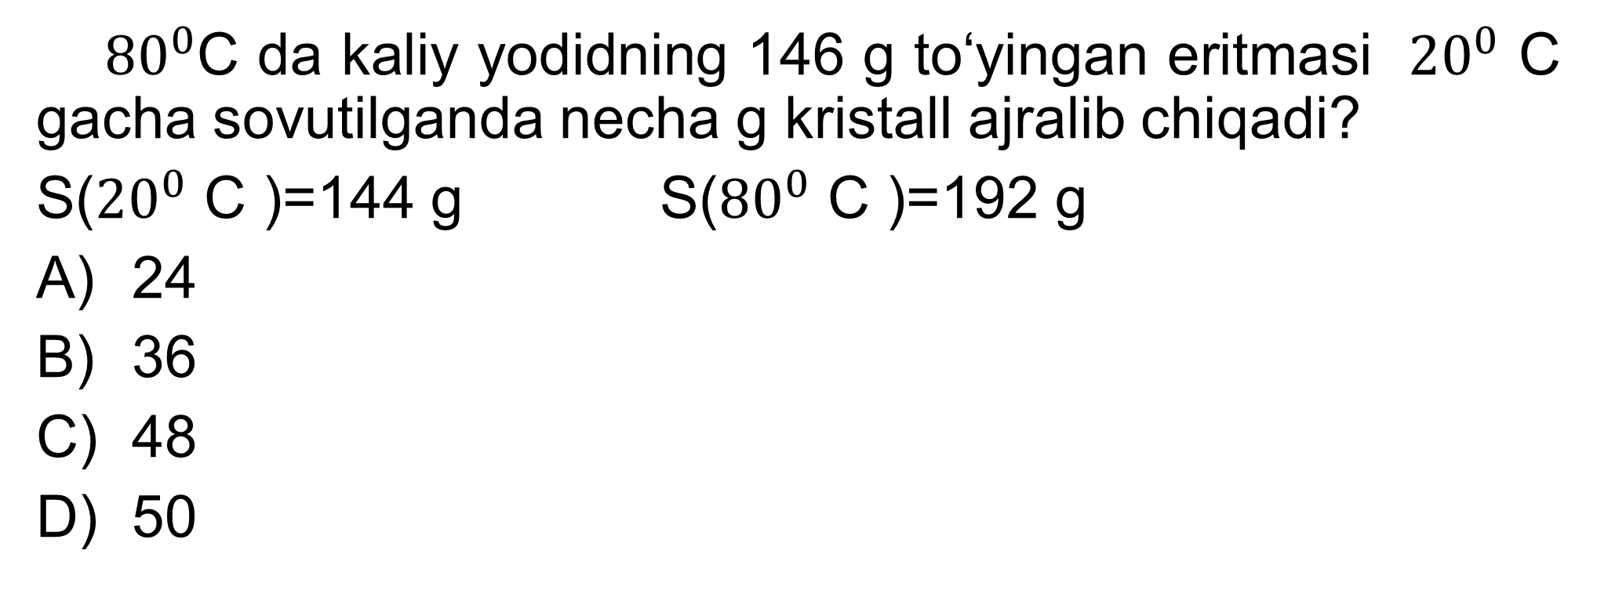
2-masala
${80}^{0}$C da kaliy yodidning 146 g to‘yingan eritmasi ${20}^{0}$ C gacha sovutilganda necha g kristall ajralib chiqadi?
S(${20}^{0}$ C )=144 g S(${80}^{0}$ C )=192 g
24
36
48
50

Slide 8
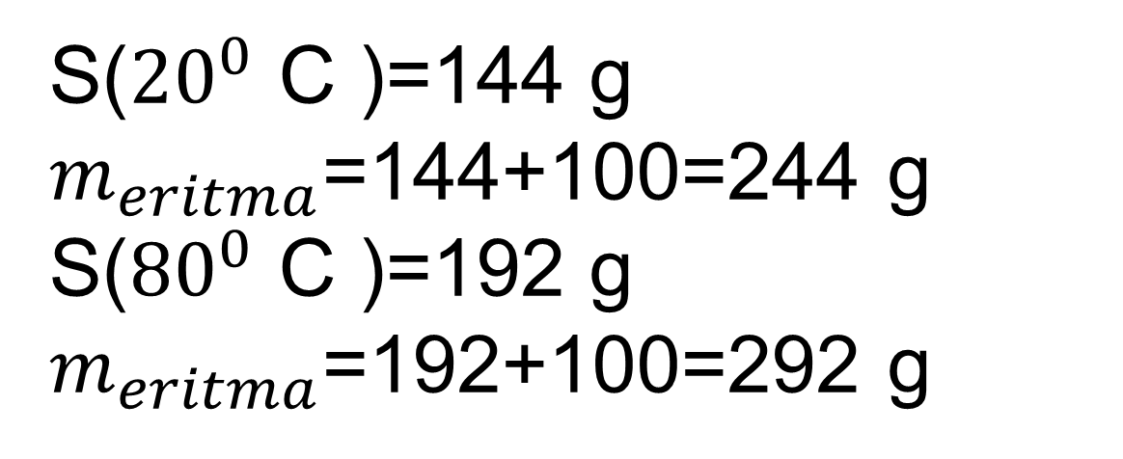
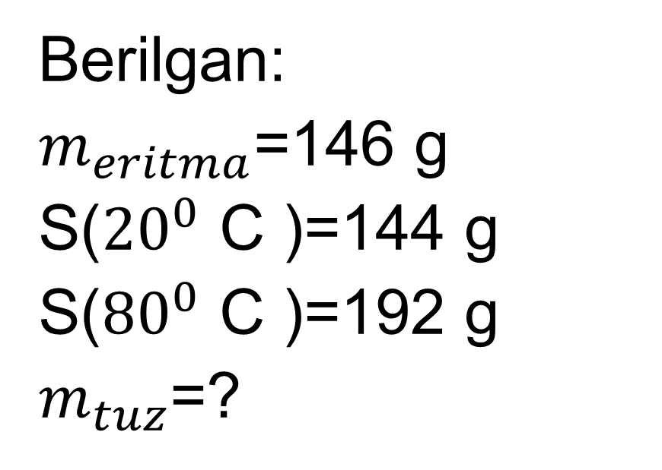
Masalaning yechimi
Berilgan:
$m_{eritma}$=146 g
S(${20}^{0}$ C )=144 g
S(${80}^{0}$ C )=192 g
$m_{tuz}$=?
S(${20}^{0}$ C )=144 g $m_{eritma}$=144+100=244 g
S(${80}^{0}$ C )=192 g $m_{eritma}$=192+100=292 g
292-244= 48 g cho‘kma

Slide 9
Masalaning yechimi
292 g eritmadan------- 48 g cho‘kma
146 g eritmadan--------x
x= $\frac{146x48 }{292}$ = 24 g javob:A

Slide 10
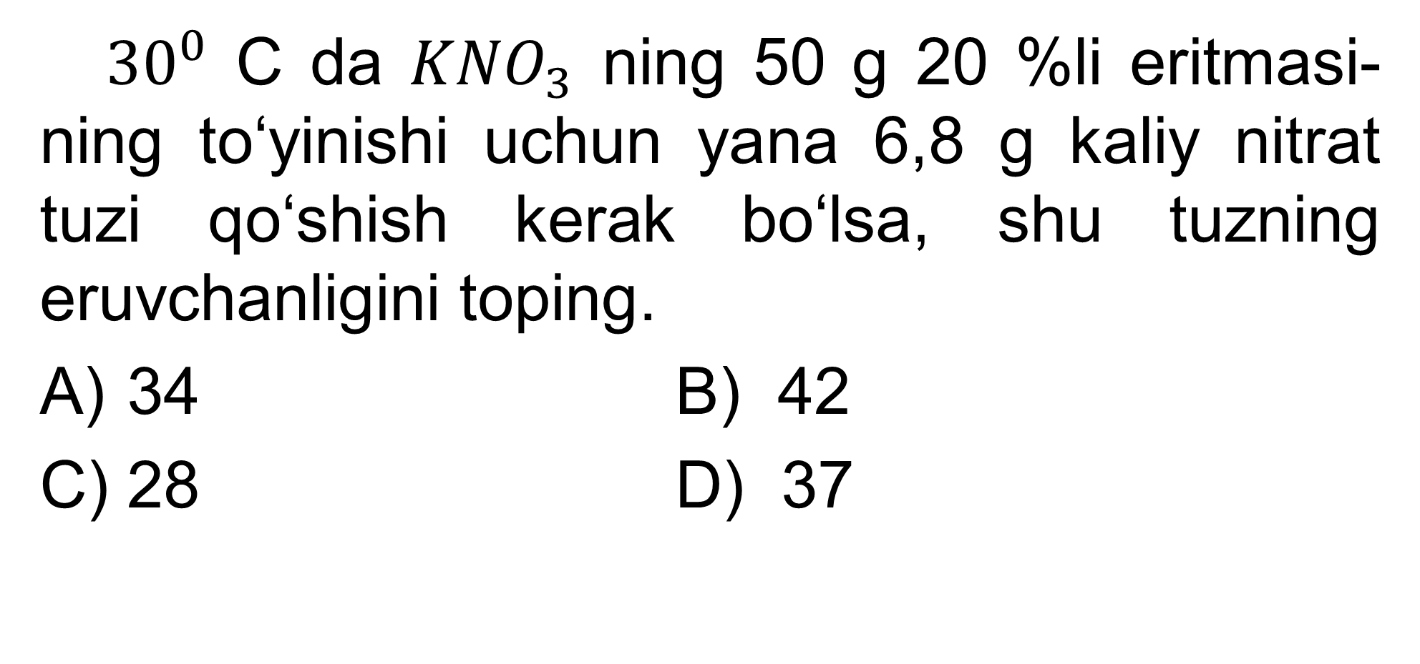
3-masala
${ 30}^{0}$ C da ${KNO}_{3}$ ning 50 g 20 %li eritmasi-ning to‘yinishi uchun yana 6,8 g kaliy nitrat tuzi qo‘shish kerak bo‘lsa, shu tuzning eruvchanligini toping.
34 B) 42
C) 28 D) 37

Slide 11
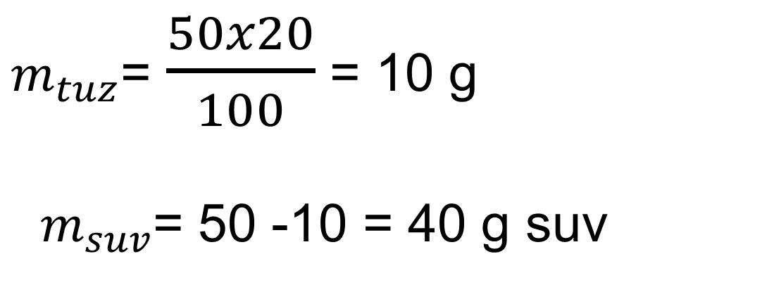
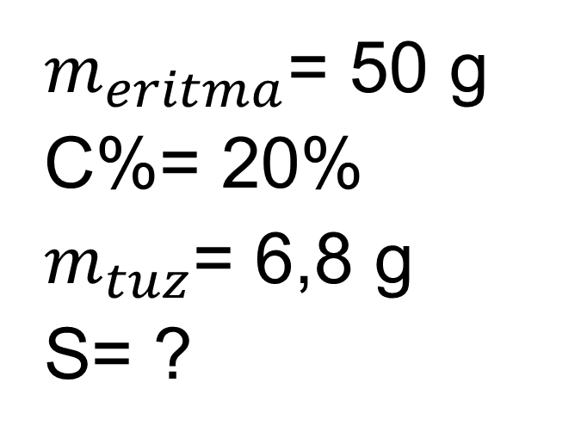
Masalaning yechimi
$m_{eritma}$= 50 g
C%= 20%
$m_{tuz}$= 6,8 g
S= ?
$m_{tuz}$= $\frac{50x20}{100}$ = 10 g
$m_{suv}$= 50 -10 = 40 g suv
40 g suvda ---------10+6,8 g tuz
100 g suvda---------x
x = $\frac{100x16,8}{40}$ = 42 javob:B

Slide 12
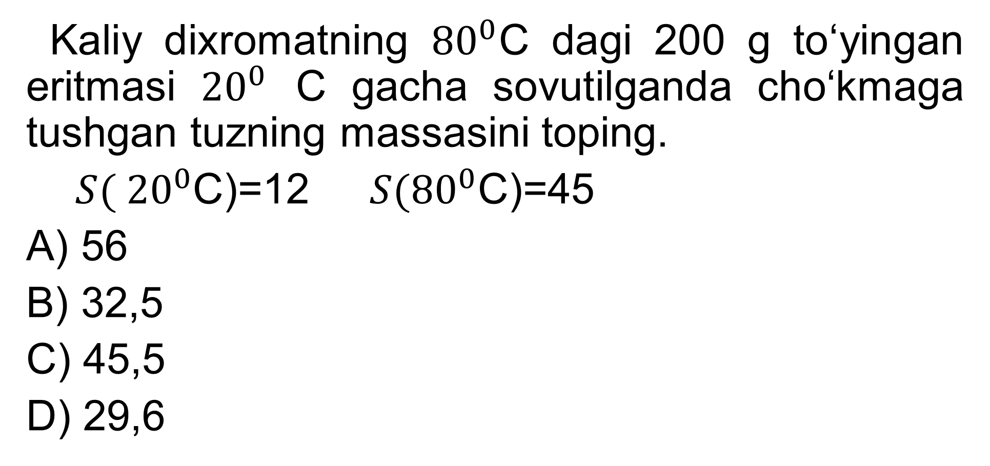
4-masala
Kaliy dixromatning ${80}^{0}$C dagi 200 g to‘yingan eritmasi ${20}^{0}$ C gacha sovutilganda cho‘kmaga tushgan tuzning massasini toping.
${ S( 20}^{0}$C)=12 ${S(80}^{0}$C)=45
A) 56
B) 32,5
C) 45,5
D) 29,6

Slide 13
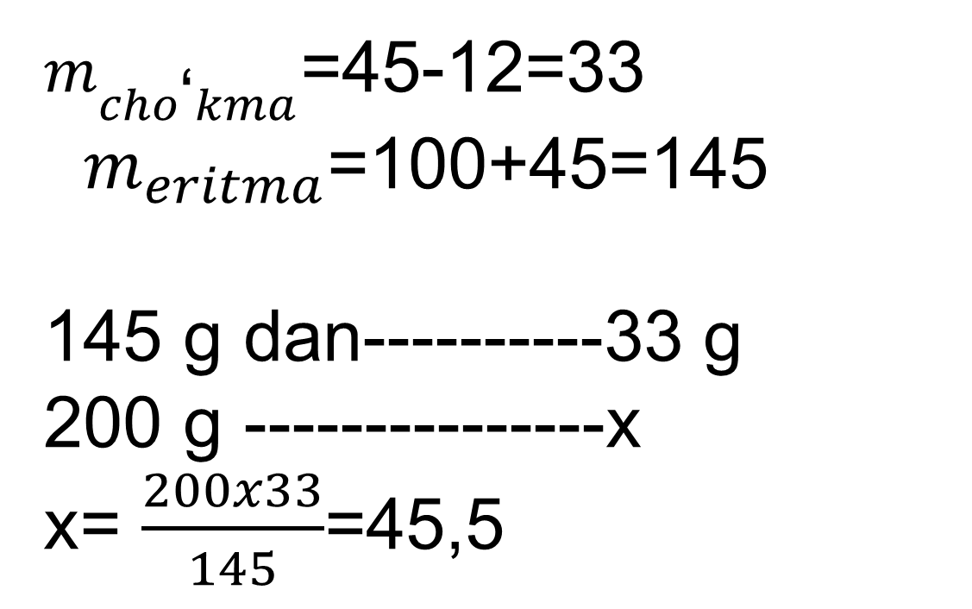
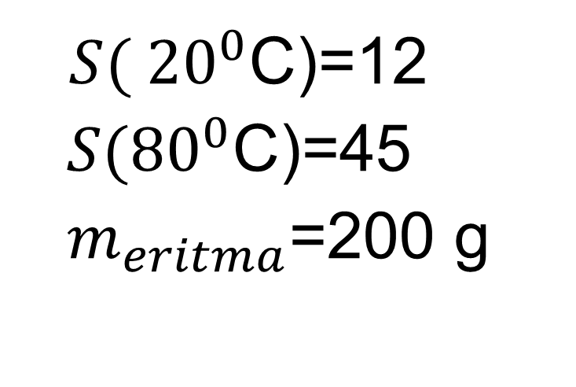
Masalaning yechimi
${ S( 20}^{0}$C)=12
${S(80}^{0}$C)=45
$m_{eritma}$=200 g
$m_{cho\text{‘}kma}$=45-12=33
$m_{eritma}$=100+45=145
145 g dan----------33 g
200 g ---------------x
x= $\frac{200x33}{145}$=45,5

Slide 14
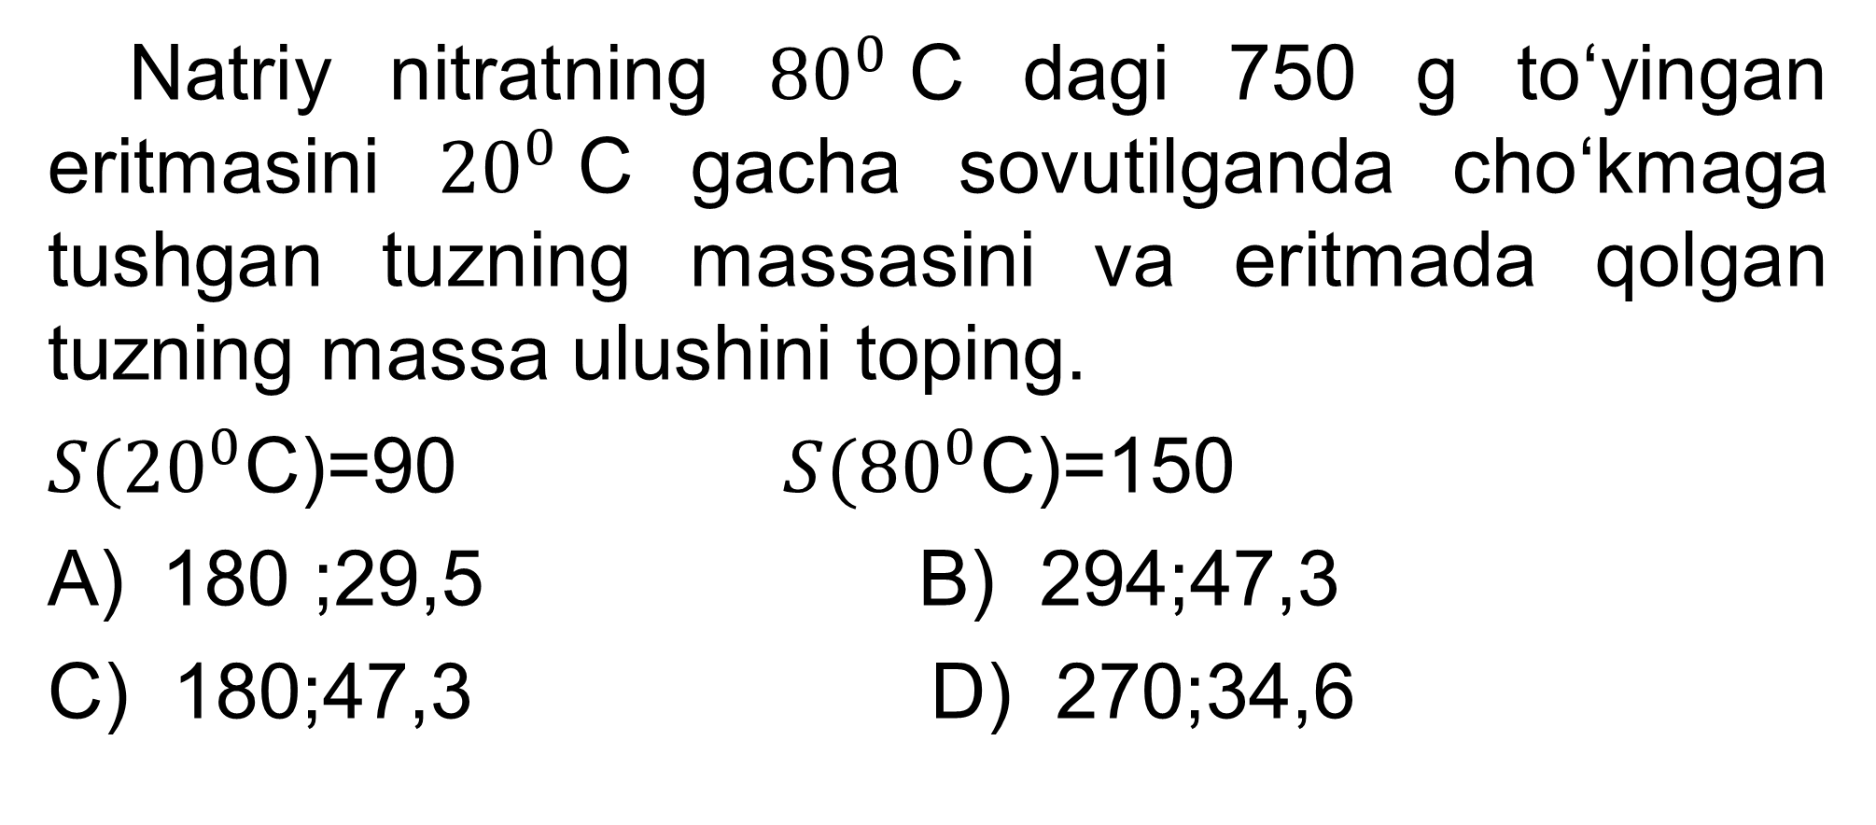
5-masala
Natriy nitratning ${80}^{0}$C dagi 750 g to‘yingan eritmasini ${20}^{0}$C gacha sovutilganda cho‘kmaga tushgan tuzning massasini va eritmada qolgan tuzning massa ulushini toping.
${S(20}^{0}$C)=90 ${S(80}^{0}$C)=150
180 ;29,5 B) 294;47,3
C) 180;47,3 D) 270;34,6

Slide 15
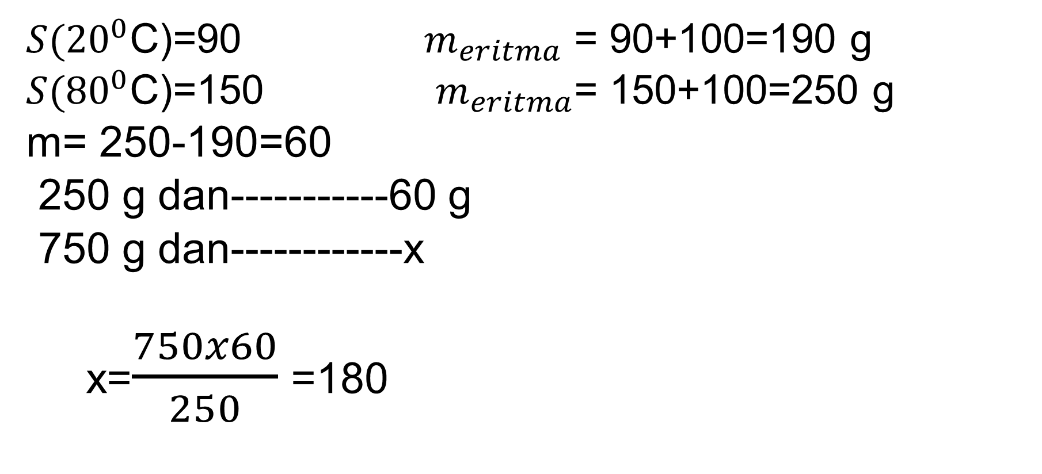
Masalaning yechimi
${S(20}^{0}$C)=90 $m_{eritma}$ = 90+100=190 g
${S(80}^{0}$C)=150 $m_{eritma}$= 150+100=250 g
m= 250-190=60
250 g dan-----------60 g
750 g dan------------x
x=$\frac{750x60}{250}$ =180
C%=$\frac{90}{190}$x100=47,3

Slide 16
Mustaqil bajarish uchun topshiriq
Kaliy dixromatning ${78}^{0}$C da to‘yingan 400 g eritmasi ${18}^{0}$ gacha sovutilganda qancha massa kaliy dixromat cho‘kmaga tushadi?
${S(18}^{0}$C)=10 ${S(78}^{0}$)=50
800
116,8
360
107

