Slide 1
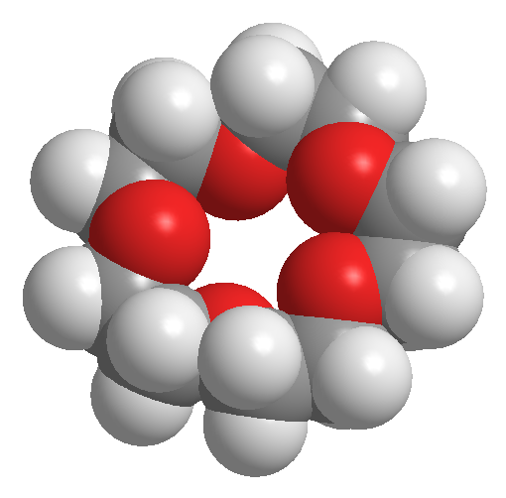
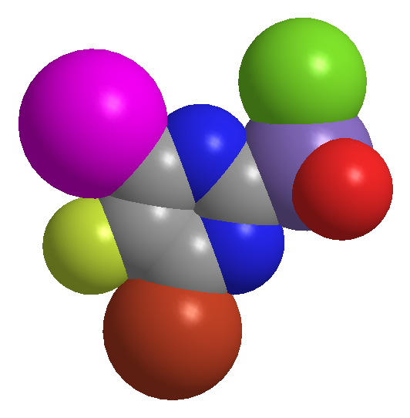
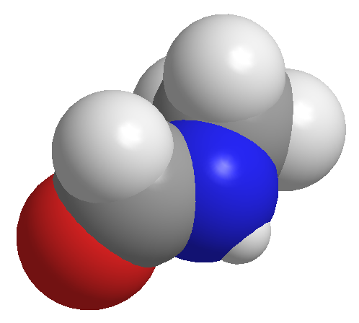
KIMYO
11-sinf
Mavzu: Eritmalardagi moddalarning atomlar sonini topish bo‘yicha masalalar

Slide 2
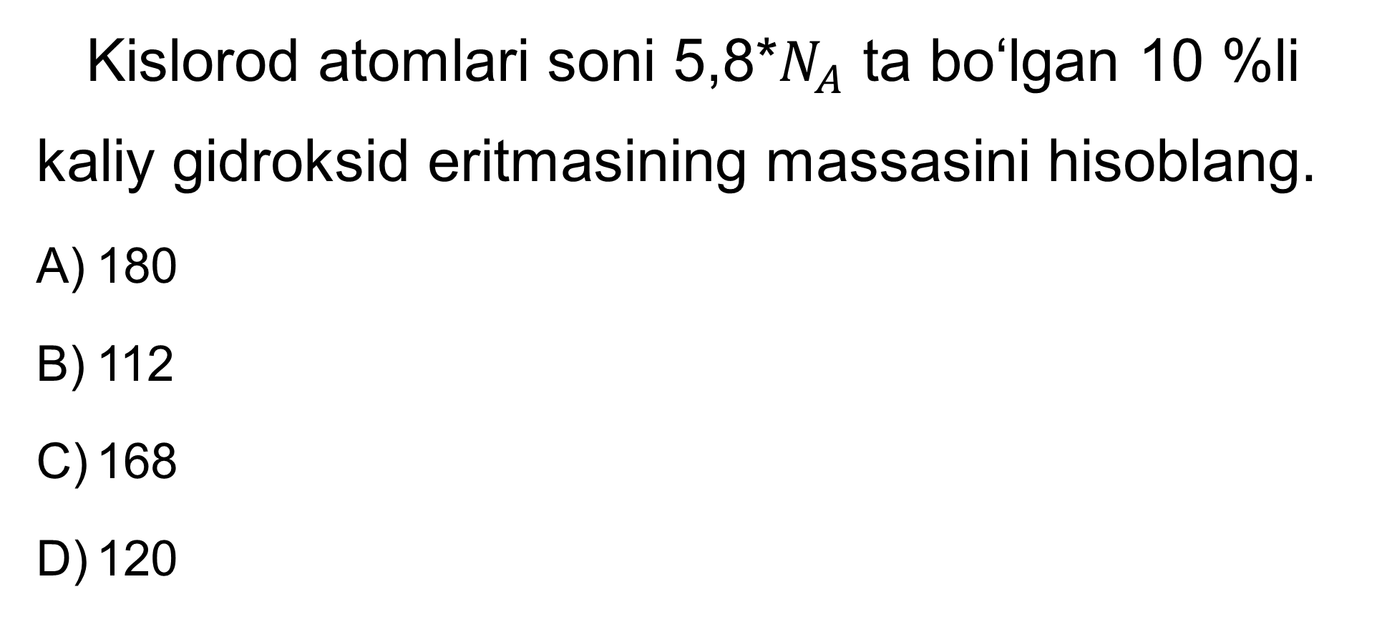
1-masala
Kislorod atomlari soni 5,8*$N_{A}$ ta bo‘lgan 10 %li kaliy gidroksid eritmasining massasini hisoblang.
180
112
168
120

Slide 3
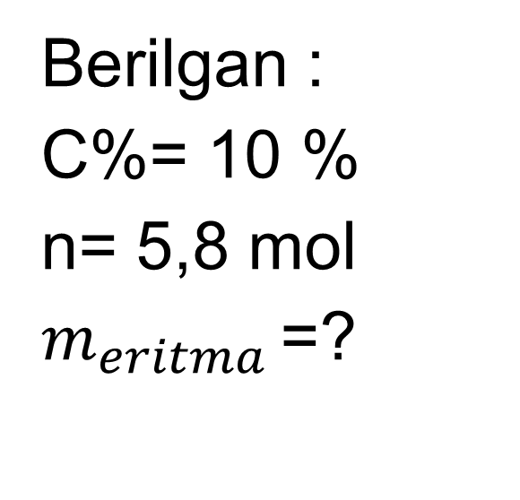
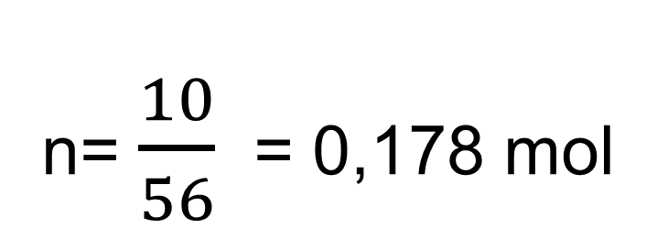
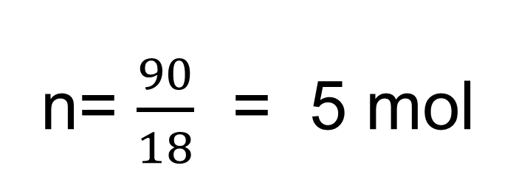
Masalaning yechimi
Berilgan :
C%= 10 %
n= 5,8 mol
$m_{eritma }$=?
$m_{m}=\frac{10x100}{100}$= 10 g
$m_{suv}$= 100-10=90 g
n= $\frac{10}{56}$ = 0,178 mol
n= $\frac{90}{18}$ = 5 mol

Slide 4
Masalaning yechimi
5+0,178 = 5,178 mol
5,178 mol -------- 100 g eritmada 5,8 mol ----------x
x = $\frac{5,8x100}{5,178}$ = 112
javob : B

Slide 5
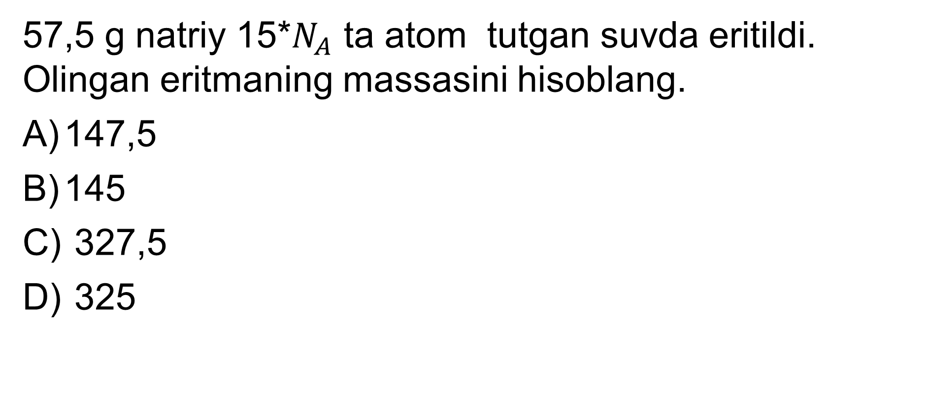
2-masala
57,5 g natriy 15*$N_{A}$ ta atom tutgan suvda eritildi. Olingan eritmaning massasini hisoblang.
147,5
145
327,5
325

Slide 6
Masalaning yechimi
3 ta atom-------18 g 15 ta ------------x x=90
${2Na+2H}_{2}$O$→{2NaOH+H}_{2}$
$m_{e}$=57,5+90=147,5
Javob:A

Slide 7
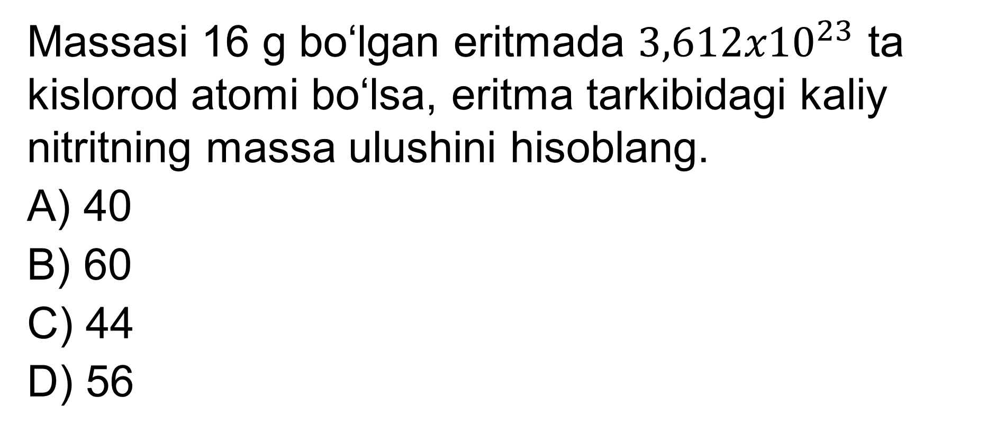
3-masala
Massasi 16 g bo‘lgan eritmada ${3,612x10}^{23}$ ta kislorod atomi bo‘lsa, eritma tarkibidagi kaliy nitritning massa ulushini hisoblang.
40
60
44
56

Slide 8
Masalaning yechimi
Berilgan:
$m_{eritma}$=16 g
N = ${3,612x10}^{23}$ ta
C %=?
n =$\frac{{3,612x10}^{23} }{{6,02x10}^{23}}$ = 0,6 mol
x y
${KNO}_{2}{ + H}_{2}$O
M(${KNO}_{2}$)= 85
2x y
$$\left\{\begin{aligned}85x+18y=16 \\ 2x+y=0,6\end{aligned}\right\}$$
$$\left\{\begin{aligned}85x+18y=16 \\ 36x+18y=10,8\end{aligned}\right\}$$
49x=5,2
x= 0,106
(*18)

Slide 9
Masalaning yechimi
m= nxM=85x0,106=9,01
C%=$\frac{9,01}{16}$x100= 56 javob:D

Slide 10
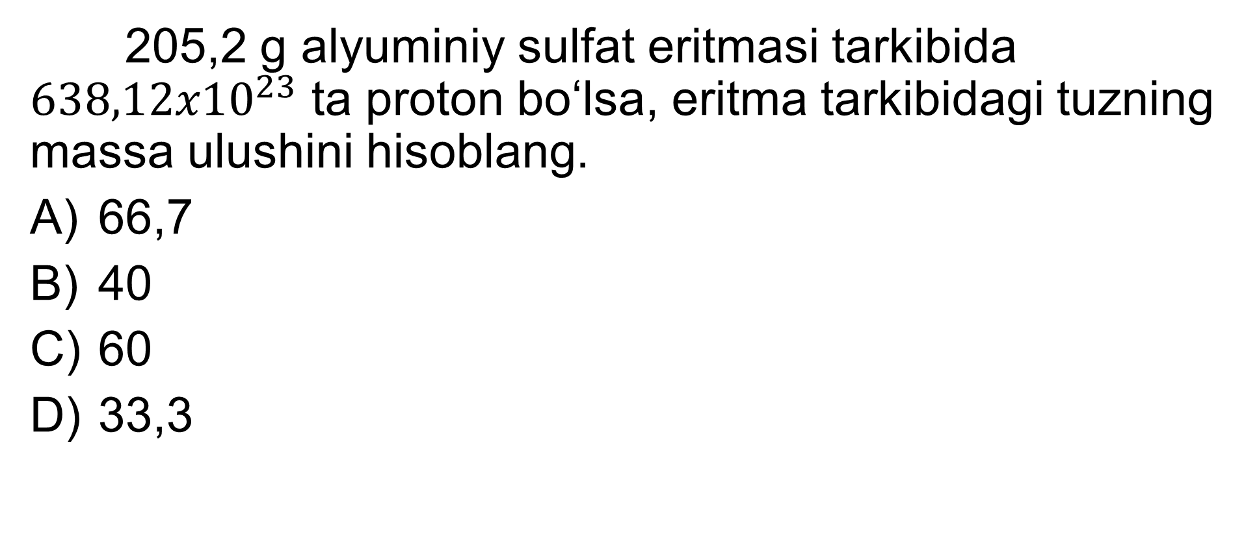
4-masala
205,2 g alyuminiy sulfat eritmasi tarkibida ${638,12x10}^{23}$ ta proton bo‘lsa, eritma tarkibidagi tuzning massa ulushini hisoblang.
66,7
40
60
33,3

Slide 11
Masalaning yechimi
n= $\frac{{638,12x10}^{23}}{{6,02x10}^{23}}$ =106
${AI}_{2}{(SO}_{4})_{3}{ + H}_{2}$O
342 18
170 ta 10 ta

Slide 12
Masalaning yechimi
170x+10 y=106 342x+18y=205,2
(x1,8)
342x+18y=205,2 306x+18y=190,8
36x=14,4
x=0,4
m=342x0,4=136,8
C%=$\frac{136,8}{205,2}$ x100=66,7
Javob: A

Slide 13
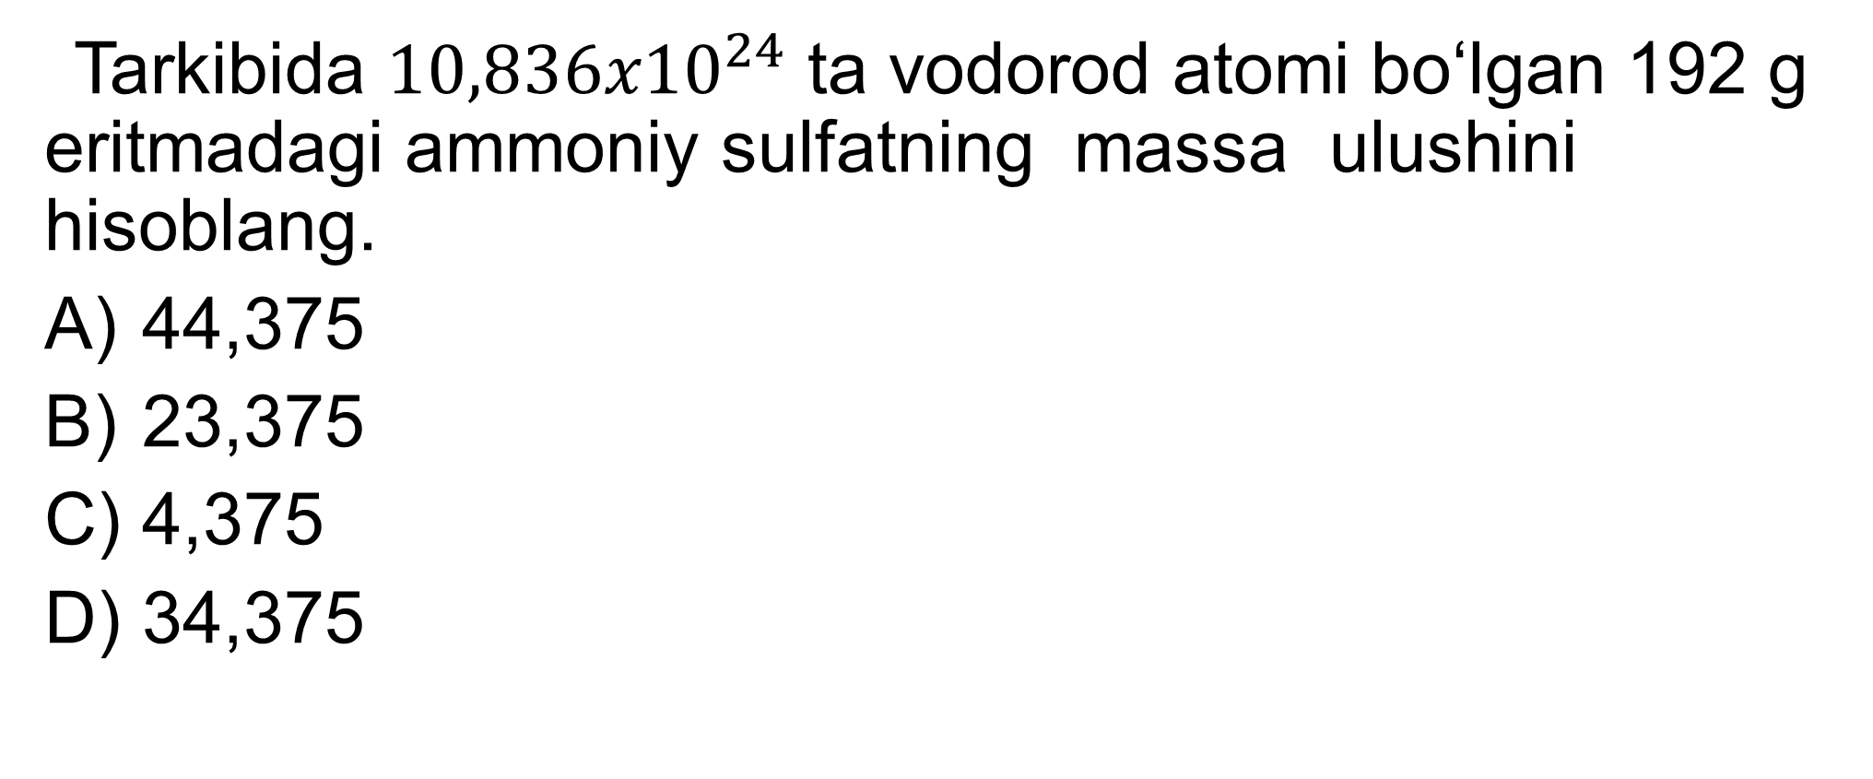
5-masala
Tarkibida ${10,836x10}^{24}$ ta vodorod atomi bo‘lgan 192 g eritmadagi ammoniy sulfatning massa ulushini hisoblang.
44,375
23,375
4,375
34,375

Slide 14
Masalaning yechimi
n=$\frac{{10,836x10}^{24}}{{6,02x10}^{23}}$=18 mol
${x(NH}_{4})_{2}{SO}_{4}{+yH}_{2}$O
(x9)
8x+2y=18 132x+18y=192
72x+18y=162 132x+18y=192
60x=30
x=0,5
m=0,5x132=66
C%=$\frac{66}{192}$ x100=34,375
javob:D

Slide 15
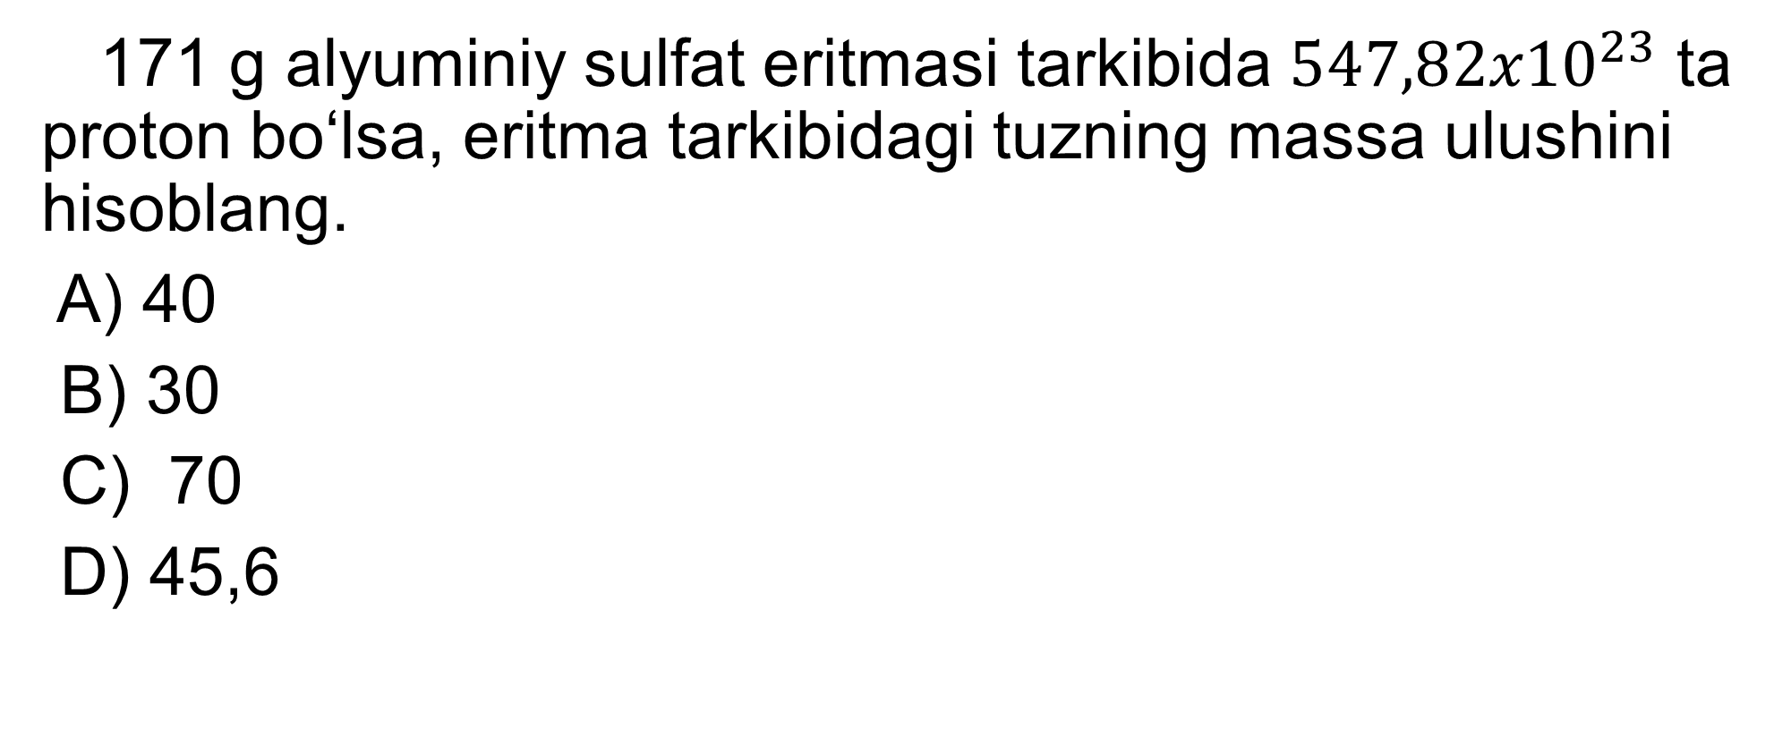
Mustaqil bajarish uchun topshiriqlar:
171 g alyuminiy sulfat eritmasi tarkibida ${547,82x10}^{23}$ ta proton bo‘lsa, eritma tarkibidagi tuzning massa ulushini hisoblang.
A) 40
B) 30
C) 70
D) 45,6

